Slide 1
Chapter 10: Virtual Memory
Background
Demand Paging
Process Creation
Page Replacement
Allocation of Frames
Thrashing
Operating System Examples

Slide 2
Background
Virtual memory
  Only part of the program needs to be in memory for execution.
  Logical address space can therefore be much larger than physical address space.
  Allows for more efficient process creation.
Separation of user logical memory from physical memory.
Virtual memory can be implemented via:
  Demand paging
  Demand segmentation

Slide 3
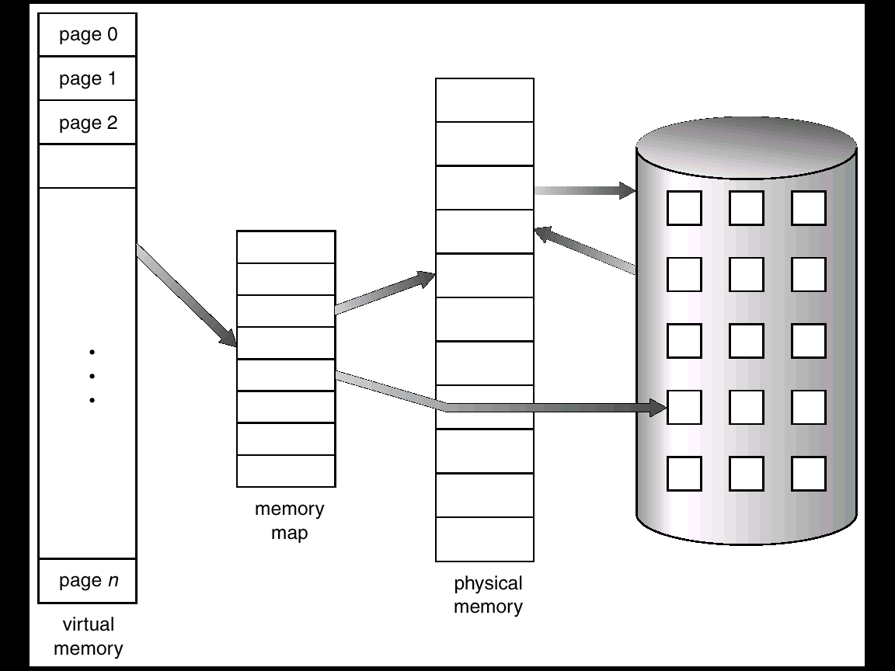
Virtual Memory That is Larger Than Physical Memory

Slide 4
Demand Paging
Bring a page into memory only when it is needed.
  Less I/O needed
  Less memory needed
  Faster response
  More users
Page is needed ⇒ reference to it
  invalid reference ⇒ abort
  not-in-memory ⇒ bring to memory
Extreme case -- Pure demand paging: Never bring a page into memory until it is required.

Slide 5
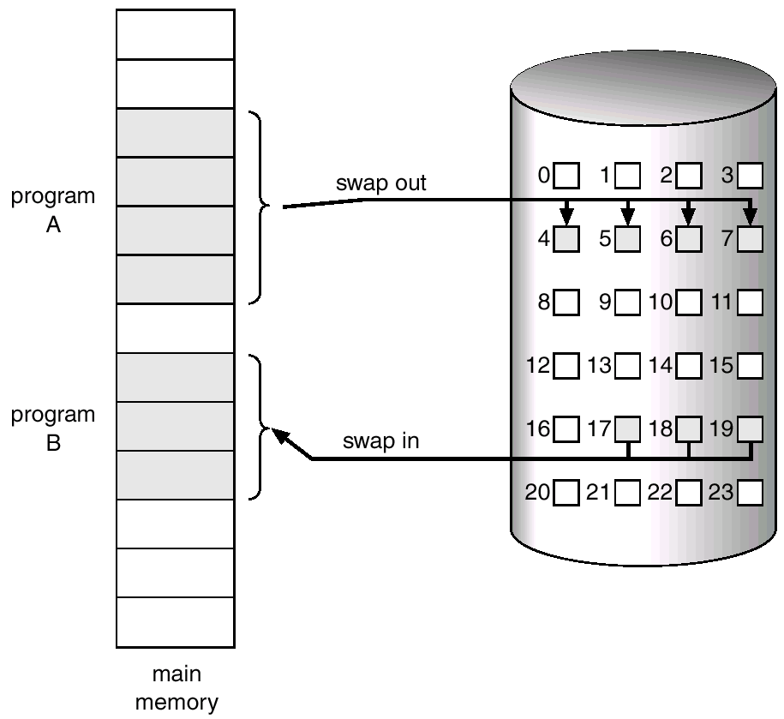
Transfer of a Paged Memory to Contiguous Disk Space
Notes:
Paging with swapping

Slide 6
Valid-Invalid Bit
With each page table entry a valid–invalid bit is associated
(1 ⇒ in-memory, 0 ⇒ not-in-memory)
Initially valid–invalid but is set to 0 on all entries.
Example of a page table snapshot.
During address translation, if valid–invalid bit in page table entry is 0 ⇒ page fault.
1
1
0
…
0
0

Slide 7

Page Table When Some Pages Are Not in Main Memory

Slide 8
Hardware Support
Page Table
  Has the ability to mark an entry invalid.
Secondary Memory -- Swap Space.
  May just hold those pages that are pushed out from memory.

Slide 9
Page Fault
If there is ever a reference to a page that is marked invalid, paging hardware traps to OS ⇒ page fault
OS looks at another internal table to decide:
  Invalid reference ⇒ abort.
  Just not in memory.
Get empty frame.
Swap page into frame.
Reset tables, validation bit = 1.
Restart instruction.

Slide 10

Steps in Handling a Page Fault

Slide 11
Some Architectural Constrains of Paging
Restart instruction after page fault:
  What if the instruction is doing block move and it across the page boundary?
    Do a page fault before anything is modified.
    Store the modfied locations.
modified
Page boundary

Slide 12
What happens if there is no free frame?
Page replacement – find some page in memory, but not really in use, swap it out.
  Page-replacement algorithm
  performance – want an algorithm which will result in minimum number of page faults.
Same page may be brought into memory several times.

Slide 13
Performance of Demand Paging
Page Fault Rate 0 ≤ p ≤ 1.0
  if p = 0 no page faults
  if p = 1, every reference is a fault
Effective Access Time (EAT)
EAT = (1 – p) * memory access
+ p * Page Fault Time
Typically: Page Fault Time =
page fault trap overhead
+ [swap page out ]
+ swap page in + restart overhead

Slide 14
Demand Paging EAT Example
Memory access time = 1 microsecond
50% of the time we need to swap out a page for replacement.
Swap Page Time = 10 millsec = 10,000 microsec
EAT = (1 – p) * 1 + 0.5p * (10000) + 0.5p * (20000)
= 1 –p + 15000P
= 1 + 14999 P (microsec)
EAT is directly proportional to the page-fault rate.

Slide 15
Process Creation
Virtual memory allows other benefits during process creation:
- Copy-on-Write
- Memory-Mapped Files

Slide 16
Copy-on-Write
Copy-on-Write (COW) allows both parent and child processes to initially share the same pages in memory.
If either process modifies a shared page, only then is the page copied.
COW allows more efficient process creation as only modified pages are copied.
Modern Unix have two ways to create new processes other than the traditional fork():
  vfork() --- meant for the child that runs exec().
  Copy-on-write

Slide 17
Memory-Mapped Files
Memory-mapped file I/O allows file I/O to be treated as routine memory access by mapping a disk block to a page in memory.
A file is initially read using demand paging. A page-sized portion of the file is read from the file system into a physical page. Subsequent reads/writes to/from the file are treated as ordinary memory accesses.
Simplifies file access by treating file I/O through memory rather than read() write() system calls.
Allows several processes to map the same file allowing the pages in memory to be shared.
Example: mmap() system call on solaris.

Slide 18
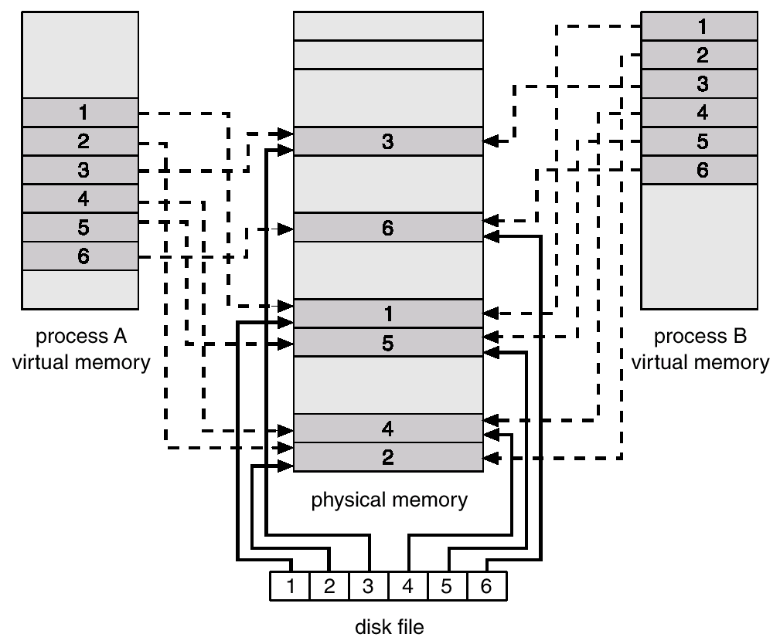
Memory Mapped Files

Slide 19
When there is no free frames left --- Page Replacement
We we increase the degree of multiprogramming with limited memory, we may over-allocate memory.
Solve over-allocation of memory by including page replacement.

Slide 20
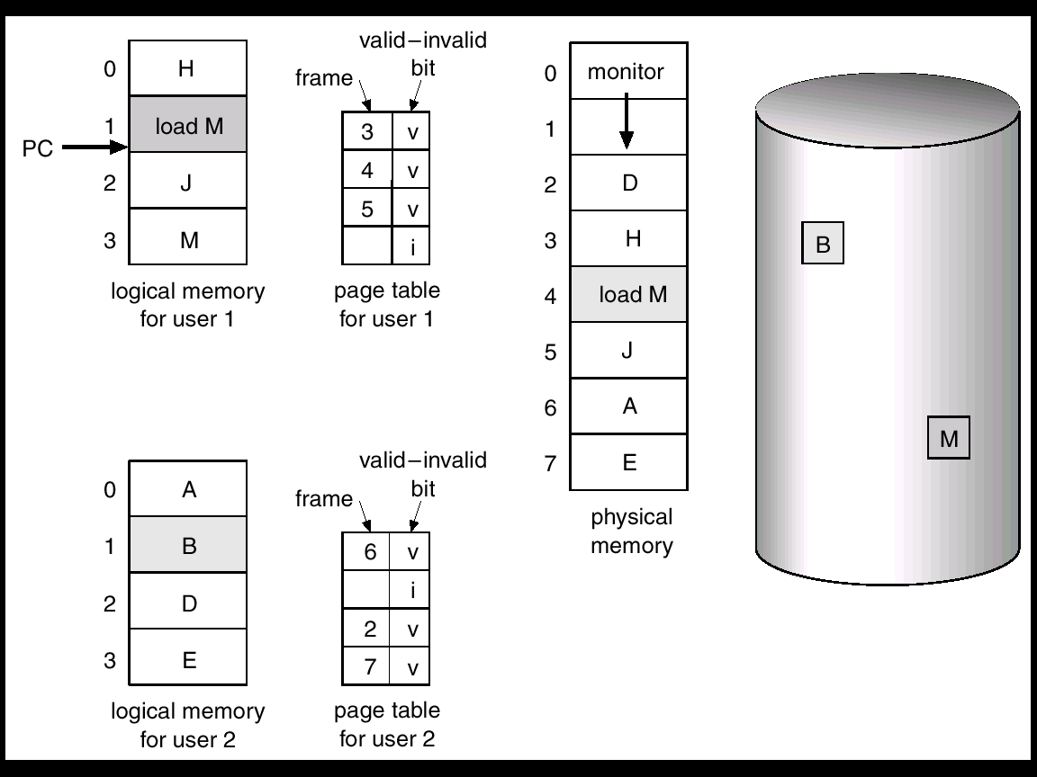
Need For Page Replacement

Slide 21
Basic Page Replacement
Find the location of the desired page on disk.
Find a free frame:
- If there is a free frame, use it.
- If there is no free frame, use a page replacement algorithm to select a victim frame.
Read the desired page into the (newly) free frame. Update the page and frame tables.
Restart the process.

Slide 22

Page Replacement

Slide 23
Page Replacement (Cont.)
Use modify (dirty) bit to reduce overhead of page transfers – only modified pages are written to disk.
Page replacement completes separation between logical memory and physical memory – large virtual memory can be provided on a smaller physical memory.
We need to have two algorithms:
  Frame-allocation algorithm
  Page-replacement algorithm

Slide 24
Page Replacement Algorithms
Performance criterion: lowest page-fault rate.
Evaluate algorithm by running it on a particular string of memory references (reference string) and computing the number of page faults on that string.
For example, the reference string
1, 2, 3, 4, 1, 2, 5, 1, 2, 3, 4, 5.

Slide 25

Graph of Page Faults Versus The Number of Frames
Notes:
Money always solves it ? Not with Belady’s anomaly.

Slide 26
First-In-First-Out (FIFO) Algorithm
Reference string: 1, 2, 3, 4, 1, 2, 5, 1, 2, 3, 4, 5
3 frames (3 pages can be in memory at a time per process)
4 frames
FIFO Replacement – Belady’s Anomaly
  more frames ⇒ more page faults
1
1
4
5
2
2
1
3
9 page faults
3
3
2
4
1
1
5
4
2
2
1
5
10 page faults
3
3
2
4
4
3

Slide 27

FIFO Illustrating Belady’s Anamoly

Slide 28
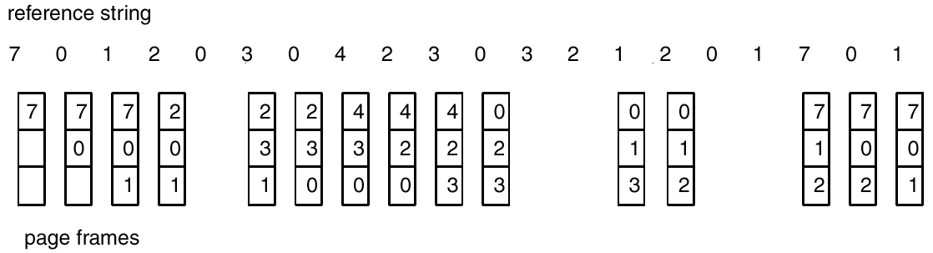
FIFO Page Replacement: Another Example
How many page faults?
-- 15.

Slide 29
Optimal Algorithm
Replace page that will not be used for longest period of time.
4 frames example
1, 2, 3, 4, 1, 2, 5, 1, 2, 3, 4, 5
1
4
2
6 page faults
3
4
5

Slide 30
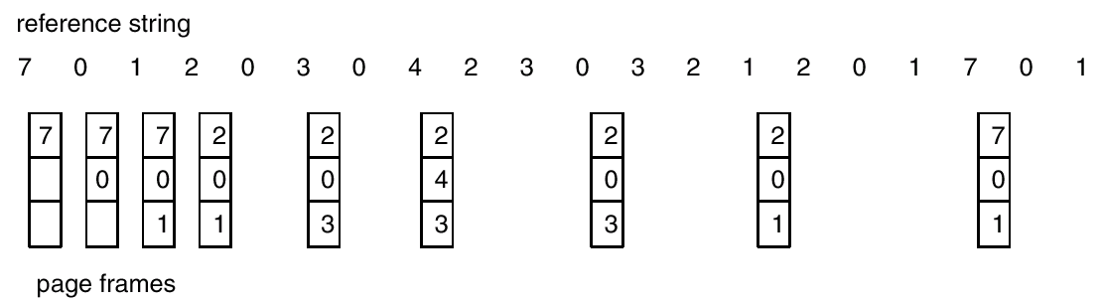
Optimal Page Replacement: Another Example
How many page faults?
-- 9.

Slide 31
Optimal Page Replacement (Cont.)
How do you know this future information? – difficult to implement.
Used for measuring how well your algorithm performs.
Similar problem as the shortest-job-first during CPU scheduling. Approximation is needed – LRU.

Slide 32
Least Recently Used (LRU) Algorithm
Reference string:
  1, 2, 3, 4, 1, 2, 5, 1, 2, 3, 4, 5
8 page faults.
1
5
2
3
5
4
4
3

Slide 33
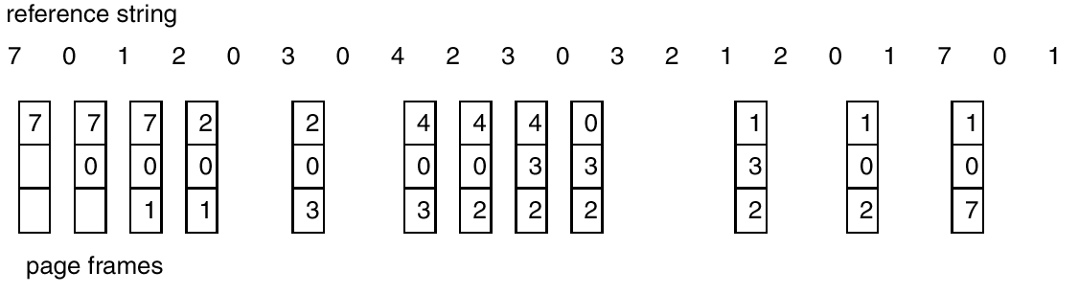
LRU Page Replacement

Slide 34
Example of LRU
With 3 frame and reference string as:
  4 6 5 1 6 7 1 4 7 6 1
  How many page fault?
Notes:
8 page faults.

Slide 35
LRU does not have Belady’s anomaly.
  Generally condition: The set of pages in memory for n frames is always a subset of the set of pages that would be in memory for n+1 frames.
  For LRU, the set of pages would be the n most recently referenced pages, which will still be most recent if there are more frames available.

Slide 36
LRU Algorithm (Cont.)
Counter implementation
  Every page entry has a counter; every time page is referenced through this entry, copy the clock into the counter.
  When a page needs to be changed, look at the counters to determine which one is LRU.
Stack implementation – keep a stack of page numbers in a double link form:
  Page referenced:move it to the top, the MRU.
  Entries may be removed from the middle of the top. So use doubly linked list.
  No search for replacement, bottom is the LRU.

Slide 37
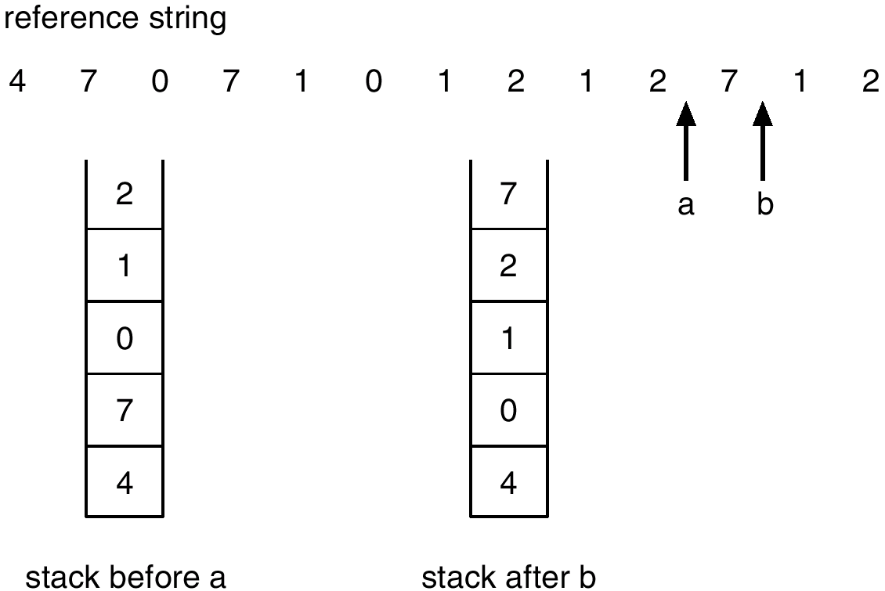
Use Of A Stack to Record The Most Recent Page References

Slide 38
LRU Approximation Algorithms
Lack of sufficient hardware support for true LRU=> Approximations.
Reference bit
  With each page associate a bit, initially = 0
  When page is referenced bit set to 1.
  Replace the one which is 0 (if one exists). We do not know the order, however.

Slide 39
Second Chance Algorithm
Second chance (clock algorithm)
  Need reference bit.
  Clock replacement.
  If page to be replaced (in clock order) has reference bit = 1. then:
    set reference bit 0.
    leave page in memory.
    replace next page (in clock order, i.e. FIFO order), subject to same rules

Slide 40

Second-Chance (clock) Page-Replacement Algorithm

Slide 41
Counting Algorithms
Keep a counter of the number of references that have been made to each page.
LFU (Least Frequently Used) Algorithm: replaces page with smallest count.
MFU (Most Frequently Used)Algorithm: based on the argument that the page with the smallest count was probably just brought in and has yet to be used.
Do not approximate optimal replacement very well.

Slide 42
Allocation of Frames
Each process needs minimum number of pages.
Example: IBM 370 – 6 pages to handle MVC instruction (storage to storage):
  instruction is 6 bytes, might span 2 pages.
  2 pages to handle from.
  2 pages to handle to.
Two major allocation schemes.
  fixed allocation
  priority allocation

Slide 43
Fixed Allocation
Equal allocation – e.g., if 100 frames and 5 processes, give each 20 pages.
Proportional allocation – Allocate according to the size of process.

Slide 44


Proportional Allocation (cont.)

Slide 45
Priority Allocation
Use a proportional allocation scheme using priorities rather than size.
If process P_{i} generates a page fault,
  select for replacement one of its own frames.
  select for replacement a frame from a process with lower priority number.

Slide 46
Global vs. Local Allocation
Global replacement – process selects a replacement frame from the set of all frames; one process can take a frame from another.
Local replacement – each process selects from only its own set of allocated frames.
Notes:
Global replacement usually cause higher system throughput, however, it has less control over thrashing.

Slide 47
Thrashing
If a process does not have “enough” pages, the page-fault rate is very high. This leads to:
  low CPU utilization.
  operating system thinks that it needs to increase the degree of multiprogramming.
  another process added to the system.
Thrashing ≡ a process is busy swapping pages in and out.

Slide 48

Thrashing
Why does paging work?
Locality model
  Process migrates from one locality to another.
  Localities may overlap.
Why does thrashing occur?
Σ size of locality > total memory size

Slide 49
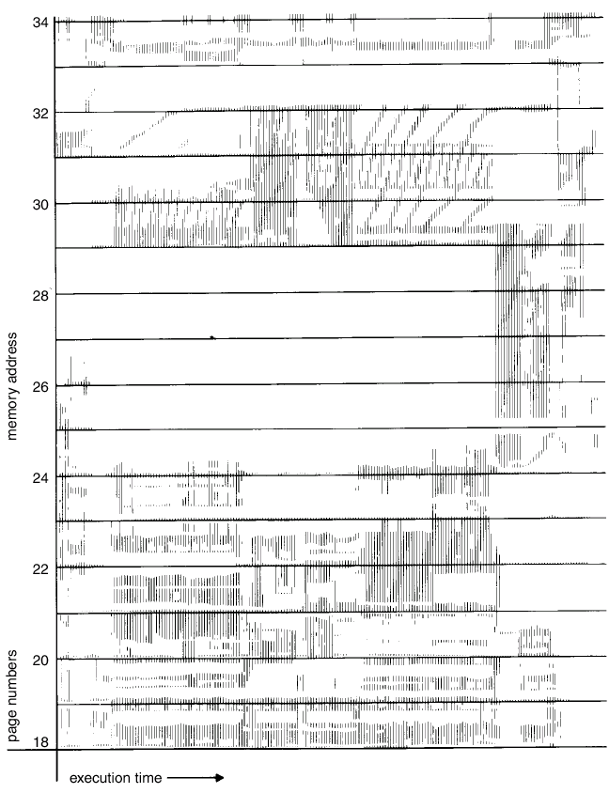
Locality in Memory Access Pattern

Slide 50
Working-Set Model
Δ ≡ working-set window ≡ a fixed number of page references
Example: 10,000 instruction
WSS_{i} (working set of Process P_{i}) =
total number of pages referenced in the most recent Δ (varies in time)
  if Δ too small will not encompass entire locality.
  if Δ too large will encompass several localities.
  if Δ = ∞ ⇒ will encompass entire program.
D = Σ WSS_{i} ≡ total demand frames
if D > m ⇒ Thrashing
Policy: if D > m, then suspend one of the processes.

Slide 51

Working-set model

Slide 52
Keeping Track of the Working Set
Approximate with interval timer + a reference bit
Example: Δ = 10,000
  Timer interrupts after every 5000 time units.
  Keep in memory 2 bits for each page.
  Whenever a timer interrupts copy and sets the values of all reference bits to 0.
  If one of the bits in memory = 1 ⇒ page in working set.
Improvement = 10 bits and interrupt every 1000 time units.
Impractical to get a true measurement – need to timestamp every reference and maintain a time-ordered queue.

Slide 53

Page-Fault Frequency Scheme
Establish “acceptable” page-fault rate.
  If actual rate too low, remove a frame from the process.
  If actual rate too high, process get more frames.

Slide 54
Other Considerations
Prepaging
Attempt to prevent the initial paging.
Page size selection
  Fragmentation => small page size reduces internal fragmentation
  Locality => small page size matches locality more accurately
  table size => large page size needs smaller page table
  I/O overhead => large page size reduces I/O overhead

Slide 55
Other Considerations (Cont.)
TLB: (translation look-aside buffer)
  Ideally, the working set of each process is stored in the TLB. Otherwise the process will spend a lot of time resolving memory references in the page table.
  TLB Reach - The amount of memory accessible from the TLB.
    TLB Reach = (TLB entries) * (Page Size)

Slide 56
Other Considerations (Cont.)
Increasing TLB Reach
  Increase the Page Size. This may lead to an increase in fragmentation as not all applications require a large page size.
  Provide Multiple Page Sizes. This allows applications that require larger page sizes the opportunity to use them without an increase in fragmentation. – Software complexity.

Slide 57
Other Considerations (Cont.)
Program structure
  int A[][] = new int[1024][1024];
  Each row is stored in one page. (row major)
  Program 1 for (j = 0; j < A.length; j++)
  for (i = 0; i < A.length; i++)
  A[i,j] = 0;
  1024 x 1024 page faults
  Program 2 for (i = 0; i < A.length; i++)
  for (j = 0; j < A.length; j++)
  A[i,j] = 0;
  1024 page faults

Slide 58
Operating System Examples
Linux
Windows NT
Solaris 2

Slide 59
Linux Memory Management
Linux uses a three-level page table structure:
  Page directory
  Page middle directory
  Page table
Page Size: 4 KB
Page allocator based on buddy system algorithm
Virtual memory manager creates pages of virtual memory on demand. It maintains logical regions and pages.

Slide 60
Page Allocation
  The kernel establishes strategy for allocating groups of contiguous page frames without “external fragmentation”. – Buddy System algorithm
  The kernel maintains a list of contiguous page frame groups of fixed size; a group may consists of 1, 2, 4, 8, 16, 32 page frames. The available groups are split and merged using the buddy algorithm, typically represented by binary tree.
  A compromise of fixed and dynamic partitioning schemes. (Virtual memory based on paging and segmentation is usually superior.)
Page Replacement
  Modification of clock algorithm

Slide 61
Buddy System
  void get_hole(int i)
  { if (i == (U+1))
  <failure>; // greater than largest size block
  If ( <i_list empty)
  {
    get_hole (i+1);
    <split hole into buddies>;
    <put buddies on I_list>;
    }
    <take first hole on I_list>;
  }

Slide 62
Windows NT
Uses demand paging with clustering. Clustering brings in pages surrounding the faulting page.
Processes are assigned working set minimum and working set maximum.
Working set minimum is the minimum number of pages the process is guaranteed to have in memory. A process may be assigned as many pages up to its working set maximum.
When the amount of free memory in the system falls below a threshold, automatic working set trimming is performed to restore the amount of free memory.Working set trimming removes pages from processes that have pages in excess of their working set minimum.

Slide 63
Solaris Memory Management
Paging System – effective for user processs and disk I/O
  Maintains a list of free pages to assign faulting processes.
  Lotsfree – the threshold parameter to begin paging out.
  Paging is peformed by pageout process. pageout scans pages using modified clock algorithm. Scanrate is the rate at which pages are scanned. This ranged from slowscan to fastscan.
  Pageout is called more frequently depending upon the amount of free memory available.

Slide 64
Solaris Memory Management (Cont.)
Kernel Memory Allocator
  Kernel tables are significantly smaller than the typical machine page size. So a “lazy buddy system” is used to achieve fast and efficient operations.

Slide 65
Summary
Virtual memory – extend paging and segmentation to allow larger logic address space than physical space.
Page fault and its impact on performance.
Page-replacement Algorithms
  FIFO; OPT; LRU; Second-chance (clock).
Thrashing – Cause and solution

