Slide 1
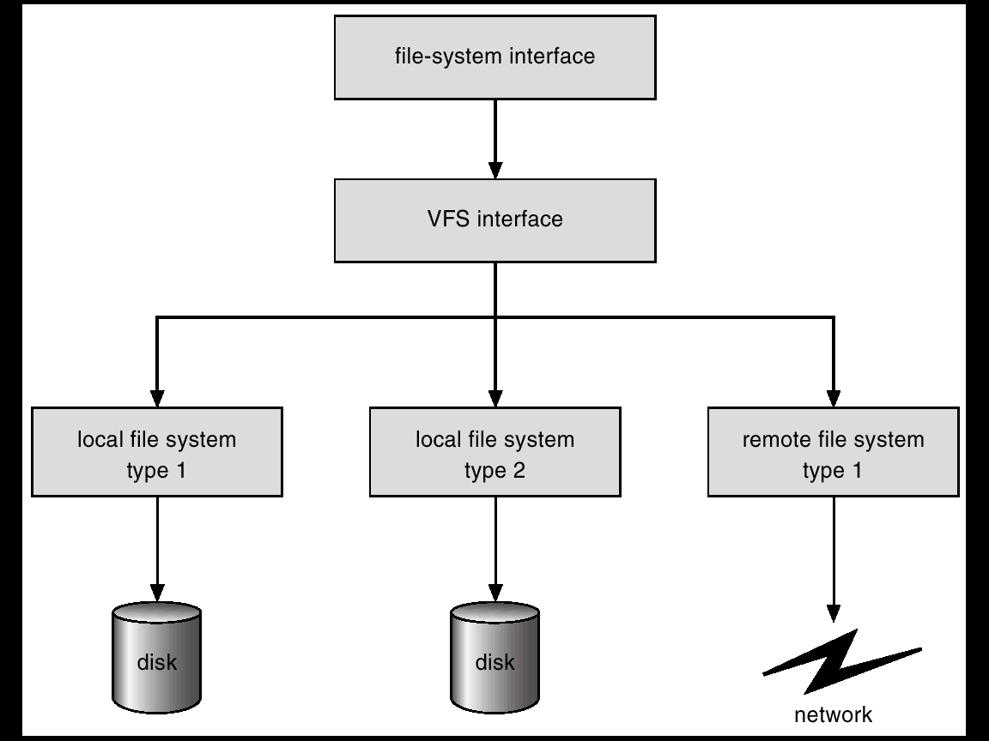
Chapter 11 File System Interface
What does file system “interface” fit in?
Notes:
VFS: provide a common interface to several kinds of filesystems – ext2, fat32, ntfs, ufs, nfs ..

Slide 2
Roles of File System Interface and VFS
Copy (open, read, write…)
fin = open (“/floppy/test”, O_RDONLY, 0);
fout = open(“/tmp/test”, O_WRONLY|O_CREATE|O_TRUNC, 0600);
Do{ len= read(fin, buf, 4096);
write(fout, buf, len);
}while (1);
close(fin);
close(fout);
VFS
Ext2
MS-DOS
/tmp/test
/floppy/test
Notes:
VFS – kernel impl. Supports the interface

Slide 3
File System Interface
File Concept
Access Methods
Directory Structure
File System Mounting
File Protection

Slide 4
File
Concept: Contiguous logical address space.
Attributes:
  Name – only information kept in human-readable form.
  Type – needed for systems that support different types.
  Location – pointer to file location on device.
  Size – current file size.
  Protection – controls who can do reading, writing, executing.
  Time, date, and user identification – data for protection, security, and usage monitoring.
  Information about files are kept in the directory structure, which is maintained on the disk.

Slide 5

File Types
Types:
  Data
    numeric
    character
    binary
  Program

Slide 6
File Structure
Who decides/recognizes:
  Operating system
  User Programs
None - sequence of words, bytes (Unix)
Simple record structure
  Lines
  Fixed length
  Variable length
Complex Structures
  Formatted document
  Specific structure for executable file
  Control characters for different file structures.

Slide 7
File Operations
Create
Write
Read
Reposition within file – file seek
Delete
Truncate
Open(F_{i}) – search the directory structure on disk for entry F_{i}, and move the content of entry to memory, typically a open-file table.
  Return a pointer to the entry in the open-file table. The table has fixed length. So there is a fixed limit on the number of concurrently open files.
Close (F_{i}) – removes its entry in the open-file table.
Notes:
Implementation details of Open is not in the interface scope.

Slide 8
Information Associated with Open File
File pointer: track the last read-write location
File open count: decide when the system can remove the entry.
Disk location of the file
Access rights

Slide 9
Access Methods
Sequential Access
read next
write next
reset/rewind
Direct Access
read n
write n
position to n
read next
write next
rewrite n
n = relative block number to the beginning of the file

Slide 10

Simulation of Sequential Access on a Direct-access File
Notes:
Not so easy to simulate direct-access based on sequential access

Slide 11

Directory Structure
A collection of nodes containing information about all files.

Slide 12
Operations Performed on Directory
Search for a file
Create a file
Delete a file
List a directory
Rename a file
Traverse the file system

Slide 13
Goals When Organizing the Directory Logically
Efficiency – locating a file quickly.
Naming – convenient to users.
  Two users can have same name for different files.
  The same file can have several different names.
Grouping – logical grouping of files by properties.

Slide 14

Single-Level Directory
A single directory for all users.
Naming problem
Grouping problem

Slide 15

Two-Level Directory
Path name
Can have the same file name for different user
Efficient searching
No grouping capability
Notes:
Path name
Can have the same file name for different user
Efficient searching
No grouping capability

Slide 16

Tree-Structured Directories

Slide 17
Tree-Structured Directories (Cont.)
Efficient searching
Grouping Capability
Current directory (working directory)
  cd /spell/mail/prog
  type list
Absolute or relative path name
Creating a new file is done in current directory.
Delete a file: rm <file-name>
Creating a new subdirectory is done in current directory. mkdir <dir-name>

Slide 18
If in current directory /mail
mkdir count
mail
prog
copy
prt
exp
count
Deleting “mail” ⇒ deleting the entire subtree rooted by “mail”.

Slide 19

Acyclic-Graph Directories
Have shared subdirectories and files.

Slide 20
Links in Acyclic-graph Dir Tree
Two different names (aliasing)
Link: a pointer to another file or directory.
If the original file is deleted, the space for the file is deallocated ⇒ dangling links.
Alternative:
  Keep a reference count. (hardlinks)

Slide 21

General Graph Directory
How do we guarantee no cycles? – for traverse and file deletion
  Allow only links to file not subdirectories.(do not search the directory twice.)
  Garbage collection.
  Every time a new link is added use a cycle detection
  algorithm to determine whether it is OK.
Notes:
Hardlink may not span file systems and may not refer to directories.

Slide 22
File System Mounting
A file system must be mounted before it can be accessed.
A unmounted file system is mounted at a mount point.

Slide 23
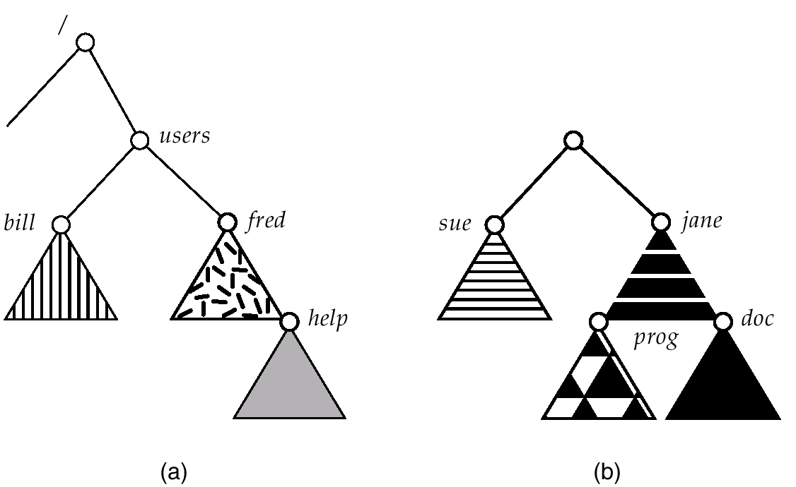
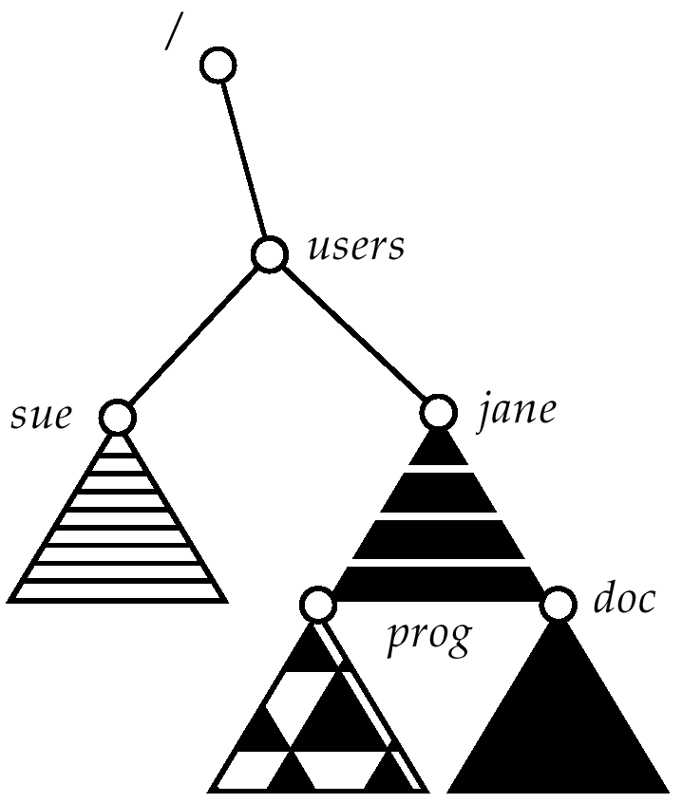
Notes:
Expand of naming space “/” is a powerful symbol used in different protocols for name space expanding – file system (local and distributed, http, ftp …)

Slide 24
File Sharing
Sharing of files on multi-user systems is desirable.
Sharing may be done through a protection scheme.
On distributed systems, files may be shared across a network.
Network File System (NFS) is a common distributed file-sharing method.
File owner/creator should be able to control:
  what can be done
  by whom
Types of access
  Read;Write;Execute;Append;Delete;List.

Slide 25
Unix File Protection
Mode of access: read, write, execute
Three classes of users
RWX
a) owner access 7 ⇒ 1 1 1
RWX
b) group access 6 ⇒ 1 1 0
RWX
c) public access 1 ⇒ 0 0 1
chmod 761 filename
chmod a+r filename
chmod o-w filename

Slide 26
Chapter 12 File System Implementation
File System Structure
File System Implementation
  Virtual File System
Directory Implementation
Allocation Methods
Free-Space Management
NFS
Linux ext2

Slide 27

File-System Structure
File structure
  Logical storage unit
  Collection of related information
File system resides on secondary storage
(disks).
Block: transfer unit between memory
and disk, one or more sectors.
File system organized into layers:
Notes:
File-organization module: translate between logical block addresses and physical block addresses; Logical file system: FCB/Inodes

Slide 28

File Control Block
File control block – storage structure consisting of information about a file.

Slide 29

In-Memory File System Structures
Open:
Read:

Slide 30
Virtual File Systems
Virtual File Systems (VFS) provide an object-oriented way of implementing file systems.
VFS allows the same system call interface (the API) to be used for different types of file systems.
The API is to the VFS interface, rather than any specific type of file system.
First VFS was included in SunOS in 1986. Most Unix file systems and Linux include a VFS.

Slide 32
VFS (Cont.)
The common file model of VFS consists of the following object types:
  The superblock object; -- info of a mounted filesystem. Usually corresponds to a filesystem control block..
  The inode object; -- info about a specific file. Usually corresponds to a file control block. Each inode object is associated with an inode number, which uniquely identifies the file within the filesytem. Or vnode in Unix implementation.
  The file object; -- info about the interation between an open file and a process. Exists only in kernel memory during the period each process accesses a file.
  The dentry object. – info about the linking of a directory entry with the corresponding file. Different file system stores it differently (as we will discuss).

Slide 33
Fields of the inode object (Linux Impl.)
    Pointers for the hash list
    Pointers for the inode list
    Pointer for the dentry list
    Inode number
    Usage counter
    Device Identifier
    File type and access rights
    Number of hard links
    Owner identifier
    Group identifier
    Real device number
    File length in bytes
    Time of last file access
    Time of last file writer
    Time of last inode change
    Block size in bytes
    Number of blocks of the file

Slide 34
    Version number, auto increased
    Number of pages containing file data
    Inode semaphore
    Inode semaphore for atomic write
    Inode operations
    Pointer to superblock object
    Inode wait queue
    Pointer to file lock list
    Pointer to memory regions used to map the file
    Pointer to page descriptor
    Inode disk quotas
    Inode state flag
    Filesystem mount flag
    True if file is a pipe
    True if file is a socket
    Usage counter for writing process
    File creation flags
    Reserved for future development
    Specific filesystem information

Slide 35
Example:
Hash List:
  The hash table speeds up the search of the inode object. The list contains a backward and a forward pointer to other inode that has to the same position to resolve collision.
Inode state flag in inode object
  I_DIRTY -- corresponding disk inode must be updated.
  I_LOCK -- inode object is locked
  I_FREEING -- inode object is being freed.

Slide 36
inode_operations
create(); lookup(); link(); unlink(); symlink(); mkdir(); rmdir(); mknod(); rename(); readlink(); follow_link(); readpage(); writepage(); bmap(); truncate(); permission();smap();updatepage(); revalidate(dentry);
Only a subset of these applies to any specific inode and filesystem;
  revalidate() is usually invoked by the network filesystem

Slide 37
Directory Implementation
Linear list of file names with pointer to the data blocks.
  simple to program
  time-consuming to execute
Hash Table – linear list with hash data structure.
  decreases directory search time
  collisions – situations where two file names hash to the same location
  fixed size

Slide 38
Allocation Methods
An allocation method refers to how disk blocks are allocated for files:
  Contiguous allocation
  Linked allocation
  Indexed allocation

Slide 39
Contiguous Allocation
Each file occupies a set of contiguous blocks on the disk.
Simple – only starting location (block #) and length (number of blocks) are required.
Fast.
Random access.
Wasteful of space (dynamic storage-allocation problem).
Files cannot grow.

Slide 40

Contiguous Allocation of Disk Space

Slide 41


Slide 42
Linked Allocation
Each file is a linked list of disk blocks: blocks may be scattered anywhere on the disk.
block =
pointer
Simple – need only starting address
Free-space management system – no waste of space
No random access
Mapping

Slide 43

File-allocation Table (FAT)
Variation of linked allocation.
Improve random access.
Used by MS-DOS and OS/2.

Slide 44
Indexed Allocation
Each file has its own index block
index table

Slide 45

Indexed Allocation

Slide 46
Indexed Allocation
Good side:
  Support random access.
  Dynamic access without external fragmentation.
The other side:
  Have overhead of index block.(wasted space.)

Slide 47
Indexed Allocation
How large should an index block be?
  Linked scheme – link together several index blocks. (no maximum file size limit)
  Multilevel Index – first-level points to second-level index blocks
  Combined -- UFS

Slide 48
Two Level Indexed Allocation

outer-index
index table
file
Max File Size With Block Size 512B?

Slide 49

Combined Scheme: UNIX (4KB per block)
How many bytes are accessible with 12 direct block pointers?
Notes:
Triple indirect: (4K)**5 => 2**60

Slide 50
Pointers to disk blocks in UFS inode (with block pointer of 4 bytes)
12 direct blocks
  4K * 12 = 48K
1 single indirect blocks
  1K entries * 4Kbytes per entry
1 double indirect
  (1K)*(1K)*(4K) = 2 **32
1 triple indirect
Since the file pointer is 2**32 and a signed integer, the actual max file size is 2**31 or 2GB.

Slide 51
Free-Space Management
Manage a list of free-space to reuse disallocated blocks.
  Simple Approach: Bit Vector.
    Easy to calculate the block numbers if hardware provides instruction to get the offset of first 1 bit.
    Not possible to keep in memory for large disks.
0
1
2
n-1
…
0 ⇒ block[i] free
1 ⇒ block[i] occupied
bit[i] =


Slide 52
Other Free-Space Management
  Linked list (free list)
    Cannot get contiguous space easily
    No waste of space
  Grouping
    Stored addresses of n free blocks in the first free block. Faster to find many free blocks than linked list.
  Counting
    Keep address of the first free block and the number n of free contiguous block after it. (commonly used in storing digital image)

Slide 53

Linked Free Space List

Slide 54
The Sun Network File System (NFS)
Why do we get our home environment no matter which Unix machine we log in to?
  NFS!
An implementation and a specification of a software system for accessing remote files across LANs (or WANs).
The implementation is part of the Solaris and SunOS operating systems running on Sun workstations using an unreliable datagram protocol (UDP/IP protocol) and Ethernet.

Slide 55
NFS – what does it do?
Interconnected workstations viewed as a set of independent machines with independent file systems, which allows sharing among these file systems in a transparent manner. -- USER MOBILITY
A remote directory (server) is mounted over a local file system directory. The mounted directory looks like an integral subtree of the local file system.
Files in the remote directory can then be accessed in a transparent manner.
Potentially any file system (or directory within a file system), can be mounted remotely on top of any local directory. (subject to access-rights accreditation)

Slide 56
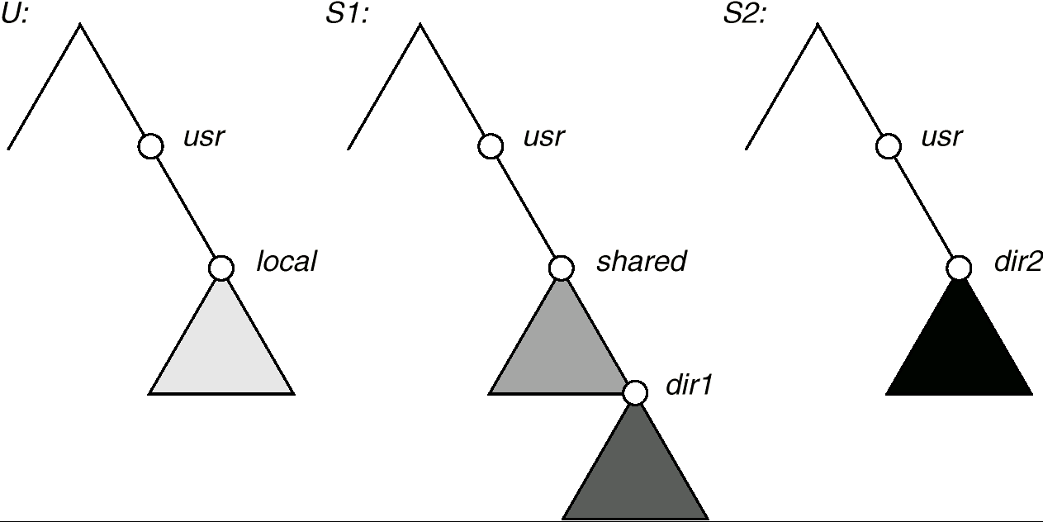
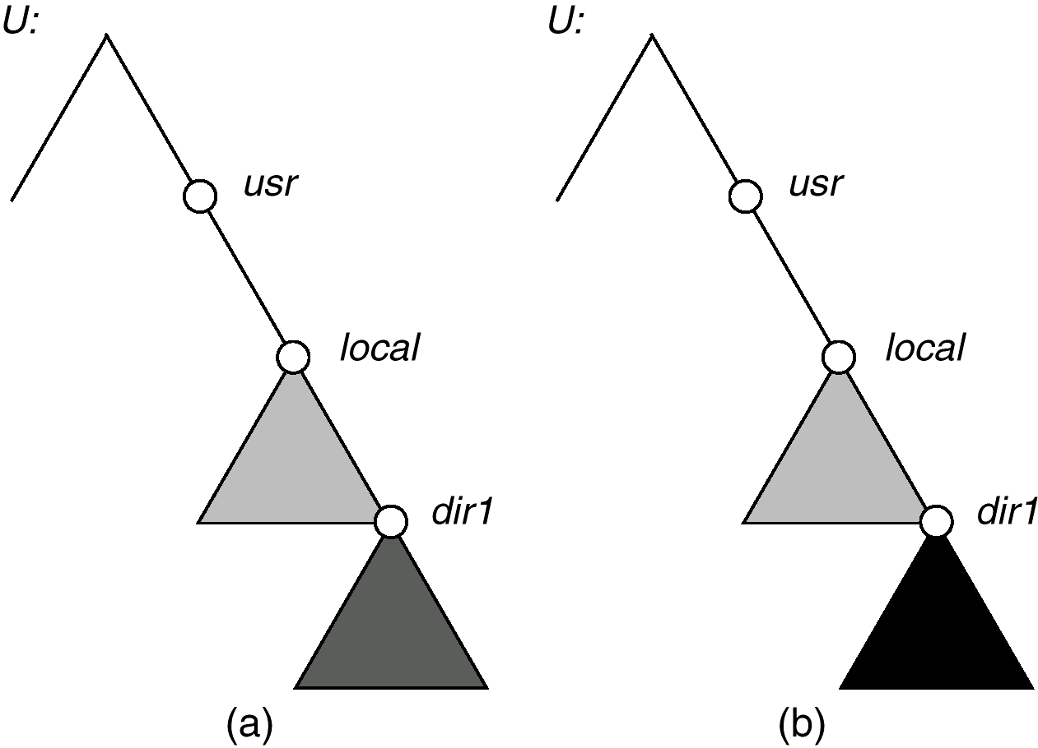

Slide 57
NFS (Cont.)
NFS is designed to operate in a heterogeneous environment of different machines, operating systems, and network architectures; the NFS specifications are independent of these media.
This independence is achieved by:
  RPC (Remote Procedure Call) primitives built on top of an XDR(External Data Representation) protocol used between two implementation-independent interfaces.
NFS: Client-server application built using RPC/XDR.

Slide 58
Recall RPC
Client calls the remote procedure, which is calling a function on the local host, called “client stub”.
A “server stub” on the server receives the network message from the client stub and calls the server procedure that the programmer wrote.

Slide 59
Why RPC?
Programming is easier with little or no network programming involved. The programmer writers a client program and the server procedures.
For an unreliable protocol like UDP, RPC takes care of the timeout and retransmission.
RPC library handles any required data translation for the arguments and return values, if there are stored differently on two machines. Good for heterogeneous environment.

Slide 60
XDR: External Data Representation
The standard used to encode the values in the RPC call and reply messages – the RPC header fields (XID – transaction id, program number, accept status, etc), procedure parameters, results.
Defined in RFC 1014.

Slide 61
The NFS specification distinguishes between the services provided by a mount mechanism and the actual remote-file-access services.
  Mount Protocol
  NFS Protocol

Slide 62
NFS Mount Protocol
Establishes initial logical connection between server and client.
Mount operation includes name of remote directory to be mounted and name of server machine storing it.
  Mount request is mapped to corresponding RPC and forwarded to mount server running on server machine.
  Export list – specifies local file systems that server exports for mounting, along with names of machines that are permitted to mount them.
Normally done when the client’s boot time.

Slide 63
File Handle
Following a mount request that conforms to its export list, the server returns a file handle—a key for further accesses.
File handle – a file-system identifier, and an inode number to identify the mounted directory within the exported file system.
The NFS server creates it, passes it back to the client for it to access the file. The client never looks at the contents of the file handler since it only makes sense to the server.
Normal user process never deal with file handles. NFS client and server code pass them back and forth.

Slide 64
sun> mount –t nfs bsdi:/usr /nfs/dsdi/usr
sun: the NFS client
/
bsdi: The NFS server
nfs
/
bsdi
usr
usr
Z123
Hello.c
This mounts the directory /usr on the host bsdi (the NFS server)
as the local filesystem /nfs/bsdi/usr.
We reference the file /nfs/bsdi/usr/Z123/hello.c on the client sun, we are
really reference the file /usr/Z123/hello.c on the server bsdi.

Slide 65
NFS Protocol
Provides a set of remote procedure calls for remote file operations. The procedures support the following operations:
  searching for a file within a directory
  reading a set of directory entries
  manipulating links and directories
  accessing file attributes
  reading and writing files
Notes:
No open close

Slide 66
NFS server provides 15 procedures
    GETATTR
    SETATTR
    STATFS
    LOOKUP
    READ
    WRITE
    CREATE
    REMOVE
    RENAME
    LINK
    SYMLINK
    READLINK
    MKDIR
    RMDIR
    READDIR

Slide 67
Stateful vs. Stateless
NFS servers are stateless. (feature?)
Each request has to provide a full set of arguments.
Server never knows if the client is really going to reference the file after it looks it up.
Modified data must be committed to the server’s disk before results are returned to the client
  lose advantages of caching.
  Simplify server crash recovery
The NFS protocol does not provide concurrency-control mechanisms. Need extra help on locking.
Notes:
http is another stateless protocol.

Slide 68
Three Major Layers of NFS Architecture
UNIX file-system interface (based on the open, read, write, and close calls, and file descriptors).
Virtual File System (VFS) layer – distinguishes local files from remote ones, and local files are further distinguished according to their file-system types.
  The VFS activates file-system-specific operations to handle local requests according to their file-system types.
  Calls the NFS protocol procedures for remote requests.
NFS service layer – bottom layer of the architecture; implements the NFS protocol.

Slide 69
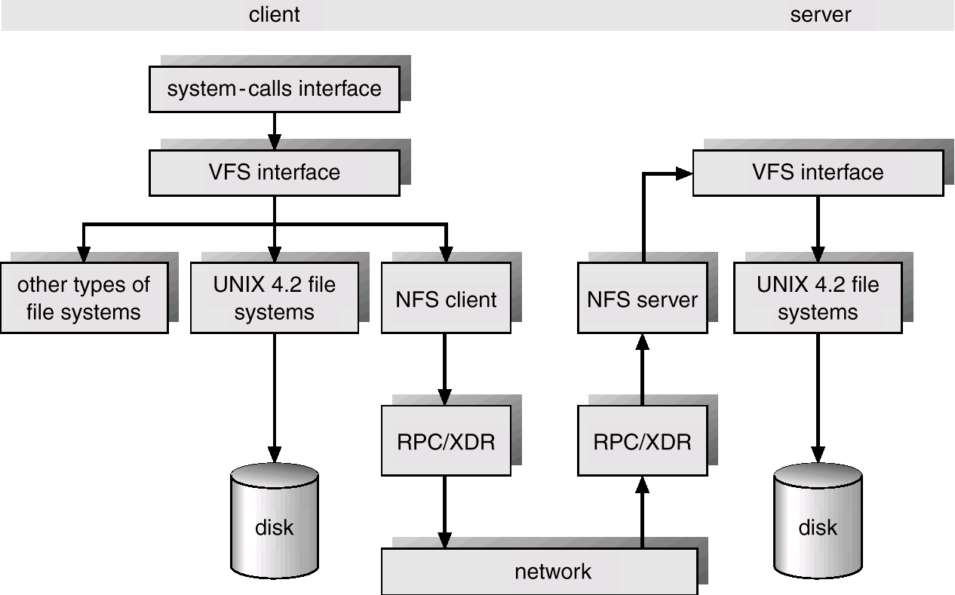

Slide 70
NFS Path-Name Translation
Performed by breaking the path into component names and performing a separate NFS lookup call for every pair of component name and directory vnode.
To make lookup faster, a directory name lookup cache on the client’s side holds the vnodes for remote directory names.

Slide 71
NFS Remote Operations
Nearly one-to-one correspondence between regular UNIX system calls and the NFS protocol RPCs (except open and close).
NFS employs buffering and caching techniques for the sake of performance.
  File-blocks cache – when a file is opened, the kernel checks with the remote server whether to fetch or revalidate the cached attributes. Cached file blocks are used only if the corresponding cached attributes are up to date.
  File-attribute (inode-information) cache – the attribute cache is updated whenever new attributes arrive from the server.

Slide 72
Problems and Improvements
Performance over Wide Area Networks
Secure Communication
  Early naïve days
  Key based secure NFS
  More advanced
    in NFS V4 RPCSEC_GSS

Slide 73
Ext2FS
Introduced in 1994, named ext2 due to historical reasons.
Features:
  SA may choose the optimal block size from 1KB to 4KB, depending on the expected average file length.
  Pre-allocate disk data blocks to regular files before they are actually used. When the file increases its size, several block are already reserved at physically adjacent positions.
  Careful implementation of file-updating strategy. I.e: count of head links in the disk inode is incremented, before the new name is added into the proper directory.
  Block group
Notes:
If hardware failure happens in between, avoid directory entry that refers to an nonexist inode.

Slide 74
Ext2fs (Cont.)
First block: partition boot sector
The rest is split into block groups. All the block groups have the same size and are stored sequentially. The kernel can derive the location of a block group in a disk simply from its integer index.
Block groups reduce file fragmentation, since kernel tries to keep the data blocks of a same file in the same block group if possible.

Slide 75
Ext2 block group
Boot
block
Block group 0
…
Super
block
Group
Descriptors
Data block
Bitmap
Inode
Bitmap
Inode
Table
Data
Blocks
1 blk
N blks
1 blk
1 blk
N blks
N blks
Bitmap: free-space management. 0 indicates free space.
Data block pointer: up to three levels of indirection.

Slide 76
Ext2 File Types
Regular file
Directory – a special kind of file whose data blocks store filenames and the corresponding inode numbers.
Symbolic link – Fast symbolic links are supported. If the path name has 60 or less char, stored in the inode only, no data block.
Device file, pipe, socket – no data block.

Slide 77
Linux Proc File System
/proc/.. -- list process info with pid as directory name.
A special file system to allow users to access the contents of some kernel data structures.
  e.g: simplify the implementation of ps command.
Also in SVR4 Unix.

Slide 78
NTFS in Windows 2000
Windows 2000 supports FAT, NTFS and OS/2 HPFS.
Highly complex system designed from scratch.
Features:
  Recoverability
  Security
  Large disks and large files: max file size: 2**64.

Slide 79
NTFS in Win2K (Cont.)
Files are structured objects not simple byte streams as in MS-DOS or Unix.
Fundamental entity: volume.
  Volume Layout:
Partition
boot
sector
Master
file
table
System
files
File area

Slide 80
MFT in NTFS
Master file table: Info of all the files and folders on this volume; info of available unallocated space, organized as a set of rows called records.
A record is 1KB, contains file’s attributes. Large files may need one or more records.
Itself is a file and can be placed anywhere within the volume, thus eliminating the problem with defective sectors in the first track. Can grow as needed.

Slide 81
Records for Files/Folders …
Extentions: quotas etc
Case conversion table
Security descriptors for all files
List of bad block
Bootstrap loader
Bitmap of blocks used
Root directory
Attribute definitions
Volume file
Log file to recovery
Mirror copy of MFT
Notes:
The NTFS master file table

Slide 82
NTFS Recoverability
Key elements that support recoverability during system crash or disk failure:
  I/O manager – handles basic functions.
  Log file service -- the essence for recovery.
  Cache manager – cache file reads and writes
  Virtual memory manager: mapping file references to virtual memory. File I/O becomes memory operations.
File system data structure updates are performed in transactions.
Recover file system data, ensure the metadata files are undamaged, but not user file contents.

Slide 83
NTFS Security
NTFS uses the W2K object model to enforce security.
An open file is implemented as a file object with a security descriptor that defines its security attributes.
Stored in Master File Table record.

Slide 84
NTFS (cont.)
Filenames are in Unicode.
Supports transparent file compression
  A file can be created in compressed mode, NTFS will compress when writing to disk and automatically uncompress when they are read back.
Supports file encryption
  Use a variant of DES (Data Encryption Standard)

Slide 85
Summary
File System Data Structures:
boot control block; partition control block (superblock/Master File Tables), file control block (inode), directory Structure.
  Structures in memory;
  Structure in disk;
Allocation Methods
  Contiguous Allocation
  Linked Allocation
  Indexed Allocation
Free-space management
Network File System

