Slide 1
Why?
Why do I need to study Operating Systems?
  an essential question you typically don’t know the complete answer until later.
Instructor’s views

Slide 2
What?
What is the Operating Systems?
Application Software
Operating Systems
Computer Hardware

Slide 3
What?
What is the Operating Systems?
  OS is a software
  Resource Manager
    Time
    Space
  Extended Machine
    High usability for programmers
    High usability for users

Slide 4
What?
What is the Operating Systems?
  The operating systems is the most fundamental part of all the system programs. It controls the computer’s resources and provides the base upon which the application program can be written and the environment within which the programs can be executed.

Slide 5
What?
What are the contents of a typical operating system?
  Process management
  Main-memory management
  Secondary-storage management
  File system
  I/O systems
  Protection system
  Networking

Slide 6
Textbook Outline
Chapter 1-3 Overview
Chapter 4-8 Process Management
Chapter 9-10 Main-memory Management
Chapter 11-12 File System
Chpater 13-14 I/O and Secondary-storage Management
Chpater 18-19 Protection and Security
Notes:
What is process (analogy of recipe and cooking process). Contents …
File is a logic abstraction
Device controllers and drivers. USB shares a same driver.

Slide 7
Course Characteristics
Interesting course!
Hard course?!
  Solutions:
    Attend the class
    Read the textbook
    Do the lab

Slide 8
Chapter 1 Introduction
History of OS
  Non-exist
  Mainframes
  PC World / GUI World
  Multiprocessor systems
  Distributed systems

Slide 9
History of OS (cont.)
  Clustered systems
  Real-time systems
  Handheld systems
  Computing Environments

Slide 10
Mainframes
Batch Systems (50s)
  Reduce setup time by batching similar jobs
  turn-around time can be large from user standpoint
  lack of protection between two user programs, or between user programs and kernel (monitor) systems.
card reader
Tape drives
CPU
Tape drives
Line printer
operator
operator

Slide 11


Slide 12
Spooling Batching Systems
  Spooling (Simultaneous Peripheral Operation On Line)
    Use disk as a buffer so that the computer can do I/O and computing at the same time.
    The simplest multiprogramming system
DISK
Card reader
CPU
Line printer

Slide 13

Multi-programming Systems
Populated by IBM OS/360
    Increases CPU utilization by organizing jobs so that the CPU always has one to execute.
    Requires special hardware to protect each job against snooping by the other ones.

Slide 14
OS Features Needed for Multiprogramming
I/O routine supplied by the system.
Memory management – the system must allocate the memory to several jobs.
CPU scheduling – the system must choose among several jobs ready to run.

Slide 15
OS/360 (Cont.)
  Sideproduct --“the mythical man-month” of F. Brooks
    Software engineering experience of developing the OS/360

Slide 16
Time-sharing systems (70s)
A logical extension of multiprogramming.
Allows users to share the computer simultaneously
If the response time is quickly enough, the user had the impression that he or she had direct access to the computer. (concept of “context switch”).
On-line communication between the user and the system is provided; when the operating system finishes the execution of one command, it seeks the next “control statement” from the user’s keyboard
Unix is a time-sharing system

Slide 17
A bit about Unix/Linux.
  First edition of UNIX was released 11/03/1971
  1974 Ritchie & Thompson at Bell Labs published a landmark paper about Unix
  System V from AT&T
  BSD (Berkeley Software Distribution)
  POSIX (IEEE standard for system call interface)
  Linus Torvalds vs. Linux

Slide 18
1991, Linus Torvalds posted to the comp.os.minix newsgroup with the words: Hello everybody out there using minix -
I'm doing a (free) operating system (just a hobby, won't be big and professional like gnu) for 386(486) AT clones.

Slide 19
Personal Computer
Computer system dedicated to a single user.
I/O devices – keyboards, mice, display screens, small printers.
User convenience and responsiveness.
Can adopt technology developed for larger operating system’ often individuals have sole use of computer and do not need advanced CPU utilization. May need protection features.
May run several different types of operating systems (Windows, MacOS, UNIX, Linux)

Slide 20
Parallel Systems
Multiprocessor systems with more than on CPU in close communication.
Tightly coupled system – processors share memory and a clock; communication usually takes place through the shared memory.

Slide 21
Distributed Systems
Distribute the computation among several physical processors.
Loosely coupled system – each processor has its own local memory; processors communicate with one another through various communications lines, such as high-speed buses or telephone lines.
Requires networking infrastructure.
Local area networks (LAN) or Wide area networks (WAN)
May be either client-server or peer-to-peer systems

Slide 22
Clustered Systems
Clustering allows two or more systems to share storage.
Provides high reliability.
Asymmetric clustering: one server runs the application while other servers standby.
Symmetric clustering: all N hosts are running the application.

Slide 23
Real-Time Systems
Often used as a control device in a dedicated application such as controlling scientific experiments, medical imaging systems, industrial control systems, and some display systems.
Well-defined fixed-time constraints.
Real-Time systems may be either hard or soft real-time.

Slide 24
Handheld Systems
Personal Digital Assistants (PDAs)
Cellular telephones

Slide 25
Computing Environments – horizontal view
Traditional computing
Web-Based Computing
  Load balancing/high performance
  Clustering/high availability
Embedded Computing
Different environments lead to different requirements of operating systems.

Slide 26
Chapter 2 Computer-System Structures
One or more CPU, memory and its controller, devices (Disks, Printers, Tapes, Audio devices, network card) and their controllers.
System bus provides access to the memory for the CPU and the device controllers.

Slide 27


Slide 28
Facts about Devices
  Devices (disks, printers, tapes)– mechanical components.
  Device Controllers – electronic components that can handle one or more (identical) devices.
  OS/Device Drivers deals with the controllers, never physical devices.
  Device controller informs CPU that it has finished its operation by causing an interrupt.
  Device Driver – the code that talks to a controller, giving it commands and accepting responses.
  Each device controller has a local buffer and a few registers. CPU moves data from/to main memory to/from local buffers
  CPU and device controllers have access to the memory through the memory controller.

Slide 29
Interrupt
Operating Systems communicate with its environment by interrupts.
Hardware interrupt:
  Example: signal from a device about completion of an I/O operation.
Software-generated interrupt (trap):
  Example: a system call from user program for reading a file.
Notes:
System call can also be implemented using interrupt, by trapping to a specific location in interrupt vector.

Slide 30
Interrupt (Cont.)
Interrupt vector stores the address of interrupt handlers.
Interrupt handler receives interrupts – routine at a fixed address in memory: determines the cause of the interrupt, performs the necessary processing and executes a “return from interrupt” to return to the CPU.
Maskable to ignore or delay some interrupts. Some are unmaskable.
Interrupt vector to dispatch interrupt to correct handler.
Notes:
Interrupt vector: a table of pointers in low memory
Once interrupted, CPU goes to interrupt vector -> interrupt handler. Upon completion, resume the original state.

Slide 31
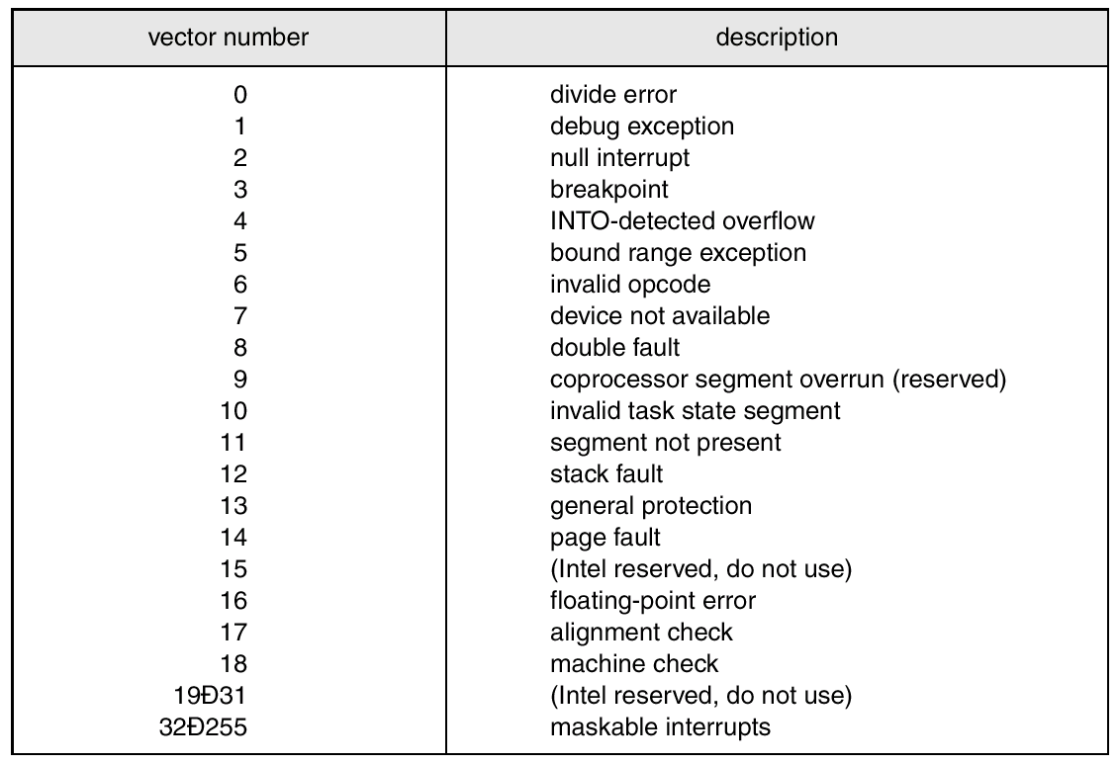
A typical interrupt vector table

Slide 32
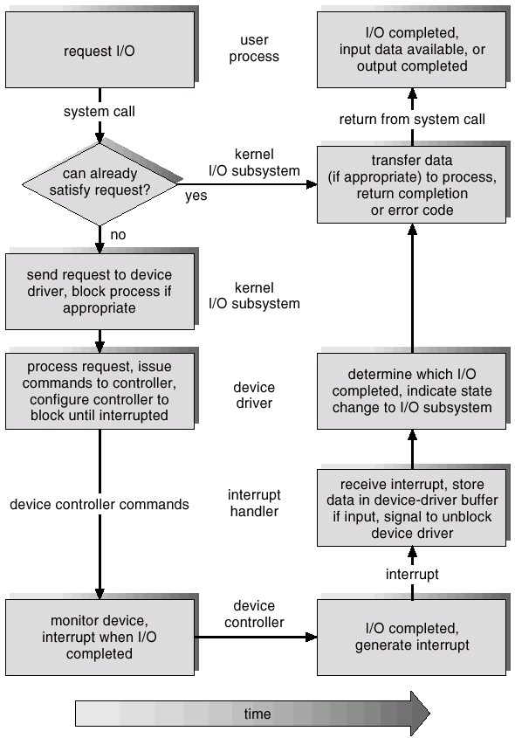
I/O interrupt life cycle
Notes:
System call switches from user mode to kernel mode.

Slide 33

Synchronous I/O
Asynchronous I/O
Notes:
Different not non-blocking or blocking I/O, which are from system call perspective.

Slide 34

Notes:
Asynchronous allow more than more concurrent devices. So need a table to maintain.

Slide 35
DMA (Direct Memory Access)
Used for high-speed I/O devices able to transmit information at close to memory speeds.
Device controller transfers blocks of data from buffer storage directly to main memory without CPU intervention.
Only on interrupt is generated per block, rather than the one interrupt per byte.

Slide 36

The Storage Hierarchy
Typical access time:
register: 1 nsec
cache: 2 nsec
memory: 10 nsec
mag disk: 10 msec
tape: 100 sec

Slide 37

Magnetic Disks
Notes:
Tracks, sectors, cylinders.

Slide 38
Coherency and Consistency
Use of high-speed memory to hold recently-accessed data.
Requires a cache management policy.
Caching introduces another level in storage hierarchy. This requires data that is simultaneously stored in more than one level to be consistent.
Multiprocessor cache coherency. Usually handled at hardware level.

Slide 39
Web-computing environment Distributed Cache Synchronization
User1
AppServer1
LB
DB
User2
AppServer2
Notes:
A problem in modern applications but were encountered by computer system designers long time ago.

Slide 40
Hardware Protection
Dual-Mode Operation
I/O Protection
Memory Protection
CPU Protection

Slide 41
Dual Mode Operation
Sharing system resources requires operating system to ensure that an incorrect program cannot cause other programs to execute incorrectly.
Without this hardware support, OS can have big shortcomings.
Provide hardware support to differentiate between at least two modes of operations.
  1. User mode – execution done on behalf of a user.
  2. Monitor mode (also kernel mode or system mode) – execution done on behalf of operating system.
Notes:
MS-DOS based on Intel 8088 has no dual mode. A program could wipe out the OS.

Slide 42
Mode bit added to computer hardware to indicate the current mode: monitor (0) or user (1).
When an interrupt/system call occurs, hardware switches to monitor mode.
Privileged instructions can be issued only in monitor mode

Slide 43
I/O protection
All I/O instructions are privileged instructions.
Must ensure that a user program could never gain control of the computer in monitor mode (I.e., a user program that, as part of its execution, stores a new address in the interrupt vector).
Revisit I/O interrupt diagram.

Slide 44
Memory protection
Must provide memory protection at least for the interrupt vector and the interrupt service routines.
In order to have memory protection, add two registers that determine the range of legal addresses a program may access:
  Base register – holds the smallest legal physical memory address.
  Limit register – contains the size of the range
Memory outside the defined range is protected.
Loading base & limit registers are privileged instructions

Slide 45



Slide 46
CPU protection
Timer – interrupts computer after specified period to ensure operating system maintains control.
  Timer is decremented every clock tick.
  When timer reaches the value 0, an interrupt occurs.
Timer commonly used to implement time sharing.
Timer also used to compute the current time.
Load-timer is a privileged instruction.

Slide 47
Summary for Chapter 1-2
Why is OS needed?
What can it do?
How is it evolved?
Concepts
  Spooling
  Multiprogramming
  Time-sharing
  Dual-mode, privileged operations
Notes:
Spooling: different speed of I/O operations and computations
Multiprogramming – CPU usage
Time sharing – user interaction

Slide 48
Chapter 3 Operating System Structures
System Components
System Services
System Calls
System Programs
System Structure
Virtual Machines
System Design

Slide 49
System Components
Process Management
Main Memory Management
File Management
I/O System Management
Secondary Management
Networking
Protection System
Command-Interpreter System
Notes:
I have mentioned most of them in last week. So I will go over them quickly,just to give out the formal definitions.

Slide 50
Process Management
A process is a program in execution.
A process needs certain resources, including CPU time, memory, files, and I/O devices, to accomplish its task.
The operating system is responsible for the following activities in connection with process management.
  Process creation and deletion.
  process suspension and resumption.
  Provision of mechanisms for:
    process synchronization
    process communication

Slide 51
Main-Memory Management
Main memory is a volatile storage device. It loses its contents in the case of system failure.
The operating system is responsible for the following activities in connections with memory management:
  Keep track of which parts of memory are currently being used and by whom.
  Decide which processes to load when memory space becomes available.
  Allocate and deallocate memory space as needed

Slide 52
File Management
A file is a collection of related information defined by its creator. Commonly, files represent programs (both source and object forms) and data.
The operating system is responsible for the following activities in connections with file management:
  File creation and deletion.
  Directory creation and deletion.
  Support of primitives for manipulating files and directories.
  Mapping files onto secondary storage.
  File backup on stable (nonvolatile) storage media.

Slide 53
I/O System Management
The I/O system consists of:
  A buffer-caching system
  A general device-driver interface
  Drivers for specific hardware devices

Slide 54
Secondary-Storage Management
Since main memory (primary storage) is volatile and too small to accommodate all data and programs permanently, the computer system must provide secondary storage to back up main memory.
Most modern computer systems use disks as the principle on-line storage medium, for both programs and data.
The operating system is responsible for the following activities in connection with disk management:
  Free space management
  Storage allocation
  Disk scheduling

Slide 55
Networking
A distributed system is a collection of processors that do not share memory or a clock. Each processor has its own local memory.
The processors in the system are connected through a communication network.
Communication takes place using a protocol.
A distributed system provides user access to various system resources.
Access to a shared resource allows:
  Computation speed-up
  Increased data availability
  Enhanced reliability

Slide 56
Protection System
Protection refers to a mechanism for controlling access by programs, processes, or users to both system and user resources.
The protection mechanism must:
  distinguish between authorized and unauthorized usage.
  specify the controls to be imposed.
  provide a means of enforcement.

Slide 57
Command-Interpreter System
Many commands are given to the operating system by control statements which deal with:
  process creation and management
  I/O handling
  secondary-storage management
  main-memory management
  file-system access
  protection
  networking

Slide 58
Command-Interpreter System (Cont.)
The program that reads and interprets control statements is called variously:
  command-line interpreter
  shell (in UNIX)
Its function is to get and execute the next command statement.

Slide 59
Operating System Services
  Program execution – system capability to load a program into memory and to run it.
  I/O operations – since user programs cannot execute I/O operations directly, the operating system must provide some means to perform I/O.
  File-system manipulation – program capability to read, write, create, and delete files.
  Communications – exchange of information between processes executing either on the same computer or on different systems tied together by a network. Implemented via shared memory or message passing.
  Error detection – ensure correct computing by detecting errors in the CPU and memory hardware, in I/O devices, or in user programs.
Notes:
User point of view. Like specification for a software, where the software is the OS.

Slide 60
Additional Operating System Functions
Additional functions exist not for helping the user, but rather for ensuring efficient system operations.
  Resource allocation – allocating resources to multiple users or multiple jobs running at the same time.
  Accounting – keep track of and record which users use how much and what kinds of computer resources for account billing or for accumulating usage statistics.
  Protection – ensuring that all access to system resources is controlled.

Slide 61
System Calls
System calls provide the interface between a running program and the operating system.
  Generally available as assembly-language instructions.
  Languages defined to replace assembly language for systems programming allow system calls to be made directly (e.g., C, C++)
Three general methods are used to pass parameters between a running program and the operating system.
  Pass parameters in registers.
  Store the parameters in a table in memory, and the table address is passed as a parameter in a register.
  Push (store) the parameters onto the stack by the program, and pop off the stack by operating system.

Slide 62

Passing A Parameter As A Table

Slide 63
System Calls and Library Functions in Unix
Defined in the C language, regardless of the actual implementation.
In Unix, each system call has a function of the same name in the standard C library.
General purpose functions in C are not entry points into the kernel, some don’t involve OS at all.
Distinction between a system call and library function – critical for an implementor.
Notes:
The implementation of system call many put the C arguments into general registers and then execute some machine instruction that generates a software interrupt in the kernel.

Slide 64
Types of System Calls
Process control
File management
Device management
Information maintenance
Communications

Slide 65
Some of the Major POSIX System Calls
Process management
Call | Description
Pid = fork() | Create a child process
Pid = waitpid(pid, &statloc, options) | Wait for a child to terminate
S= execve(name, argv, envionp) (Totally 6 exec system calls) | Replace current process’s image
exit(status) | Terminate a process execution

Slide 66
#include <sys/types.h>
#include <sys/wait.h>
#include <stdio.h>
int main(void)
{
char buf[1024];
pid_t pid;
int status;
printf("%% ");
while (fgets(buf,1024,stdin) != NULL)
{
buf[strlen(buf) -1] =0;
if ((pid = fork()) <0)
printf("fork error");
else if (pid==0) { /* child */
execlp(buf, buf, (char *) 0);
printf("couldn't execute: %s", buf);
exit(127);
}
/* parent */
if ( (pid = waitpid(pid, &status, 0)) <0)
printf("waitpid error");
printf("%% ");
}
exit(0);
}
Example:

Slide 67
Some of the Major POSIX System Calls
File management
Call | Description
open(…)/close(…) | Open/close a file
Read(…)/write(…) | Read/write data from/into a file
lseek() | Move the file pointer
stat() | Get a file’s status information

Slide 68
Some of the Major POSIX System Calls
Directory and file system management
Call | Description
mkdir() | Create a new directory.
rmdir() | Remove a empty directory.
link() | Create a link to the existing file.
unlink() remove() | Removes the directory entry and decrement the link count of the file. NOT ALWAYS DELETE THE CONTENTS. (1. link count=0; 2. File is closed.)
Notes:
Examples of unlink; web server log files.

Slide 69
Some of the Major POSIX System Calls
Others
Call | Description
kill(pid, signal) | Send a signal o a process.
alarm() | Set a timer that will expire at a specified time.
time() | The number of seconds since 00:00:00 01/01/1970.

Slide 70
System Programs
System programs provide a convenient environment for program development and execution. The can be divided into:
  File manipulation
  Status information
  File modification
  Programming language support
  Program loading and execution
  Communications
  Application programs
Notes:
Some are just user interfaces of system calls. From OS point of view, system program and user program are same.

Slide 71
System Programs
Some are just user interfaces of system calls.
Most users’ view of the operation system is defined by system programs, not the actual system calls.
From OS point of view, system programs and user programs are same.

Slide 72
System Structures
Monolithic
Layered
Microkernel

Slide 73
UNIX System Structure
UNIX – limited by hardware functionality, the original UNIX operating system had limited structuring. The UNIX OS consists of two separable parts.
  Systems programs
  The kernel
    Consists of everything below the system-call interface and above the physical hardware
    Provides the file system, CPU scheduling, memory management, and other operating-system functions; a large number of functions for one level.

Slide 74

UNIX System Structure

Slide 75

An Operating System Layer

Slide 76
Microkernel System Structure
Moves as much from the kernel into “user” space.
Communication takes place between user modules using message passing.
Features:
  easier to extend a microkernel
  more secure
  the line between microkernel and user space is vague
Notes:
Time and hardware limit. Personal preference.

Slide 77
System Design
Mechanism vs. Policy
User goals – operating system should be convenient to use, easy to learn, reliable, safe, and fast.
System goals – operating system should be easy to design, implement, and maintain, as well as flexible, reliable, error-free, and efficient.
Notes:
Mechanism: How. Policy: What.

Slide 78
System Generation
Bootstrap loader in ROM
  Responsible for locating the kernel, loading it into main memory, doing all the initialization and start its execution.

Slide 79
Virtual Machine
IBM VM/370
VM does the multiprogramming and provide several exact copies of the bare hardware, different virtual machine can run different operating systems.

Slide 80

Virtual Machine System
VM/370

Slide 81
Benefits
Robustness and security
Have a environment for system development
Increase server utilization

Slide 82
Virtual Machine Software (VMWare)
Java Virtual Machine (JVM)

Slide 83
Java Virtual Machine
Compiled Java programs are platform-neutral bytecodes executed by a Java Virtual Machine (JVM).
JVM consists of
- class loader
- class verifier
- runtime interpreter
Just-In-Time (JIT) compilers increase performance

Slide 84

JVM

Slide 85
Summary for Chapter 3
A more complete view:
  An operating system is a set of software extensions of primitive hardware, culminating in a virtual machine that serves as a high level programming environment.
Concepts:
  Different views of OS
    Services – User
    Components – OS designer
    System Call – programmer
  Virtual Machine

