Slide 1
Chapter 13: I/O Systems
I/O Hardware
Application I/O Interface
Kernel I/O Subsystem
Transforming I/O Requests to Hardware Operations
OS examples

Slide 2
Three Techniques for I/O
Programmed I/O (polling): the CPU issues an I/O command, on behalf of a process, to an I/O module; the process busy waits for the operation to be completed;
Interrupt-driven I/O: the CPU issues an I/O command on behalf of a process, continues to execute subsequent instructions, and is interrupted by the I/O module when it completed its work.
Direct memory access (DMA): A DMA module controls the exchange of data between main memory and an I/O module. The CPU sends a request for the transfer of a block of data to the DMA module and is interrupted only after the entire block has been transferred.

Slide 3
Polling
Processor determines the state of device, by reading (polling) the status register over and over until the busy bit becomes clear.
Handshaking notions:
  command-ready – processor signals the wishes
  busy – controller signals it is busy working
  error
Busy-wait cycle to wait for I/O from device

Slide 4
Interrupts
CPU senses the interrupt-request line triggered by I/O device after every instruction.
Interrupt handler receives interrupts
Maskable to ignore or delay some interrupts, e.g when another interrupt handler is running.
Interrupt vector (with addresses of specialized interrupt handlers) to dispatch interrupt to correct handler
  Based on priority
  Some unmaskable
Interrupt mechanism also used for exceptions e.g. dividing by zero (not maskable).

Slide 5
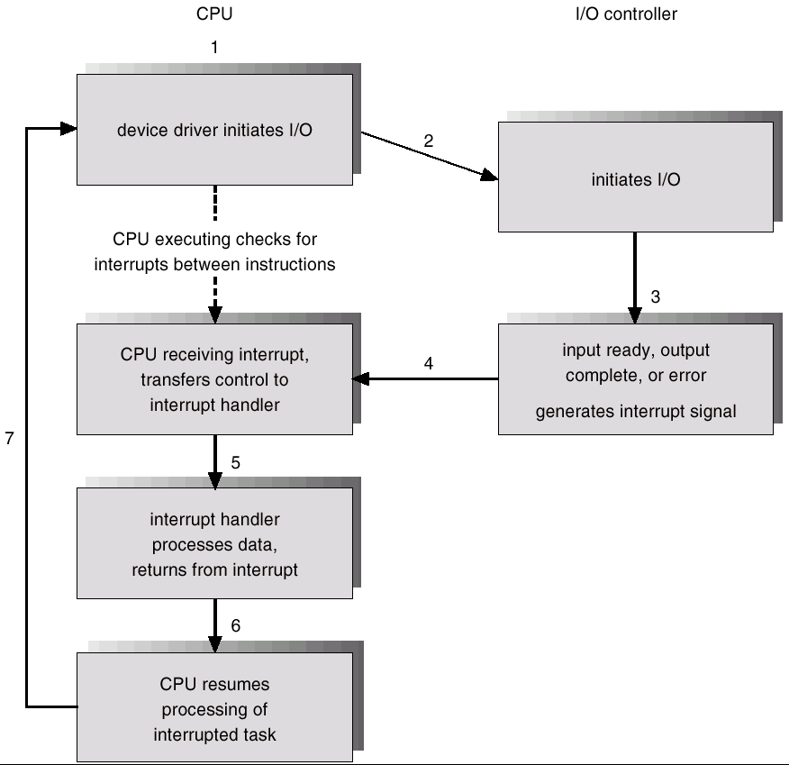
Interrupt-Driven I/O Cycle

Slide 6
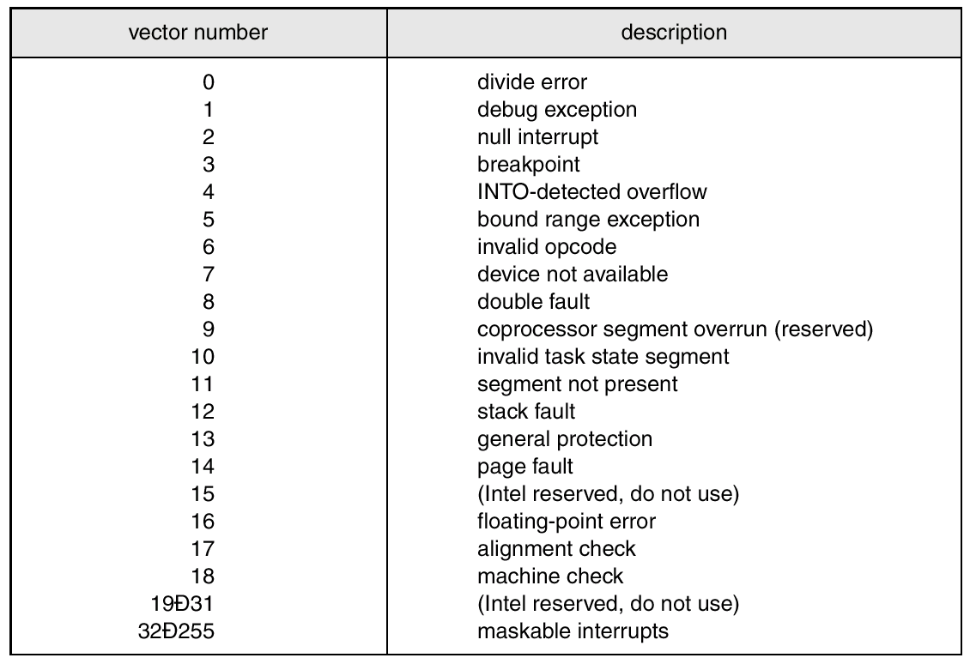
Intel Pentium Processor Event-Vector Table

Slide 7
Direct Memory Access
Used to avoid programmed I/O for large data movement
Requires DMA controller
Bypasses CPU to transfer data directly between I/O device and memory

Slide 8

Six Step Process to Perform DMA Transfer

Slide 9
I/O Hardware
Incredible variety of I/O devices
Common concepts
  Port: connection point
  Bus: a set of wires and a rigidly defined protocol that specifies a set of messages that can be set on the wires.
  Controller: a collection of electronics that operates a port, a bus or a device.
Devices have addresses:
  Direct I/O instructions: specify the transfer of a byte/word to an I/O port address
  Memory-mapped I/O: standard data-transfer instructions can read and write.
Notes:
Registers: status, control, data-in; data-out

Slide 10
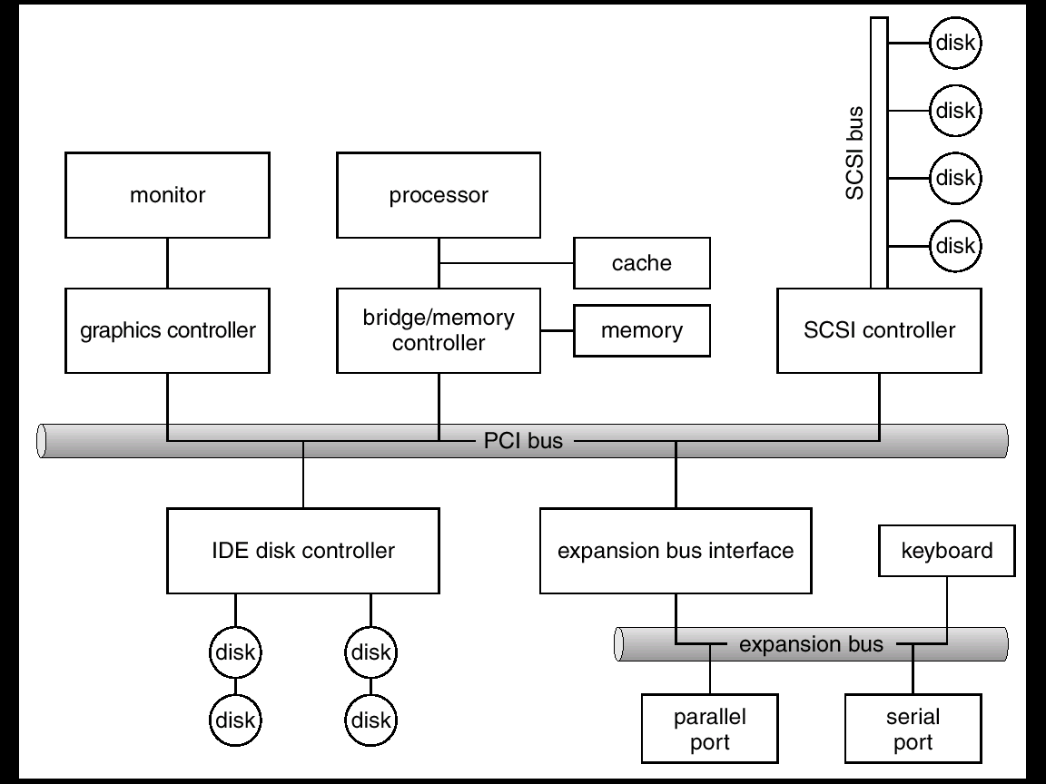
A Typical PC Bus Structure

Slide 11
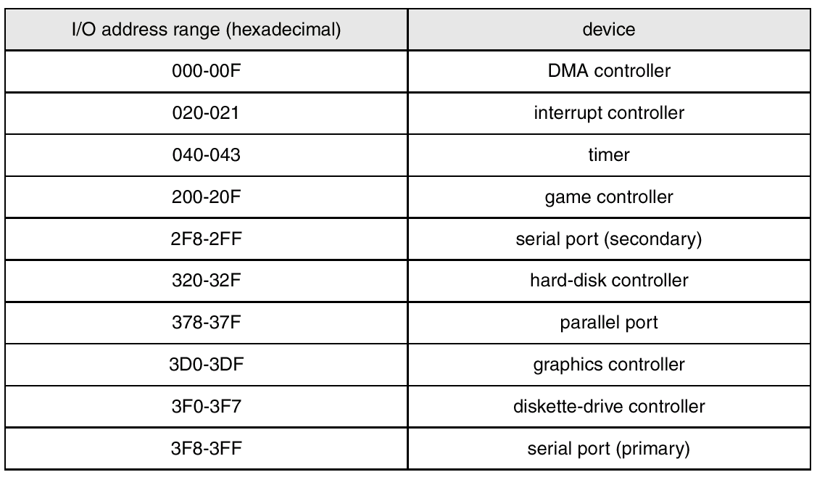
Device I/O Port Locations on PCs (partial)

Slide 12
Application I/O Interface
I/O system calls encapsulate device behaviors in generic classes
Device-driver layer hides differences among I/O controllers from kernel
Devices vary in many dimensions
  Character-stream or block
  Sequential or random-access
  Sharable or dedicated
  Speed of operation
  read-write, read only, or write only

Slide 13
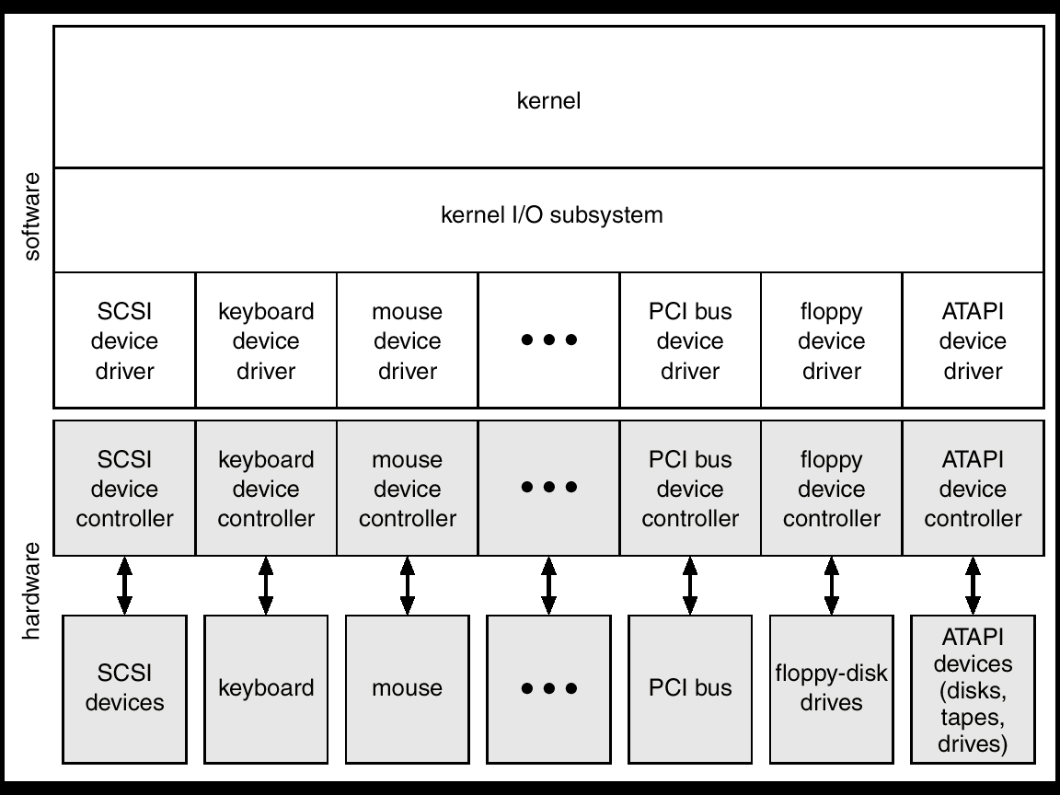
A Kernel I/O Structure

Slide 14
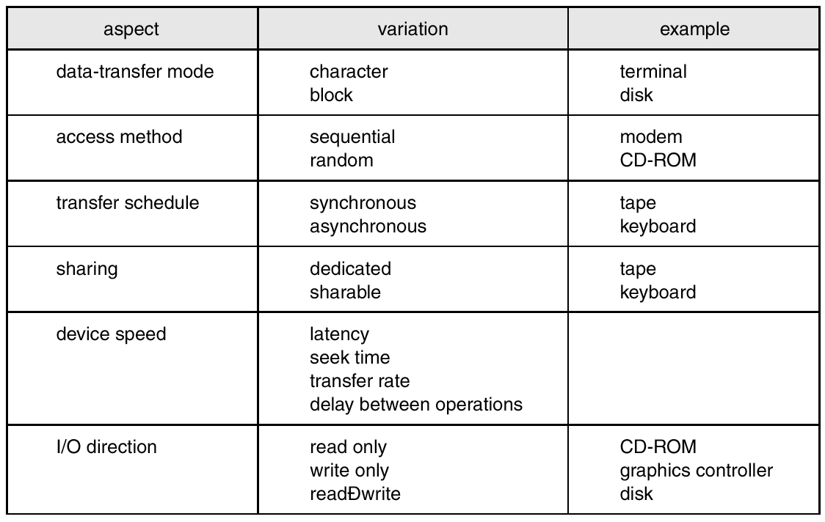
Characteristics of I/O Devices

Slide 15
Block and Character Devices
Block devices include disk drives
  Commands include read, write, seek
  Raw I/O or file-system access
  Memory-mapped file access possible
Character devices include keyboards, mice, serial ports
  Commands include get, put
  Libraries layered on top allow line editing

Slide 16
Network Devices
Varying enough from block and character to have own interface
Unix and Windows NT/9i/2000 include socket interface
  Separates network protocol from network operation
  Includes select functionality
  -- which of the sockets have packet waiting to be received (read), or have room to accept a packet to be sent (write).
Approaches vary widely (pipes, STREAMS, message queues, sockets)

Slide 17
Clocks and Timers
Functions:
  current time
  elapsed time
  timer
programmable interval timer used for timings, generate periodic interrupts
ioctl (on UNIX) covers aspects of I/O such as clocks and timers

Slide 18
Blocking and Nonblocking I/O
Blocking - process suspended until I/O completed
  Easy to use and understand
  Insufficient for some needs
Nonblocking - I/O call returns as much as available
  User interface, data copy (buffered I/O)
  Implemented via multi-threading
  Returns quickly with count of bytes read or written
  Example: select()
Asynchronous - process runs while I/O executes
  Difficult to use
  I/O subsystem signals process when I/O completed

Slide 19
Kernel I/O Subsystem
Scheduling – maintain the queue of requests for each device.
Buffering - store data in memory while transferring between devices
  To cope with device speed mismatch
  To cope with device transfer size mismatch
  To maintain “copy semantics”
Caching - fast memory holding copy of data
  Always just a copy
  Key to performance
Notes:
Buffer: disk write is performed form kernel buffer, not from application buffer. Process changes does not affect.

Slide 20
Kernel I/O Subsystem (cont.)
Spooling - hold output for a device
  If device can serve only one request at a time
  i.e., Printing
Device reservation - provides exclusive access to a device
  System calls for allocation and deallocation
  Watch out for deadlock

Slide 21
Error Handling
OS can recover from disk read, device unavailable, transient write failures
Most return an error number or code when I/O request fails
System error logs hold problem reports

Slide 22
Kernel Data Structures
Kernel keeps state info for I/O components, including open file tables, network connections, character device state
Many complex data structures to track buffers, memory allocation, “dirty” blocks
Some use object-oriented methods and message passing to implement I/O

Slide 23
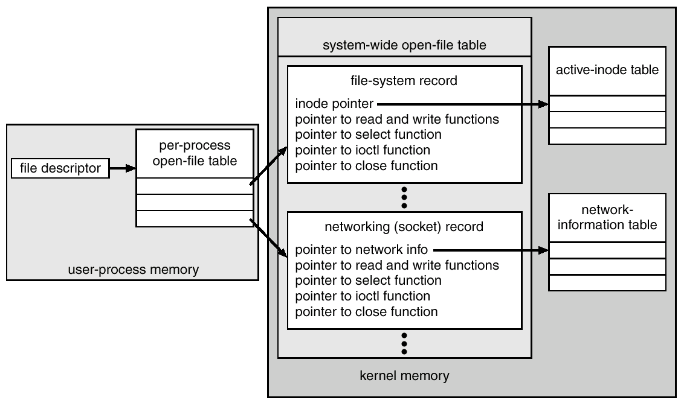
UNIX I/O Kernel Structure

Slide 24
I/O Requests to Hardware Operations
Consider reading a file from disk for a process:
  Determine device holding file
  Translate name to device representation
  Physically read data from disk into buffer
  Make data available to requesting process
  Return control to process

Slide 25
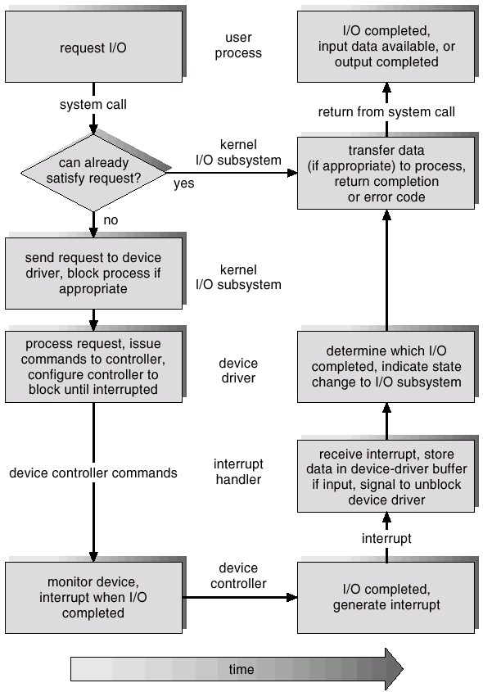
Life Cycle of An I/O Request

Slide 26
STREAMS
Preferred interface to write device drivers, supported by most Unix, but not Linux.
System V and Solaris socket is implemented using STREAMS.
open, close, read, writer, ioctl, getmsg, putmsg, poll

Slide 27
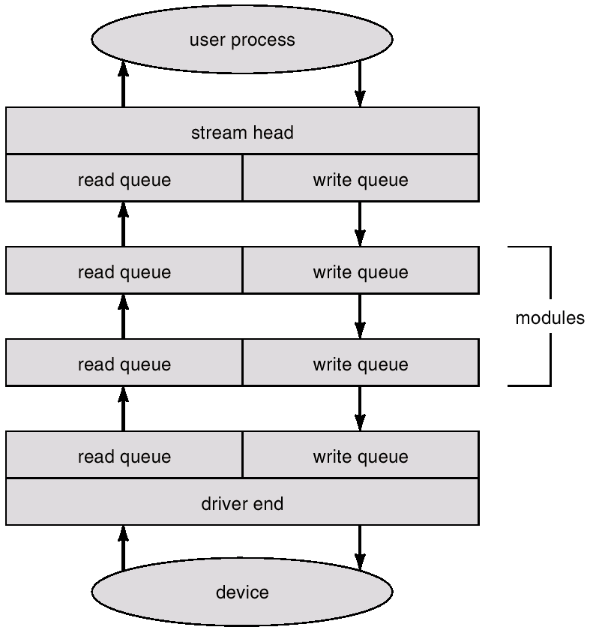
Structure of STREAMS
Downstream
Upstream
Notes:
Pipeline assembly.

Slide 28
Unix I/O
Block Buffer Cache
  The block devices use a block buffer cache.
Character Queue
  Character devices such as terminals and printers use character queue for buffering.
Unbuffered I/O (DMA)

Slide 29
 | Unbuffered I/O | Block Buffer Cache | Character Queue
Disk Drive | x | x
Tape Drive | x | x
Terminals |  |  | x
Communication lines |  |  | x
Printers | x |  | x
Notes:
Slow printer uses character buffer, fast printer uses DMA. But no buffer cache since never reused.

Slide 30
Unix Terminal I/O
Terminal: a keyboard and an attached display.
Canonical mode – cooked mode (line-oriented)
Noncanonical mode – raw mode (character-oriented). E.g.:vi editor, emacs editor.
Useful commands:
  stty –a
  stty erase ^H

Slide 31
Terminal (cont.)
POSIX.1 defines 11 special input characters, 9 of which can be changed, except the carriage return (\r) and the linefeed (\n).
Examples:
  CTRL-H ERASE
  CTRL-D End of file
  CR carriage return

Slide 32
Terminal (cont.)
Echoing: With most terminals, nothing is automatically displayed when a key is struck. It is up to the software (drivers) to display the character if desired.
  Tab handling
  Long line wrapping
  Device equivalence: drives convert whatever comes in to the standard internal format of the OS: Unix: only a linefeed; Windows: Carriage return and linefeed.

Slide 33
Summary of I/O Systems
Three techniques to perform I/O.
Interrupt-driven I/O cycle.
Block device, character device and network device.
Buffering vs. Caching.

