Slide 1
Chapter 14: Mass-Storage Systems
Disk Structure
Disk Scheduling
Disk Management
Swap-Space Management
RAID Structure
Tertiary Storage Devices
Operating System Issues
Performance Issues

Slide 2
Disk Structure
Disk drives are addressed as large 1-dimensional arrays of logical blocks, where the logical block is the smallest unit of transfer.
The 1-dimensional array of logical blocks is mapped into the sectors of the disk sequentially.
  Sector 0 is the first sector of the first track on the outermost cylinder.
  Mapping proceeds in order through that track, then the rest of the tracks in that cylinder, and then through the rest of the cylinders from outermost to innermost.

Slide 3

Virtual Geometry for the Disk
0
1
Driver is instructed to act
as if there are same sectors per
track. Hardware controller may
do some translation.
2

Slide 4
Disk Scheduling
The operating system is responsible for using hardware efficiently — for the disk drives, this means having a fast access time and disk bandwidth.
Access time has two major components
  Seek time is the time for the disk arm to move the heads to the cylinder containing the desired sector.
  Rotational latency is the additional time waiting for the disk to rotate the desired sector to the disk head.

Slide 5
Disk Scheduling (Cont.)
Minimize seek time
Seek time ≈ seek distance
Disk bandwidth is the total number of bytes transferred, divided by the total time between the first request for service and the completion of the last transfer.

Slide 6
Example
Total access time is average seek time + rotational delay + transfer time:
  T = average seek time + 1/(2*r) +b/(r*N)
  where
  r: rotation speed , in revolutions per second.
  b: number of bytes to be transferred.
  N: number of bytes on a track

Slide 7
Example
Average seek time of 10ms.
Rotation speed: 10,000 revolutions per second. (i.e.: 1 revolution per 6 ms)
512-byte sectors with 320 sectors per track
A file occupies all the sectors on 8 adjacent tracks (8* 320 = 2560 sectors) of 1.3MB.
Time to read the first track: (19ms)
  Average seek: 10ms
  Rotational delay: -- 1/(2*r) = 3ms
  Read 320 sectors: -- b/(r*N) = 6ms
  1) no further seek time: 19 + 7*9 =82ms=0.082s
  2) randomly scattered sectors: 2560 * (10 + 3 + 0.01875) = 33.328s

Slide 8
Disk Scheduling
Several algorithms exist to schedule the servicing of disk I/O requests.
We illustrate them with a request queue for blocks on cylinders (0-199).
98, 183, 37, 122, 14, 124, 65, 67
Head pointer 53

Slide 9

FCFS
Illustration shows total head movement of 640 cylinders.

Slide 10
SSTF (shortest-seek-time-first)
Selects the request with the minimum seek time from the current head position.
SSTF scheduling is a form of SJF scheduling; may cause starvation of some requests.
Illustration shows total head movement of 236 cylinders.

Slide 11

SSTF (Cont.)

Slide 12
SCAN
The disk arm starts at one end of the disk, and moves toward the other end, servicing requests until it gets to the other end of the disk, where the head movement is reversed and servicing continues.
Sometimes called the elevator algorithm.
We need to know the direction of head movement. The head continuously scans back and forth across the disk.
Notes:
Elevator metaphor: UP or DOWN.

Slide 13
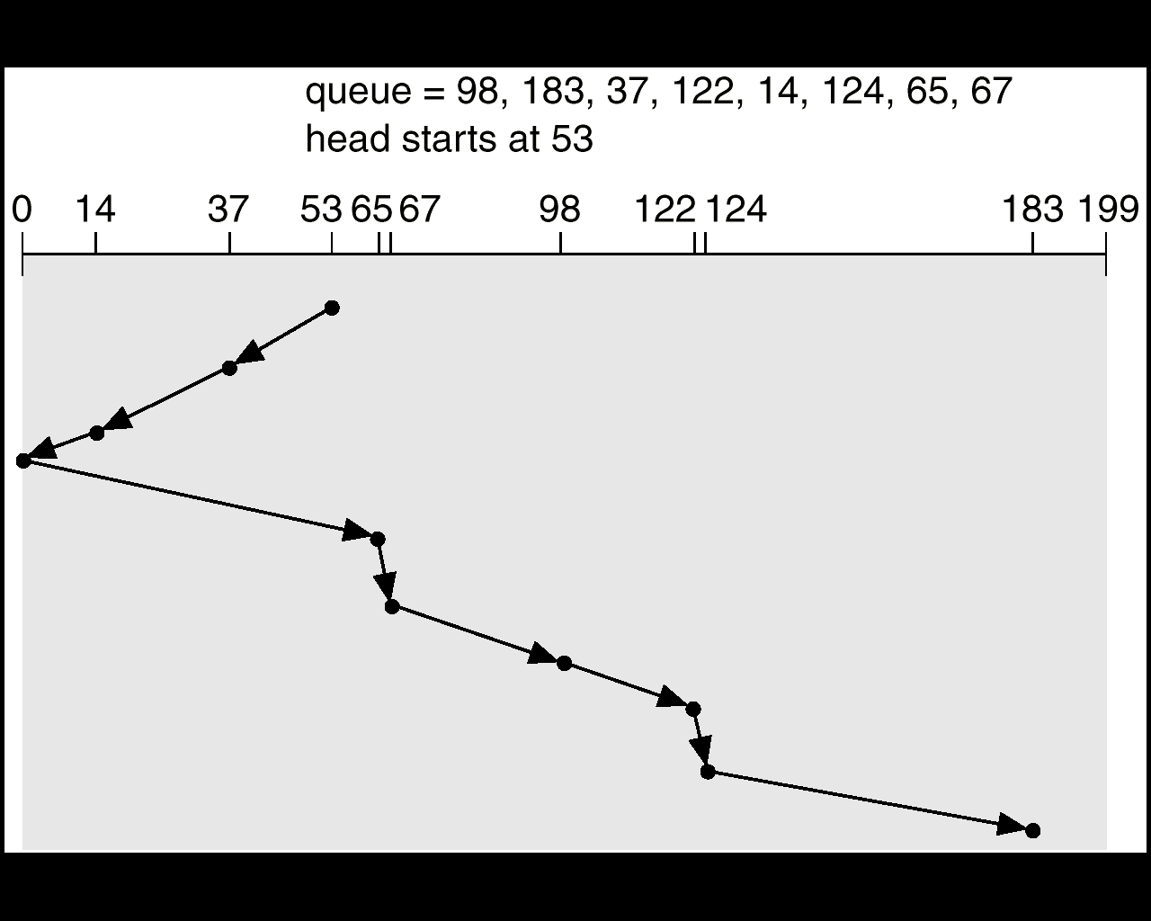
SCAN (Cont.)
Notes:
http://www.dcs.ed.ac.uk/home/stg/pub/D/disk.html

Slide 14
C-SCAN
Provides a more uniform wait time than SCAN.
The head moves from one end of the disk to the other. servicing requests as it goes. When it reaches the other end, however, it immediately returns to the beginning of the disk, without servicing any requests on the return trip.
Treats the cylinders as a circular list that wraps around from the last cylinder to the first one.
Support from controller and hardware is assumed.

Slide 15

C-SCAN (Cont.)

Slide 16
C-LOOK
Version of C-SCAN
Arm only goes as far as the last request in each direction, then reverses direction immediately, without first going all the way to the end of the disk.

Slide 17

C-LOOK (Cont.)

Slide 18
Selecting a Disk-Scheduling Algorithm
SSTF is common and has a natural appeal
SCAN and C-SCAN perform better for systems that place a heavy load on the disk.
Performance depends on the number and types of requests.
Requests for disk service can be influenced by the file-allocation method.
The disk-scheduling algorithm should be written as a separate module of the operating system, allowing it to be replaced with a different algorithm if necessary.
Either SSTF or LOOK is a reasonable choice for the default algorithm.
Notes:
Some controller has the algorithm in the hardware, but may not be sufficient due to causes such as demand paging.

Slide 19
Example
Queue: 50, 70, 85, 184, 20, 29
Heads start at 30, moving to the lower end.
Using LOOK disk scheduling.
What is the total head movement?

Slide 20
Disk Management
Low-level formatting, or physical formatting — Dividing a disk into sectors that the disk controller can read and write.
Sector contains special information such as error-correcting code (ECC), which is a value calculated from all the bytes in the sector. Controller uses it to correct corrupted data (if only a few bytes).
To use a disk to hold files, the operating system still needs to record its own data structures on the disk (such as FAT or inodes, empty directory).
  Partition the disk into one or more groups of cylinders.
  Logical formatting or “making a file system”.
Notes:
ECC: error-correcting code

Slide 21
A disk sector
Preamble
Data
ECC

Slide 22
Disk Management (cont.)
Boot block initializes system.
  The bootstrap is stored in ROM.
  Bootstrap loader program.
Methods used to handle bad blocks.
  Manually -- chkdsk
  sector sparing – replace bad sector with spare sectors logically
  sector slipping
Restoration of bad files is usually a manual process.

Slide 23
Swap-Space Management
Swap-space — Virtual memory uses disk space as an extension of main memory.
Swap-space can be carved out of the normal file system,or, more commonly, it can be in a separate disk partition, with separate swap-space manager.
Swap-space management
  4.3BSD allocates swap space when process starts; holds text segment (the program) and data segment.
  Kernel uses swap maps to track swap-space use.
  Solaris 2 allocates swap space only when a page is forced out of physical memory, not when the virtual memory page is first created.

Slide 24
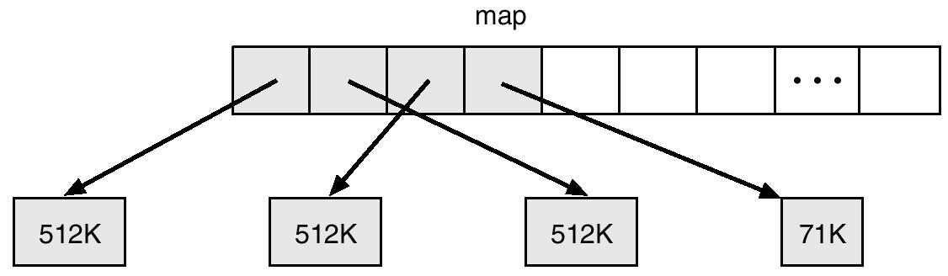
4.3 BSD Text-Segment Swap Map

Slide 25
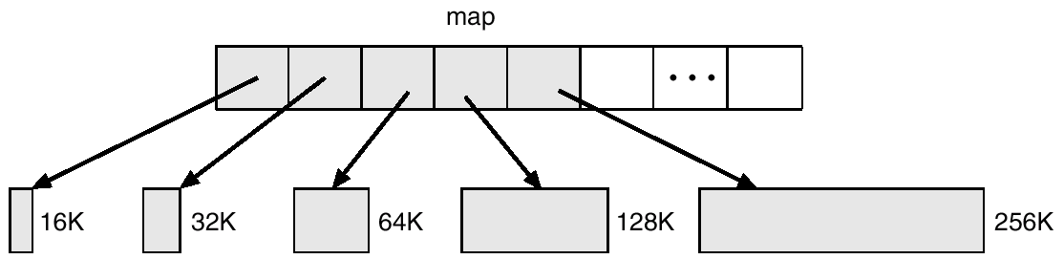
4.3 BSD Data-Segment Swap Map
Accommodate the growing data segment of the process.

Slide 26
RAID (Redundant Arrays of Inexpensive Disks)
RAID – multiple disk drives provides reliability via redundancy.
Several improvements in disk-use techniques involve the use of multiple disks working cooperatively.
RAID schemes improve performance and improve the reliability of the storage system by storing redundant data.

Slide 27
RAID (cont)
Disk striping uses a group of disks as one storage unit. --- Gain performance via parallelism.
Mirroring or shadowing keeps duplicate of each disk. – Gain reliability.
Block interleaved parity uses much less redundancy.
  Parity bit: numbers of bits in the byte: even => parity =0; odd => parity = 1
RAID is arranged into different levels.

Slide 28

RAID Levels

Slide 29
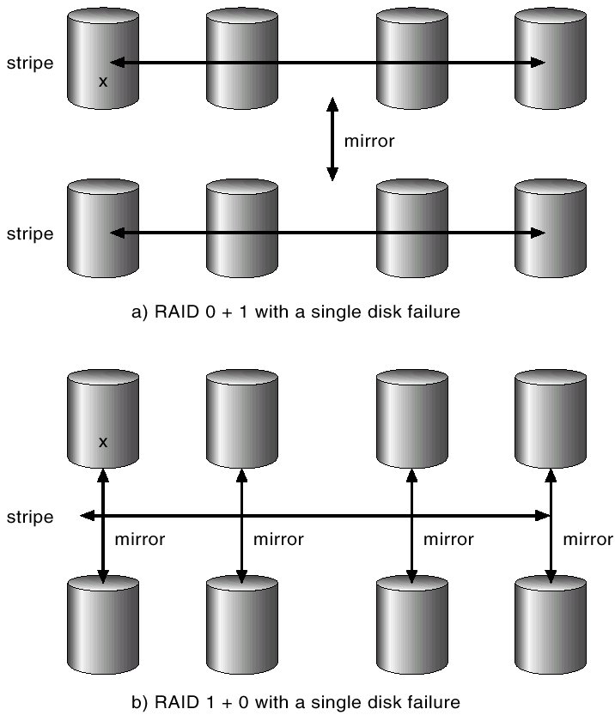
RAID (0 + 1) and (1 + 0)

Slide 30
Stable Storage
Disks supposed to be stable, but …
RAID does not protect against writing errors or crashes during writes that corrupting the original data.
Requirement: whenever a failure occurs during writing of a block, the system invokes recovery to restore the block to a consistent state.
  Replicate information on more than one nonvolatile storage media with independent failure modes. (2 blocks for one logical block)
  Update information in a controlled manner to ensure that we can recover the stable data after any failure during data transfer or recovery.

Slide 31
Tertiary-Storage Structure
Low cost is the defining characteristic of tertiary storage.
Generally, tertiary storage is built using removable media
Common examples of removable media are floppy disks and CD-ROMs; other types are available.

Slide 32
CD-ROMs
Compact Disc – Read Only Memory
Optical instead of magnetic.
Introduced in 1980, supposed to last 100 years.
Technical details published in “Red Book”
High-power infrared laser to burn holes. Burned areas: pits. Unburned areas: lands.
The player uses a low-power infrared light to tell pits/lands.
Audio -> data -> graphics -> file system.
Notes:
Redbook – yellow book – green book

Slide 33
CD-Recordables
“Orange book”
A group of consecutive sectors written at once is called a CD-ROM track.
For incremental writes, each track has its own VTOC (Volume Table of Contents).
Tracks can be grouped into sessions.
Protection from unauthorized copying.

Slide 34
DVD
Digital Video Disk / Digital Versatile Disk
  Smaller pits
  Tighter spiral
  Red Laser
  Raise the capacity sevenfold to 4.7 GB or more.(MPEG-2)
A consortium of 10 consumer electronics companies instead of computer industries, introduced interesting features such as “region code”, good for Hollywood releasing new films.

Slide 35
File Naming
The issue of naming files on removable media is especially difficult when we want to write data on a removable cartridge on one computer, and then use the cartridge in another computer.
Contemporary OSs generally leave the name space problem unsolved for removable media, and depend on applications and users to figure out how to access and interpret the data.
Some kinds of removable media (e.g., CDs) are so well standardized that all computers use them the same way.

Slide 36
Speed: bandwidth and latency
Bandwidth is measured in bytes per second.
  Sustained bandwidth – average data rate during a large transfer; # of bytes/transfer time.
    Data rate when the data stream is actually flowing.
  Effective bandwidth – average over the entire I/O time, including seek or locate, and cartridge switching.
    Drive’s overall data rate.
Access latency – amount of time needed to locate data.
  Access time for a disk – move the arm to the selected cylinder and wait for the rotational latency; < 35 milliseconds.
  Random access on tape: tens or hundreds of seconds.
  Generally, random access within a tape cartridge is about a thousand times slower than random access on disk.
Notes:
Tape requires winding the tape reels until the selected block reaches the tape head;

Slide 37
Speed (cont.)
The low cost of tertiary storage is a result of having many cheap cartridges share a few expensive drives.
A removable tape library is best devoted to the storage of infrequently used data.

Slide 38
Reliability
A fixed disk drive is likely to be more reliable than a removable disk or tape drive.
An optical cartridge is likely to be more reliable than a magnetic disk or tape.
A head crash -- head make contact wit the disk surface -- in a fixed hard disk generally destroys the data, whereas the failure of a tape drive or optical disk drive often leaves the data cartridge unharmed.

Slide 39
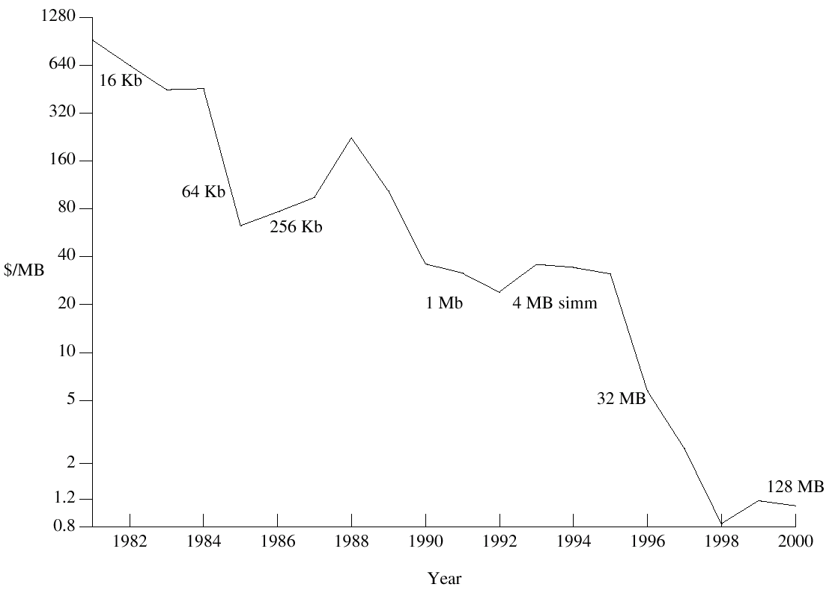
Cost: Price per Megabyte of DRAM, From 1981 to 2000
Notes:
Main memory is much more expensive than disk storage. The cost per megabyte of hard disk storage is competitive with magnetic tape if only one tape is used per drive

Slide 40
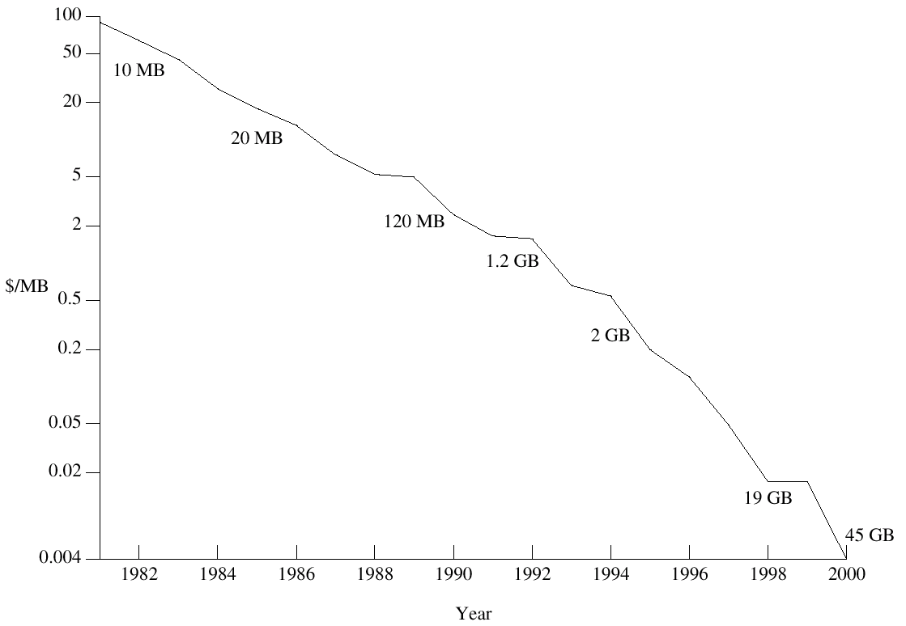
Cost: Price per Megabyte of Magnetic Hard Disk, From 1981 to 2000

Slide 41
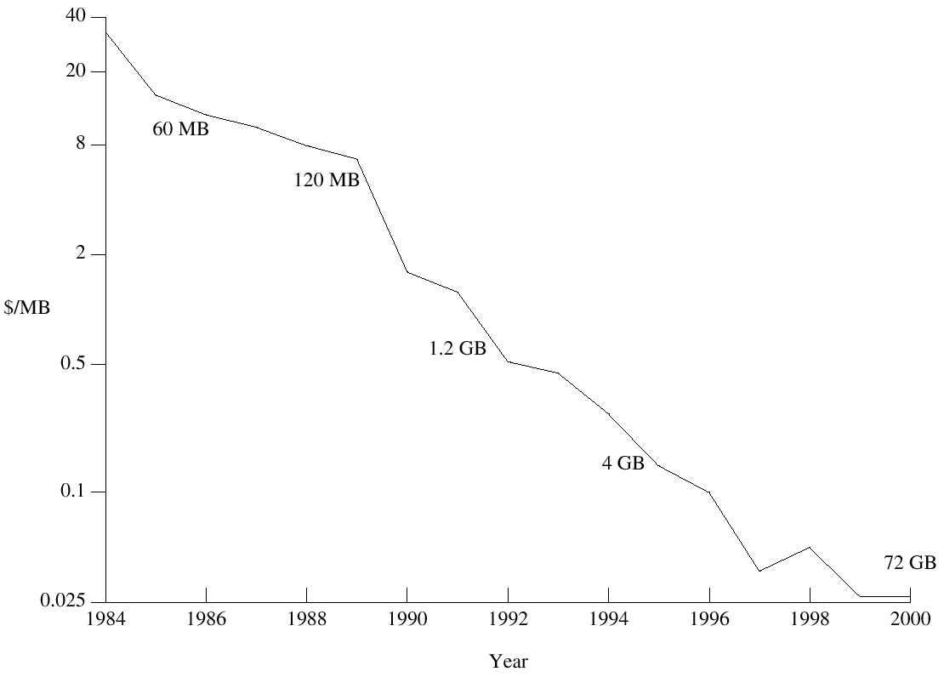
Cost: Price per Megabyte of a Tape Drive, From 1984-2000

Slide 42
Summary
Disk scheduling
  FCFS, SSTF, SCAN/C-SCAN, C-LOOK
Disk Management
Swap-space management
Tertiary storages

