Slide 1
Chapter 18 Protection
Goals of protection
  Operating system consists of a collection of objects, hardware or software
  Each object has a unique name and can be accessed through a well-defined set of operations.
  Protection problem - ensure that each object is accessed correctly and only by those processes that are allowed to do so.

Slide 2
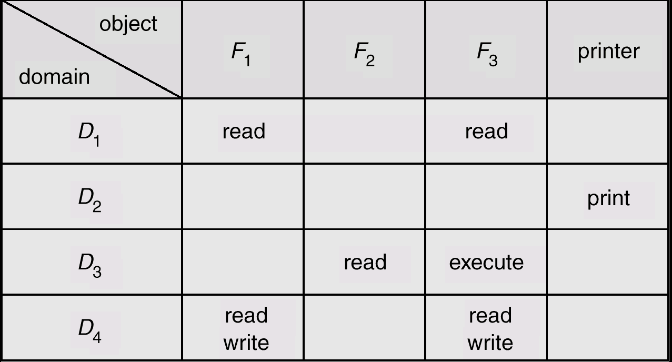
Access Matrix

Slide 3
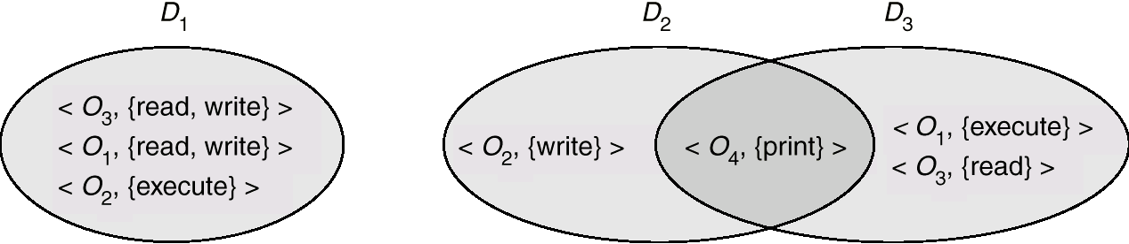
Domain
Domain: A collection of access rights, each of which is an ordered pair:
  <object-name, rights-set>
Association between a process and a domain may be either static or dynamic.

Slide 4
Domain (cont.)
Each user may be a domain. Domain switching when changing users.
Each procedure/method with local variables and local objects can be seen as a domain.

Slide 5
Use of Access Matrix
If a process in Domain D_{i} tries to do “op” on object O_{j}, then “op” must be in the access matrix.
Can be expanded to dynamic protection.
  Operations to add, delete access rights.
  Special access rights:
    owner of O_{i}
    copy op from O_{i} to O_{j}
    control – D_{i} can modify D_{j} access rights
    transfer – switch from domain D_{i} to D_{j}

Slide 6
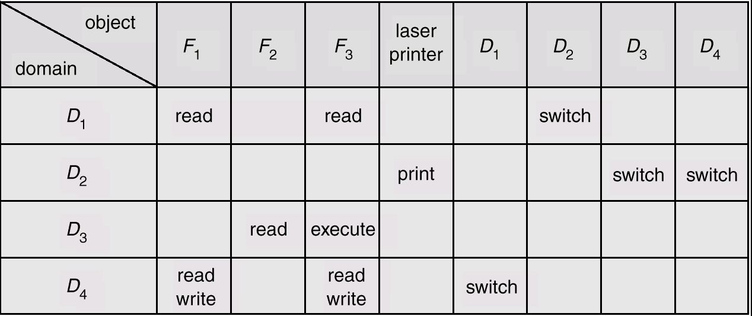
Domain Switching in Access Matrix

Slide 7
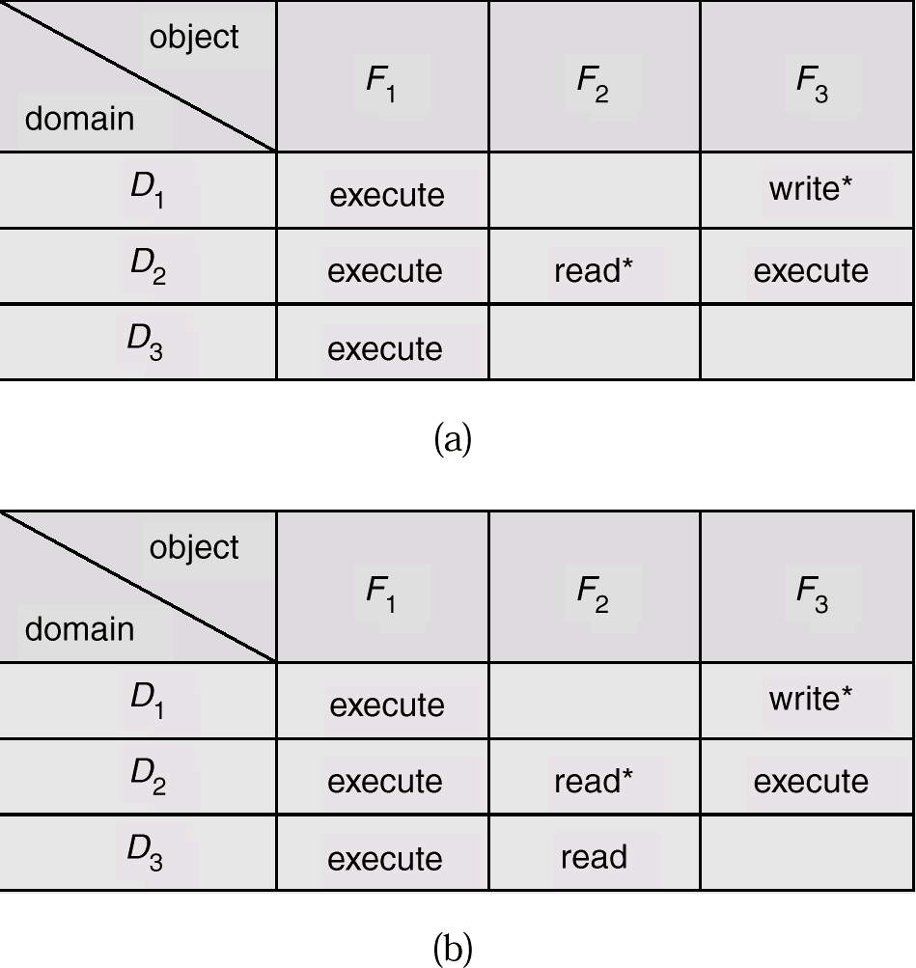
Access Matrix with Copy Rights (within the column)

Slide 8
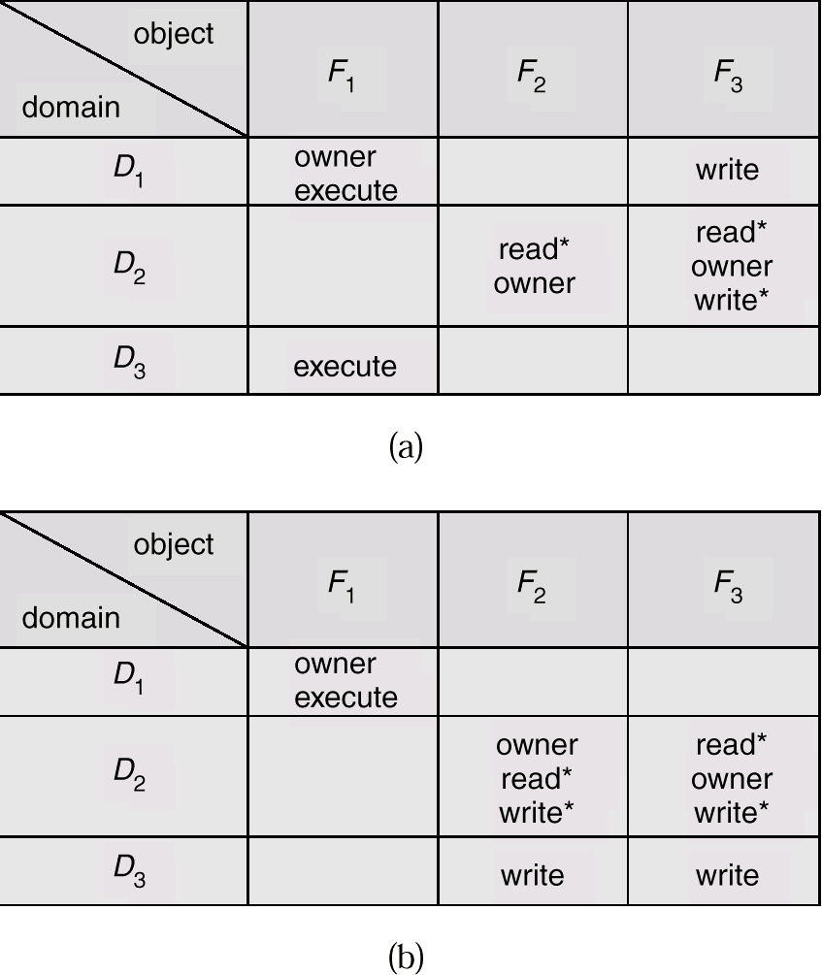
Access Matrix With Owner Rights

Slide 9
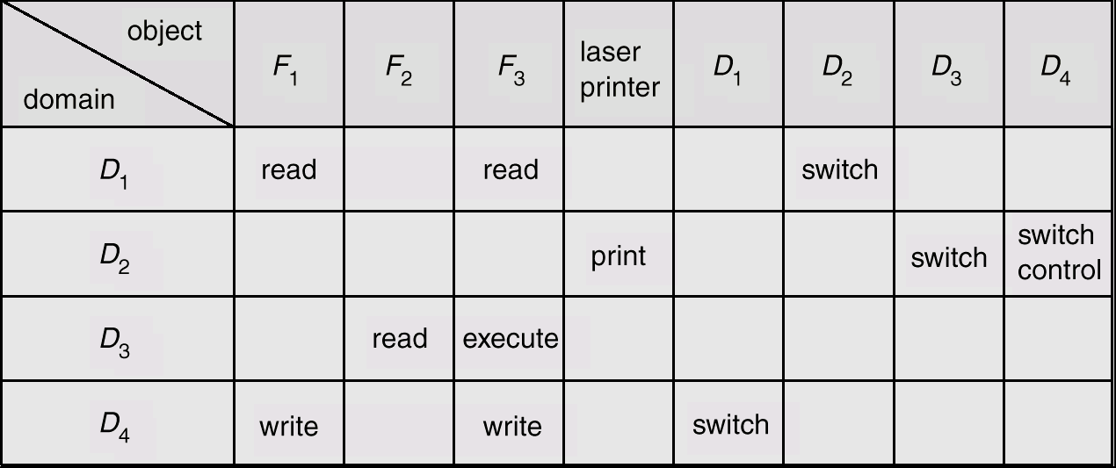
Access Matrix With Control Rights
A process in D2 and modify D4.
Notes:
Control is usually with switch

Slide 10
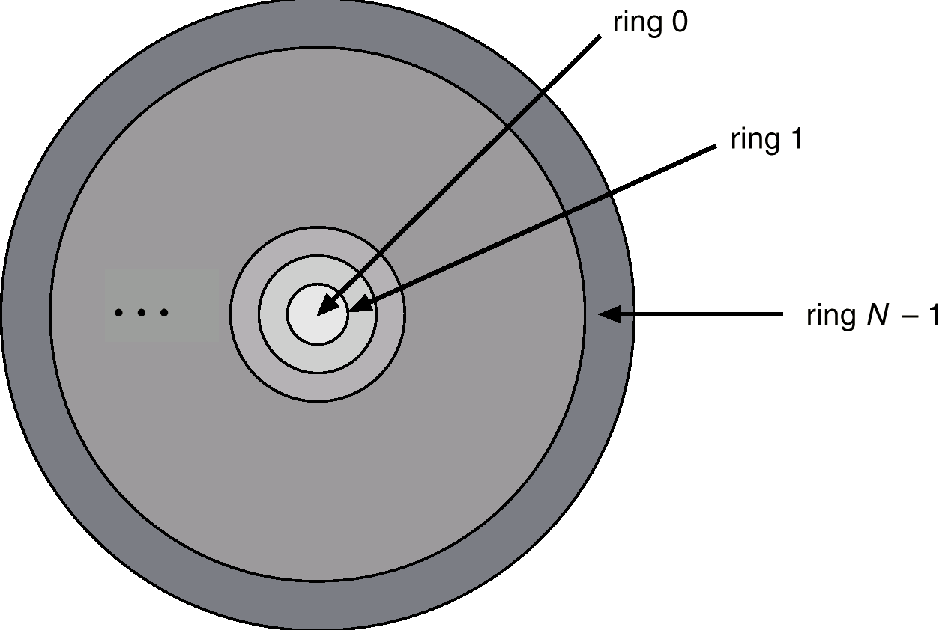
Example
Unix: domain is associated with the user.
  Two types of domains: User and Superuser.
  You can switch the domain temporarily, by setuid mechanism. (effective user is same as the owner, instead of the real user)
Multics:
  Ring structure

Slide 11
Implementation of Access Matrix
Global table
  <domain, object, rights-set>
Access lists for objects
  Object: <domain, rights-set>
Capability lists for Domains
  Domain: <objects, operations>
  Capability list for a domain: a list of objects together with the operations allowed on those objects.
Lock-key mechnism:
  Object has a list of unique patterns, called locks; domain has a list of unique patterns called keys;
  A process in a domain can access an object only if that domain has a key that matches one of the locks of the object.

Slide 12
Example:
Jack wants his file readable by all except Jane.
  Capability list: no row for Jane.
Jane wants some of her files to be public.
  Access list: file 1: (*, rwx)
  no need to list all domain.
Unix: file: rwx rwx rwx -> access list

Slide 13
Example: Investment Banking
  Implementation similar to lock-key mechanism:
  The domains (users) belong to geography, industry.
    E.g: A banker covers Midwest Telecom.
  The objects are the deals defined by geography, industry, and product.
    E.g: Deal A is an IPO (product) in Europe (geography) about telecom (industry) .
  A banker in different domain will have different access rights on the deals. S/he has access to the deal only if the domain pattern matches the object pattern in certain way. Say, both are working on telecom, or both are in New York coverage team.
    E.g.: A banker in a new york coverage team may not access to Deal A, while a banker in Midwest can modify deal A.

Slide 14
Language-based Protection
Protection in Java
  For privileged operation such as writing to the local disk. your applet would get Security Exception by default (which is good!).
  Or use signed applet: Different JVM handles it differently, e.g.: The JRE in Internet Explorer and Netscape can be different and they require different techniques.

Slide 15
Signed Applet (cont.)
Signed applet guarantee the source and integrity by the author. (We will talk about digital signature when discussing encryption.)
Typically, you need to get a certificate from a CA, such as VeriSign. (You can create your test certificate.)
Then sign your applet using “signtool” (NS) or “signcode”(IE cab file) to attach your digital signature.
The browser (JVM or MS VM) then examines the signature and prompt the user to accept the applet’s behavior if s/he agrees so.
Special java code segment in your source may be needed to request privilege.

Slide 16
Chap 19 Security
Difference between protection and security:
  Protection– an internal problem
  Security – protection + consideration of the external environment

Slide 17
Contents
Cryptography
  Secret-key algorithm
  Public-key algorithm
Authentication
  Digital signature
Threats (program/system)
Intrusion Detection
Unix Security
Internet Security

Slide 18
Cryptography
Elements:
  Plaintext – the messages to be encrypted
  Key – the function/parameter to transform the plaintext
  Ciphertext – output of the encryption process
  Cryptography – the art of devising ciphers.

Slide 19
Encryption is a process in which a plaintext is transformed into a ciphertext by the use of a key. Decryption is the reverse process.
KEY
ABCD
Encryption Algorithm
Plaintext
Ciphertext

Slide 20
Substitution ciphers
Oldest cipher – Caesar cipher:
  a -> D; b -> E, c -> F, …, z -> C
  attack -> DWWDFN
Improvements:
  Shift k letters -> k becomes the key
  Full alphabet key:
    a b c d e f g h i j k l m n o p q r s t u v w z y z
    QWERTYU I O PASD F GH JKLZXCVBNM

Slide 21
Substitution ciphers (cont.)
    a b c d e f g h i j k l m n o p q r s t u v w z y z
    QWERTYU I O PASD F GH JKLZXCVBNM
  Number of possible keys: 26! = 4 * 10^26
  In practice, deciphers can study the pattern of the ciphertext and reduce possibilities, such as three letter combinations of “the”, “ing”, “and” etc.
Enigma device in WWII.

Slide 22
Secret-key Algorithms (symmetric key)
DES (Data Encryption Standard) -- Issused by NIST (National Institute of Standards and Technology)in Jan 1977 -- developed by IBM.
IBM’s cipher used a 128-bit key instead of a 56-bit key.
NSA (National Security Agency) discussed with IBM for reducing it to 56 bits.
The first official U.S. government cipher intended for commercial use.
As of Apr. 2001, 56-bit DES is considered insecure, since the keys can be exhaustively searched with moderate computing resources.

Slide 23
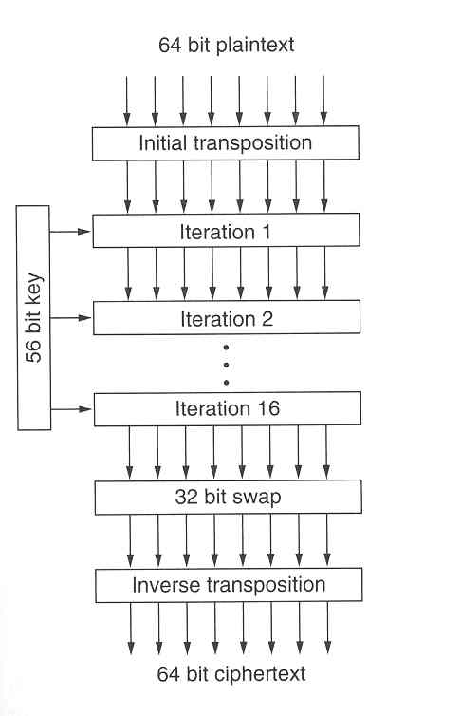
DES – a substitution cipher
Source: Computer Networks, A. Tanennbaum.
Notes:
19 stages

Slide 24
Public-key algorithm
Encryption and decryption keys were different, and the decryption key could not be derived from the encryption key.
Three requirements:
  D(E(P)) = P
  It is exceedingly difficult to deduce D from E
  E cannot be broken by a chosen plaintext attack.
If Alice want to receive secrete message, she needs E_a and D_a. E_a is public. D_a is private.

Slide 25
Secure Channel Between Alice and Bob
Public keys: E_a ; E_b
1. E_b(P)
Bob
Alice
2. D_b(E_b(P)) = P
No one can read message P other than Bob.

Slide 26
RSA algorithm
Satisfy the three requirements.
RSA: Rivest, Shamir, Adleman.
Based on principles from number theory:
  Choose two large primes, p and q.
  Computer n = pq and z = (p-1)(q-1)
  Choose a number relatively prime to z and call it e.
  Find d such that ed - 1 is divisible by z.
  To encrypt: Divide the plaintext into blocks P. computer C = P^e (mod n)
  To decrypt: compute P = C^d (mod n).
So public key: (e, n). Private key: (d, n).

Slide 27
It is currently difficult to obtain the private key (d, n) from the public key (e, n).
Further Reading:
  http://www.rsasecurity.com/rsalabs/faq/3-1.html

Slide 28
Authentication
Authentication is the technique by which a process verifies that its communication partner is who it is supposed to be.
Can be based on cryptography, but different from encryption for protecting contents (secrecy).
Authentication is also a different concept from authorization (what the person can do).

Slide 29
Authentication Using Password
Password Lifetime | Password Length | Probability of Guessing
1 month | 6 | 1 in 250
1 month | 8 | 1 in 1,980,000
12 months | 6 | 1 in 19
12 months | 8 | 1 in 165,000
Calculated according to National Computer Security Center’s procedure.

Slide 30
Authentication Using Password
In the early 1960s, when the passwords were not encrypted, something happened at MIT ….
Authentication Using SecureId (one-time password)

Slide 31
Authentication using Biometrics
Biometrics refers to the automatic identification of a person based on his/her physiological or behavioral characteristics.
This method of identification is preferred over traditional methods involving passwords and PIN numbers for various reasons: (i) the person to be identified is required to be physically present at the point-of-identification; (ii) identification based on biometric techniques obviates the need to remember a password or carry a token.
http://biometrics.cse.msu.edu/publications.html (An interview).

Slide 32
Authentication using Secret Key
Assume that Alice and Bob share a secret key K_ab.
Alice
A
Bob
R_b
K_ab(R_b)
R_a
K_ab(R_a)

Slide 33
Shortened two-way authentication protocol
Alice
A, R_a
Bob
R_b, K_ab(R_a)
K_ab(R_b)

Slide 34
Authentication using Public Key
Run it in reverse, assume that E(D(p))=P.
Public key of Alice: E_a
Private key of Alice: D_a
1. D_a(P)
Bob
Alice
2. E_a(D_a(P))
Bob knows it is from Alice since only
Alice has the D_a.
Use the private key to do the encryption, the public key to do the decryption..

Slide 35
Digital Signature
Authentication and Integrity
  The receiver can verify the claimed identify of the sender.
  The sender cannot later repudiate the contents of the message
  The receiver cannot possibly have made the message himself.

Slide 36
Digital Signatures (cont.)
Digital signature creation
  the process of the computing a code derived from and unique to both the signed message and a given private key.
  For that code or digital signature to be secure, there must be at most only a negligible chance that the same digital signature could be created by any other message or private key.
Digital signature verification
  the process of checking the digital signature by reference to the original message and a public key, and thereby determining whether the digital signature was created for that same message using the private key that corresponds to the referenced public key.
Message digest (hash function) -- achieve both.

Slide 37


Process of signing and verifying the contents
( not for secrecy )
Message
Hash
Results:
Digital
Signature
hash
function
Signing
Function
Verify
Message
345543421
436272896
Public
Key
Private Key
Only private key holder can sign!
No two message that have the same message digest.
Only encrypt the hash results.
Most widely used message digest: MD5 (1992) and SHA (1993):
input: arbitrary string, output: 128bits or 160bits digests.

Slide 38
Digital Signature (Cont.)
CA and Certificate
  CA: channel of delivering the public keys
  The Certificate is issued by CA to the subscriber. It contains the public key of the subscriber, and ensure that the subscriber holds the corresponding private key.
  CA digitally sign the certificate.
  The user can examine CA’s signature to make sure the certificate is unaltered (everyone has CA’s public key), s/he can further verify the message to make sure it is unaltered and from the correct source.

Slide 39
Threats -- Story One:
Worm in Nov 2, 1988
  Self-replicating program. Copy itself form machine to machine, causing the infected machines to labor under huge loads.
  Although most of the security holes exploited by the worm were well known, the scope of break-ins was a great surprise.
  Effectively denial of service.
  Did not delete or modify infected systems
  Robert T Morris, the then Cornell student who authored the worm was sentenced three years’ probation, 400 hours of community service and a $10,000 fine (with a legal cost of much bigger number).

Slide 40
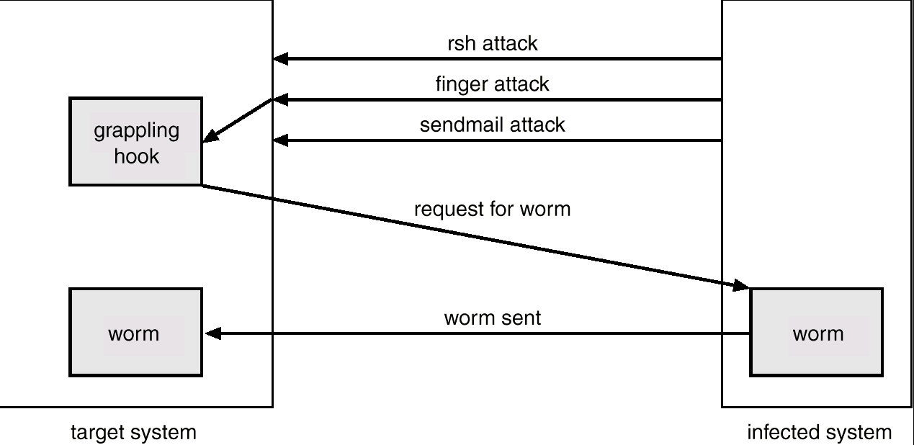
The Morris Internet Worm
Notes:
Grappling hook is also called a bootstrap
Senmail’s debug option in 4.3BSD.

Slide 41
Threats -- Story Two: Thompson’s Story about Back Door In Compiler
K. Thompson is one of the original creators of Unix. He suggested the possibility.
He described the approach of using C compiler to include a back door and use it as a Trojan Horse.

Slide 42
Some Concepts First
Trojan Horse
  Trojan horse resemble a program that the user wishes to run, login, game, etc, but doing sth else unrelated to the advertised purpose.
  Code segment that misuses its environment.
  Exploits mechanisms for allowing programs written by one and executed by other users.
  How to protect: Never execute anything that you are not sure what it is actually doing. Read the entire file first. Never run as root unless you have to.

Slide 43
Some Concepts First (Cont.)
Trap Door/Back Door
  Specific user identifier or password that circumvents normal security procedures.
  Could be included in a compiler.
  Can be added by the programmers and used by themselves.
  Hackers can make use of back doors accidentally left open (Sendmail debug option used by Worm)
  Hackers can install their backdoor after break-in.
Stack and Buffer Overflow
  Exploits a bug in a program and overflow either the stack or memory buffers.
  Could bypass firewall.

Slide 44
Some Concepts First (Cont.)
Virus
  True virus: a sequence of code that is inserted into other executable code. So when the regular program is run, the viral code is also executed.
  Typically they cannot run on their own. Viruses of this sense are more found on PC than Unix.
  What you can do:
    Run integrity checks on a regular basis
    Set the file permission of commands to a appropriate mode to protect unauthorized alteration.
    Do not load binary code onto your machine from untrusted sources.
    Do not boot from questionable diskettes.
Notes:
Internet increased popularity, but also provides ways to distribute patches …

Slide 45
Go Back to Backdoor in Compiler
C compiler is a self-producing tool. A compiler is able to recompile itself.
    if ( c ! = ‘\\’)
    return(c ); /* normal character */
    C = next();
    if (c == ‘\\’) return ‘\\’;
    if (c == ‘n’) return ‘\n’;
What if we want to modify the compiler to recognize the new escape “\v’?

Slide 46
Back Door In Compiler
    To make the following work, the compiler (of the compiler) needs to know about “\v” first.
    if (c == ‘v’) return ‘\v’;
    So:
    Writer an interim compiler with source:
    if (c == ‘v’) return 11;
    Compile this interim compiler using existing compiler.
    Install this interim compiler to compile the version with code
    if (c == ‘v’) return ‘\v’;
    Use the compiler to compile.
    Conclusion:
    Your code of “if (c == ‘v’) return 11;” disappeared from any source code.

Slide 47
Back Door In Compiler (Cont.)
How can a Trojan horse leverage this:
Suggestion 1: change the compiler source:
    Compile (line)
    { if (match(line, “code for login”);
    compile(“login-bug”); // doing sth different such as accept a known password
    }
Will soon be caught …

Slide 48
Back Door In Compiler (Cont.)
Suggestion 2: Use interim compiler:
    Compile (line)
    { if (match(line, “code for login”);
    compile(“login-bug”) // doing sth different
    if (match(line, “code from c compiler”);
    compile(“bug the compiler”);
    }
The code then removed and recompiled by the interim compiler.
The official compiler will miscompile the login, without traces in the source code.
The moral: You can't trust code that you did not totally create yourself.
Further reading: Reflections on Trusting Trust, Ken Thompson, Communication of the ACM, Vol. 27, No. 8, August 1984, pp. 761-763

Slide 49
Denial of Service
Network-based
  Service overloading (network requests/message flooding)
  Clogging TCP open connections
System-based
  Too many processes
  Disk full
  Swap space problem
  Inode problem (consume all the free inodes on the disk)
  df –o i /export/home
Filesystem iused ifree %iused Mounted on
/dev/dsk/123 45 485674 0 /export/home
Solutions (prevention)
  Partition the subnet
  “protected” monitoring and analysing system

Slide 50
Intrusion Detection
Detect attempts to intrude into computer systems.
Detection methods:
  Auditing and logging.
    /var/adm
  Tripwire (UNIX software that checks if certain files and directories have been altered – I.e. password files)
  System call monitoring
Statistical view of intrusion detection: detect anomaly using statistical methods.

Slide 51
Firewall
A firewall is placed between trusted and untrusted hosts.
The firewall limits network access between these two security domains.
Components:
  Choke: device that restrict the packet flow (can use routers)
  Gate: program, device or computers receive connections and handle them.
Programs on the gate(s):
  Network client system (telnet, ftp)
  Proxy server
  Network servers (smtp server)

Slide 52
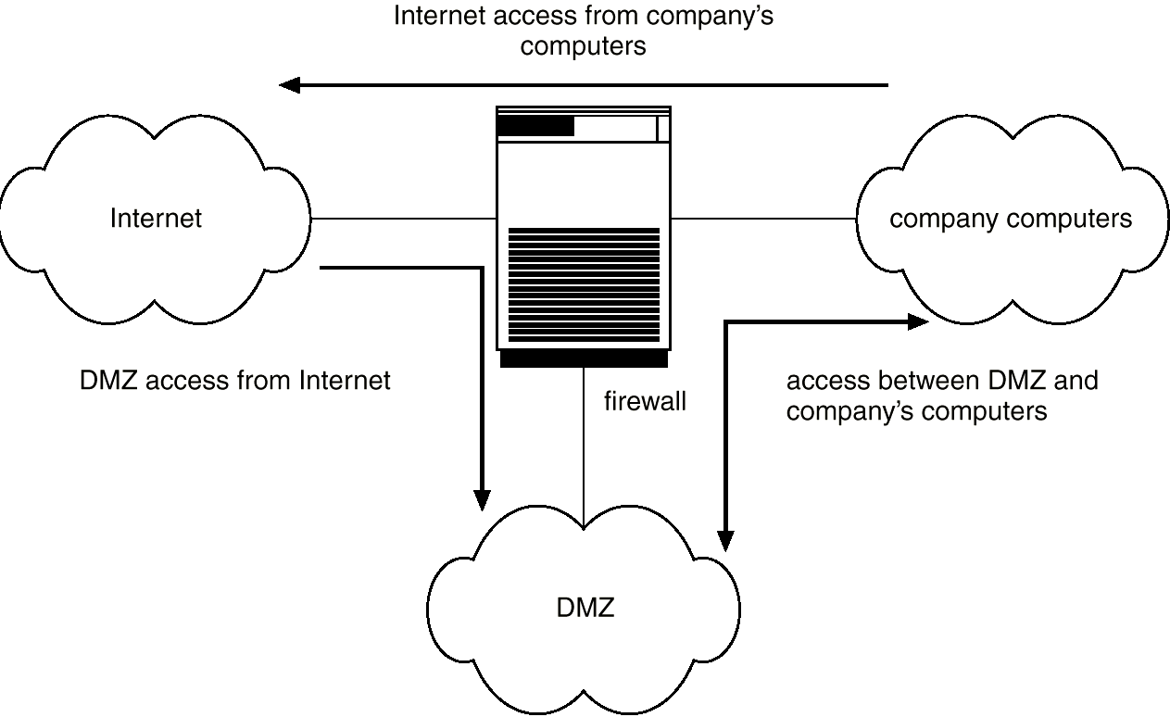
Firewall (cont.)

Slide 53
Firewall (cont.)
History:
  Dual-port host
  Packed filtering (one choke)
  One choke + gate
  Two chokes (one exterior, one interior) + gate
  Two chokes and multiple gates (one for each protocol)
Just one component of the security system. Not a panacea:
  Tunnel; IP spoofing (hacker pretends to be the authorized host); Stack overflow

Slide 54
VPN
VPN (Virtual Private Network)
Cost effective than private, dedicated data lines.
Use the internet as your private WAN without compromising the data.
Commonly based on IPSec standard: cryptography inserts at network layer, defines the IP packet formats that allow the insertion of authenticators and the encryption of packet contents.

Slide 55
VPN
Internet
Site A
Site B
unencrypted
encrypted
unencrypted

Slide 56
Unix Security
Protect the account
  Not include “.” in your search path. Trojan horses might reside in the working paths.
Startup file (.profile, .cshrc, .forward ..)
  Only users can write to them.
Use automatic mechanism carefully
Logout after idle for a while.
X windows security
  Allow users to write to the display
Notes:
Csh: “set autologout = 10”

Slide 57
Internet Security
Modem:
  Protect from eavesdropping/wiretapping.
Network sniffers
IP spoofing
Data spoofing
DNS
RPC
NIS / NIS+
NFS

Slide 58
Internet Security (cont. )
NIS/NIS+:
  Sun’s Network Information Services (old name: yellow page)
  Centralization of password info, group info, automount tables, network configurations etc.
  Root accounts should be local.
  NIS+ with Solaris 2.x provides better control.

Slide 59
Summary
Protection vs. Security
Cryptography
  Secret-key (symmetric)
  Public-key (asymmetric)
Authentication
Digital signature
Various threats

