Slide 1
Chapter 4 Processes
Process Concept
Process Scheduling
Operations on Processes
Cooperating Processes
Interprocess Communication
Communication in Client-Server Systems

Slide 2
Process
All the definitions …
  Program in Execution
  Animated spirit of a program
  What is represented by process control block
  Entity to which processors are assigned
  Dispatchable unit.
process execution must progress in sequential fashion.

Slide 3
Process Control Block (PCB)
Information associated with each process.
Process state
Program counter
CPU registers
CPU scheduling information
Memory-management information
Accounting information
I/O status information

Slide 4
Process State
As a process executes, it changes state
  new: The process is being created.
  running: Instructions are being executed.
  waiting: The process is waiting for some event to occur.
  ready: The process is waiting to be assigned to a process.
  terminated: The process has finished execution.

Slide 5

Process State (Cont.)

Slide 6

PCB (Cont.)

Slide 7
Revisit Program vs. Process
Program and Process are not one-to-one.
  Program execution -> process – (spawn)-> child process
Uniprogramming system; Multiprogramming system; Multiprocessing systems.
Thread

Slide 8

CPU Switch from Process to Process

Slide 9
Process Scheduling Queues
Job queue – set of all processes in the system.
Ready queue – set of all processes residing in main memory, ready and waiting to execute.
Device queues – set of processes waiting for an I/O device.
Process migration between the various queues.

Slide 10


Slide 11

Representation of Process Scheduling
Notes:
Error handling is the responsibility of the execution code, not the scheduler.

Slide 12
Schedulers
Long-term scheduler (or job scheduler) – selects which processes should be brought into the ready queue, typically from a disk.
Short-term scheduler (or CPU scheduler) – selects which process should be executed next and allocates CPU.
Notes:
Ready queue is not necessary FIFO. Depend on the algorithm and implementation.

Slide 13
Short-term scheduler is invoked very frequently (milliseconds) ⇒ (must be fast).
Long-term scheduler is invoked very infrequently (seconds, minutes) ⇒ (may be slow).
The long-term scheduler controls the degree of multiprogramming.
Processes can be described as either:
  I/O-bound process – spends more time doing I/O than computations, many short CPU bursts.
  CPU-bound process – spends more time doing computations; few very long CPU bursts.

Slide 14
CPU burst frequencies
I/O bound job: many short CPU bursts
CPU bound job: few very long CPU bursts
freqency
Burst duration

Slide 15

Medium-term Scheduler

Slide 16
Context Switch
When CPU switches to another process, the system must save the state of the old process and load the saved state for the new process.
Context-switch time is overhead; the system does no useful work while switching.
Time dependent on hardware support.
Importance of the Timer for multiprogramming

Slide 17
Operation on Process
Process Creation
  Parent process create children processes, which, in turn create other processes, forming a tree of processes
  Login process (for each terminal)
Shell Process
program1
program2
Notes:
Thread and vfork are alternative without copying the whole address space of the parent.

Slide 18
Unix: fork() and execlp()
  Resources owned by the parent process are copied to the child process.
  Both processes continue execution after fork(), the difference is on return value;
  execlp() replaces the existing address space.
Example code.
Notes:
Thread and vfork are alternative without copying the whole address space of the parent.

Slide 19
Resource sharing
  Parent and children share all resources.
  Children share subset of parent’s resources.
  Parent and child share no resources.
Execution
  Parent and children execute concurrently.
  Parent waits until children terminate.

Slide 20
Process Termination
Process executes last statement and asks the operating system to decide it (exit).
  Output data from child to parent (via wait).
  Process’ resources are deallocated by operating system.
Parent may terminate execution of children processes (abort).
  Child has exceeded allocated resources.
  Task assigned to child is no longer required.
  Parent is exiting. Operating system does not allow child to continue if its parent terminates-> Cascading termination.

Slide 21
  Q: In Unix, what is the behavior of a child process when the parent process is killed?

Slide 22
Cooperating Processes
Independent process cannot affect or be affected by the execution of another process.
Cooperating process can affect or be affected by the execution of another process
Advantages of process cooperation
  Information sharing
  Computation speed-up
  Modularity
  Convenience

Slide 23
Producer-Consumer problem
Bounded-buffer vs. unbounded-buffer

Slide 24
Producer
While(1) {
/* produce an item in nextProduced */
while (((in +1) % BUFFER_SIZE == out; /* full, do nothing*/
buffer[in] = nextProducted;
in = (in+1)%BUFFER_SIZE;
}

Slide 25
Consumer
While (1)
{
while (in == out) ; /* empty, do nothing */
nextConsumed = buffer [out];
out = (out+1) % BUFFER_SIZE;
}

Slide 26
Allow at most BUFFERSIZE –1 items in the buffer at the same time.
Other solutions exist, with concurrency issue.

Slide 27
Inter-process Communication
Mechanism for processes to communicate and to synchronize their actions.
IPC facility provides two operations:
  send(message) – message size fixed or variable
  receive(message)

Slide 28
Implementations Decisions
IPC can be synchronous or asynchronous
Synchronous – blocking
  Analogy: phone calls
Asynchronous – non-blocking. Not wait for response from another side.
  Analogy: emails

Slide 29
Implementations Decisions
IPC can be intra-system or inter-system
IPC can be unidirectional or bi-directional
IPC can be one-to-one, one-to-many or many-to-many
IPC can send message/object by reference or by copy.
Queues for IPC can be:
  Zero capacity – 0 messages
  Sender must wait for receiver (rendezvous).
  Bounded capacity – finite length of n messages
  Sender must wait if link full.
  Unbounded capacity – infinite length
  Sender never waits.
Notes:
Different ways of implementation.

Slide 30
Various IPC Mechanisms
Pipes
Message Passing
Shared memory
Sockets
RPC
JAVA RMI

Slide 31
Pipes
The oldest form of Unix IPC
Data flows only in one direction
Used between processes that have a common ancestor.
Normally the process that calls pipe() then calls fork(), creating an IPC channel from the parent to the child or vice versa.

Slide 32
Parent
Child
fd[0]
fd[1]
fd[0]
fd[1]
Pipe

Slide 33
System V Message Queues
msgsnd()
msgrcv()
msgget()
msgctl()

Slide 34
Shared Memory
Allow tow or more processes to share a given region of memory.
Fast since no copy is needed.
Often semaphores are used for synchronization.

Slide 35
Communication in Client-Server System
Sockets
  A socket is defined as an endpoint for communication.
  Concatenation of IP address and port
  The socket 161.25.19.8:1625 refers to port 1625 on host 161.25.19.8
  Communication consists between a pair of sockets

Slide 36


Slide 37
In Java
  java.net package
  Socket; DatagramSocket; MulticastSocket.
In Unix C library
  Server: socket(); bind(); listen();accept();
  Client: socket(); bind(); connect();
In Perl
Example

Slide 38
Remote Procedure Call
Provide a stub – client-side proxy for the actual procedure on the server.
The client-side stub locates the server and marshalls the parameters.
The server-side stub receives this message, unpacks the marshalled parameters, and peforms the procedure on the server.
Base of NFS

Slide 39
Java RMI (Remote Method Invocation)
Remote Method Invocation (RMI) is a Java mechanism similar to RPCs, but based on the concept of OBJECTs.
RMI allows a Java program on one machine to invoke a method on a remote object.

Slide 40
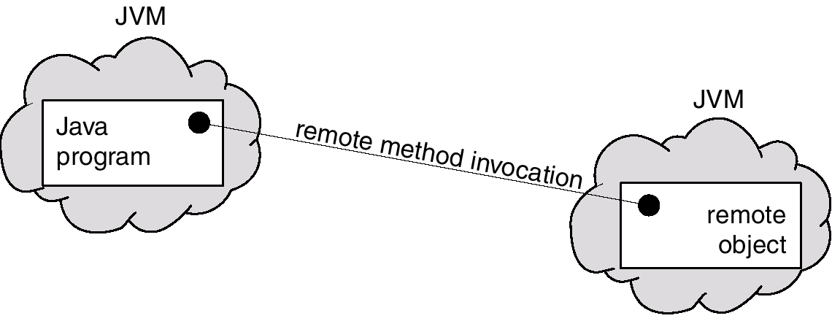

Slide 41
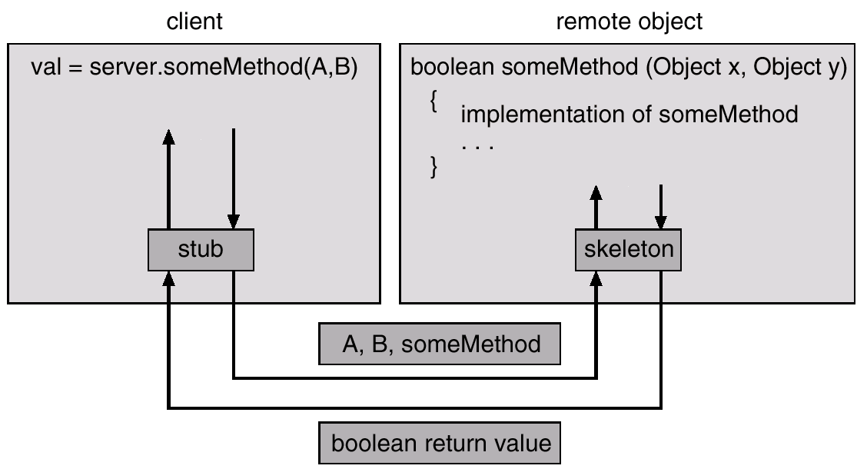
Marshalling

Slide 42
RMI (Cont.)
Pass by Value vs. Pass by Reference
By Value – serialize the parameter or return value object and send over network.
By Reference – treat the paramter or return value object as remote objects. Do not serialize them.
Decision of user (Policy vs. Mechanism)

Slide 43
Factory Pattern and RMI
What is design pattern?
  GangofFour book:
  Design Patterns, Elements of Reusable Object Oriented Software, E. Gamma et al.
What is factory pattern?
    Define an interface for creating an object
Its importance in object-based client-server communication scheme such as RMI. (One remote object is one instance of server.)
Notes:
New is used to create an object in local memory space. Cannot use new directly to create a remote object.

Slide 44
Example of Factory Method
public static A factoryForA()
{
….
return new A();
}
Notes:
Create an instance of A. Difference between a class and an object instance – similar to a program and a process.

Slide 45
Extensions to Enterprise JavaBean (EJB)
  Home Interface -- factory pattern
  Remote Interface – remote objects
J2EE (Java 2 Enterprise Edition)

Slide 46
Chapter 5 Threads
Overview
Multithreading Models
Threading Issues
Pthreads
Solaris 2 Threads
Windows 2000 Threads
Linux Threads
Java Threads

Slide 47
Thread: consists of a program counter, set of registers and stack space.
Share with its peers code section, data section and resources such as open files.
Notes:
Examples: earlier version of Netscape; web server; application server

Slide 48


Slide 49
Process 1
Process2
Process 3
Process
Thread1
Thread2
Thread3
Thread1
Thread1
Thread1

Slide 50
Multithreaded Web Server
Dispatcher thread
Web Server Process
Worker threads
cache
User Space
Kernel Space

Slide 51
No protection are provided between threads’ stacks. -- a process is always owned by one user, who has presumably created threads to cooperate.

Slide 52
Benefits
Responsiveness
-- multiple activities going “concurrently”
Resource Sharing
-- since they share the memory and resources.
Economy
-- easier to create and destroy
Utilization of MP Architectures
-- each thread may be running in parallel on a different processor concurrently
Notes:
With single CPU, parallelism is an illusion created by OS.

Slide 53
User Threads
Thread management done by user-level threads library
Examples
- POSIX Pthreads
- Mach C-threads
- Solaris 2 UI-threads

Slide 54
Kernel Threads
Supported by the Kernel
Examples
- Windows 95/98/NT/2000
- Solaris
- Tru64 UNIX
- BeOS
- Linux

Slide 55
Multithreading Models
Many-to-One
  Many user-level threads mapped to single kernel thread.
  Used on systems that do not support kernel threads.
One-to-One
  Each user-level thread maps to kernel thread.
  Examples: Windows 95/98/NT/2000; OS/2
Many-to-Many
  Allows many user level threads to be mapped to many kernel threads.
  Allows the operating system to create a sufficient number of kernel threads.
  Solaris 2
  Windows NT/2000 with the ThreadFiber package

Slide 56

Many-to-one

Slide 57

One-to-one

Slide 58

Many-to-many

Slide 59
Threading Issues
Semantics of fork() and exec() system calls.
Thread cancellation
  Asynchronous cancellation: the target thread terminates immediately
  Deferred cancellation: The target thread has an opportunity to terminate itself in an orderly fashion

Slide 60
Threading Issues (Cont.)
Signal handling
  Signal is used in Unix to notify a process that a particular event has occurred.
Thread pools
Thread specific data
Notes:
Ignore some of the signals, SIGKILL is not ignorable

Slide 61
Pthreads
a POSIX standard (IEEE 1003.1c) API for thread creation and synchronization.
API specifies behavior of the thread library, implementation is up to development of the library.
Common in UNIX operating systems.

Slide 62
pthread_attr_init()
pthread_create()
pthread_join()
pthread_exit()

Slide 63

Solaris 2 Threads

Slide 64

Solaris 2 Process

Slide 65
Windows 2000
Implements the one-to-one mapping.
Each thread contains
- a thread id
- register set
- separate user and kernel stacks
- private data storage area

Slide 66
Linux Threads
Linux refers to them as tasks rather than threads.
Thread creation is done through clone() system call.
Clone() allows a child task to share the address space of the parent task (process)

Slide 67
Java Threads
Java threads may be created by:
  Extending Thread class
  Implementing the Runnable interface
Java threads are managed by the JVM.
Relationship with their host system.
Notes:
Jvm 1.1 or later on Solaris 2.6 or later use many-to-many model

Slide 68
Java Threads
JVM Process
Java threads
cache
User Space
Kernel Space

Slide 69
Java Threads
Methods: start(); sleep(); join();
Never stop();
  Inherently unsafe. Locked objects maybe in an inconsistent state, and become visible to other threads, potentially resulting in arbitrary behavior. Asynchronous cancellation.
Thread safety

Slide 70
public static void main(String[] args)
{
Runnable ping = new RunPingPong("ping",99);
Runnable pong = new RunPingPong("PONG",500);
new Thread(ping).start();
new Thread(pong).start();
}

Slide 71
Chapter 6 CPU Scheduling
Basic Concepts
Scheduling Criteria
Scheduling Algorithms
Multiple-Processor Scheduling
Real-Time Scheduling
Algorithm Evaluation

Slide 72
Some concepts
CPU burst: A continuous CPU execution time.
I/O burst: A continuous I/O time.
The alternating diagram of a process execution between CPU burst and I/O burst.
The histogram of CPU burst distribution.

Slide 73


Slide 74


Slide 75
CPU scheduling decisions may take place when a process:
  1. Switches from running to waiting state.
  2. Switches from running to ready state.
  3. Switches from waiting to ready.
  4. Terminates.
Scheduling under 1 and 4 is nonpreemptive.
All other scheduling is preemptive.
Notes:
Revisit state diagram

Slide 76
Nonpreemptive Scheduling
  Once the CPU has been allocated to a process, the process keeps the CPU until it releases the CPU either by terminating or by switching to the waiting state.
Preemptive Scheduling
  Concurrency issues at user level and kernel design

Slide 77
Dispatcher vs. Scheduler
Dispatcher module gives control of the CPU to the process selected by the short-term scheduler; this involves:
  switching context
  switching to user mode
  jumping to the proper location in the user program to restart that program
Dispatch latency – time it takes for the dispatcher to stop one process and start another running.

Slide 78
Scheduling Criteria
CPU utilization – keep the CPU as busy as possible
Throughput – # of processes that complete their execution per time unit
Turnaround time – amount of time to execute a particular process
Waiting time – amount of time a process has been waiting in the ready queue
Response time – amount of time it takes from when a request was submitted until the first response is produced, not output (for time-sharing environment)

Slide 79
Optimization Criteria
Max CPU utilization
Max throughput
Min turnaround time
Min waiting time
Min response time

Slide 80
Scheduling Algorithms
First-come, First-Served (FCFS)
Shortest-Job-First
Priority Scheduling
Round-Robin
Multilevel Queue Scheduling
Multilevel Feedback Queue Scheduling

Slide 81
Scheduling Algorithms
FCFS -- First-Come, First-Served
Process Burst Time
P₁ 24
P₂ 3
P₃ 3

Slide 82
Suppose that the processes arrive in the order: P₁ , P₂ , P₃
The Gantt Chart for the schedule is:
Waiting time for P₁ = 0; P₂ = 24; P₃ = 27
Average waiting time: (0 + 24 + 27)/3 = 17
P₁
P₂
P₃
0
24
27
30

Slide 83
Suppose that the processes arrive in the order
P₂ , P₃ , P₁ .
The Gantt chart for the schedule is
Waiting time for P₁ = 6; P₂ = 0; P₃ = 3
Average waiting time: (6 + 0 + 3)/3 = 3
Much better than previous case.
Convoy effect short process behind long process
P₂
P₃
P₁
0
3
6
30

Slide 84
Shortest-Job-First (SJF) Scheduling
Associate with each process the length of its next CPU burst. Use these lengths to schedule the process with the shortest time.
Two schemes:
  nonpreemptive – once CPU given to the process it cannot be preempted until completes its CPU burst.
  preemptive – if a new process arrives with CPU burst length less than remaining time of current executing process, preempt. This scheme is know as the
  Shortest-Remaining-Time-First (SRTF).
SJF is optimal – gives minimum average waiting time for a given set of processes.

Slide 85
Example of Non-Preemptive SJF
Process Arrival Time Burst Time
P₁ 0.0 7
P₂ 2.0 4
P₃ 4.0 1
P₄ 5.0 4
SJF (non-preemptive)
Average waiting time = (0 + 6 + 3 + 7)/4 - 4
P₁
P₃
P₂
P₄
0
3
7
8
12
16

Slide 86
Example of Preemptive SJF (shortest-remaining-time-first)
Process Arrival Time Burst Time
P₁ 0.0 7
P₂ 2.0 4
P₃ 4.0 1
P₄ 5.0 4
SJF (preemptive)
Average waiting time = (9 + 1 + 0 +2)/4 - 3
P₁
P₂
P₃
P₂
P₄
P₁
0
2
4
5
7
11
16

Slide 87
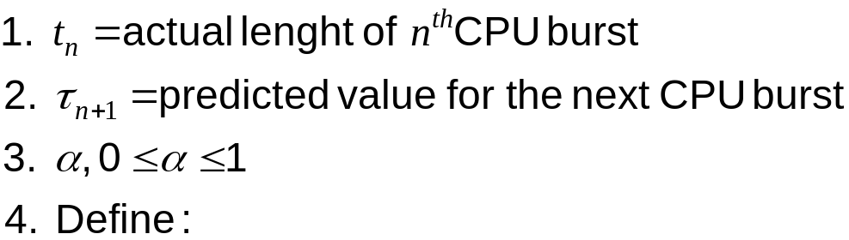

Determining Length of Next CPU Burst
Can only estimate the length for short-term CPU scheduling.
Can be done by using the length of previous CPU bursts, using exponential averaging.

Slide 88
α =0
  τ_{n+1} = τ_{n}
  Recent history does not count.
α =1
  τ_{n+1} = t_{n}
  Only the actual last CPU burst counts.
If we expand the formula, we get:
    τ_{n+1} = α t_{n}+(1 - α) α t_{n} -1 + …
    +(1 - α )^{j} α t_{n} -1 + …
    +(1 - α )^{n=1} t_{n} τ₀
Since both α and (1 - α) are less than or equal to 1, each successive term has less weight than its predecessor.

Slide 89

Prediction of the Length of the Next CPU Burst
Notes:
Alpha = 0.5 and T(0) = 10

Slide 90
Priority Scheduling
Each process is assigned a priority.
The runnable process with highest priority is allowed to run. (FCFS it tie exists)
Relationship with SJF – SJF is a special case of priority scheduling, where priority is the inverse of the predicted next CPU burst. (lower number means higher priority).
How is the priority determined?
  Internally: time limits, resource held by the process; resource requirements;
  Externally: e.g.: user priority
Notes:
Priority is 1/(predicted cpu burst)

Slide 91
Priority Scheduling (cont.)
Problem: Starvation – low priority processes may never execute.
Solution: Aging – as time progresses increase the priority of the process.

Slide 92
Example: non-preemptive priority scheduling
Process Burst Time Priority
------------------------------------------------
P1 10 3
P2 29 5
P3 3 1
P4 7 2
P5 12 4
Notes:
10+32+0+3+20=65
65/5 = 13

Slide 93
Round-Robin Scheduling
Designed especially for time-sharing systems.
Time interval -- quantum
At the end its quantum, the CPU is preempted (use of timer) and given to another process. Then suspended process is put at the tail of ready queue.
Most fairest and widely used algorithm
Notes:
If too short: context switches waste time
If too long: process no longer appear to be executed concurrently. –similar to FCFS
Rule of thumb: choose a duration as long as possible, while keeping good system response time.

Slide 94
How long must a quantum last?
the quantum duration is critical for system performances. It should be neither too long nor too short.
  q large ⇒ FIFO; less responsive
  q small ⇒ q must be large with respect to context switch, otherwise overhead is too high.
Typically, higher average turnaround than SJF, but better response.

Slide 95
Example:
Quantum = 4ms
Consider a set of processors P1, P2 and P3, order of arrival into the ready queue: P1,P2, then P3. Their respective CPU-burst times (ms): P1: 24ms; P2: 5ms; P3: 3ms
Question: What is their average waiting time?

Slide 96
Gantt Chart:
P1
P2
P3
P1
P2
P1
P1
P1
P1
0
4
8
11
15
16
20
24
28
32
Waiting time:
P1: 0+7+1=8
P2: 4+7 = 11
P3: 8
Average waiting time: 9ms

Slide 97
What if the quantum = 3ms?
Notes:
P1=0+6+2=8
P2=3+6=9
P3=6
23/3=7.6

Slide 98
Multilevel queue scheduling
Ready queue is partitioned into separate queues:
foreground (interactive)
background (batch)
Each queue has its own scheduling algorithm,
foreground – RR
background – FCFS
Scheduling must be done between the queues.
  Fixed priority scheduling; (i.e., serve all from foreground then from background). Possibility of starvation.
  Time slice – each queue gets a certain amount of CPU time which it can schedule amongst its processes; i.e., 80% to foreground in RR
  20% to background in FCFS

Slide 99


Slide 100
Multilevel Feedback Queue
A process can move between the various queues; aging can be implemented this way.
Multilevel-feedback-queue scheduler defined by the following parameters:
  number of queues
  scheduling algorithms for each queue
  method used to determine when to upgrade a process
  method used to determine when to demote a process
  method used to determine which queue a process will enter when that process needs service

Slide 101

Example: Multilevel feedback queue scheduling
Three queues:
  Q₀ – time quantum 8 milliseconds
  Q₁ – time quantum 16 milliseconds
  Q₂ – FCFS

Slide 102
Summary of the CPU scheduling algorithms
List of algorithms
  FCFS – non-preemptive
  SJF – preemptive or non-preemptive
  Priority Scheduling -- preemptive or non-preemptive
  Round-Robin -- preemptive
  Multilevel queue scheduling
  Multilevel feedback queue scheduling
Why CPU scheduling can help
  Alternating scheme of CPU burst & I/O burst of most processes

Slide 103
Multi-processor scheduling
CPU scheduling more complex when multiple CPUs are available.
Homogeneous processors within a multiprocessor.
Load sharing
Asymmetric multiprocessing – only one processor accesses the system data structures, alleviating the need for data sharing.

Slide 104
Real time scheduling
Hard real-time systems – required to complete a critical task within a guaranteed amount of time.
  Non possible with virtual memory.
Soft real-time computing – requires that critical processes receive priority over less fortunate ones.

Slide 105
Algorithm Evaluation
Deterministic modeling
  Takes a particular workload and defines the performance.
Queuing models
  Estimate average queue length, average waiting time, average arrival rate using Little’s formula.
Simulation

Slide 106
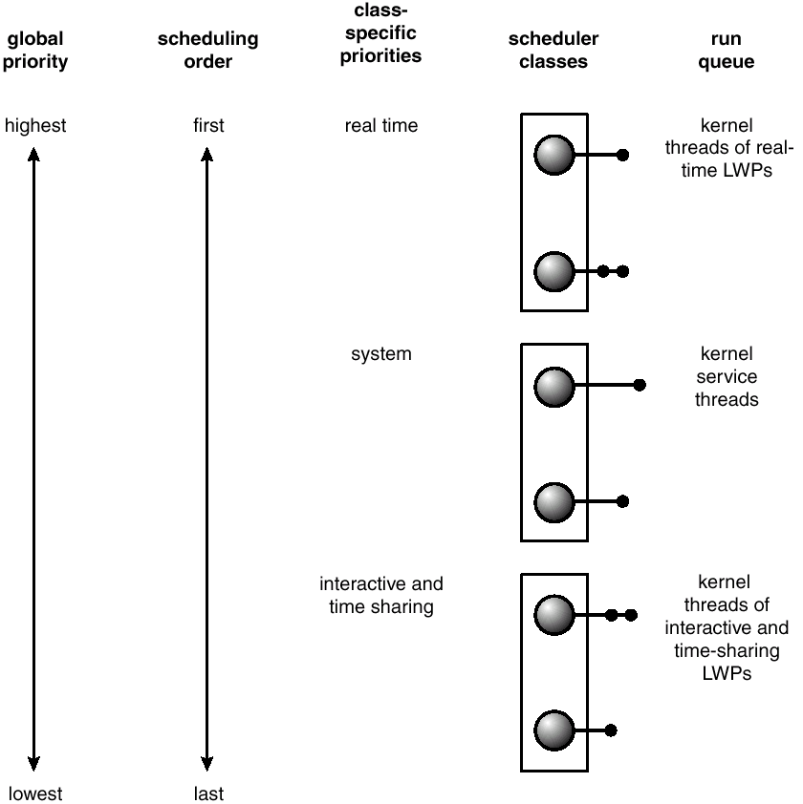
Solaris 2 Scheduling – priority based
Notes:
Preemptive
Time sharing class uses multilevel feedback queue – the higher the priority(interactive get higher priority), the smaller the time slice. give good response time for interactive process and good throughput for CPU-bound process.

