Slide 1
Multiplication and Division,
Miscellaneous Topics
Multiplication and Division (Chapter 2.10)
Register Equates (6.4) and Extended Mnemonics (4.2)
Literals (2.11)
The LA Instruction (2.12)
STC, IC (3.1)
BCT & BCTR (3.2)
© Department of Computer Science
Northern Illinois University
1999

Slide 2
Even/Odd Pairs
With multiplication and division, the register in the first operand actually stands for a pair of registers.
This register must be an even register, and it implies that the odd register following it is used, too.
Called an even/odd pair.
Allows calculations on larger numbers because the even/odd pair can hold a 64-bit answer.

Slide 3
Multiplication (RR)
Even/odd
pair
MR r1,r2 Multiply registers,
RR instruction.
r1 (even)
r1 + 1 (odd)
r2
Before
Irrelevant
multiplicand
multiplier
After
answer
unchanged

Slide 4
Multiplication (RR)
r1 stands for a pair of registers, an even/odd pair. Holds 64-bit answer when done.
r2 has multiplier, unchanged afterward.
Afterward, r1+1 (odd register) will contain the answer and r1 (even register) will have just an extension of sign bit, unless the answer is very large.

Slide 5
Multiplication (RR)
MR 2,6 Multiply registers
R2 (even)
R3 (odd)
R6
Before
irrelevant
00000007
00000003
After
00000000 00000015
00000003

Slide 6
Multiplication (RR)
r2 can even be either of the even/odd pair designated by r1:
MR 2,3 Multiply registers;
i.e., R2/R3 x R3 (R3²)
R2 (even)
R3 (odd)
Before
irrelevant
00000007
After
00000000 00000031

Slide 7
MR 2,2 Multiply using only 2 registers; i.e., R2/R3 x R2
(slick way to save a register)
Multiplication (RR)
R2 (even)
R3 (odd)
Before
00000003
00000007
After
00000000 00000015

Slide 8
Multiplication (RX)
M r1,address Multiply a register times a fullword
r1 stands for a pair of registers, an even/odd pair, holds answer (just like RR)
Number at address must be on a fullword boundary. It is unchanged afterward.
Afterward, r1 will have just an extension of sign bit, unless answer is very large.

Slide 9
Multiplication (RX)
M r1,address Multiply a register times a fullword
fullword at
address
r1 (even)
r1 + 1 (odd)
Before
irrelevant
multiplicand
multiplicand
After
answer
unchanged

Slide 10
Multiplication (RX)
M 2,NUMBER Multiply
R2 (even)
R3 (odd)
NUMBER
Before
irrelevant
00000007
00000003
After
00000000 00000015
00000003

Slide 11
Multiplication Errors
Addressing exception -- outside all memory.
Protection exception -- outside program's memory.
Specification exception -- not on boundary.

Slide 12
Division (RR)
DR r1,r2 Divide registers,
RR instruction.
r1 (even)
r1 + 1 (odd)
r2
Before
dividend
divisor
(number to be divided)
After
remainder
quotient/
unchanged
result

Slide 13
Division (RR)
r1 stands for a pair of registers, an even/odd pair. Contains dividend/number to be divided.
Remainder put in even register, always the same sign as the dividend.
Quotient (answer) put in odd register.
r2, divisor is unchanged.

Slide 14
Division (RR)
DR 2,6 Divide registers
R2 (even)
R3 (odd)
R6
Before
00000000 00000011
00000002
After
00000001
00000008
00000002

Slide 15
Division (RX)
D r,address Divide register
by a fullword
r1 (even)
r1 + 1
address
(odd)
Before
dividend
divisor
(number to be divided)
After
remainder
quotient/
unchanged
result

Slide 16
Division (RX)
D 2,NUMBER Divide
R2 (even)
R3 (odd)
NUMBER
Before
00003456 00000011
00000002
After
00000001
00000008
00000002

Slide 17
Division (RR and RX)
Must initialize the even register to be an extension of the sign bit in the odd register; i.e., it must be set to 00000000 (positive) or FFFFFFFF (negative).
Initialize
to zero 1st
R2 (even)
R3 (odd)
NUMBER
Before
00003456 00000011
00000002
After
00000001
00000008
00000002

Slide 18
Division (RR and RX)
Otherwise, this would divide into the number 345,600,000,011 instead of into the number 11, as was intended.
Initialize
to zero 1st
R2 (even)
R3 (odd)
NUMBER
Before
00003456 00000011
00000002
After
00000001
00000008
00000002

Slide 19
Division (RR and RX)
To do that:
  M R2,ONE Multiply even odd pair by 1, with result propagating into register. … ONE DC F'1'

Slide 20
Register Equates
Used to establish a correspondence between a label and an expression, so that the program treats them the same.
Primary use: to enable using ‘R’ in front of register labels; e.g., R2, R4

Slide 21
Register Equates
Format:
  label EQU expression
Examples:
  R0 EQU 0
  R1 EQU 1
A label the
assembler already
recognizes
New alias

Slide 22
Register Equates
Can then use instructions such as
  L R6, NUMBER
Put at end of program, just before END statement
EQU instruction is just to the assembler, so it doesn’t generate executable code.

Slide 23
Register Equates
Benefits:
  Readability.
  Cross-reference table listing the numbers of all instructions in which the label was used.
    Unfortunately, the Assist compiler, which is the one you use, doesn’t do this.
Disadvantage:
  A small typo can cause a very nasty bug!

Slide 24
Extended Mnemonics
Branching instructions without masks; using easy-easy-to-remember codes instead.
Most are for BC instruction -- only one right now for the BCR.
Table of equivalents on page 339 of text and page 19 of yellow booklet.

Slide 25
Extended Mnemonics
Note the masks
are the same because
CC is the same.
Examples:
  Branch on equal:
  BC B’1000’, LOOP = BE LOOP
  Branch on zero:
  BC B’1000’, LOOP = BZ LOOP
  Branch on not high
  BC B’1101’, LOOP = BNH LOOP
  Branch on last (after XREAD)
  BC B ‘0100’, LOOP = BL LOOP

Slide 26
Extended Mnemonics
  Branch on not zero
  BC B’0111’, LOOP = BNZ LOOP
  Branch no matter what
  BC B’1111’, LOOP = B LOOP
  Branch no matter what, register version
  BCR B’1111’, R8 = BR R8
    BCR - for the moment, can be replaced only with BR (unconditional branch).

Slide 27
Literals
One way to be able to use the number '4' A R8,FOUR … FOUR DC F'4'
Another way, often more convenient: A R8,=F'4'
The =F'4' is called a literal, an in-line constant preceded by the equals sign.

Slide 28
Literals
Assembler sets up a fullword storage area for fullword literals.
To control where this should be located, use the LTORG command just after the exit BCR and before storage for constants (DCs).
Must put in the LTORG, or the constants will not necessarily be placed within your routine, and the program could abend.

Slide 29
Literals
Can also use character literals: XPRNT =CL11'1PRINT THIS’,11
which will skip to the top of the next page and print:
  PRINT THIS

Slide 30

LA Instruction
So far, working pretty much with buckets (registers and storage) that have contents that we need.
What we want is
in here, and we
can get it directly.

Slide 31
LA Instruction
But now we are going to remove ourselves a step further away from the real data; now a bucket can hold a pointer that points at another bucket that holds what we need.
This contains
the location
of the bucket
with the data.
This still
contains
the actual data
we need.

Slide 32
LA Instruction
label LA r,D(X,B) Loads address -- D(X,B) -- into register.
LA R3,WORD Puts address of WORD into R3, not what WORD contains.

Slide 33
LA Instruction
Contrast LA with L: LA points, L gets.
Suppose NUMBER contains 0000 0008. Contrast:
  L R5,NUMBER R5 now contains 0000 0008
with
  LA R3,NUMBER R3 now contains the @
  L R5,0(,R3) R5 now contains 0000 0008
Same results
Same results

Slide 34
LA Instruction
The address that LA loads is in the rightmost three bytes; leftmost byte set to 00.
  LA r, 0(,r) Sets leftmost byte to 00
  without changing number.
Most common Assembler error: Confusing L and LA.

Slide 35
LA Instruction
”Special" uses of the LA instruction
  LA r,n Load a number (0 to 4095) into a register.
  LA R3,8 Puts the number 8 into R3.
  This works because it resolves the address by adding the displacement “n” to the registers, which are, in this case, omitted. So, only the displacement is resolved and put into the register.
  Easiest way to put a small positive integer into a register. Use this!

Slide 36
LA Instruction
  LA r,n(r) Increments value in r by the number n (0 to 4095).
  LA R3,6(R3) Adds six to the number in R3.
  This works because it resolves the address by adding the displacement “n” to R3 and putting the result back in R3. Use this!

Slide 37
STC & IC Instructions
STC (Store Character) and IC (Insert Character) are similar to ST and L but work with a single character (a byte), not a fullword.

Slide 38
STC & IC Instructions
Label STC r,address Store rightmost byte of register at address.
Label IC r,address Load single byte at address into rightmost byte of register. Leftmost 3 bytes of register unchanged.

Slide 39
STC & IC Instructions
Example:
    IC R3,BYTE1 STC R3,BYTE2 … BYTE1 DC C'*' BYTE2 DS CL1
Protection and addressing errors possible.
Results in an * in
rightmost byte of R3
and in BYTE2

Slide 40
BCTR & BCT
Originally intended to control bottom driven loops….

Slide 41
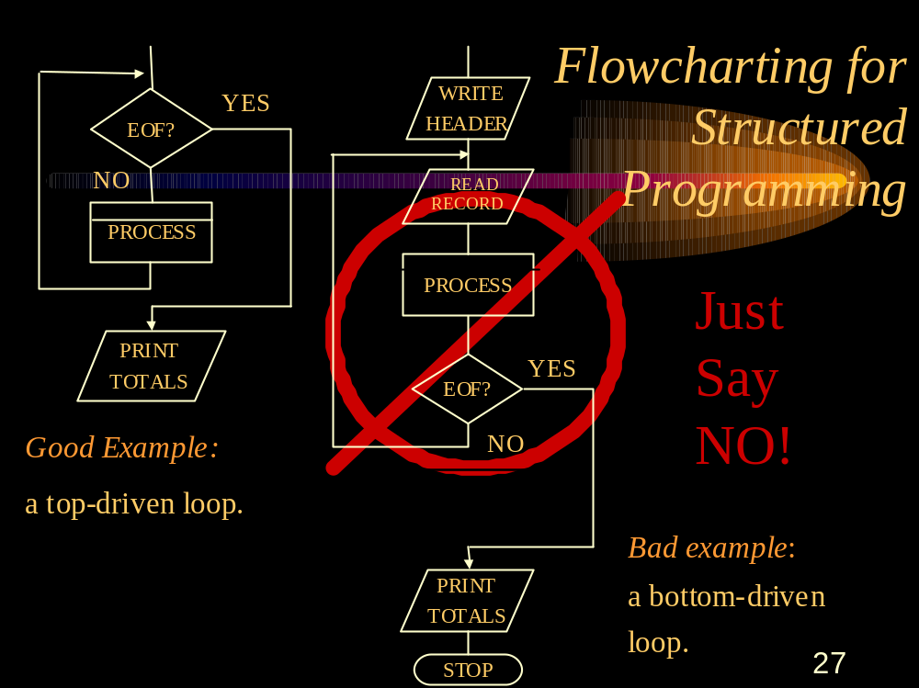

Slide 42
BCTR & BCT
We consider bottom-driven loops to be a no-no, so we won’t use BCT and BCTR for their normal purposes.
However, there is one legal use of the BCTR that we will allow, because it doesn’t result in looping...

Slide 43
BCT & BCTR
BCTR r1,r2 Branch on count to where register points.
If the second register is R0, no branch is taken, but R1 is decremented by one.
  Used for exactly that purpose -- to subtract one from the first register without looping.
  The only allowed use in this class.

Slide 44
BCT & BCTR
Example:
  BCTR R6,R0 Subtract 1 from R6.

