Slide 1
WizWord — Product Pitch
AI‑assisted word game with shareable moments

Slide 2
Problem & Opportunity
Word games often feel shallow or slow
Need quick, meaningful sessions with progress

Slide 3
What WizWord Does
AI‑assisted yes/no & hints keep momentum
5‑minute Beat sprint with dynamic scoring
Beautiful share cards with QR
Optional Personal mode (privacy aware)

Slide 4
How to Play (Brief)
Choose mode: Fun, Wiz, or Beat (4‑minute sprint)
Pick a category or 'Any'
Actions: yes/no (−1), hints (−10 up to 3), guess anytime
Scoring: correct +20×length; wrong −10; skip −10
SEI efficiency powers leaderboards; Personal gives profile‑aware hints

Slide 5
Account Options
Image not found: assets/ui/account_options.png

Slide 6
How to Play
Image not found: assets/ui/how_to_play.png

Slide 7
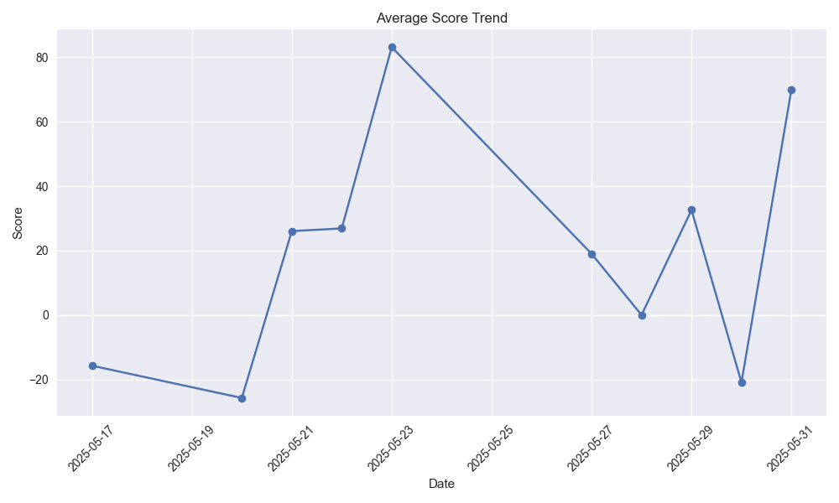
Score Trend

Slide 8
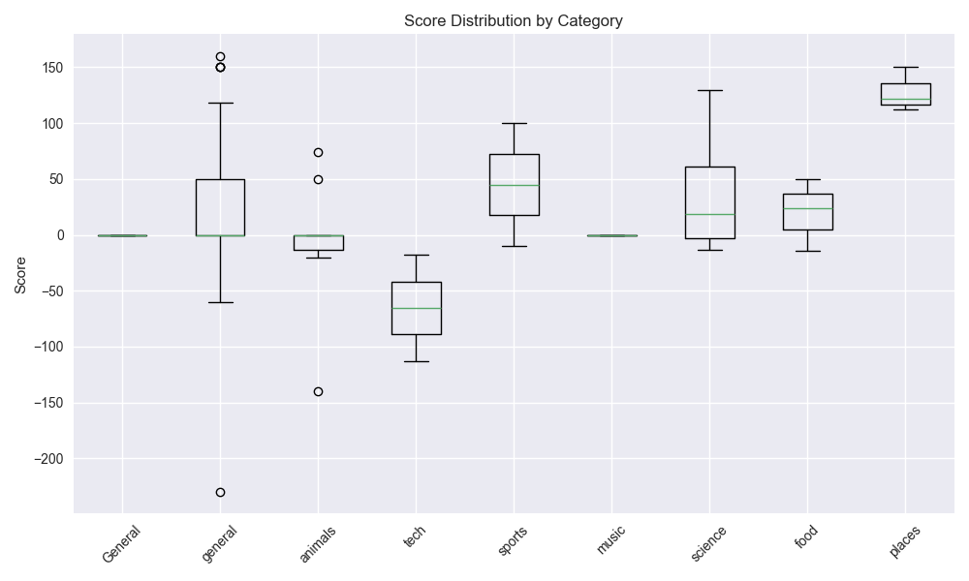
Score Distribution

Slide 9

Share Card Template

Slide 10
Key Features
Fast play on web/mobile
SEI rewards speed + accuracy
Share cards with QR
Offline fallback (no API key required)

Slide 11
Setup (1‑minute)
python -m venv venv
pip install -r requirements.txt
streamlit run streamlit_app.py

