Slide 1

PROJECT PROPOSAL
Evidence-Based Fact Verification
using RAG and Large Language Models
Hybrid retrieval, evidence verification, and confidence scoring for grounded AI answers
STUDENT NAMES
SCHOOL
Divik Dhiman | Satyam Jha | Safal Goyal
SCOPE
REGISTRATION NOS.
GUIDE
23BCE1365 | 23BCE1139 | 23BCE1234
Dr. Rabindra Kumar Singh
Vellore Institute of Technology, Chennai
Notes:
Title slide for the capstone proposal. Presenter should introduce themselves, their registration number, department, guide, and university before stating the project title. Emphasize that this is a research-inspired proposal, not a finished product, and that the talk will walk through motivation, related work, proposed architecture, methodology and expected outcomes.

Slide 2


THE RISE OF LARGE LANGUAGE MODELS
Introduction
Large Language Models (LLMs) have achieved remarkable fluency in natural language understanding and generation.
Widely adopted general-purpose models include ChatGPT, Llama, Qwen, and Gemini.
These models are increasingly used for question answering, summarization, and decision support.
A Simple Illustration
User Question
LLM (No External Evidence)
ChatGPT
Llama
Qwen
Gemini
Generated Answer
Despite their fluency, LLMs still generate:
Hallucinations — confident but false statements
Outdated information beyond training cut-off
Unsupported claims with no traceable evidence
No evidence trail — risk of hallucination
EVIDENCE-BASED FACT VERIFICATION ·
Notes:
LLMs like ChatGPT, Llama, Qwen and Gemini are trained on large static corpora and generate answers purely from learned parameters, with no mechanism to verify claims against current, external evidence. This motivates augmenting LLMs with retrieval and verification.

Slide 3





GROUNDING LLMS IN EXTERNAL KNOWLEDGE
What is Retrieval-Augmented Generation (RAG)?
User Question
Retriever
Knowledge Base
Relevant Documents
LLM
Answer
The query submitted by the user.
Finds candidate content for the query.
External corpus of documents.
Top-ranked evidence passages.
Reasons over retrieved evidence.
Grounded, evidence-based response.
How it works: RAG grounds a language model in an external knowledge base. The retriever searches the knowledge base for documents relevant to the user’s question; the most relevant passages are passed to the LLM as context, which then generates an answer supported by that retrieved evidence rather than by memory alone.
EVIDENCE-BASED FACT VERIFICATION ·
Notes:
Walk through each stage: the retriever converts the query into a search over the knowledge base (often using dense embeddings), returns relevant documents, and the LLM conditions its generation on this retrieved context, producing a grounded rather than purely parametric answer.

Slide 4
09
KEY DIFFERENCES
Basic RAG vs. Our CRAG
Feature | Basic RAG | Our CRAG
Retrieval Passes | Single pass | Iterative (multi-round)
Search Method | Dense only | FAISS + BM25 hybrid
Evidence Check | None | LLM verification
Query Refinement | None | improve_query node
Web Fallback | None | Tavily Search API
Confidence Score | Not provided | Always included
EVIDENCE-BASED FACT VERIFICATION ·
Notes:
Evaluation will use RAGAS-style metrics — answer correctness, faithfulness, context precision and recall — alongside hallucination rate and response time, comparing the proposed evidence-verified pipeline against a traditional single-pass RAG baseline. The bar values shown are illustrative targets, not measured results.

Slide 5
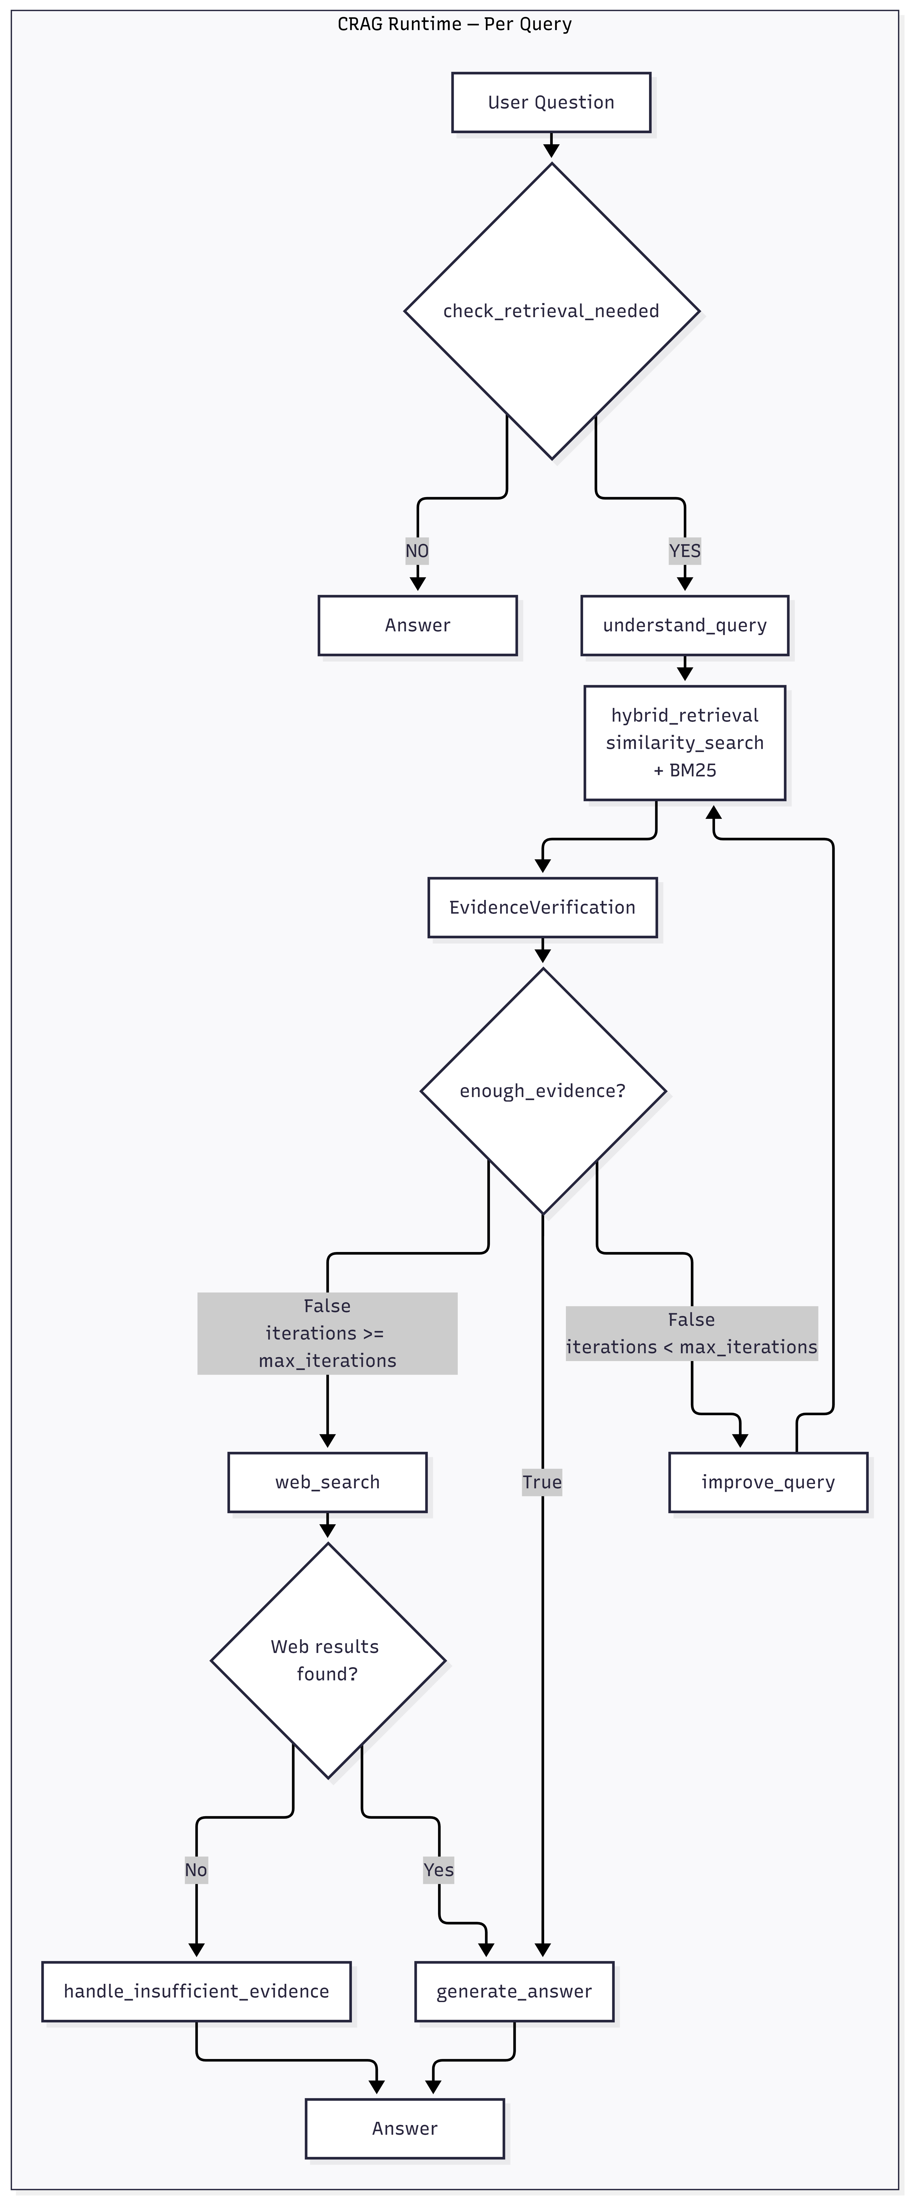
PER-QUERY EXECUTION LOGIC
CRAG Runtime Flow
Runtime Steps:
1. check_retrieval_needed
Greeting or needs retrieval?
2. understand_query
LLM -> search_query
3. hybrid_retrieval
FAISS + BM25 -> deduplicated docs
4. verify_evidence
LLM -> EvidenceVerification object
5. enough_evidence?
YES -> generate_answer
NO (iter < max) -> improve_query -> retrieve again
NO (iter >= max) -> web_search (Tavily)
6. Output: Answer + Sources + Confidence
Notes:
The methodology follows seven steps from receiving the question through hybrid retrieval, evidence evaluation, optional re-retrieval, grounded answer generation, citation attachment, and finally confidence scoring.

Slide 6
HOW WE RETRIEVE AND VALIDATE EVIDENCE
Hybrid Retrieval & Evidence Verification
Hybrid Retrieval
Evidence Verification
Iterative Query Refinement
Web Search Fallback
FAISS similarity search (dense semantic vectors)
BM25 keyword scoring (sparse retrieval)
Results deduplicated and merged
Covers both semantic and keyword relevance
LLM evaluates each retrieved document
Checks relevance, coverage, and reliability
Returns structured EvidenceVerification output
If insufficient -> triggers query refinement
improve_query node creates a refined search query
Retrieves again from the same knowledge base
Repeats until sufficient or max iterations reached
Max iterations reached -> Tavily web search
Web results added to evidence pool
No results -> low-confidence fallback response
Notes:
Expected outcomes: fewer hallucinations, improved factual correctness, greater transparency into the reasoning process, evidence-backed responses, and ultimately improved user trust in the system.

Slide 7






TOOLS AND TECHNOLOGIES USED
Technology Stack
Frontend
Streamlit
Backend
FastAPI + LangGraph
AI Orchestration
LangChain + LangGraph
Embedding Model
Cohere
Large Language Models
Gemini
Vector Store
FAISS
Web Search
Tavily Search API
Notes:
The stack spans a Next.js/React frontend, a FastAPI backend, LangChain and LlamaIndex for orchestration, Sentence Transformers for embeddings, open LLMs (Llama 3, Qwen, Gemma), ChromaDB/FAISS as vector stores, and a hybrid of BM25 keyword search with dense retrieval.

Slide 8








POSSIBLE EXTENSIONS
Future Scope
GraphRAG
Multi-Agent RAG
Knowledge Graph Integration
Medical RAG
Legal AI Assistant
Research Paper Assistant
Enterprise Knowledge Base
...and more
Notes:
Beyond this capstone, the architecture generalizes toward graph-structured retrieval, multi-agent verification pipelines, deeper knowledge-graph integration, and domain-specific deployments in medicine, law, research assistance, and enterprise knowledge management.

Slide 9

Conclusion
We built a Corrective RAG (CRAG) system that goes beyond basic RAG:
Hybrid retrieval: FAISS + BM25 for broader evidence coverage
LLM-based evidence verification before answer generation
Iterative query refinement when evidence is insufficient
Tavily web search as a final fallback option
Every answer includes sources + confidence score
Conversation history stored in PostgreSQL via SQLAlchemy
Result: trustworthy, transparent, evidence-grounded AI answers.
Thank you ? Questions and Feedback Welcome
Notes:
Close by restating the core contribution — combining RAG with evidence verification and confidence estimation to reduce hallucinations and improve trust, transparency, and factual reliability — then invite questions.

