Slide 1
◉
SMARTBUS
SmartBus
Face-Recognition Boarding, Distance-Based Fares, and a Digital Wallet
for Nepal's Public Buses
HACKATHON FINAL PRESENTATION
Computer Vision
Digital Wallet
eSewa Payments

Slide 2
THE PROBLEM
Nepal's buses still run on cash and guesswork
Kathmandu has tried to fix this before: Sajha Yatayat's smart travel cards launched in 2017 on 10 buses, and similar card systems ran in Pokhara and Bharatpur — all saw adoption stay low.
💸
The “penny war”
❓
Discounts nobody can verify
Drivers and conductors earn a cut of the fares they collect, so buses race each other for passengers — a documented cause of unsafe driving on Kathmandu's roads.
Students, seniors and people with disabilities are legally entitled to discounted fares, but checking physical ID on a crowded bus creates constant disputes.
📄
No record of what was collected
↻
Smart cards that didn't stick
Fares are undocumented cash handed to a conductor — operators can't audit route revenue or resolve a dispute after the fact.
Sajha, Pokhara and Bharatpur all piloted rechargeable travel cards; recharge friction and no government mandate left most riders back on cash.
02

Slide 3
THE SOLUTION
SmartBus, in one loop
SmartBus is a fare-collection app that replaces the cash-and-guesswork loop above with the one thing every rider already has — their face.
👤
🚌
💳
🧾
→
→
→
Board
Ride
Exit & Pay
Recorded
Face recognized at the door
Distance tracked automatically
Fare auto-calculated, wallet charged
Transaction logged for driver & admin
What makes it “smart”
No cards or cash — the passenger's face is the ticket
Fare is computed live from distance actually travelled
Wallet, credit fallback, and real eSewa top-up, all in one app
Separate Passenger, Driver and Super Admin roles with real access control
03

Slide 4
ARCHITECTURE
Three apps, one shared dataset
👤
🚌
🔐
Passenger Portal
Driver Dashboard
Super Admin App
Self-register face + password
View wallet balance & history
Top up instantly via eSewa
Board / exit passengers by face scan
Registers new passengers on the bus
Simulates bus movement & sees today's revenue
Create / remove driver accounts
Reset passenger passwords
Today's & all-time revenue across buses
All three apps read and write the same passengers.json, drivers.json and transactions.json — kept consistent with atomic writes (see Slide 10).
04

Slide 5
HOW A RIDE WORKS
Boarding to payment, step by step
1
Face Scan
2
Passenger Identified
3
Bus Travels
Camera detects the passenger's face and matches it against the trained LBPH model.
Matched ID is looked up in passengers.json; name, type and discount are pulled and the passenger is marked onboard with entry distance recorded.
The driver dashboard advances distance (simulated in 0.5 / 1 km steps) while the passenger is onboard.
4
Exit Scan & Fare Calc
5
Payment
6
Logged
A second scan detects exit. Fare = max(distance × Rs.5/km, Rs.20 minimum), minus the passenger's discount.
Wallet is charged if balance allows (Rs.20 minimum reserve enforced); otherwise the ride is logged on credit as a negative balance.
Transaction is appended to transactions.json and the driver's revenue total is updated for the Super Admin view.
Every step above runs inside a single Tkinter session shared by the driver and passenger views — no separate backend service required.
05

Slide 6
COMPUTER VISION
How a rider gets recognized
👁
Face Recognition
📝
Fast, In-App Registration
Haar cascade (haarcascade_frontalface_default.xml) detects the face region in each frame
OpenCV's LBPH recognizer matches the detected face against faces trained from registered photos
A confidence threshold (< 70) decides “known passenger” vs. “unknown”
New registrations retrain the model on the spot, so a passenger can ride minutes after signing up
A new passenger's face is captured live through the same OpenCV camera feed used for boarding
Passenger ID auto-assigns, alongside name, passenger type, login ID and password
Passenger type sets the fare discount automatically — 45% off for students, 50% off for elder citizens
The LBPH model retrains immediately after registration, with no separate admin step required
06

Slide 7
APP DESIGN
One visual language, three apps
🧭
Welcome / Role Picker
🚍
Driver Login
📝
Passenger Registration
One hero screen offers three ways in — Driver Login, Passenger Login, or New Registration — so a single shared kiosk screen serves every role.
A focused two-field card (username + password) with inline red error text on a failed attempt — no page reload, just a label swap.
Auto-assigns a Passenger ID, then collects name, passenger type, login ID and password alongside a live face capture.
👤
Passenger Login
📊
Driver Dashboard
🔐
Super Admin Dashboard
Login ID and password take a rider straight into their own wallet dashboard — balance, history and top-up in one view.
A dark top bar tracks bus ID and running revenue at a glance, above large tap-friendly Board/Exit actions sized for a moving bus.
Password-gated entry into driver management, password resets and a one-click revenue refresh — the same navy-and-white language as the rider apps.
Soft blue-grey canvas, white cards, Segoe UI throughout — the same system this deck borrows its palette from
Navy for headers, blue for actions, green for success, red for errors — consistent across all three apps
The wallet screen leads with a large balance figure and a persistent low-balance reminder, so fare rules stay visible without extra taps
07

Slide 8
FARE & WALLET ENGINE
How much, and who pays
FARE FORMULA
AT EXIT, TWO OUTCOMES
base = max(distance × Rs. 5/km, Rs. 20)
Wallet covers fare + Rs. 20 reserve → charged instantly
final = max(base − (base × discount%), Rs. 20)
Balance too low → exit blocked, prompted to top up via eSewa first
A flat Rs. 20 minimum applies even after distance or discount would price the ride lower — covers the smallest hops.
(A driver-side “credit” override exists for edge cases — it records the fare as negative wallet balance / debt instead of turning the passenger away.)
🛡
A payment-safety fix worth calling out
Earlier builds let a passenger's “quick top-up” button mint free wallet credit — now every top-up is a real eSewa payment
eSewa stays available as a payment choice even when the wallet alone could already cover the fare
The credit-payment exit path no longer passes a stray argument into finish_exit() — that call now completes cleanly
08

Slide 9
PAYMENTS
Real eSewa ePay v2 integration (sandbox)
1
Sign
2
Redirect
3
Pay on eSewa
App builds an HMAC-SHA256 signed request over amount, a unique transaction UUID, and product code.
An auto-submitting form opens in the default browser and posts straight to eSewa's sandbox endpoint.
User completes payment on eSewa's own hosted page — SmartBus never touches eSewa credentials.
4
Callback
5
Verify
6
Credit Wallet
eSewa redirects to a local HTTP server (127.0.0.1) that SmartBus spins up just to catch that one redirect.
SmartBus recomputes the HMAC signature itself and checks UUID, amount and status before trusting the result.
Only after independent verification does the passenger's wallet balance update.
Test credentials only exist inside eSewa's public UAT sandbox — nothing here is a production secret, and going live only means swapping merchant credentials.
09

Slide 10
RELIABILITY & SECURITY
Small file store, careful engineering
💾
Atomic writes
🔁
Reload-before-increment
Every save writes to a temp file, fsyncs it, then os.replace()s the real file — a crash mid-write can never leave a half-written database.
Before adding a fare to a driver's revenue, the app reloads drivers.json from disk — so a concurrent Super Admin edit isn't silently overwritten.
🔒
Hashed passwords
🧾
Persistent history
Passenger and driver passwords are stored as SHA-256 hashes, never in plain text, in passengers.json / drivers.json.
Every completed ride is appended to transactions.json — survives app restarts and powers the admin revenue views.
10

Slide 11
OVERSIGHT
Super Admin dashboard
What an admin can do
🔑
Manage drivers
Master password
Create or remove driver accounts, each tied to a bus ID.
Configurable via the SMARTBUS_ADMIN_PASSWORD environment variable, so it never has to be hard-coded for a real deployment.
Reset passenger passwords
Recover access without touching a passenger's face profile.
Revenue at a glance
A local super123 fallback is kept only for running the project on a laptop during judging.
Today's Revenue and All-Time Revenue, refreshed on demand.
Always current data
Driver list reloads from disk on every refresh — no stale view.
11

Slide 12
UNDER THE HOOD
Tech stack
🐍
Python + Tkinter
👁
OpenCV
🖼
Pillow (PIL)
Application logic and the desktop GUI across all three apps.
Haar cascades for face/eye detection, LBPH for face recognition.
Image handling for the camera feed and captured face photos.
📁
JSON + atomic I/O
🔐
hashlib (SHA-256)
💸
eSewa ePay v2
passengers.json / drivers.json / transactions.json as the shared data store.
One-way password hashing for both passengers and drivers.
HMAC-SHA256-signed sandbox payment flow with a local verification server.
12

Slide 13
LOOKING AHEAD
Limitations & roadmap
⚠
Known limitations, stated up front
🚀
Where it goes from here
JSON files, not a real database — fine for a hackathon demo, not for concurrent multi-bus scale
Recognition needs a clear frontal face and reasonable lighting — glare or an extreme angle can still cause a missed match and prompt a manual re-scan
Single shared master admin password model rather than per-admin accounts
Migrate to SQLite/PostgreSQL for real multi-bus, multi-admin concurrency
Replace the simulated bus-distance stepper with real GPS/odometer tracking for live distance
Move eSewa integration from sandbox to live merchant credentials
Per-admin accounts and an audit log of admin actions
13

Slide 14
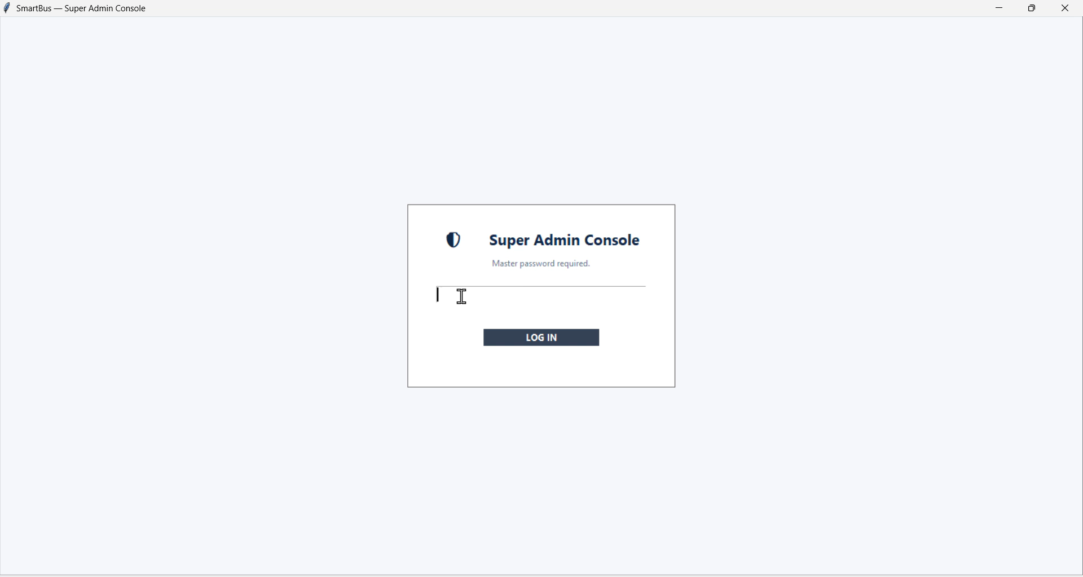

Slide 15
◉
Thank You
SmartBus — Let's watch it board, ride, and pay a passenger live.
Questions welcome

