Slide 1
Listening

Slide 2
Summarize spoken text
Multiple choice, Multiple Answer
Fill in the blanks
Highlight Correct Summary
Multiple Choice, Single Answer
Select missing words
Hightlight incorrect words
Write from Dictation

Slide 3
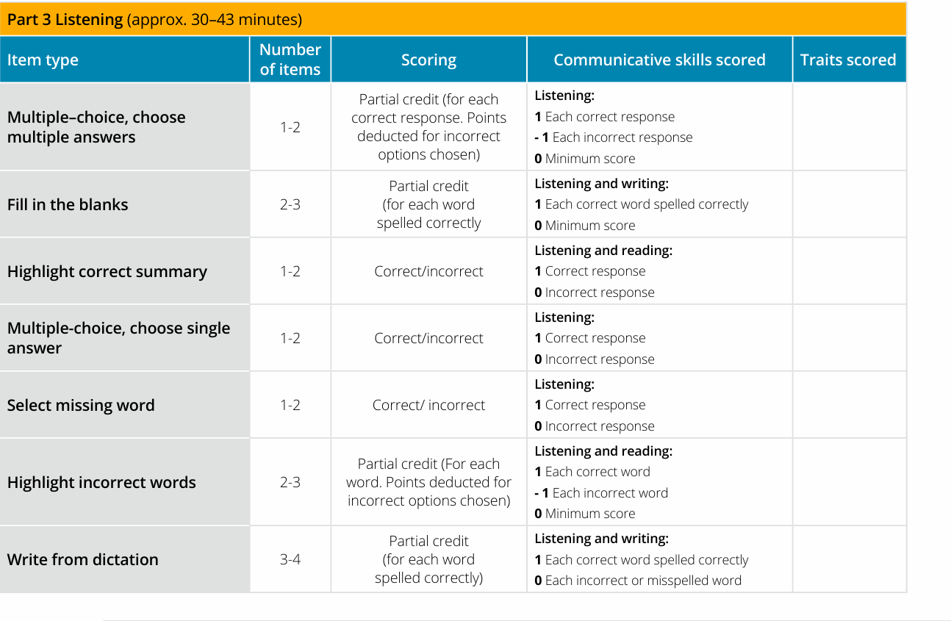

Slide 4
Summarize spoken text
Prompt Length
60–90 seconds
Skills Assessed
Listening and writing

Slide 5
How to answer this question
For this item type, you will hear an audio recording and will need to write a 50–70 word summary of what you heard.
You have 10 minutes to listen and write your summary.
The audio begins to play automatically. You are only able to listen to the audio recording once.
The Word Count at the bottom of the screen counts the number of words you write. Make sure to write a minimum of 50 words, but no more than 70 words.
There are also cut, copy and paste buttons, which you may choose to use while constructing your summary.
Cut: Select text from your answer that you wish to remove and left-click “Cut”.
Copy: Select text from your answer that you wish to copy and left-click “Copy”.
Paste: Place the cursor where you wish to paste the cut/copied text and left-click “Paste”.

Slide 6
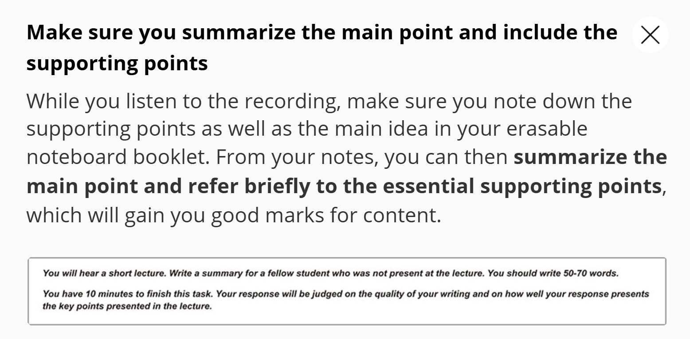

Slide 7
How the question is scored?
Content
Form
Grammer
Vocabulary
Spelling

Slide 8
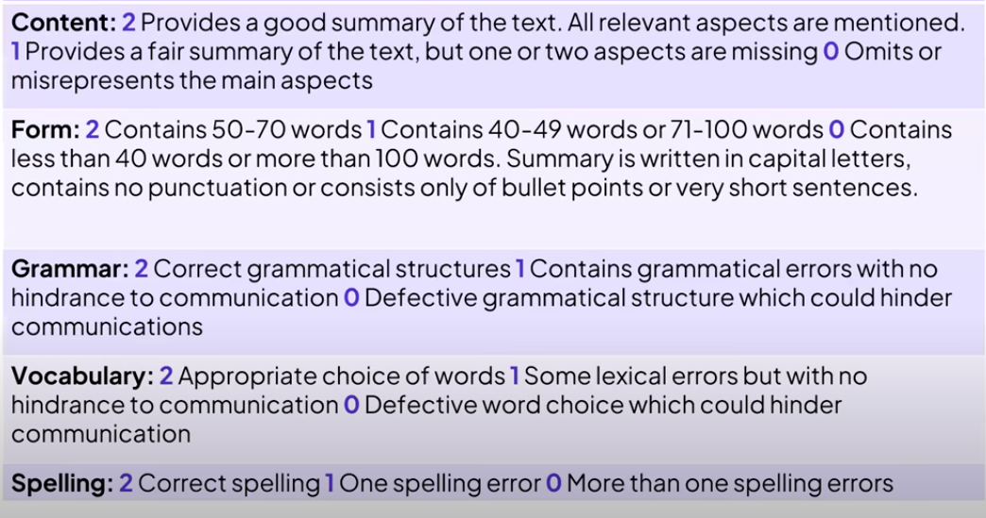

Slide 9
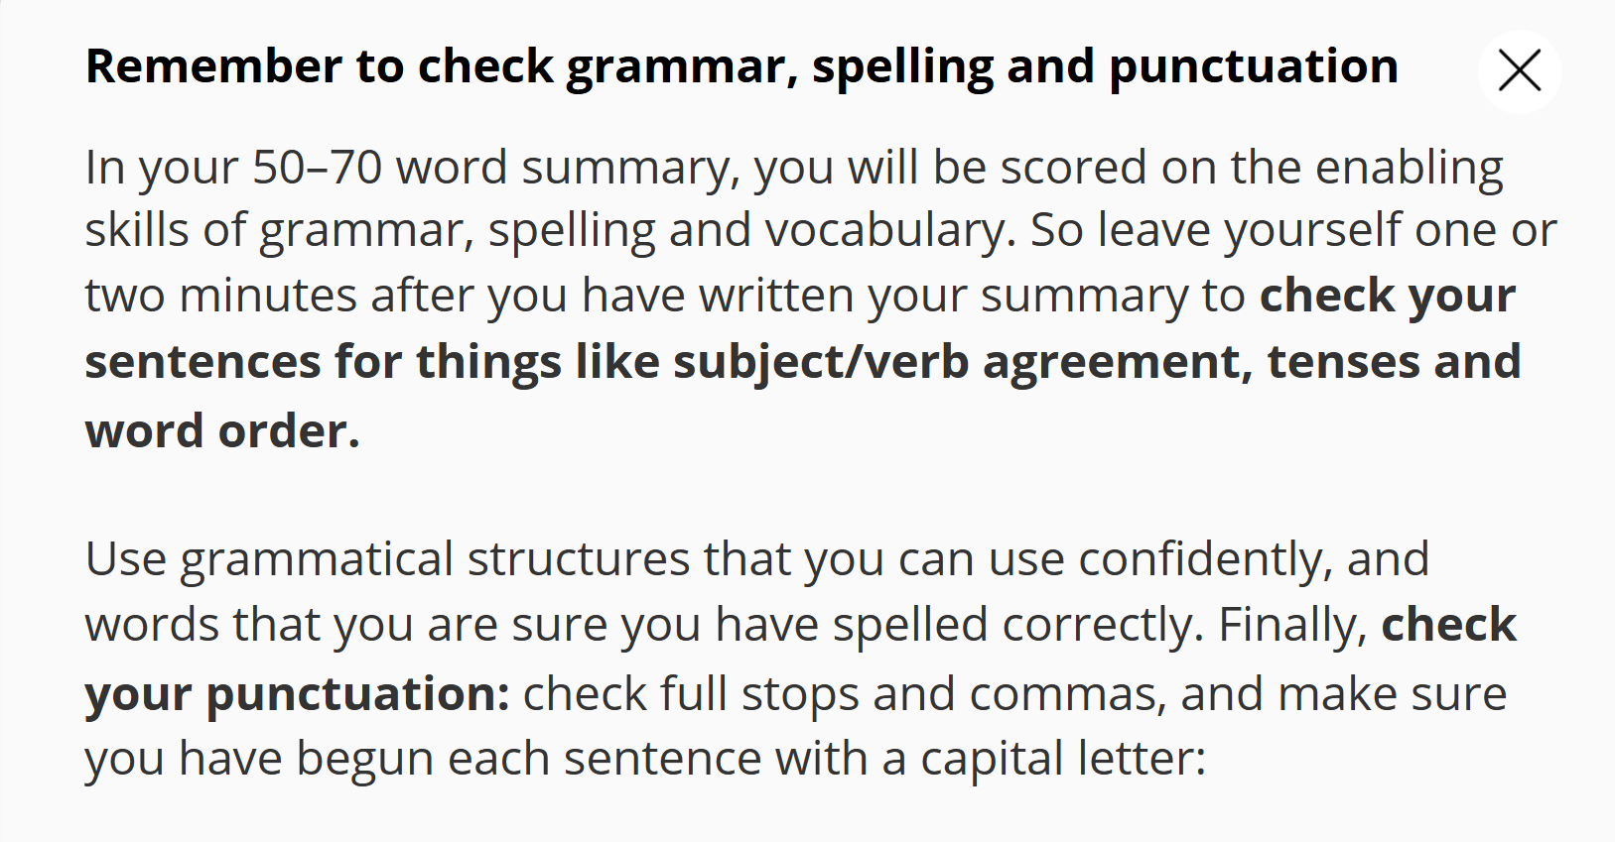

Slide 10
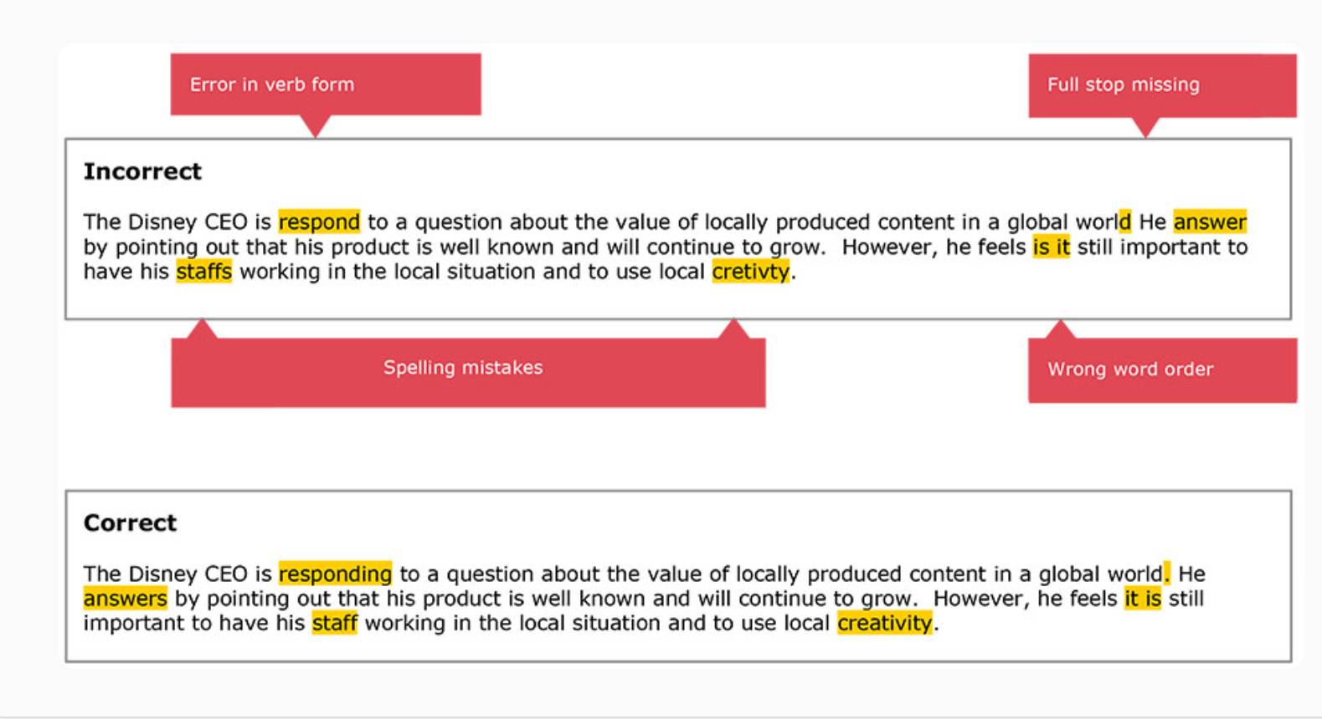

Slide 11
Common Structure to Use
"The passage discusses [main idea], highlighting [supporting idea 1], [supporting idea 2], and [supporting idea 3]."
Useful Connectors:
while, although, despite, due to, as a result, furthermore, in addition
Example Connector Sentence: "The passage explains that... although..., it also emphasizes..."

Slide 12
Step-by-Step Strategy
Read the passage once for overall meaning
Identify the main idea and key supporting points
Also identify the speaker’s motive, tone and attitude.
Highlight keywords (not full sentences)
Construct one sentence using connectors
Check grammar, punctuation, and word count (5–75 words)

Slide 13
Common mistakes most of us made
Not understanding the main point
Not paraphrasing or errors in paraphrasing

Slide 14
Final Thoughts
Summarize Written/Spoken Text measures how well you understand and express key ideas
Regular practice improves vocabulary, grammar, and summarizing skill
Homework:
Read one article and summarize it in one sentence
Bring it to class for feedback

Slide 15
Aspect | Summarize Written Text (SWT) | Summarize Spoken Text (SST)
Section | Writing | Listening
Input | Written passage (150–300 words) | Audio (spoken lecture of 60–90 seconds)
Time Limit | 10 minutes per task | 10 minutes per task
Word Limit | 5–75 words (strict one sentence) | 50–70 words (usually 1–2 sentences)
Main Skill Focus | Reading comprehension & writing | Listening comprehension & writing
What You Do | Read and summarize in one sentence | Listen, take notes, and write a summary
Structure Similarity | Yes — both require capturing main ideas + key points | Yes — main idea, supporting ideas, and examples
Scoring Criteria | Content, Form, Grammar, Vocabulary | Content, Form, Grammar, Vocabulary

Slide 16
Synonyms of "Speaker" (depending on context):
Common Term | Synonyms / Variations | Context Use
Speaker | Presenter, Lecturer, Orator | General use
Speaker | Narrator, Commentator, Announcer | If explaining or describing events
Speaker | Expert, Researcher, Scientist, Economist, Historian, Professor | If the person is an authority
Speaker | Individual, Person, Figure | When less specific or more formal
Speaker | Voice, Source | For audio/text perspective

Slide 17
Examples in Sentences:
"The lecturer discussed environmental issues in depth."
"According to the expert, globalization has both pros and cons."
"The presenter highlighted three critical elements of the topic."
"The professor concluded with a strong argument about ethics in science."
"The narrator illustrated the impact of technology on communication."

Slide 18
Template
"The speaker provided a comprehensive overview of [main topic],emphasizing crucial components such as[points 1], 2], and 3,in addition to stressing the significance of [important insight], he/she also highlighted [an example or cause-and-effect information] connector the talk's overall goal was to (increase awareness/your logic based on condition) connector offer insight into [conclusion or purpose].

Slide 19
The speaker provided a comprehensive overview of domestication of dogs and wolves, emphasizing crucial components such human journey and wolf in addition to stressing the significance of less aggressive wolf with garbage and he also highlighted complex phenomena such as emotional and psychological changes in their bond although the talk's overall goal was to demonstrate how the dogs are socially bonded with humans and offer insight into wolf history.

Slide 20
The speaker provided a comprehensive overview of [main topic],emphasizing crucial components such as[points 1], 2], and 3,in addition to stressing the significance of [important insight], he/she also highlighted [an example or cause-and-effect information] connector the talk's overall goal was to (increase awareness/your logic based on condition) connector offer insight into [conclusion or purpose].

Slide 21
Introduction to Punctuation in PTE
Punctuation plays a key role in writing tasks like SST and SWT.
Correct punctuation helps with clarity, grammar scoring, and logical flow.
Focus on commas, semicolons, full stops, and connectors for long sentences.

Slide 22
Common Punctuation Marks in PTE
Punctuation | Use
Comma (,) | Separate ideas, list items, after introductory phrases
Full stop (.) | Only at the end of the sentence (NOT allowed mid-summary in SST/SWT)
Semicolon (;) | Rare in PTE, but separates two related independent clauses
Colon (:) | Introduce examples or explanations
Dash (–) | Add emphasis or extra info (not common in formal academic writing)

Slide 23
Comma – The Most Used Punctuation
✅ Use comma:
After introductory phrases "According to the speaker, climate change is rising rapidly..."
To separate three or more items in a list "...including pollution, population growth, and deforestation."
Before coordinating conjunctions (and, but, so, while) if they join independent clauses "The speaker discussed renewable energy, and he emphasized solar technology.“
He loves to cook, and he loves to sing.

Slide 24
Where NOT to Use a Full Stop
❌ Do NOT use full stop (.) in the middle of summaries.
SST and SWT require only ONE complete sentence.
Instead of full stop, use conjunctions or commas to join ideas.
✔ Correct: The speaker discussed climate change, and he emphasized the need for global policies.
❌ Wrong: The speaker discussed climate change. He emphasized the need for global policies.

Slide 25
Mistake Type | Example (❌) | Correction (✅)
Missing comma in list | "pollution deforestation and energy" | "pollution, deforestation, and energy"
Two sentences | "He talked about water. He gave data." | "He talked about water and gave data."
Comma splice | "He explained the topic, it was useful." | "He explained the topic, and it was useful."
Fragment | "Because he wanted to." | "He emphasized the point because he wanted to."

Slide 26
Before Coordinating Conjunctions (FANBOYS: for, and, nor, but, or, yet, so)
Rule: Use a comma before the connector only if it connects two complete (independent) clauses.
Examples:
The speaker discussed climate change, and he explained its global consequences.
The topic was complex, but the explanation was clear.
He emphasized literacy, so education became a key focus.
No comma if the second part is not a complete sentence:
The speaker discussed climate change and its global consequences.

Slide 27
After Introductory Words or Phrases
✅ Rule: Use a comma after introductory connectors or phrases like However, In addition, Therefore, As a result, For example, To conclude, etc.
Examples:
However, the issue remains unresolved.
In addition, he pointed out educational disparities.
As a result, the government introduced reforms.
To conclude, the speaker emphasized unity.
💡 Tip for students: These are common in SST and essays, especially when shifting between ideas.

Slide 28
Connector | Comma Before? | Comma After? | Example
and, but, so | ✅ (if full clause) | ❌ | He spoke clearly, and the audience understood.
however, therefore, in addition | ✅ (if mid-sentence) | ✅ (if at start) | However, he gave no solution. / The speaker, however, offered an example.
because, although, while | ✅ (if mid-sentence) | ❌ | The topic was relevant, because it affects students.
for example, for instance | ✅ (if mid-sentence) | ✅ (if at start) | For example, he discussed recycling. / The speaker, for instance, used statistics.

Slide 29
🔁 Comparison | - In comparison to...- Unlike...,- Whereas... | “In comparison to [A], [B] was considered more effective.”
 | - Similar to...,- Compared with... | “Unlike [manual work], [automation] increases efficiency.”
🔗 Cause & Effect | - Due to...,- As a result of...,- Consequently | “Due to [urbanization], the speaker mentioned [environmental concerns].”
 | - Because of this...,- This leads to... | “As a result of [cultural exchange], global awareness increased.”
📌 Emphasis / Focus | - The speaker emphasized...- Special attention was given to... | “The speaker emphasized [mental health] as a critical issue.”
 | - He/She laid stress on...- A strong emphasis was placed on... | “A strong emphasis was placed on [education reform].”
🧠 Purpose / Goal | - The aim was to...- The lecture was designed to... | “The aim was to explain [climate policies] and their implications.”
 | - The speaker’s objective was to...- This was intended to... | “This was intended to raise awareness about [cyberbullying].”
✅ Conclusion / Summary | - In conclusion,- Ultimately,- The talk concluded by... | “In conclusion, the speaker advocated for [global cooperation].”

Slide 30
To Show Speaker’s Intent
The primary aim was to...
The speaker's objective was to...
This was intended to...
The lecture was designed to...
Examples
"The speaker's objective was to raise awareness about [climate change]."
"This was intended to encourage critical thinking regarding [social norms]."

Slide 31
Purpose
This was intended to encourage critical thinking regarding [topic].
Emphasis
The speaker placed significant emphasis on [key concept].
Cause & Effect
This led to increased awareness about [result].
Contrast
This contrasts with the conventional belief surrounding [idea].
Solution/Proposal
A potential solution suggested was [proposed action].
Importance
This was highlighted as a crucial factor in addressing [issue].
Conclusion
The talk concluded by reinforcing the relevance of [main theme].

Slide 32
Broader Impact | This had implications for [society/education/health/etc.] as a whole.
Perspective | This offered a new perspective on [subject], challenging traditional views.
Supporting Evidence | This was supported by examples related to [case/example].
Comparison | This was compared to similar issues in [context].
Future Implications | This is likely to influence future developments in [field/topic].
Underlying Message | The underlying message conveyed was the value of [principle/value].
Awareness Objective | The talk aimed to raise awareness about [social/environmental/political issue].
Practical Application | This can be applied to real-life situations involving [application].

Slide 33
Function | Insertable Template
Purpose | encouraging critical thinking regarding [topic]
Emphasis | placing significant emphasis on [key concept]
Cause & Effect | leading to increased awareness about [result]
Contrast | contrasting with conventional beliefs surrounding [idea]
Solution | suggesting a potential solution such as [proposed action]
Importance | highlighting a crucial factor in addressing [issue]
Conclusion | reinforcing the relevance of [main theme]
Broader Impact | having broader implications for [society/education/health]
Perspective | offering a new perspective on [subject]
Evidence | supporting this idea with examples related to [case/example]
Comparison | comparing this issue with similar concerns in [context]
Future Implication | projecting future developments in [field/topic]
Message | conveying the value of [principle/value]
Awareness | raising awareness about [issue]
Application | demonstrating real-life application in [area]

Slide 34
The speaker provided an insightful discussion on educational reform, emphasizing equity in access, highlighting digital innovation, and encouraging critical thinking regarding outdated teaching norms, ultimately reinforcing the relevance of inclusive global policy development.

Slide 35
Summarize spoken text
Multiple choice, Multiple Answer
Fill in the blanks
Highlight Correct Summary
Multiple Choice, Single Answer
Select missing words
Hightlight incorrect words
Write from Dictation

Slide 36
Summarize spoken text
Multiple choice, Multiple Answer
Fill in the blanks
Highlight Correct Summary
Multiple Choice, Single Answer
Select missing words
Hightlight incorrect words
Write from Dictation

Slide 37
Multiple choice, Multiple Answer

Slide 38
Introduction to Multiple Choice (Listening)
Task Types:
Multiple Choice, Choose Single Answer (MCQ–SA)
Multiple Choice, Choose Multiple Answers (MCQ–MA)
Skills Tested: Listening + Reading Comprehension
Audio: 30–90 seconds (played once)
Prompt: Question + options shown after audio ends

Slide 39
Task
Select one correct option that best answers the question based on the audio
Scoring:
Correct = 1 point
Incorrect = 0 points
Skills Needed:
Identifying main idea, tone, and speaker intent
Understanding inferences, cause-effect, comparisons

Slide 40
Task Overview – MCQ: Multiple Answers
Your Task: Select all correct options based on the audio
Scoring:
+1 for each correct answer
–1 for each incorrect option
Minimum score = 0 (no negative total)
Strategy Needed: Select only the sure answers

Slide 41
Preview the question and options (before audio)
Listen actively for:
Key terms from options
Contrasts (however, although, but)
Examples, statistics, cause-effect
Note down key ideas while listening
Eliminate wrong choices by:
Misinterpretation of facts
Not mentioned in audio
Contradicted by speaker

Slide 42
Common Traps in MCQ (Listening)
Option uses same words from audio but twists the meaning
Option is partially correct but not the best answer
Distractors: details mentioned but not the main point
Tip: Listen for intention and logic, not just matching words.

Slide 43
Vocabulary Cues to Listen For
Type | Signal Words
Cause/Effect | because, as a result, due to
Contrast | however, whereas, although
Examples | for example, such as, to illustrate
Conclusion | therefore, in conclusion, overall
Notes:
b

Slide 44
Audio Summary: A speaker discusses how renewable energy is overtaking fossil fuels in terms of growth and investment.
Question: What is the main point made by the speaker?
Options: A. Fossil fuel usage continues to rise globally. B. Renewable energy is receiving more global investment. C. Governments are banning fossil fuels completely. D. Climate change is no longer a concern.

Slide 45
Tips
Before Listening:
Encourage students to scan options and predict topic
🎧 During Listening:
Ask students to write short notes on:
Who is speaking?
What are they discussing?
Key reasons/examples

Slide 46
Introduction to Select Missing Word
Task Type: Listening (Fill in the blank)
Audio Length: 20–70 seconds
Prompt: A sentence ends with a beep sound — you must choose the correct word that completes the meaning.
Options: 3–5 choices
Scoring:
Correct = 1
Incorrect = 0 (no negative marking)

Slide 47
Common Audio Types
Academic talks (history, science, society)
News reports or interviews
Lectures and explanations
🧠 The tone can help — is it serious, positive, warning, neutral?

Slide 48
Signal Phrases Before the Gap
Type of Phrase | Example
Conclusion | "And this ultimately led to..."
Emphasis | "The most important factor is..."
Contrast | "However, despite all efforts..."
Listing | "Firstly, we discussed..., then..."
The missing word is often a conclusion, strong adjective, or abstract noun

Slide 49
The government introduced stricter environmental laws to reduce emissions. This policy was met with mixed reactions, but over time, it proved to be highly..." [BEEP]
Options: A. controversial B. effective ✅ C. irrelevant D. complicated
Answer: ✅ Effective (context = positive result over time)

Slide 50
Highlight Correct Summary
You will hear a short lecture about of (30–90 seconds) Your task: Choose the best summary from 3–4 options
Tests:
Listening comprehension
Identifying main ideas and supporting points
Understanding speaker's purpose

Slide 51
What to Focus On
🧠 While Listening:
Main topic
Speaker’s tone (neutral, informative, persuasive)
Key points (who, what, why, how)
⚠️ Don’t get distracted by examples or small details

Slide 52
Step-by-Step Strategy
Read the options first (preview – no skimming)
Listen for the main idea and logic flow
Eliminate incorrect summaries:
Too detailed
Factually wrong
Wrong focus or tone
Choose the most complete and accurate option

Slide 53
Common Traps
❌ Mentions specific details but misses the main point ❌ Changes the speaker’s opinion ❌ Adds info not in the audio
✅ Correct summary = complete, concise, accurate

Slide 54
🎧 Audio about renewable energy investment increasing worldwide
Options: A. Discusses fossil fuel limitations B. Summarizes growth and support for clean energy ✅ C. Talks about the history of electricity D. Focuses on energy storage
🟩 Correct = B (matches purpose and tone)

Slide 55
Fill in the blanks
The answer will never in two words.
Some time the answer is in the paragraph.
Skills Tested:
Listening for detail
Spelling and grammar
Vocabulary in context

Slide 56
Key Task Details
Audio plays ONCE only Typed answers must be spelled correctly Focus on:
Nouns, verbs, adjectives, adverbs
Content words, not function words (e.g., "the", "and")

Slide 57
Step-by-Step Strategy
Preview the text before the audio starts - Guess what type of word (noun, verb, etc.) is missing
Listen actively and write the word as you hear it
After audio:
Check for spelling
Ensure the word fits grammatically
Use your notes if needed

Slide 58
Listening & Spelling Tips
Focus on:
Word endings (e.g., “-ed”, “-s”)
Homophones (e.g., “their” vs “there”)
Word stress to catch full word
Common mistakes:
Incorrect verb tense
Singular/plural confusion
Misspellings (affects score)

Slide 59
Preview the text ✔ Predict word types ✔ Listen carefully – write as you hear ✔ Check spelling and grammar ✔ Use grammar clues around the blank

Slide 60
Summarize spoken text
Multiple choice, Multiple Answer
Fill in the blanks
Highlight Correct Summary
Multiple Choice, Single Answer
Select missing words
Hightlight incorrect words
Write from Dictation

Slide 62
Highlight Incorrect words
🎧 Listen to a short audio recording A transcript appears on the screen click on the words that are different from the audio
Skills Tested:
Listening for details
Reading accuracy
Attention to word choice

Slide 63
Skim the text quickly before audio plays 🔍 Look for complex or academic vocabulary
Listen and read at the same time
Click immediately when you hear a mismatch
Don’t overclick — be selective and confident
Audio: "The scientists discovered a new species in the rainforest."
Transcript: "The researchers discovered a new animal in the desert."
Incorrect words:
researchers (instead of scientists)
animal (instead of species)
desert (instead of rainforest)

Slide 64
Commonly Changed Words
Watch out for:
Synonyms (e.g., "buy" → "purchase")
Verb tenses ("is" vs "was")
Plurals vs singulars
Prepositions/articles ("in", "on", "the", etc.)

Slide 65
Final Tips
✔ Skim before listening ✔ Follow along word by word ✔ Click only when confident ✔ Don’t panic — stay calm and focused ✔ Practice with transcripts and short academic clips (TED, BBC)

Slide 66
Summarize spoken text
Multiple choice, Multiple Answer
Fill in the blanks
Highlight Correct Summary
Multiple Choice, Single Answer
Select missing words
Hightlight incorrect words
Write from Dictation

Slide 67
Write from dictation
You will hear a sentence (3–13 words) Type exactly what you hear into the text box
Skills Tested:
Listening
Spelling
Grammar
Word order

Slide 68
Key Task Details
Audio plays once only
Sentences are short but grammatically complete
Must type every word in correct order
Spelling and capitalization must be accurate

Slide 69
Scoring Breakdown
✅ Content: 1 point per correct word (correct order + correct spelling)
❌ Errors:
Missed word = no point
Wrong word = no point
Spelling error = no point
✳️ Partial credit is awarded — even if the full sentence isn’t perfect

Slide 70

Strategies to Score High
Listen carefully to the full sentence
Take quick notes (keywords or first letters if needed)
Type the sentence immediately after the audio
Review grammar (capital letter, punctuation) before submitting
Divided them into phrases.
Write both if you get confused on both topic

