Slide 2
Describe Image
You will be shown an image (graph, chart, map, picture, etc.).
You will get 25 seconds to prepare and 40 seconds to speak.
Your goal: Provide a structured and fluent description.

Slide 3
Types of images
Bar graph
Line graph
Pie chart
Table
Map
Flowchart
Picture (scene, process, etc.)

Slide 4
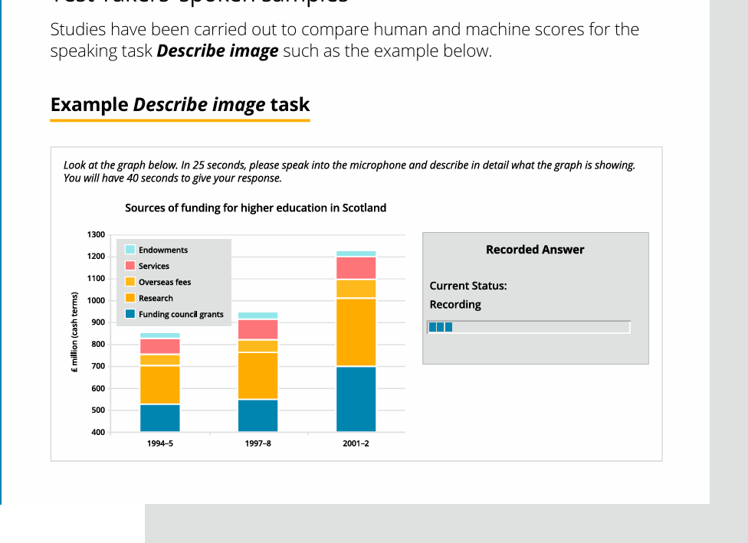

Slide 5
Scoring??
The Describe image task is scored on 3 different traits:
● Content
● Oral fluency
● Pronunciation

Slide 6
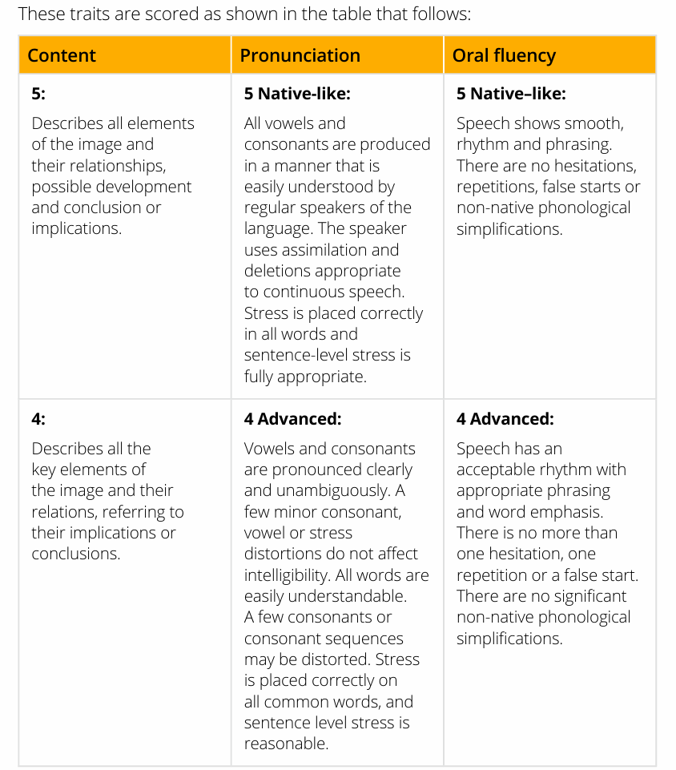
Notes:
This means the speaker is speaking naturally and fluently, like a native English speaker would in a conversation.

Slide 7
Assimilation
Assimilation happens when sounds blend together during fluent speech.
📌 Example:
"Don't you" → becomes "Doncha"
"Did you" → becomes "Didja"
Native speakers often connect sounds between words to speak faster and more naturally.

Slide 8
2. Deletions
Deletions happen when some sounds are dropped in fast or connected speech.
📌 Example:
"next day" → becomes "nex day" (the "t" is dropped)
"friend of mine" → becomes "fren of mine"
This is normal in fluent, continuous speech.

Slide 9
In the Speaking section, especially in Repeat Sentence or Read Aloud, the system gives more marks if you:
Speak fluently and naturally
Use connected speech
Avoid sounding robotic or overly slow
But don’t go too fast as well.

Slide 10
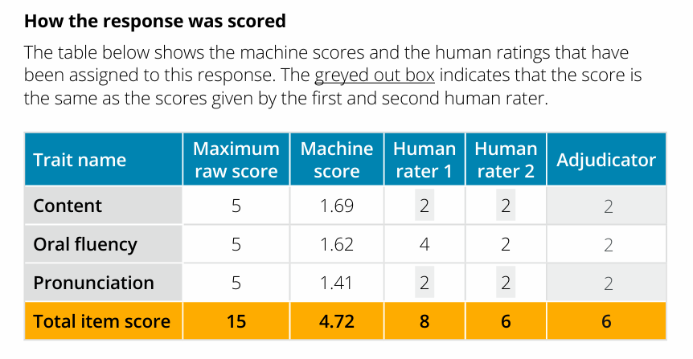

Slide 11
Tips and tricks
Note key data points.
Don’t try to describe everything.
Use linking words: moreover, however, in contrast.
Use filler structures if stuck:
"Another aspect worth noting is..."
"Looking further into the data..."
Speak with rising and falling intonation.

Slide 12
Category | Tips
Content | Cover all main parts of the image without inventing data.
Fluency | Speak smoothly, avoid long pauses or repeating yourself.
Pronunciation | Be clear. Don’t mumble or over-pronounce. Use natural intonation.
Oral grammar | Use varied sentence structures and transitions.

Slide 13
Summary
Understand structure.
Focus on fluency and natural speech.
Practice under timed conditions.
Use template until fluent naturally.

Slide 14
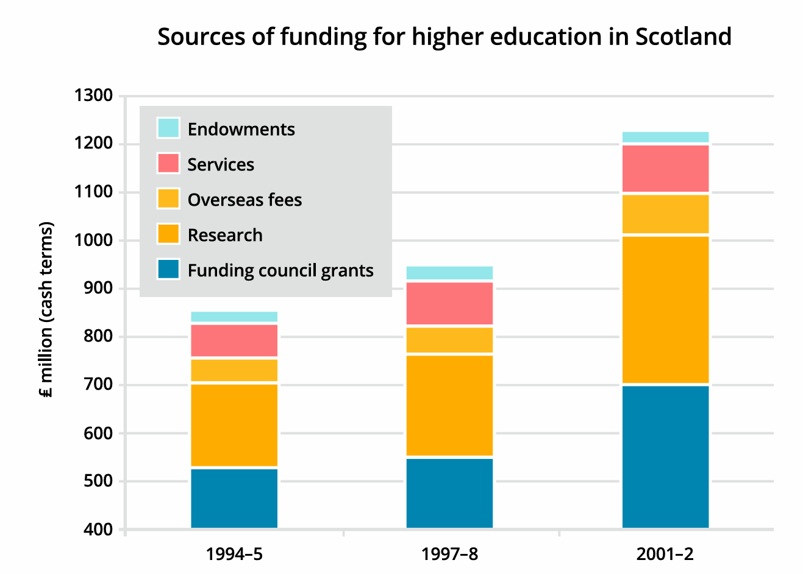

Slide 15
The bar graph shows sources of funding for higher education in Scotland across the years 1994–95, 1997–98, and 2001–02. Overall, total funding increased steadily, with funding council grants and research being the major contributors.
Notably, research funding saw a sharp rise in 2001–02, while overseas fees and services also grew gradually. Endowments remained the smallest source throughout.
In summary, the graph highlights a consistent growth in educational funding with a clear shift towards more research-based income.

Slide 16
Template
Introduction “The image shows / illustrates / presents...”
Main Features Describe 2–3 key trends, comparisons, or figures.
Comparison / Growth Use words like “increased,” “declined,” “remained stable,” “largest,” etc.
Conclusion (Optional but helpful) Summarize general trend or pattern.

Slide 17
avoid default openers like “This bar chart shows…” by using:
“The visual representation outlines…”
“This graph provides a breakdown of…”
“The image presents data regarding…”
Or you can create a new one for eg –”A consistent upward trajectory is visible across multiple funding sources.”

Slide 18
1. Verbs for Describing Change or Trend
Basic Word | Advanced Alternative
Increase | Surge, escalate, soar, rise sharply
Decrease | Decline, plummet, dip, fall sharply
Stay the same | Stabilize, plateau, remain unchanged
Go up slowly | Climb steadily, grow moderately
Go down slowly | Diminish, drop gradually, contract
Notes:
Research funding soared in 2001–02.”
“Service revenue plateaued during the second period

Slide 19
2. Adjectives for Describing Amounts / Size
Basic Word | Advanced Word
Big | Substantial, considerable, significant
Small | Modest, minor, marginal, minimal
High | Elevated, peak, leading
Low | Lower-tier, bottom level
Notes:
“A substantial amount of funding came from grants.”
“Modest growth was observed in overseas fees.”

Slide 20
3. Linking and Transition Words
Purpose | Words/Phrases
Adding | Moreover, in addition, similarly, likewise
Contrasting | However, in contrast, whereas, although
Explaining | This indicates, which shows, meaning that
Concluding | Overall, to summarize, in brief
Notes:
“In contrast, endowment funding remained minimal.”
“Overall, the total funding grew significantly over time.”

Slide 21
Describing Patterns and Comparisons
Function | Phrases
Compare levels | Slightly higher than, nearly double, far lower
General pattern | A consistent trend, a recurring pattern
Distribution | Evenly spread, disproportionately represented
Notes:
“Research was nearly double that of services.”
“Funding was evenly distributed in the earlier years.”

Slide 22
5. Words for Describing Graphs and Visuals
Use | Words/Phrases
Talking about data | The chart shows, the graph illustrates, the table provides
Describing axes | Vertical axis, horizontal axis, categories, segments
Mentioning time | Over the period of, across three years, in the given timeframe
Notes:
“The vertical axis represents funding in million pounds.”
“The chart illustrates the change in contributions over time.”

Slide 23
General Scene (Picture/Photo) Use when describing real-life scenes, campus, people, or nature.
Template:
At first glance, this image shows a [keyword: scene/topic].
In the foreground, I can see [keyword: main detail], while in the background there is [keyword: secondary detail].
The overall impression is that it represents [keyword: theme/idea].
Collocations inside: at first glance, in the foreground, overall impression, represents

Slide 24
At first sight, the picture draws attention to ___, while in the background we notice ___.
One noticeable element is ___, which seems to be connected with ___.
The setting appears lively/calm, and this atmosphere is mainly created by ___.
Altogether, the scene reflects ___.

Slide 25
Bar Graph / Line Graph Use when describing trends, numbers, comparisons.
Template:
This graph provides information about [keyword: topic].
The highest point is seen in [keyword: category], whereas the lowest is in [keyword: category].
Overall, the data highlights [keyword: trend/finding].
Collocations inside: provides information about, highest point, lowest point, overall highlights

Slide 26
Graph (line, bar)
The graph opens with ___, and as the timeline moves forward, ___ becomes more visible.
A gradual increase is observed in ___, whereas ___ tends to decline.
The turning point occurs around ___, showing a clear shift in the pattern.
Taken together, the graph highlights the dominance of ___ over ___.

Slide 27
Pie Chart / Table (Proportion / Distribution) Use when describing percentages, divisions, shares.
Template:
This chart illustrates the distribution of [keyword: subject].
The largest share belongs to [keyword: category], while the smallest portion is taken by [keyword: category].
Altogether, the chart makes clear the relative importance of [keyword: overall idea].
Collocations inside: illustrates the distribution, largest share, smallest portion, makes clear

Slide 28
Chart / Table (comparisons, percentages)
The chart clearly divides the data, with ___ taking the largest portion.
In contrast, ___ occupies only a minor share, which makes it stand out.
The distribution suggests that ___ is prioritized, while ___ is relatively neglected.
Overall, the chart illustrates a balance between ___ and ___, though with some variations.

Slide 29
Process / Flowchart / Cycle Use for diagrams showing stages, development, life cycle.
Template:
This diagram explains the process of [keyword: topic]."
It begins with [keyword: stage 1], continues through [keyword: stage 2], and then moves to [keyword: stage 3].
Finally, it ends with [keyword: outcome]."
Collocations inside: explains the process, begins with, continues through, ends with

Slide 30
Process / Cycle (step-by-step)
The sequence begins with ___, followed by ___ in the next stage.
Each step logically connects to the next, creating a smooth progression.
A key transformation occurs when ___ turns into ___.
Finally, the cycle concludes with ___, which completes the process.

Slide 31
Map / Layout (Campus / Geography / Facilities) Use when describing places, directions, facilities.
Template:
This map displays the layout of [keyword: location].
In the center, there is [keyword: feature], while on the [keyword: direction] we can see [keyword: feature].
Altogether, the map provides a clear overview of [keyword: topic].
Collocations inside: displays the layout, provides a clear overview, in the center, on the side

Slide 32
Map (locations, changes)
The map indicates that ___ is positioned near ___, making it a central point.
Over time, ___ has expanded, while ___ has either disappeared or shifted.
The main development can be seen in ___, which contrasts with the unchanged ___.
In summary, the map highlights both continuity and change across the area.

Slide 33
Abstract / Concept Diagram Use for images with no obvious objects (like mind maps, abstract figures).
Template:
The diagram highlights the concept of [keyword: idea].
It connects [keyword: element 1] with [keyword: element 2], showing a strong relationship.
"Overall, it suggests that [keyword: conclusion].
Collocations inside: highlights the concept, strong relationship, overall suggests

Slide 34
Extra Plugins for Any Image (Flexible Sentences)
These can be dropped anywhere for fluency:
As we can see, [insert keyword detail].
Another important aspect is [insert keyword].
This clearly indicates [insert keyword/conclusion].
From the image, it is evident that [insert keyword].
In short, the picture demonstrates [insert keyword].

Slide 35
Universal Plug-in Sentences for PTE Describe Image
It connects [element 1] with [element 2], showing a strong relationship.
The main focus is on [element 1], while [element 2] provides supporting detail.
A clear contrast appears between [element 1] and [element 2].
The image highlights how [element 1] gradually shifts towards [element 2].
There is a balance between [element 1] and [element 2], reflecting overall stability.
The central idea revolves around [element 1], which is strongly influenced by [element 2].
It illustrates the movement from [element 1] to [element 2], marking a transition.
The relationship between [element 1] and [element 2] is evident throughout the image.
A noticeable pattern is formed as [element 1] increases while [element 2] decreases.
Together, [element 1] and [element 2] capture the essence of the image.

Slide 36
Re-tell lecture
Start with a sentence like: "The lecture was about..."
Use linking words: "Firstly, secondly, in conclusion..."
Speak clearly and fluently — avoid long pauses

Slide 37
Scoring Criteria:
Content
Pronunciation
Oral fluency

Slide 38
1. Verbs for Describing Change or Trend
Basic Word | Advanced Alternative
Increase | Surge, escalate, soar, rise sharply
Decrease | Decline, plummet, dip, fall sharply
Stay the same | Stabilize, plateau, remain unchanged
Go up slowly | Climb steadily, grow moderately
Go down slowly | Diminish, drop gradually, contract
Notes:
Research funding soared in 2001–02.”
“Service revenue plateaued during the second period

Slide 39
2. Adjectives for Describing Amounts / Size
Basic Word | Advanced Word
Big | Substantial, considerable, significant
Small | Modest, minor, marginal, minimal
High | Elevated, peak, leading
Low | Lower-tier, bottom level
Notes:
“A substantial amount of funding came from grants.”
“Modest growth was observed in overseas fees.”

Slide 40
3. Linking and Transition Words
Purpose | Words/Phrases
Adding | Moreover, in addition, similarly, likewise
Contrasting | However, in contrast, whereas, although
Explaining | This indicates, which shows, meaning that
Concluding | Overall, to summarize, in brief
Notes:
“In contrast, endowment funding remained minimal.”
“Overall, the total funding grew significantly over time.”

Slide 41
Describing Patterns and Comparisons
Function | Phrases
Compare levels | Slightly higher than, nearly double, far lower
General pattern | A consistent trend, a recurring pattern
Distribution | Evenly spread, disproportionately represented
Notes:
“Research was nearly double that of services.”
“Funding was evenly distributed in the earlier years.”

Slide 42
5. Words for Describing Graphs and Visuals
Use | Words/Phrases
Talking about data | The chart shows, the graph illustrates, the table provides
Describing axes | Vertical axis, horizontal axis, categories, segments
Mentioning time | Over the period of, across three years, in the given timeframe
Notes:
“The vertical axis represents funding in million pounds.”
“The chart illustrates the change in contributions over time.”

Slide 43
Start with a sentence like: "The lecture was about..."
Use linking words: "Firstly, secondly, in conclusion..."
Speak clearly and fluently — avoid long pauses

Slide 44
Scoring Criteria:
Content
Pronunciation
Oral fluency

Slide 45
Tips
Point out use of paraphrasing and connectors
Discuss how to summarize without memorizing the lecture
Reinforce use of academic vocabulary and signal words
Chunking words

