Slide 1
Reading
Reading & Writing：Fill in the blanks
Multiple Choice (Multiple)
Re-order Paragraphs
Reading：Fill in the Blanks
Multiple Choice (Single)
Notes:
Comprehension of texts, vocabulary, grammar

Slide 2
Task | Number of Questions | Approximate Weightage out of 90 | Notes
Multiple Choice – Single Answer | 2 | 2 | Reading task
Multiple Choice – Multiple Answers | 2 | 4 | Reading task
Re-order Paragraphs | 2 | 6/7 | Reading task
Highlight correct summary | 2 | 2 | Reading task
Fill in the Blanks (Reading) | 5 | 24/25 | Reading task
Hightlight incorrect words | 2 | 9 | Reading task
Fill in the Blanks | 5 | 24/25 | Reading
Summarize Written Text* (already counted in Writing) | 2 | 7/8 | See Writing Section

Slide 3
Duration: 29–30 minutes
Number of Questions: 13–18

Slide 4
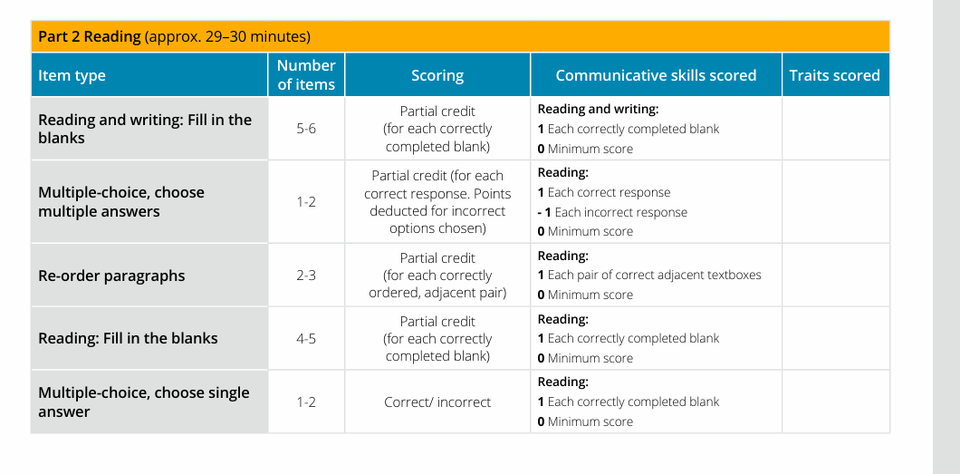

Slide 5
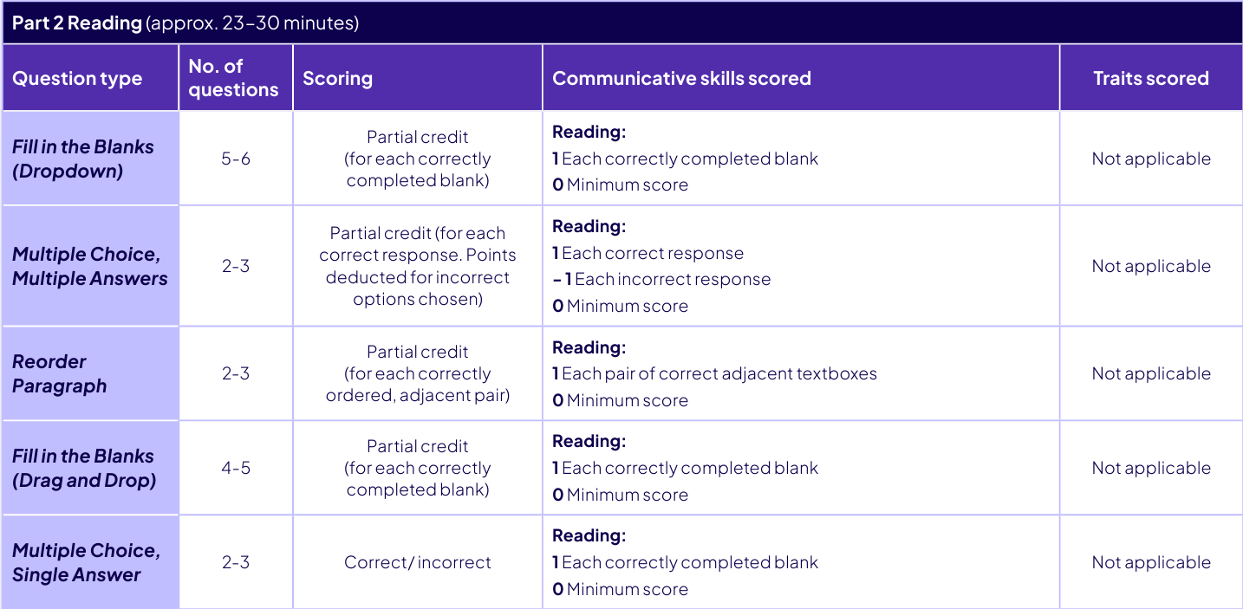

Slide 6
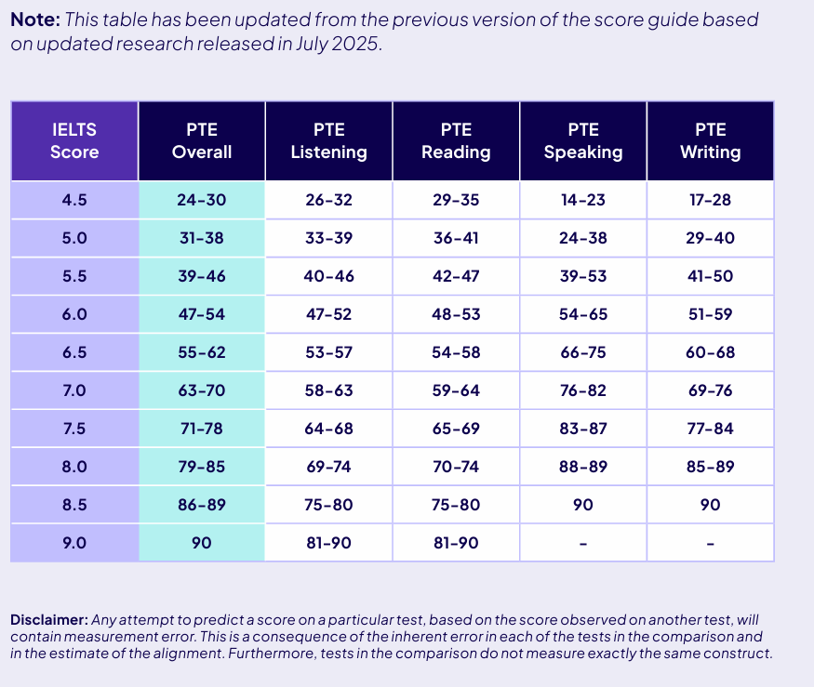

Slide 7
MCQ – Single Answer (Light Focus)
Task: Read passage & answer one correct option
Strategy:
Read the question first
Skim the text for keywords
Eliminate obviously incorrect options

Slide 8
Tips:
Don’t overthink; answer is directly stated
Focus on the main idea.
Don’t over-prioritize this task

Slide 9
MCQ – Multiple Answers (Light Focus)
Task: Choose more than one correct option
Strategy:
Find all correct options that reflect the main idea
Avoid over-selecting (no partial credit)
Tips:
Look for tone, examples, repeated words
(negative marking)

Slide 10
Re-order Paragraphs (Important for Logic Practice)
Task: Arrange sentences into correct logical order
Clues to Use:
Pronouns (he, this, these)
Sequence indicators (first, then, finally)
Noun introduction vs. reference

Slide 11
Tips:
Look for sentence that introduces topic first
Build logical flow like a story
Problem-Solution

Slide 12
Identify the Topic Sentence (Opening)
Usually does not begin with pronouns like “he,” “this,” “these.”
It introduces a person, concept, or idea clearly.
Look for Logical Flow & Connectors
Words like However, Therefore, Moreover, In addition, As a result indicate continuation or contrast.
These cannot be the first line!
Spot Pronouns and References
Words like he, she, it, this, those refer to something mentioned earlier.
Place them after their noun reference.
Eg- This invention changed transportation.” ← “Invention” must be introduced earlier.

Slide 13
Chronological/Process Order
Look for time words: first, then, next, finally, in 2020, before, later.
Helps set the timeline of the paragraph.
Use Grammar and Linking Clues
Articles: “A theory” vs. “The theory” (The = previously mentioned)
Transition verbs: shift the idea forward.
Rule of tenses
Stick to one time line unless the passage clearly shifts
Avoids mixing past and present unless justified by time indicators.
___He worked as a teacher and wrote several books. -----He worked as a teacher and writes books.
Basically past-present-future

Slide 14
Tips
Look for the clues(sentences often hint the right answer)
l

Slide 15
Reading Fill in the Blanks (Drag and Drop)
Grammar + Vocabulary
Clues:
Collocations (e.g., take a break)
Prepositions and phrasal verbs
Noun/verb/adjective agreement
Notes:
Preposition- connector of sentences. Eg in on at to for and by connect noun to other relation part. It shows relationship with noun or pronoun such as cause reason direction
Phrasal verbs- combine a main verb with preposition or atverb. Turnup – inc volume giveup-surrender or quit. Provides different meaning often to individual sentences.

Slide 16
Highly Repeated Grammar Patterns:
Noun + Preposition: access to, reason for, solution to
Verb + Preposition: rely on, consist of, lead to
Adjective + Preposition: interested in, capable of, aware of
Common Collocations: make a decision, raise an issue, take a break

Slide 17
Subject Verb Agreement
Sub sing verb sing
Sub plu verb plu
Singular = just ONE thing. Usually no "s" at the end.
Plural = MORE than one thing. Usually add an "s" or "es" at the end.
Sometimes plural words are wild and change completely (like "mouse" → "mice"), but that’s a story for another day!

Slide 18
What is the Subject?
The subject is who or what the sentence is about. It is usually a noun (a person, place, thing, or idea) or a pronoun.
The subject is the doer of the action or the one being described.
To find the subject, first find the verb, then ask: “Who or what is doing this action?” or “Who or what is this sentence about?”
What is the Verb?
The verb is the action word or the state of being in the sentence.
It tells what the subject does (action verb) or is (linking verb).
Examples of action verbs: run, jump, eat, think.
Examples of linking verbs: is, are, was, seem, become.
Find the verb first — Look for the action or state of being word. Example: In “The dog runs fast,” the verb is runs.
Ask who or what is doing the verb — That’s your subject. Example: Who runs? The dog. So, dog is the subject.

Slide 19
Sentence | Subject | Verb | How to Find It
The cat sleeps on the sofa. | The cat | Sleeps | What is happening? Sleeping → verb = sleeps; Who sleeps? The cat → subject
She is happy today. | She | is | Verb = is (state of being); Who is happy? She → subject
My friends play soccer. | My friends | play | Verb = play; Who plays? My friends → subject
Running is fun. | Running (gerund) | Is | Verb = is; What is fun? Running → subject (an action noun)

Slide 20
Try putting he or she before the word you think is the verb. If it makes sense, it’s probably the verb. Then ask who or what does that verb to find the subject.
Term | Definition | How to Find It
Subject | Who or what the sentence is about | Ask “Who or what is (verb)?” after finding the verb
Verb | The action or state of being | Find the action word or linking verb in the sentence

Slide 21
Example | Singular | Plural | Type of Grammar Rule | Explanation
Regular plural | cat | cats | Add -s | Most nouns just add -s to become plural.
Ends with s, x, z, ch, sh | box | boxes | Add -es | Nouns ending in these sounds add -es to make pronunciation easier.
Ends with consonant + y | city | cities | Change y to ies | Drop y, add -ies if preceded by a consonant.
Ends with vowel + y | boy | boys | Add -s | Just add -s if y is after a vowel.
Ends with f/fe | leaf | leaves | Change f/fe to ves | Change f/fe to v and add -es (e.g., leaf → leaves).
Ends with f/fe (exception) | roof | roofs | Just add -s | Some nouns ending in f/fe just add -s (roof → roofs).
Ends with o | potato | potatoes | Add -es | Many nouns ending in -o add -es (potato → potatoes).
Ends with o (exception) | Piano | pianos | Just add -s | Some foreign-origin words just add -s (piano → pianos).
Irregular vowel change | man | men | Vowel change | Irregular plurals change vowels inside the word.
Irregular suffix change | child | children | Add -ren | Some plurals add unusual suffixes like -ren.
Same singular and plural | sheep | sheep | No change | Some nouns have identical singular and plural forms.
Compound nouns | sister-in-law | sisters-in-law | Pluralize main noun | Plural formed by pluralizing the main noun, not the whole compound.

Slide 22
Leaf → Leaves "Yo, those leaves are falling like crazy this fall!" (f/fe to ves rule)
Man → Men "That man is cool, but those men? Straight-up legends!" (irregular vowel change)
Child → Children "One child is playing, but the children are wildin' out!" (irregular suffix -ren)
Sheep → Sheep "One sheep is chillin’, and the whole flock of sheep is just vibin’." (same singular and plural)
Potato → Potatoes "I want one potato, but we got a whole bunch of potatoes for the party!" (ends with o, add -es)

Slide 23
Singular Noun + Singular Verb
Verb Type | Used With | Verb Ending | Example
Singular Verb | Singular third person (he, she, it), singular nouns | -s / -es | She plays, He watches
Plural Verb | Plural subjects (we, they, plural nouns) | Base form | They play, We watch

Slide 24
(Singular/Plural) | Verb Form | Example Sentence | Explanation
Singular (he) | walks | He walks to the park. | Singular subject → singular verb with -s
Plural (they) | walk | They walk to the park. | Plural subject → plural verb base form
Singular (the team) | is | The team is winning. | Collective noun as a single unit → singular verb
Plural (the players) | are | The players are winning. | Plural noun → plural verb
Compound (Jack and Jill) | run | Jack and Jill run up the hill. | Compound subject → plural verb

Slide 25
Subject-Verb Agreement: Questions & Options
The teacher __________ completed this chapter. A) have B) has C) is D) are
Ram and Shyam __________ business partners. A) have B) has C) are D) had
She __________ her office by 9 a.m. daily. A) reach B) reaches C) reached D) reaching
Rahul and his friends __________ also invited to the party. A) is B) was C) had D) were
Neither you nor your sister should __________ to them. A) talk B) talks C) talked D) talking

Slide 26
All the furniture __________ old. A) look B) looks C) have looked D) are looked
Either the cat or the dog __________ responsible for knocking over the vase. A) is B) are C) were D) been
The statistics __________ clear indicators of a growing trend. A) is B) are C) were D) been
The team __________ going to their practice today. A) is B) are C) were D) have
Each of the students __________ studying for the exam. A) is B) are C) were D) has

Slide 27
# | Question | Options | Correct Answer | Explanation
1 | The teacher __________ completed this chapter. | A) have B) has C) is D) are | B) has | "Teacher" is singular, so use singular verb "has."
2 | Ram and Shyam __________ business partners. | A) have B) has C) are D) had | C) are | Compound subject "Ram and Shyam" is plural, so use plural verb "are."
3 | She __________ her office by 9 a.m. daily. | A) reach B) reaches C) reached D) reaching | B) reaches | Singular subject "She" takes singular verb "reaches."
4 | Rahul and his friends __________ also invited to the party. | A) is B) was C) had D) were | D) were | Plural subject "Rahul and his friends" takes plural verb "were."
5 | Neither you nor your sister should __________ to them. | A) talk B) talks C) talked D) talking | A) talk | With "neither...nor," verb agrees with the nearer subject "sister" (singular), but modal "should" is followed by base verb "talk."
6 | All the furniture __________ old. | A) look B) looks C) have looked D) are looked | B) looks | "Furniture" is singular uncountable noun, so singular verb "looks" is correct.
7 | Either the cat or the dog __________ responsible for knocking over the vase. | A) is B) are C) were D) been | A) is | When subjects joined by "or," verb agrees with nearer subject; "dog" is singular → "is."
8 | The statistics __________ clear indicators of a growing trend. | A) is B) are C) were D) been | B) are | "Statistics" is plural here, so plural verb "are."
9 | The team __________ going to their practice today. | A) is B) are C) were D) have | A) is | "Team" is a collective noun treated as singular → singular verb "is."
10 | Each of the students __________ studying for the exam. | A) is B) are C) were D) has | A) is | "Each" is singular → singular verb "i

Slide 28
What are Collocations?
👉 Collocations are natural combinations of words that are commonly used together.
Type | Example
Verb + Noun | make a decision, conduct research
Adjective + Noun | strong evidence, global impact
Noun + Noun | job satisfaction, data analysis
Verb + Preposition | rely on, agree with
Adjective + Preposition | capable of, interested in

Slide 29
Questions
The scientist aimed to ________ a study that would uncover new data. Options: perform / conduct / do / arrange Public campaigns are designed to ________ awareness about climate change. Options: raise / increase / create / build He is highly __________ in solving complex algorithms. Options: capable / able / skilled / adapt

Slide 30
Questions
The scientist aimed to ________ a study that would uncover new data. Options: perform / conduct / do / arrange Public campaigns are designed to ________ awareness about climate change. Options: raise / increase / create / build He is highly __________ in solving complex algorithms. Options: capable / able / skilled / adapt

Slide 31
Tense Consistency in Reading Tasks
Concept: Maintain the same time reference across the sentence unless context demands a shift.
Look at time indicators like since, before, after, already, just.
Tense Used | Example Sentence
Present Perfect | She has been working on climate change policies.
Past Perfect | They had completed the project before the review.
Simple Present | This report shows significant improvements.
Simple Past | The company launched a new initiative in 2020.

Slide 32
Clue Word / Phrase | Likely Tense | Example Sentence
has/have | Present Perfect | She has worked here since 2020.
had | Past Perfect | They had left before we arrived.
will/shall | Future | He will attend the meeting.
yesterday, ago | Simple Past | I met him two days ago.
currently, now | Present Continuous | She is working on her thesis.
by the time | Past Perfect or Future Perfect | They had arrived by the time I called.

Slide 33
Structure Clues for Verb Form Selection
Tip: If a blank comes after “to”, use base verb (V1):
He hopes to join the program. ✔️ He hopes to joining the program. ❌
Tip: After modal verbs (can, may, should, will), always use V1:
You should review the materials. ✔️
Structure/Clue | Use This Form | Example
to + V1 (base verb) | Base Verb | He wants to study abroad.
modal + V1 (can, will, must, etc.) | Base Verb | She can speak three languages.
after/before + V-ing/V3 (context) | Gerund/Past Participle | After completing the task, he rested.
has/have + V3 | Past Participle | They have completed the report.
Notes:
Painful_ collocation word

Slide 34
Didn’t
Don’t
doesn’t
Uses base verb

Slide 35
Keep Verb Tense Consistent in a Sentence
Avoid switching between past, present, and future randomly.
If the sentence starts in one tense, finish in the same unless there is a clear reason to shift.
Wrong: She works hard and was receiving an award. ❌ Correct: She works hard and receives recognition. ✔️ Correct (with time shift): She had worked hard and was awarded a prize. ✔️

Slide 36
What Are Modal Verbs?
Modal verbs are helping verbs that express ability, permission, necessity, possibility, or advice.
They are always followed by the base form (V1) of a verb.
Modal Verb | Usage | Example Sentence
can | ability, possibility, permission | She can speak French.
could | past ability, polite request | Could you help me with this?
may | permission, possibility | You may leave early.
might | weaker possibility | He might be late.
shall | suggestion, formal future | Shall we go? / I shall return soon.
should | advice, expectation | You should study more.
will | future prediction or certainty | It will rain tomorrow.
would | polite request, hypothetical | I would like some coffee.
must | strong obligation or necessity | You must wear a seatbelt.
ought to | moral duty or advice | You ought to respect elders.
need to | necessity (sometimes modal-like) | You need to submit your form.

Slide 37
Students should ______ the instructions before starting the test. a) reads b) reading c) read d) to read
He could ______ a new strategy to handle the crisis. a) proposed b) proposing c) proposes d) propose
You must ______ all required fields before submitting the form. a) filling b) fills c) fill d) to fill

Slide 38
Students should ______ the instructions before starting the test. a) reads b) reading c) read d) to read
He could ______ a new strategy to handle the crisis. a) proposed b) proposing c) proposes d) propose
You must ______ all required fields before submitting the form. a) filling b) fills c) fill d) to fill

Slide 39
We might ______ the test results by next week. a) receive b) received c) receiving d) receives
She can ______ multiple languages fluently. a) speaks b) speak c) spoke d) speaking
They will ______ the new software next month. a) launched b) launch c) launching d) launches

Slide 40
We might ______ the test results by next week. a) receive b) received c) receiving d) receives
✅ Correct Answer: a) receive
She can ______ multiple languages fluently. a) speaks b) speak c) spoke d) speaking
✅ Correct Answer: b) speak
They will ______ the new software next month. a) launched b) launch c) launching d) launches
✅ Correct Answer: b) launch

Slide 41
Tip / Trick | Explanation | Example
1. After "to", use base verb (V1) | “To” is followed by a verb in base form. | ✅ to improve, ❌ to improving
2. Articles clue: a/an/the | Use “a” before consonant sound, “an” before vowel sound, “the” when the noun is known or specific. | ✅ an hour, a university, the president
3. Preposition Collocations | Some verbs/nouns/adjectives always follow specific prepositions. | Interested in, capable of, rely on, solution to
4. Subject-Verb Agreement | Singular subjects take verb+s, plural subjects take verb base. | She runs, They run
5. Adjective + Noun | Adjectives usually come before nouns. | ✅ major problem, strong evidence
6. Verb + Object Structure | Use a verb that makes sense before the object. | ✅ Make a decision, Raise awareness
7. Elimination by Grammar | Remove grammatically incorrect options quickly. | “He decided to…” → eliminate options like “deciding”, “decision”
8. Word Form Consistency | Choose correct form: noun, verb, adjective, or adverb as required by sentence. | analyze (verb), analysis (noun), analytical (adj)
9. Look for Determiners | Words like many, much, few, every, some give clues. | Much time, few resources
10. Time References = Tense Clue | Use signal words to determine tense. | "Yesterday" → past tense, "currently" → present continuous
11. Pronoun Clues | Words like he, it, they, which, that refer to something mentioned. | "The law, which was passed..."
12. Linking Words / Connectors | Help connect ideas logically: however, therefore, in contrast | “..., however, they failed to deliver.”
13. Gerund after preposition | Verb after preposition usually takes -ing form. | She is good at drawing
14. Parallel Structure | Maintain same grammatical pattern in lists or comparisons. | He enjoys running, swimming, and cycling
15. Common Academic Collocations | Use chunks commonly seen together in academic English. | Conduct research, reach a conclusion, pose a question
16. Elimination by Logic | Use logic and tone to eliminate choices that don’t make sense. | “The results were… (a) delightful, (b) examination, (c) longer” → only (a) fits meaningfully
17. Common Verbs in Context | Some verbs are more likely in academic English. | suggest, propose, claim, analyze, imply
18. Passive Structure Hint | “was/were + past participle” used in passive voice. | “The data was collected last month.”
19. Phrasal Verbs | Watch out for two-part verbs. | Look into, put off, give up
20. Nearby Clues | Look 2–3 words before/after blank for clues. | "Due to the economic ___, jobs were lost" → crisis, downturn, etc.

Slide 42
New B.C. residents will only be required to provide their driver licence history — proof of insurance is no longer required. However, their premiums will be adjusted for the first three years (within, among, of) driving in B.C. (due to, as for, depending on) the increased risks associated with driving in a new area. Each year you remain crash-free, your discount increases. ICBC (will credit, credit, credited) you with up to 15 years of driving experience (up from eight years) upon receipt of a driver's abstract (show, showing, shown) the original date that you received your licence.

Slide 43
New B.C. residents will only be required to provide their driver licence history — proof of insurance is no longer required. However, their premiums will be adjusted for the first three years (within, among, of) driving in B.C. (due to, as for, depending on) the increased risks associated with driving in a new area. Each year you remain crash-free, your discount increases. ICBC (will credit, credit, credited) you with up to 15 years of driving experience (up from eight years) upon receipt of a driver's abstract (show, showing, shown) the original date that you received your licence.

Slide 44
within
✅ “within” refers to a time frame (first three years within driving in B.C.)
❌ among – used for groups
❌ of – incorrect structure here
🧠 Tip: Use “within” when referring to time periods or limits.
depending on
✅ This expresses a conditional relationship — premiums vary depending on risk.
❌ due to – expresses a cause, but doesn’t fit syntactically here
❌ as for – is used to introduce a new topic
🧠 Tip: Use “depending on” when something is variable based on a condition.
will credit
✅ Future tense needed here: ICBC will credit you
❌ credit – wrong verb form (not base)
❌ credited – past tense
🧠 Tip: Use “will + base verb” when referring to future actions.
showing
✅ “...a driver’s abstract showing the original date...” = present participle acting as an adjective
❌ show – would require another clause (e.g., “that shows”)
❌ shown – past participle, not suitable as modifier here
🧠 Tip: Use present participle (verb+ing) after a noun to describe its action (noun + verb-ing).

Slide 45
After modal verbs like will, can, should, must, may, might, etc., we always use the base form (V1) of the verb.
Modal Verb | Correct Usage | ❌ Incorrect Usage
will | She will go to school. | She will goes to school. ❌
can | He can swim well. | He can swam well. ❌
should | You should take notes. | You should takes notes. ❌

Slide 46
A drop in the incidence of lightning strikes could impact (for, about, on, to) the frequency of wildfires, especially in tropical regions. It could also lower the incidence of lightning strikes to infrastructure and affect how greenhouse gases in the atmosphere contribute to climate change. Scientists from the Universities of Edinburgh and Leeds and Lancaster University used a newly devised method to calculate the likely incidence of lightning flashes from storm clouds. (Unlike, Unless, Except, Besides) traditional calculations of lightning flashes at the global scale, which are based on the height of clouds, their approach takes into account the movement of tiny ice particles that form and move within clouds. Electrical charges build (of, on, up, around) in these ice particles, and in cold water droplets and soft hail formed inside clouds. These (discharge, discharged, are discharging, are discharged) during storms, giving rise to lightning flashes and thunder.

Slide 47
A drop in the incidence of lightning strikes could impact (for, about, on, to) the frequency of wildfires, especially in tropical regions. It could also lower the incidence of lightning strikes to infrastructure and affect how greenhouse gases in the atmosphere contribute to climate change. Scientists from the Universities of Edinburgh and Leeds and Lancaster University used a newly devised method to calculate the likely incidence of lightning flashes from storm clouds. (Unlike, Unless, Except, Besides) traditional calculations of lightning flashes at the global scale, which are based on the height of clouds, their approach takes into account the movement of tiny ice particles that form and move within clouds. Electrical charges build (of, on, up, around) in these ice particles, and in cold water droplets and soft hail formed inside clouds. These (discharge, discharged, are discharging, are discharged) during storms, giving rise to lightning flashes and thunder.

Slide 48
Impact On- correct collocation
Unlike traditional calculations...
✅ Unlike is used for comparison/contrast.
❌ Unless = conditional (“Unless you study...”)
❌ Except = exclusion, not suitable for this contrast
❌ Besides = addition, not contrast
🧠 Tip: Use “unlike” when directly contrasting two things.
Build up” is a phraslverb meaning accumulate.
❌ build of/on/around – incorrect in this context
Passive voice is correct: “charges are discharged”
❌ discharge – base form, not grammatically correct here
❌ discharged – past, doesn’t match the ongoing action
❌ are discharging – continuous, not correct here
🧠 Tip: “Are + past participle” = passive voice used when subject receives the action.

Slide 49
What Are Phrasal Verbs?
A phrasal verb is a verb + preposition/adverb that forms a new meaning different from the individual words.
📌 Example: Look up = to search for information (Not “look” + “up” literally)

Slide 50
Phrasal Verb | Meaning | Example
Carry out | to perform or conduct | The study was carried out in 2020.
Set up | to establish or arrange | They set up a new research lab.
Come up with | to invent or produce an idea | She came up with a solution.
Take part in | to participate | Students took part in the survey.
Figure out | to understand or solve | We need to figure out the cause.
Put forward | to suggest or propose | A new theory was put forward.
Make up | to form or constitute | Water makes up 70% of the body.
Build up | to accumulate gradually | Pressure built up inside the chamber.
Bring about | to cause something to happen | The policy brought about change.
Turn out | to result or happen in the end | It turned out to be effective.

Slide 51
Tips to Master Phrasal Verbs
Group by verb
E.g., “Take off,” “Take over,” “Take up” → helps with pattern recognition.
Use in full sentences
Don’t just memorize definitions—see how they work in context.
Focus on academic usage
Not all phrasal verbs are used in formal writing. Avoid overly casual ones like “hang out.”
Watch for passive forms
"Carried out" (passive) vs. "carry out" (active).
Practice substitution
Replace formal verbs with phrasal equivalents and vice versa. E.g., "propose" → "put forward"

Slide 52
The new technology will likely __________ significant changes in the industry. A) bring about B) take off C) run into D) break down
The scientists __________ a breakthrough in genetic testing. A) came up with B) fell apart C) gave up D) pulled over
The experiment was __________ by a team of biologists. A) carried out B) taken in C) looked over D) held back

Slide 53
The new technology will likely __________ significant changes in the industry. A) bring about B) take off C) run into D) break down
The scientists __________ a breakthrough in genetic testing. A) came up with B) fell apart C) gave up D) pulled over
The experiment was __________ by a team of biologists. A) carried out B) taken in C) looked over D) held back

Slide 54
TIPS
Start with easy ones

Slide 55
Cuypers Library
The Cuypers Library is a research library in Amsterdam’s famous Rijks museum. It is the oldest and largest of its kind in the country and aesthetically astounding. However, despite the streams of tourists that flow through the museum, far too [Blank 1] seem to trickle into its remarkable reading room. The 19th-century library, which has recently been [Blank 2], has been collecting content since 1885. Its [Blank 3] are stocked with manuscripts bound to entice any art history lover. While browsing its extensive collection, you’ll come across books, journals, and periodicals, as well as catalogues about art auctions, exhibitions, trades, and collections. Following its renovations, the museum opened the library’s reading room to visitors.
Renovated many restored collections few shelves

Slide 56
The Cuypers Library is a research library in Amsterdam’s famous Rijks museum. It is the oldest and largest of its kind in the country and aesthetically astounding. However, despite the streams of tourists that flow through the museum, far too few seem to trickle into its remarkable reading room. The 19th-century library, which has recently been renovated, has been collecting content since 1885. Its shelves are stocked with manuscripts bound to entice any art history lover. . While browsing its extensive collection, you’ll come across books, journals, and periodicals, as well as catalogues about art auctions, exhibitions, trades, and collections. Following its renovations, the museum opened the library’s reading room to visitors.
Renovated many restored collections few shelves

Slide 57
many / few
✅ Correct: few
Explanation:
“Far too few” is a collocation often used to describe something less than expected.
"Far too many" would mean more than expected, which contradicts the context.
restored / renovated
✅ Correct: renovated
Explanation:
“Renovated” fits better for modern upgrades to a building.
“Restored” means bringing back to original condition, but “renovated” covers both restoration and improvements, fitting better for a public-use space like a library.
🧠 Tip:
Use “renovated” for upgrades/improvements.
Use “restored” when referring to heritage or art being made like-new again.

Slide 58
its _ are stocked with manuscripts...
Options: shelves / collections
✅ Correct: shelves
Explanation:
“Shelves” is the physical place where books and manuscripts are stored.
“Collections” refers to the content, not the storage.

Slide 59
Concept | Strategy
Collocations | Learn common phrases like “far too few,” “stocked with,” “recently been…”
Grammar Agreement | Match verb tense and passive voice correctly (“has been renovated”)
Noun-Verb Logic | Match action words with suitable subjects/objects (e.g., “shelves” stocked)
Context Clues | Read the sentence before and after to keep logical flow
Elimination | Remove clearly incorrect options first (e.g., “many” didn’t match context)

