Slide 1
AI • FINANCIAL CRIME ANALYTICS • DECISION SUPPORT
PaySim Fraud
Intelligence Platform
From synthetic transaction history to explainable risk decisions and an interactive monitoring dashboard.
MACHINE LEARNING
SQL SERVER
DASH
PLOTLY
Project presentation • 30 October 2026 • Prepared for academic evaluation
01

Slide 2
01 / EXECUTIVE SUMMARY
What the platform does
A historical, post-transaction fraud analytics prototype built on PaySim.
DETECT
EXPLAIN
MONITOR
Score each evaluated transaction and assign LOW / MEDIUM / HIGH risk.
Expose raw model margin, risk level and recommended simulated action.
Store results in SQL Server and visualize KPIs, trends, transactions and alerts.
THE IMPORTANT SCOPE STATEMENT
This is a historical PaySim evaluation and post-transaction decision-support prototype. It is not connected to a real bank, does not authorize payments, and does not actually block or reverse funds. “Simulated hold” is a recorded project outcome only.
02

Slide 3
02 / PROBLEM FRAMING
Why fraud detection is difficult
The target is rare, decisions are asymmetric, and transaction context matters.
The analytical problem
The system objective
• Fraud is a tiny fraction of all activity: about 0.129% in the full source file.
• Missing a fraudulent transaction can be costly; flagging too many normal transactions creates review workload.
• Amount alone is not enough: transaction type and balance behavior change the interpretation.
• Rank transactions using a model trained on historical examples.
• Choose a threshold using validation data, not the final test set.
• Turn model scores into operational risk tiers and searchable evidence.
• Give analysts a transparent view of why a row was prioritized.
03

Slide 4
03 / PROJECT PLANNING
Project plan and stakeholders
The delivery is organized as a layered analytics product, with later security labs kept separate.
PROJECT PHASES
PRIMARY STAKEHOLDERS
SUCCESS CRITERIA
1. Data understanding and EDA
2. Feature engineering and temporal split
3. Model training and validation
4. Risk policy and alerts
5. SQL Server persistence
6. Dash dashboard and evidence
• Project owner / developer
• Evaluators / instructors
• Fraud analyst (intended user)
• Data / ML engineer
• Database administrator
• Security reviewer
• Reproducible model evaluation
• Leakage-aware split
• Traceable SQL records
• Interpretable risk tiers
• Working interactive dashboard
• Clear limitations and next steps
04

Slide 5
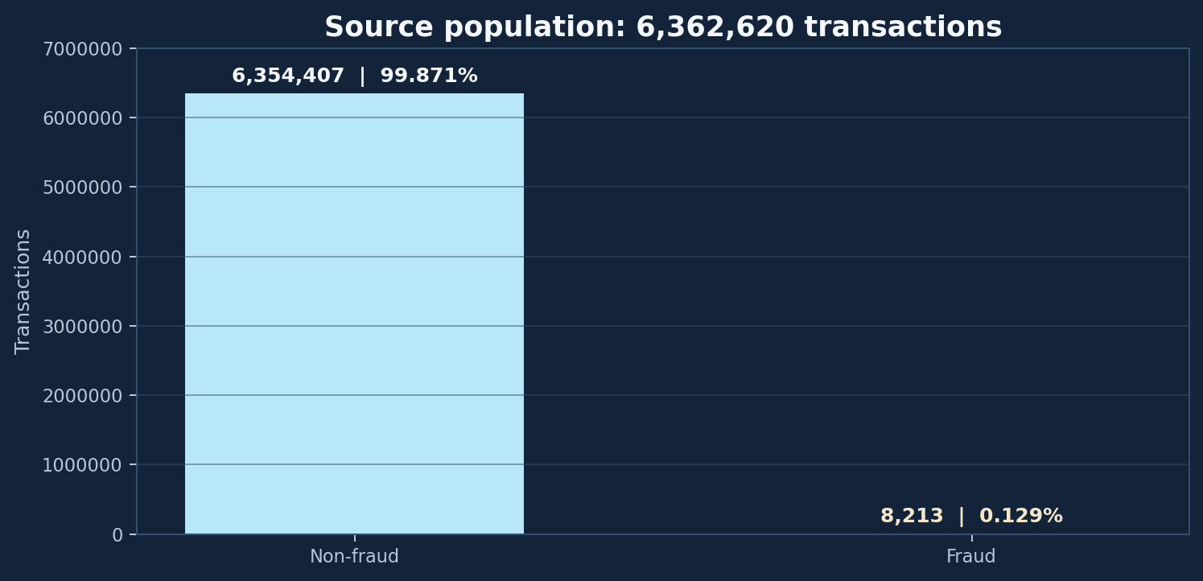
04 / DATA UNDERSTANDING
PaySim dataset at a glance
Source file: 6,362,620 rows, 11 original columns; simulated financial transactions.
LABEL
`isFraud` is the historical target: 1 = fraud, 0 = non-fraud.
TRANSACTION CONTEXT
Type, amount, origin/destination IDs, and balances before/after the transaction.
CLASS IMBALANCE
8,213 fraud rows out of 6,362,620 = approximately 0.1291%.
05

Slide 6
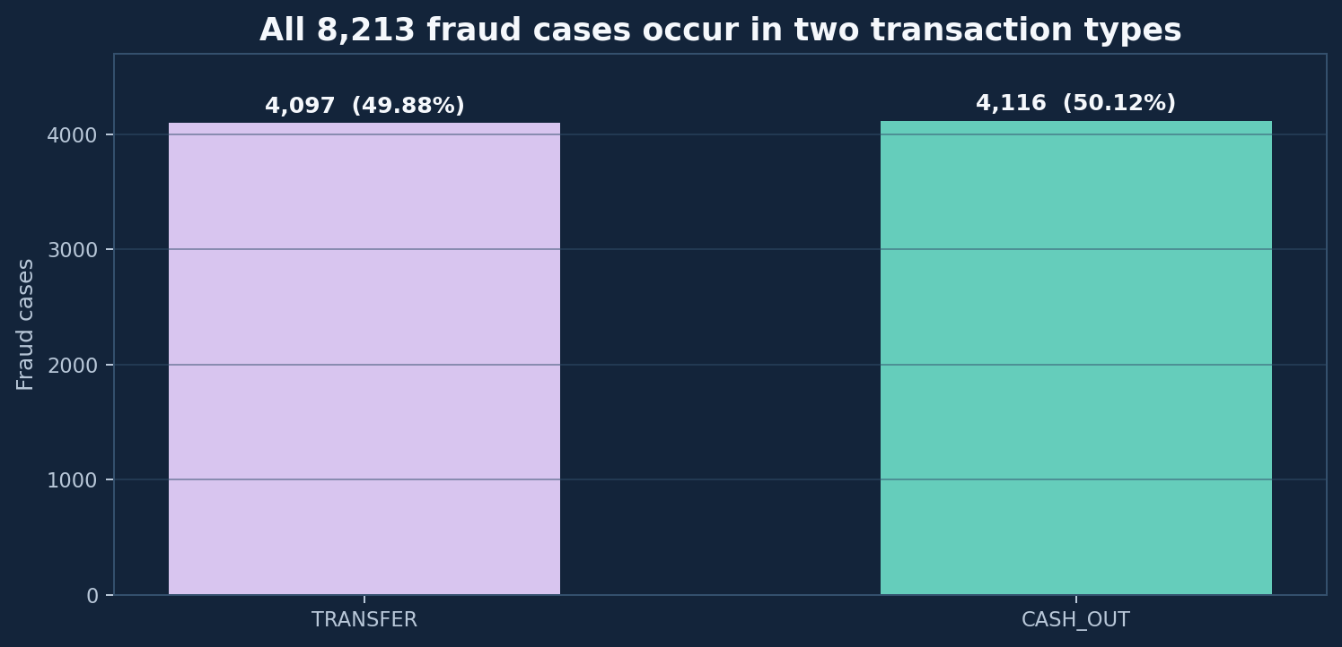
05 / EXPLORATORY ANALYSIS
EDA findings: fraud is concentrated
All observed fraud labels in this source file occur in TRANSFER and CASH_OUT.
TRANSFER
4,097 fraud cases. Fraud average amount: 1,480,891.67; normal average: 906,229.01.
CASH_OUT
4,116 fraud cases. Fraud average amount: 1,455,102.59; normal average: 173,917.16.
EDA did not “prove” that large amounts cause fraud. It identified associations worth testing and modeling.
06

Slide 7
06 / HYPOTHESIS TESTING
Four hypotheses and what the data actually showed
Separate observed evidence from interpretation; do not over-generalize one feature.
H1 • Amount
Fraud averages were higher in TRANSFER and CASH_OUT.
Supported as an association; amount is not a standalone rule.
H2 • Origin emptied
TRANSFER: 96.02% fraud vs 42.50% normal. CASH_OUT: 99.08% vs 42.78%.
Strong separation in these types; use with context.
H3 • Origin mismatch
Mismatch was far more common in normal rows: TRANSFER 96.21% vs 0.51%; CASH_OUT 89.16% vs 0.58%.
Counter-intuitive; not a universal “fraud anomaly” indicator.
H4 • Destination mismatch
TRANSFER: 99.95% fraud vs 22.07% normal. CASH_OUT: 13.24% vs 22.70%.
Highly transaction-type dependent.
07

Slide 8
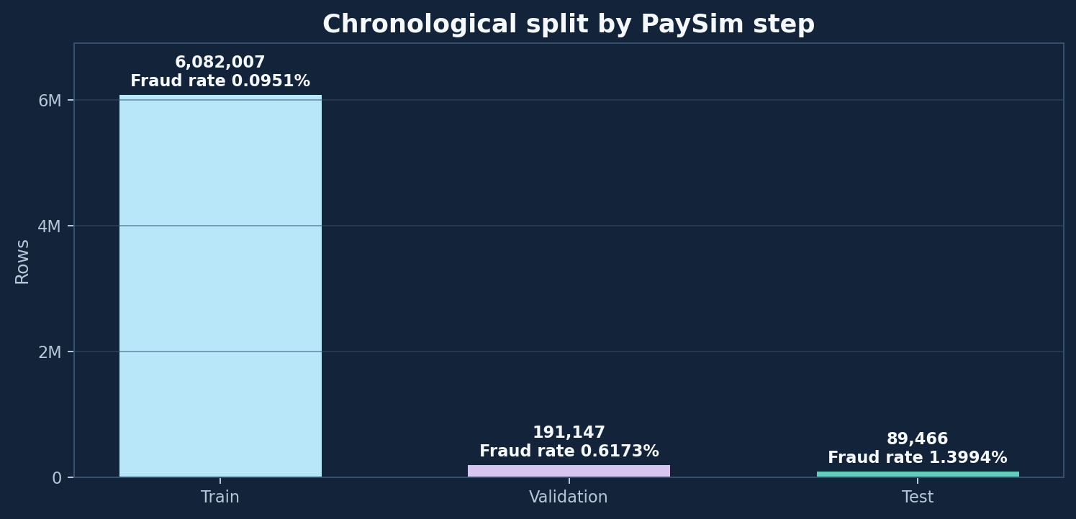
07 / EXPERIMENTAL DESIGN
Chronological split: train on the past, test on the future
Rows are split by PaySim step, not randomly, to better reflect temporal deployment.
TRAIN
Steps 1–520 • 6,082,007 rows • 5,781 fraud.
VALIDATION
Steps 521–631 • 191,147 rows • 1,180 fraud.
FINAL TEST
Steps 632–743 • 89,466 rows • 1,252 fraud.
Fraud prevalence rises from 0.0951% → 0.6173% → 1.3994%: a strong temporal distribution-shift warning.
08

Slide 9
08 / LEAKAGE AND TIMING
Why this is post-transaction monitoring
Balance-after-transaction fields are only available after the transaction has been processed.
BEFORE
TRANSACTION
AFTER
Amount + old balances
Transfer / cash-out
New balances available
FEATURE AVAILABILITY
TARGET / ID EXCLUSION
New-balance-derived features describe post-transaction evidence. The current product is therefore a post-transaction monitor, not a pre-authorization blocker.
`isFraud` is the target, never a model input. `nameOrig` and `nameDest` are identifiers for traceability, not predictive features. `isFlaggedFraud` was excluded from model features.
DATASET WARNING: PaySim / Kaggle metadata says balance-before/after fields should not be used for fraud detection because fraud transactions are cancelled. Current results therefore need a no-balance-feature ablation.
09

Slide 10
09 / FEATURE ENGINEERING
From raw balances to model-ready signals
The prepared feature table contains 13 columns; identifiers and target stay out of X.
RAW INPUTS
ENGINEERED SIGNALS
MODEL INPUT X
step
type
amount
oldbalanceOrg
newbalanceOrig
oldbalanceDest
newbalanceDest
isFraud (target)
log_amount
orig_balance_emptied
orig_balance_error
dest_balance_error
orig_balance_mismatch
dest_balance_mismatch
plus step and type
Numeric + encoded type
Scaled numerical features
No raw account IDs
No target leakage
Engineering checks: 6,362,620 rows preserved • 8,213 fraud labels preserved • no nulls in prepared feature output.
10

Slide 11
10 / MODEL CHOICE
The classifier: SGDClassifier with logistic loss
A linear decision model trained efficiently through stochastic / mini-batch updates.
WHY THIS MODEL
WHAT IT LEARNS
WHAT IT RETURNS
• Scales to millions of rows
• Supports `partial_fit` batches
• `loss="log_loss"` gives logistic-style classification
• Supports class weighting
A weighted linear score: z = w·x + b
The model learns feature weights w and an intercept b by minimizing logistic loss with regularization.
• `decision_function(X)` → raw margin z
• `predict_proba(X)` → sigmoid-transformed score
• A threshold turns score into a positive / negative decision.
Important: this is not a tree ensemble and not a neural network. It is a linear classifier optimized by stochastic gradient descent.
11

Slide 12
11 / MODEL MECHANICS
The mathematics: logistic loss + SGD
Conceptual equations used to understand the model; the implementation delegates optimization to scikit-learn.
1 • LINEAR MARGIN
2 • SIGMOID MAP
3 • LOGISTIC LOSS
z = wᵀx + b
A positive or negative margin indicates which side of the learned boundary the sample falls on.
p = 1 / (1 + e⁻ᶻ)
Maps an unbounded margin into a number between 0 and 1.
L = −[y log(p) + (1−y)log(1−p)]
Penalizes confident incorrect predictions.
SGD intuition: for each mini-batch, calculate the prediction error, compute the gradient, then update weights: w ← w − η · ∇L(w). The learning rate η controls update size; regularization discourages excessively large weights.
12

Slide 13
12 / IMBALANCE HANDLING
Why class weights matter
If the majority class dominates the loss, a model can achieve high accuracy by mostly predicting normal.
WEIGHTED LOSS
Each class contributes according to its assigned weight; the rare fraud class receives greater influence during optimization.
BALANCED-WEIGHT REFERENCE
A common reference formula is wᵢ = N / (K × nᵢ), where N is training rows, K is classes, and nᵢ is the count of class i.
Project fact: class weighting was applied during training. The exact configured numeric weights should be quoted from the saved training configuration, not guessed from the formula.
13

Slide 14
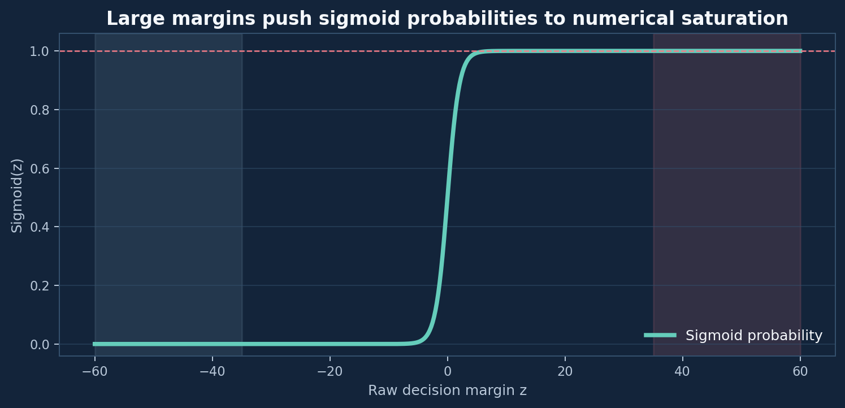
13 / PROBABILITY SATURATION
The diagnostic that changed the evaluation
Large raw margins pushed the sigmoid output close to 1.0, creating many tied probabilities.
WHAT HAPPENED
Initial validation probability output saturated near 1.0. Ranking information was compressed into ties, so probability-based Average Precision fell to 0.2046.
THE DIAGNOSTIC
Use `decision_function` raw margins to preserve the ordering of transactions. Raw-score Average Precision on validation was 0.995086.
A raw margin is not a probability. We use it as a ranking / threshold score and label it honestly in the dashboard.
14

Slide 15
14 / THRESHOLD ENGINEERING
One model score, two operational thresholds
Thresholds are selected on validation data and frozen before evaluating the final test set.
MEDIUM
HIGH
54.3042
213.8087
P99 of normal validation margins
Validation threshold maximizing F1
LOW
MEDIUM
HIGH
Score < 54.3042 → MONITOR
54.3042 ≤ score < 213.8087 → MANUAL_REVIEW
Score ≥ 213.8087 → ALERT_AND_SIMULATED_HOLD
15

Slide 16
15 / VALIDATION RESULTS
Validation: threshold selection without touching test
The high-risk threshold was selected on the validation period.
Precision
Recall
F1
1.0000
0.9941
0.9970
Average Precision
TP / FN
FP
0.9951
1,173 / 7
0
Validation confusion matrix: TN 185,428 • FP 0 • FN 7 • TP 1,173. The validation set is for model / threshold choices, not the final unbiased estimate.
16

Slide 17
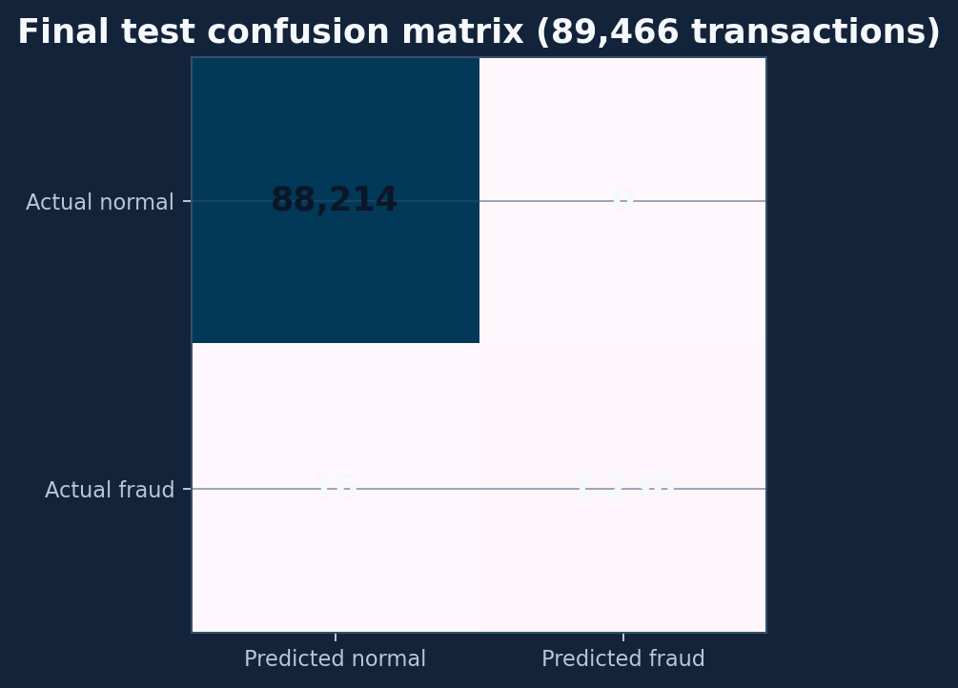
16 / FINAL TEST RESULTS
Final test: strong separation on the held-out future period
Fixed high threshold 213.80866687194845, chosen on validation, applied unchanged to test.
Accuracy
Precision
99.9821%
100.00%
Recall
F1
98.7220%
99.3569%
Average Precision
Precision lift
98.9589%
71.46×
Test counts: TN 88,214 • FP 0 • FN 16 • TP 1,236. Results describe this synthetic chronological holdout, not guaranteed performance on real bank traffic.
17

Slide 18
17 / DATA ENGINEERING
SQL Server: traceable evaluation store
Only validation + final-test rows were loaded to the dashboard database.
Transactions
FraudPredictions
FraudAlerts
TransactionID (PK)
SourceRowNumber (unique)
Step • TransactionType
Amount • NameOrig / NameDest
Balances • isFraud (evaluation label)
PredictionID (PK)
TransactionID (FK)
DatasetSplit
RawDecisionScore
PredictedFraud • RiskLevel
RecommendedAction
ModelName / ModelVersion
AlertID (PK)
PredictionID / TransactionID (FK)
AlertType • AlertStatus
AlertMessage • CreatedAtUtc
ResolvedAtUtc
SimulatedHold
Integrity audit: 280,613 transactions • 280,613 predictions • 5,255 alerts • 0 duplicate source row numbers • 0 orphan prediction / alert references.
18

Slide 19
18 / END-TO-END ARCHITECTURE
From source data to analyst-facing decision support
A layered design keeps ML, persistence, risk policy and UI responsibilities separate.
PaySim CSV
EDA + Features
SGDClassifier
Risk Engine
SQL Server
Dash UI
Historical synthetic
transactions
Quality, hypotheses,
engineered signals
Scaled features,
weighted logistic loss
Raw margin → LOW /
MEDIUM / HIGH
Transactions +
predictions + alerts
KPIs, charts, search,
alert center
The model produces a score. The risk engine applies versioned thresholds. The database preserves the decision. The dashboard makes the evidence inspectable. No real-time bank authorization is performed.
19

Slide 20
19 / DASHBOARD INTERNALS
How the Dash dashboard works
The UI is reactive: component properties trigger callbacks, which query SQL and return new component properties.
1 • INPUTS
2 • CALLBACKS
3 • DATA ACCESS
4 • OUTPUTS
Dropdown filters
Refresh button
30-second interval
Search box
Selected table row
Analytics callback
Transaction table callback
Transaction details callback
Alert table callback
Parameterized SQL
pyodbc connection
Pandas DataFrames
Error handling
6 KPI cards
3 Plotly charts
Transaction table
Alert table
Details panel
Current integration test: 4 registered callbacks • 23 unique layout IDs • 0 missing IDs • 0 duplicate outputs.
20

Slide 21
20 / DASHBOARD WALKTHROUGH
What changes when I use each filter?
Current implementation behavior, based on the actual data-access signatures.
DATASET SPLIT
TRANSACTION TYPE
RISK LEVEL
ALL / VALIDATION / TEST
Used by KPIs, charts, transaction explorer and alert center.
ALL / TRANSFER / CASH_OUT / CASH_IN / PAYMENT / DEBIT
Used by KPIs, risk distribution, temporal, explorer and alerts.
ALL / LOW / MEDIUM / HIGH
Used by type analysis and transaction explorer. Not currently part of KPI SQL signature.
REFRESH
SEARCH + SELECT
Manual button triggers refresh. `dcc.Interval` triggers refresh every 30 seconds. The controls refresh table outputs as well.
Search matches SourceRowNumber, NameOrig or NameDest. Select one row to populate Transaction Details from the selected result record.
21

Slide 22
21 / READING THE DASHBOARD
How to interpret the three charts
Every chart answers a different question; hover details provide additional context.
FRAUD BY TYPE
RISK DISTRIBUTION
FRAUD OVER TIME
Bars compare actual fraud labels with model-predicted fraud. A line on a secondary axis shows total transaction volume.
Use it to compare categories without confusing count scales.
A donut shows the number of transactions in LOW / MEDIUM / HIGH tiers. Hover shows actual fraud, predicted fraud and average amount.
It is a count distribution, not a probability chart.
Bars show transaction volume; lines show actual fraud, predicted fraud and a 7-step moving average.
The second axis prevents volume from flattening fraud counts.
22

Slide 23
22 / TRANSACTION EXPLORER
Investigate one transaction from the table
The explorer fetches a bounded result set and shows a detailed evidence panel after row selection.
SEARCH
TABLE
DETAILS
Search by SourceRowNumber or sender / receiver ID. SQL uses parameters for the search values.
Default query limit: 100 rows; data access enforces a maximum of 500.
14 displayed fields: identity, step, type, amount, sender / receiver, split, raw score, predicted label, risk, action and alert data.
Shows transaction context, model decision, raw margin, risk tier, alert status and simulated hold.
`RawDecisionScore` is explicitly not labeled as probability.
23

Slide 24
23 / ALERT CENTER
From risk decision to an investigation queue
The Alert Center is backed by persisted alert records, not hard-coded demo cards.
ALERT RECORD
FILTERS
AUTOMATED DISPLAY
AlertID, category, status, message, creation / resolution times and transaction reference.
Dataset split, transaction type, alert status (OPEN / UNDER_REVIEW / RESOLVED) and alert category (HIGH_RISK / MANUAL_REVIEW).
Manual and 30-second refresh; results serialized for the DataTable. Current default result limit: 100 alerts.
24

Slide 25
24 / DELIVERY EVIDENCE
What has been implemented and verified
Evidence-backed implementation status from project tests and dashboard execution.
DATA
6,362,620-row source profiled; engineered Parquet validated with 6,362,620 rows and 8,213 fraud labels.
MODEL
Validation threshold selected; untouched chronological test metrics computed.
DATABASE
280,613 evaluation rows loaded; 280,613 predictions; 5,255 alerts; referential integrity checked.
RISK + ALERTS
Risk engine smoke test covered LOW / MEDIUM / HIGH; JSONL alert routing verified.
DASH
3 charts tested with SQL data; 4 callbacks; 23 layout IDs; integration PASS; local server HTTP 200.
25

Slide 26
25 / RESPONSIBLE USE
What the current evidence does not prove
A strong synthetic holdout result is not a guarantee of real-world financial performance.
Technical limits
Operational limits
• PaySim is synthetic; real bank behavior, customer mix and adversarial strategies may differ.
• Temporal fraud prevalence rises across the split, indicating distribution shift.
• Raw margins are not calibrated probabilities.
• Medium tier is based on a validation normal-score percentile, not an approved business cost policy.
• Balances after transaction make this post-transaction monitoring.
• No production bank integration or real transaction blocking.
• Alert status workflow is a prototype; human case management is future work.
• Cloud deployment requires remote database access or a cloud-compatible data layer.
26

Slide 27
26 / FUTURE SECURITY WORK
Next phase: separate security labs
These are planned extensions, not completed components of the PaySim fraud model.
SQL INJECTION DEFENSIVE LAB
MAN-IN-THE-MIDDLE DEFENSIVE LAB
Goal: understand unsafe dynamic SQL, reproduce a harmless local test case, replace string concatenation with parameterized queries, add input validation, and retest.
Connection to this project: the existing data-access layer uses parameterized SQL values; the dedicated lab will deepen attack / defense testing.
Goal: build a controlled local simulation of message interception / alteration, use HMAC or signatures to detect tampering, reject invalid integrity checks, and log security events.
Scope: local educational simulation only; no real network interception.
Keep fraud detection, SQL injection testing and MITM integrity simulation as separate modules with separate datasets, tests and threat models.
27

Slide 28
27 / PUBLISHING PLAN
From local dashboard to a shareable cloud link
GitHub stores source; a cloud web service runs Dash; a remote database provides the data.
1 • GITHUB
2 • CLOUD HOST
3 • REMOTE DATA
Create a clean repository. Commit source, SQL scripts, docs and safe sample outputs. Exclude `.venv`, credentials and large raw datasets.
Deploy a Python web service with Gunicorn / Docker and environment variables. The app listens on the provider-assigned PORT.
A local Windows SQL Server is not reachable from the cloud service by default. Use a secured hosted SQL endpoint or migrate to a cloud data store.
Render free web services sleep after 15 minutes without traffic and have ephemeral local storage. A cloud link is created only after repository connection, database configuration and successful deployment.
28

Slide 29
PAYSim FRAUD INTELLIGENCE PLATFORM
Detect • Explain • Prioritize • Monitor
A reproducible analytical prototype that turns synthetic transaction history into traceable model scores, risk tiers, SQL records and an interactive investigation dashboard.
DATA → MODEL
MODEL → RISK
RISK → SQL
SQL → DASHBOARD
Thank you • Questions

Slide 30
28 / REFERENCES AND METHOD SOURCES
Sources behind the dataset and modeling choices
1. PaySim simulator paper
E. A. López-Rojas, A. Elmir, and S. Axelsson. “PaySim: A financial mobile money simulator for fraud detection.” 28th European Modeling and Simulation Symposium (EMSS), 2016.
https://www.msc-les.org/proceedings/emss/emss2016/emss2016_249.html
2. PaySim Kaggle dataset metadata
Synthetic Financial Datasets for Fraud Detection, ealaxi / PaySim1. The dataset metadata explains the synthetic data, fields and the warning about balance fields for fraud detection.
https://www.kaggle.com/datasets/ealaxi/paysim1/metadata
3. scikit-learn SGDClassifier
Official estimator documentation: logistic loss, class_weight, and incremental partial_fit learning.
https://scikit-learn.org/stable/modules/generated/sklearn.linear_model.SGDClassifier.html
4. scikit-learn SGD user guide
Stochastic gradient descent, regularized linear models, and out-of-core / mini-batch learning.
https://scikit-learn.org/stable/modules/sgd.html
5. Render deployment references
Official Flask/Python deployment guide and free-service limitations; see the cloud deployment guide included with this submission.
https://render.com/docs/deploy-flask | https://render.com/docs/free
Use the dataset citation and license required by the data provider / course. Model metrics in this presentation are project experiment results, not claims from the references.

