Slide 1

International Soccer Player Ratings
DSC 530 Final Project
Edris Safari

Slide 2
Fédération Internationale de Football Association(FIFA ) publishes Player rating data set which contains over 85 features about 18000 players. The feaures and players are updated annually and players are rated from 1(worst) to 100(best) . The data set can be used for various purposes, one of which is in the gaming industry. The goal of this study is to explore the 2019 publication of this dataset using statistical and programatic techniques.

Slide 3
Dataset description
Single csv file
18209 observations
89 features
34 features recording each player’s skills with rating of 1(bad) to 100(good)
‘Potential’, ‘Overall’ features show the ratings based on various features such as skills, age, etc.. Their value ranges from 1(bad) to 5(good)
Other features of interest:
Age, weight, height

Slide 4
Data Preparation
Import Dataset
Replace ‘lbs’ from the weight and convert to integer
Convert height from “ft’inch” to Inches as type integer place in new column(Height_Inch)
Compute experience in years from signing date

Slide 5
Question
Is the overall rating of players govern by their skill set.

Slide 6
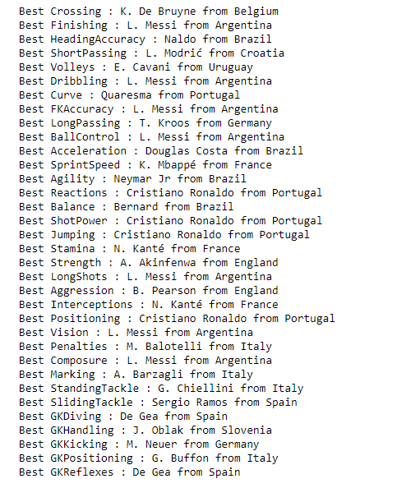
Data Exploration-Best in skill
Best player in each skill category. Lionel Messi is the best overall player and is best rated in more skills than others.

Slide 7
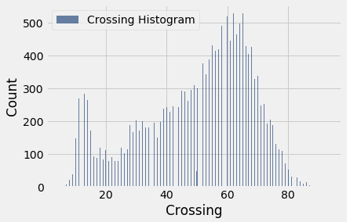
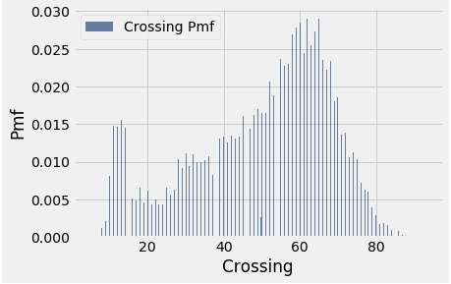
Data Exploration- Distributions

Slide 8
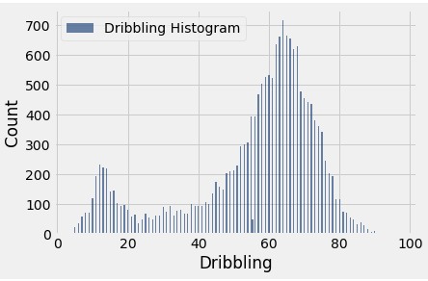
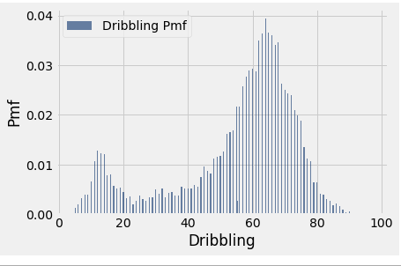
Data Exploration- Distributions

Slide 9
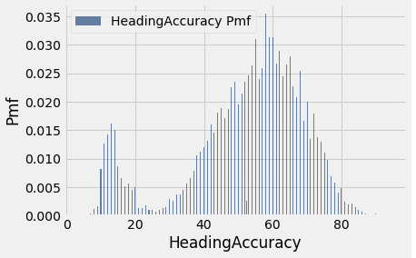
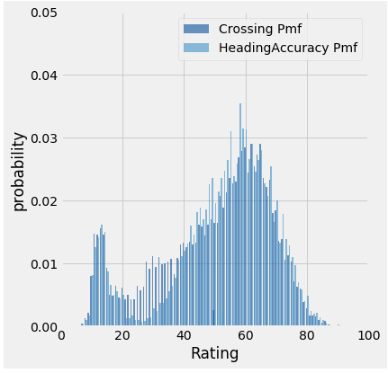
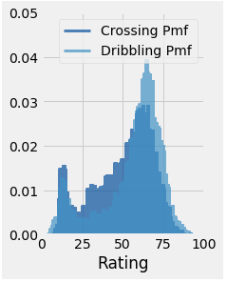
Data Exploration- Distribution comparison

Slide 10
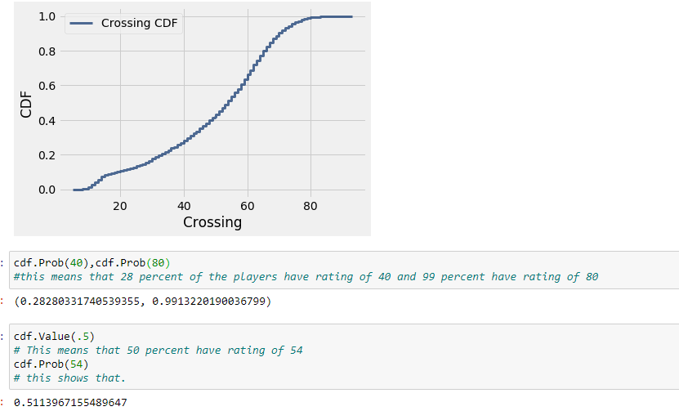
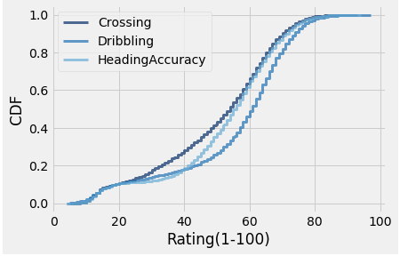
Data Exploration- Distribution

Slide 11
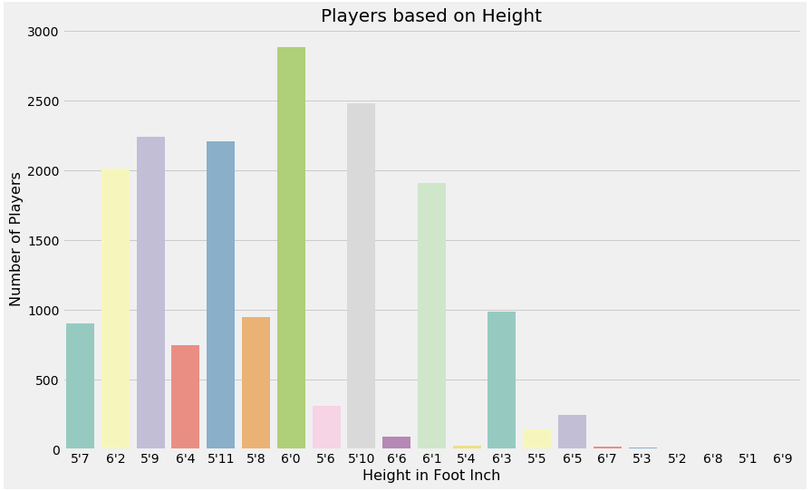
Data Exploration- Distribution

Slide 12
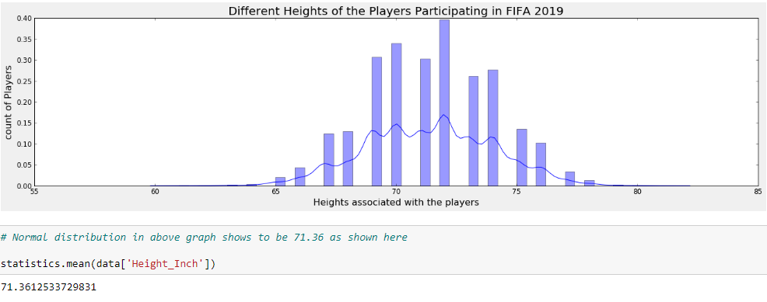
Data Exploration- Distribution

Slide 13
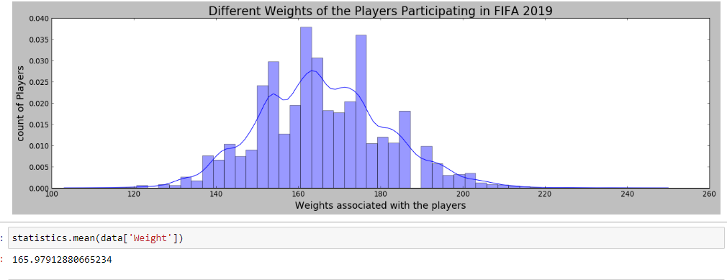
Data Exploration- Distribution

Slide 14
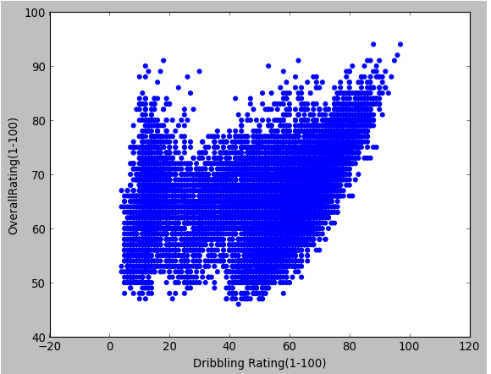
Data Exploration- Scatter plot

Slide 15
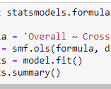
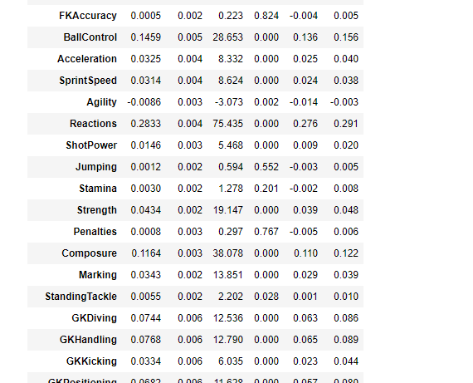
Modeling Coefficients

Slide 16
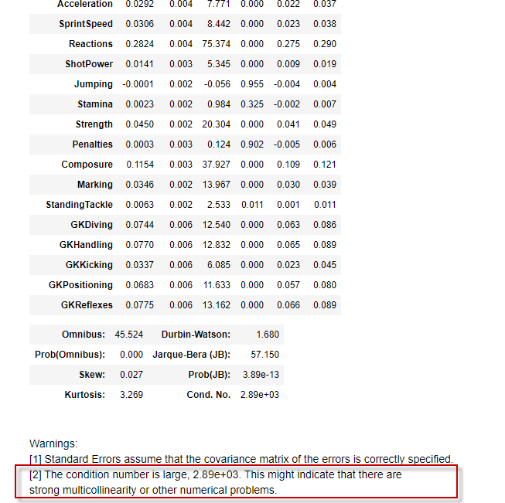
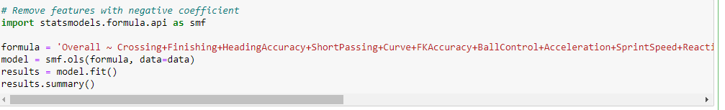
Modeling Correlations

Slide 17
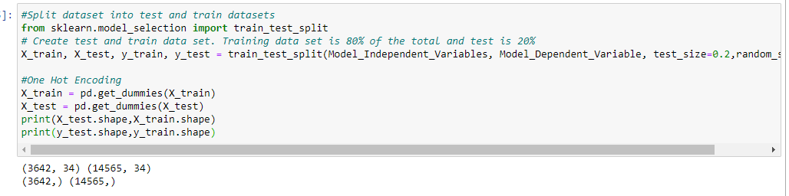
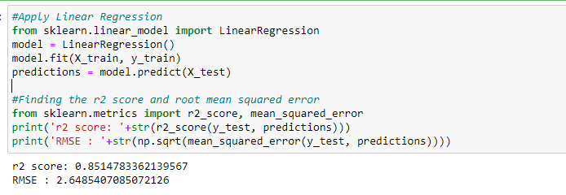
Modeling

Slide 18
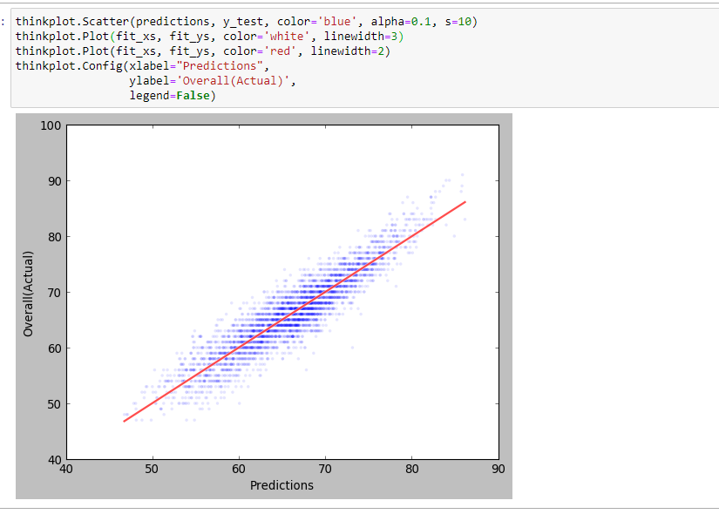
Modeling – All Skills

Slide 19
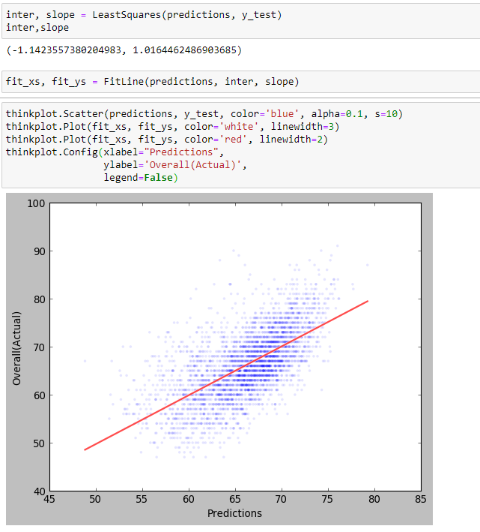
Modeling – Less Skills

Slide 20
Summary
The focus of this analysis was to determine which of the attributes in the dataset contribute the most to players rating. We focused on the 34 skills and found that even though there were collinearity among them, they are a good predictors of the overall rating.
We analyzed distributions, correlations, and ran the data through ordinary least square model and charted the result. When all skills were included the model fit better.
Further evaluation of data and other attributes would reveal more insight to not just overall rating, but also player selection, positioning and other aspects of the game.
It would be interesting to see if height can be a predictor of heading accuracy, or weight with speed and/or stamina.
The main challenge of this study was lack of experience interpreting statistical findings. With more experience and using tools available, I believe I can overcome this challenge.

Slide 21
Conclusions
The skills rating had multicollinearity. We can eliminate them using a backward elimination technique by evaluating the coefficients, R2 and p-value at each iteration.
The prediction model was run with all skills and a subset. The prediction suffered when some skills were removed.
The dataset and its analysis can answer many other questions related to whether a player should be signed, what rate should the compensated, how long a contract to offer, can be a starter or better be on the bench until certain point in the game.
You need all the skills you can get to be number one.

