Slide 1
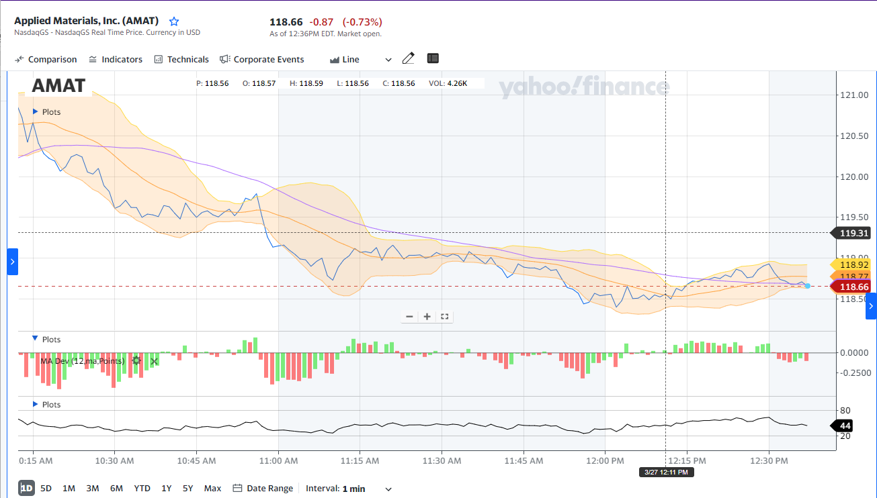
Stock Market Analysis
Technical Indicators . Price Prediction

Slide 2

Stock Market Analysis isn’t easy!
Predicting the market and the stocks can get frustrating for investors and market analysis.
Notes:
Predicting stock behavior has been and continues to be complex. Even more so in the modern world with unpredictable events that affect the market. This is a challenge for both investors and financial advisors. Knowledgeable investors equipped with additional tools based on statistical analysis and machine learning would make more calculated decisions in their investment.

Slide 3
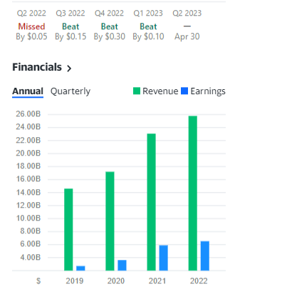
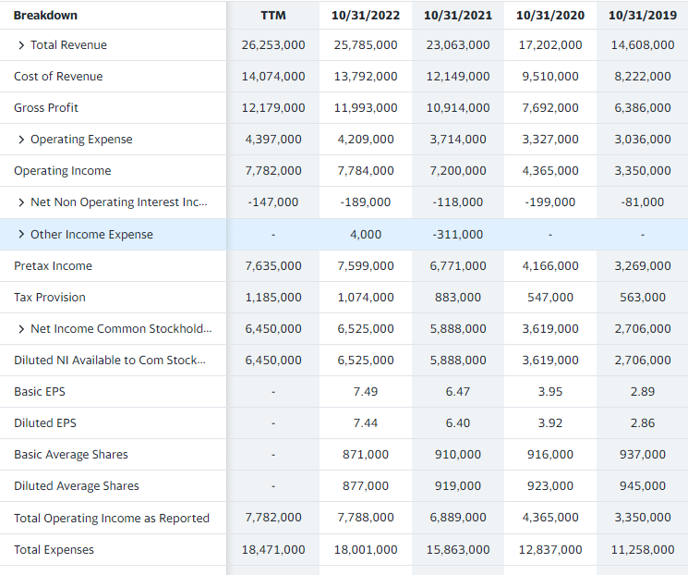
Traditional Market Analysis
Use of fundamentals to gauge a stock’s health
Notes:
The traditional market analysis looks at fundamentals. Fundamentals in market analysis refer to the economic, financial, and industry-specific data that analysts use to evaluate the health and potential of a company, sector, or market. These fundamentals provide insights into the underlying factors that drive market trends and help investors make informed decisions about buying or selling securities.

Slide 4
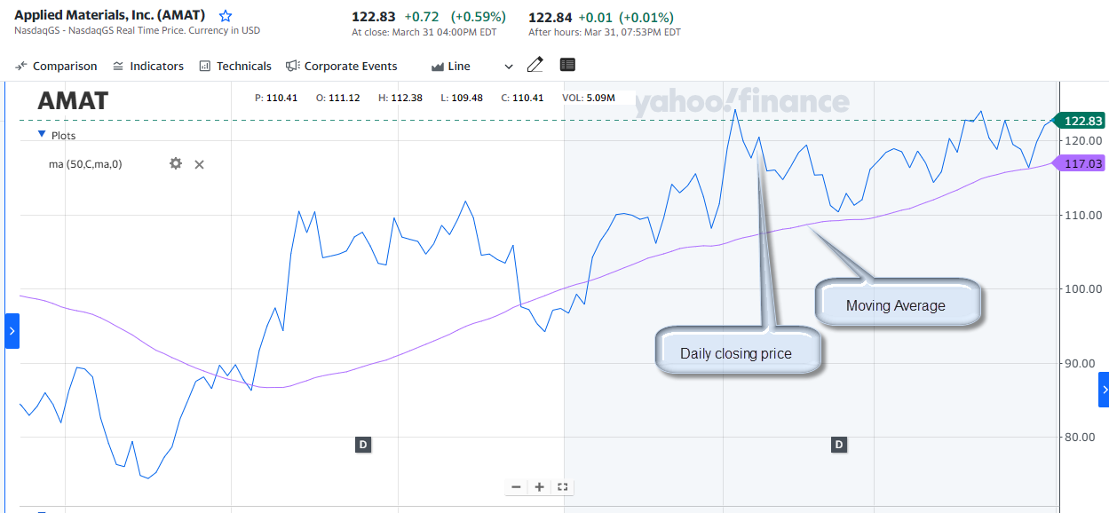
Using Technical indicators
Graphical display of moving average gives a view of the trend
Notes:
Technical indicators are mathematical calculations based on the price and/or volume of a security, such as a stock or a currency. They help investors identify trends and patterns in market behavior. Technical analysts use these indicators to analyze historical price and volume data, and to predict future price movements. Here, the technical indicator is a 50-day moving average.
When the closing price of a security is above its 50-day moving average, it suggests that the security is in an uptrend, and that the price has been trending higher over the past 50 days on average. This can indicate that the security is being bought by investors, which can lead to further price increases.

Slide 5

How to leverage from Technical indicators and can we have access to them?

Slide 6
Types of Technical Indicators
Momentum_1D
RSI_14D
Upper Band Bollinger Band
Middle Bollinger Band
Lower Bollinger Band
Aroon Oscillators
Price Volume Trend
Acceleration Bands
Stochastic Oscillator(%K and %D)
Chaikin Money Flow
Parabolic SAR
Price Rate of Change
Volume Weighted Average Price

Slide 7
How to accessTechnical Indicators
Pull individual stock data from file
Pull data from places such as yahoo finance
Programmatically Calculate the technical indicators
Graph the technical indicators

Slide 8

Technical Indicators
Notes:
We are going to show three technical indicators.

Slide 9
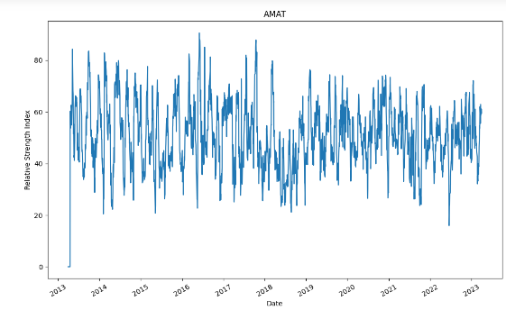
Relative Strength Index
Notes:
Relative Strength Index or RSI, measures speed and magnitude of a stock’s most recent price changes (up or down). This will help evaluate whether a stock is overvalued (don’t buy) or undervalued(buy). Shown below, the stock for AMAT was overvalued in 2016,2017 and undervalued since 2021-22.

Slide 10
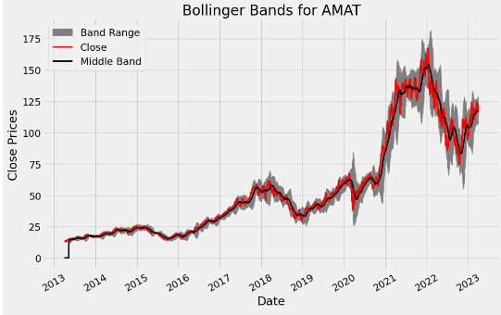
Bollinger Bands
Notes:
Bollinger Bands is a technical indicator that can help investors analyze the volatility of a security and identify potential price trends and reversals. They show volatility in the width of the band. Narrow means less volatile. It also shows that if the closing price in red is close to the upper band, the stock is over bought. It is over sold if the price is close to the lower band. If the price in red stays above middle line in black, it is trending upward; other wise it is trending downward.

Slide 11
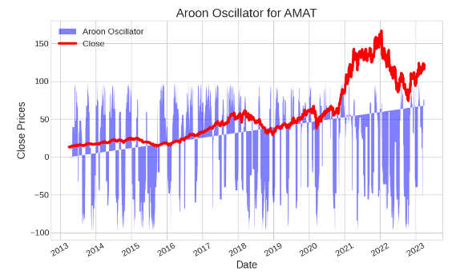
Aroon Oscillators
Notes:
Aroon Oscillators is a technical indicator that are used to identify the strength and direction of a trend. The indicator consists of two lines: the Aroon-Up and the Aroon-Down. The Aroon-Up measures the number of periods since the highest high, while the Aroon-Down measures the number of periods since the lowest low. When the Aroon-Up is above the Aroon-Down, it indicates an uptrend, while when the Aroon-Down is above the Aroon-Up, it indicates a downtrend. Shown below, AMT is trending downward.

Slide 12
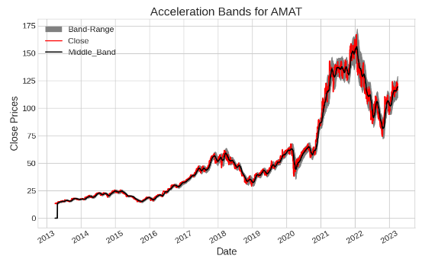
Acceleration Bands
Notes:
Acceleration Bands is a technical indicator that uses volatility to identify potential price trends in the market. The indicator consists of three lines: the upper band, the lower band, and the centerline. The upper and lower bands are based on the standard deviation of the price from the centerline, while the centerline is typically a moving average. Shown here, when the price touches or crosses the upper band it indicates that the trend is losing its momentum and due for a reversal.

Slide 13
AI/ML RNN Model
Notes:
Here, we are going to show you the results of an analysis done using Machine learning

Slide 14
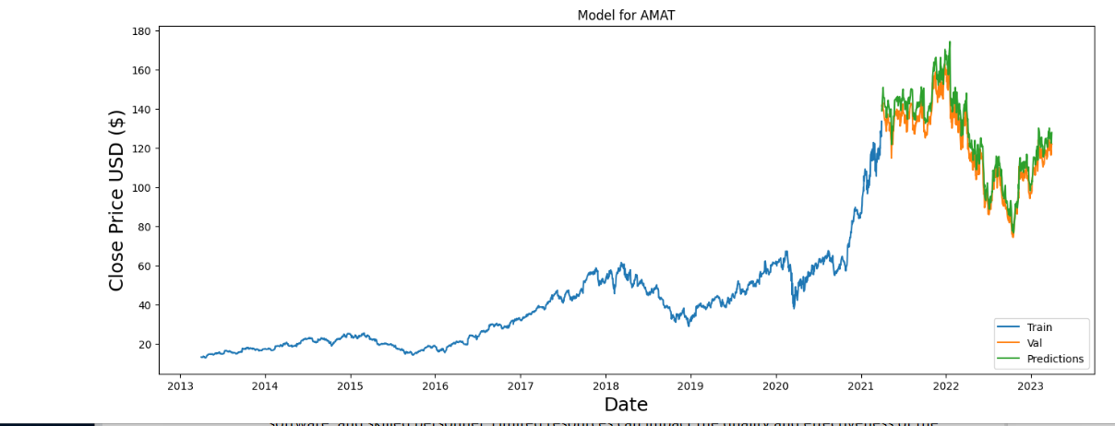
Using LSTM Algorithm
Notes:
Long Short-Term Memory (LSTM) is a type of recurrent neural network (RNN) architecture that can learn long-term dependencies and is widely used in natural language processing, speech recognition, and other sequence-based or time series tasks. We applied it to 10 years of data. The blue line is the closing price for the 1st 71/5 years. This data was used to train the model. The orange line is the actual closing price for the remainder of the data and the green line is the prediction by the algorithm.

Slide 15
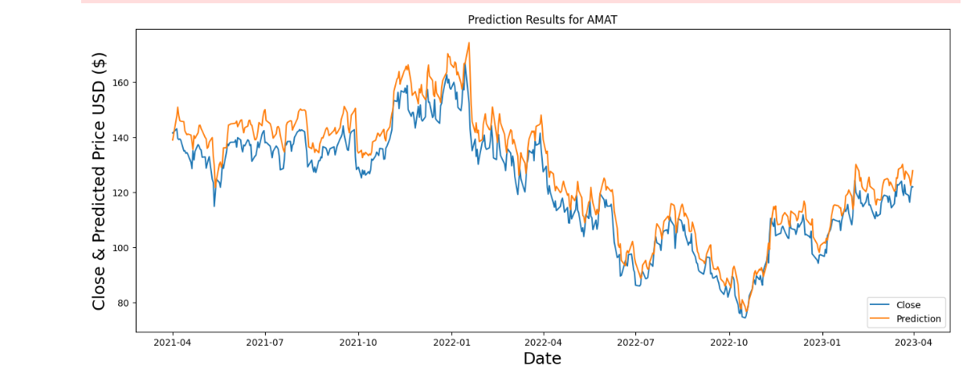
Comparison predicted vs actual
Notes:
To get a better view of the accuracy, we zoomed in and put them side by side. The accuracy is not great, but by tuning the algorithm, we can achieve better results.

Slide 16

Next Steps
Build a GUI
Add mode technical Indicators
Improve Model Performance
Add classification algorithm(up/down, Sell/NotSell, Buy/NotBuy)
Notes:
To build on this effort, we can build a front-end to this application to allow better user access. Adding more technical indicators to the portfolio, improving model performance and adding other machine learning algorithms would be a good way forward.

Slide 17

Conclusions
With amount of data available and the computing power that AI/ML provide; we can make better market decisions.

