Slide 1
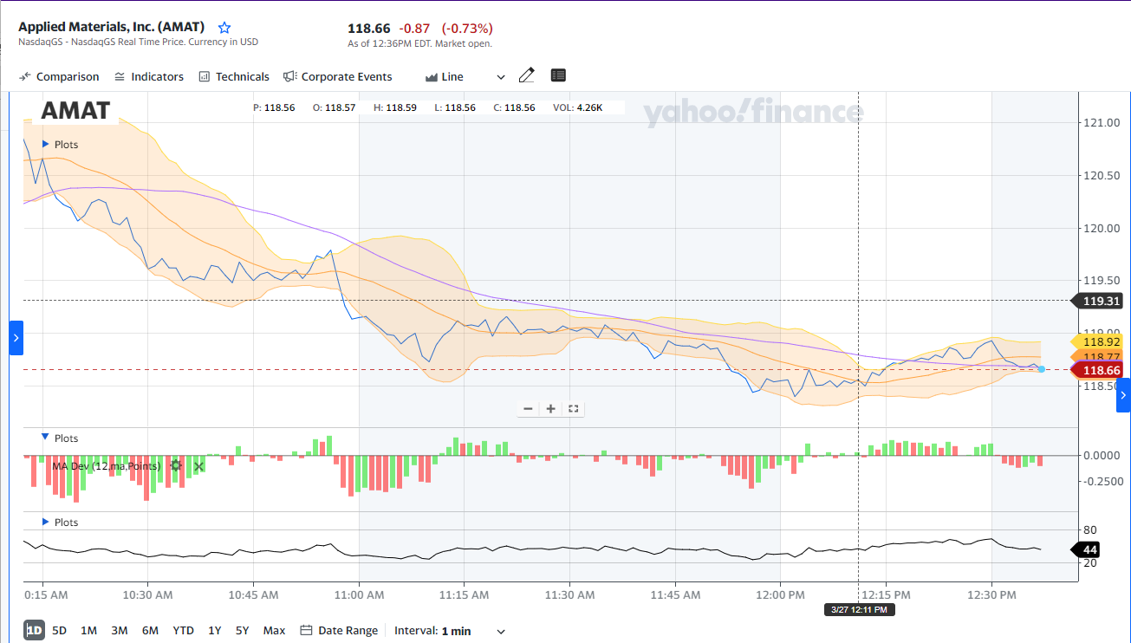
Stock Market Analysis
Technical Indicators . Price Prediction .Price Classification(UP/DOWN)

Slide 2

Stock Market Analysis isn’t easy!

