Slide 1

A Data-Driven Three-Layer Algorithm for Split Delivery Vehicle Routing Problem with 3D Container Loading Constraint
Xijun Li¹, Mingxuan Yuan², Di Chen², Jianguo Yao¹, and Jia Zeng²
Shanghai Jiao Tong University
Noah’s Ark Lab of Huawei

Slide 2
Container transportation planning:
The most important problem in large scale manufacturing logistic
Huawei’s logistics management: estimates 3% reduction in the number of containers correspond to millions of USD in savings
The Route planning of vehicles
The allocation of cargoes at different collection points to different vehicles
The feasible packing of the transported items into the available loading space
3L-SDVRP

Slide 3
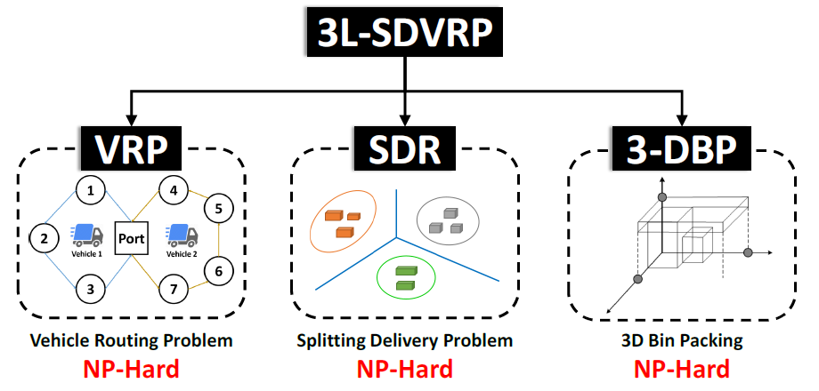

Slide 4

Challenge: enormous combined solution space of three difficult combinatorial problems
Proposed: Data-driven Three-Layer Search Algorithm
Making use of historical data
Efficient solution generation
Fast container loading evaluation

Slide 5
Problem Description: To devise a cargo transportation strategy to efficiently transport cargoes to the port with minimum transportation cost.
Inputs:
A road network
A delivery order
Configuration of each category of containers
Constraint:
Volume
Weight
Packing material
Fragility
Orientation
Support Area

Slide 6
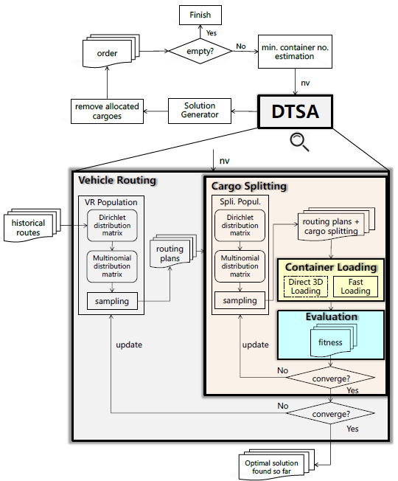
System Architecture:

Slide 7
1. Vehicle Routing:
Optimizing the routing plans using EDA
First a probability matrix representing a Dirichlet distribution is extracted from the historical routes
The prior Dirichlet distribution will be updated using information provided by the vehicle routing search algorithm

Slide 8
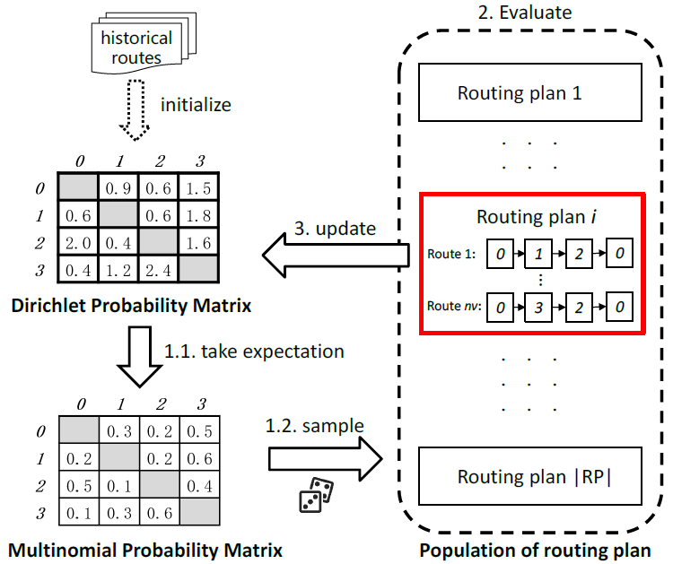
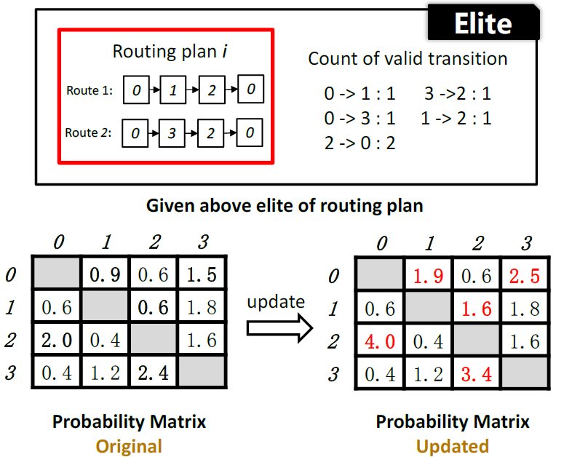
1. Vehicle Routing:
Process of vehicle routing search
Parameter update
Notes:
Netty pipeline
Traccar system is based on the Netty network framework. The framework is an asynchronous event-driven network application framework which enables quick and easy development of network applications such as protocol servers.
For each network channel or connection Traccar creates a pipeline of event handlers. Incoming messages from GPS devices are received as binary buffers and are separated into frames, decoded into an internal position model and eventually stored in the database. Outgoing messages (commands) are going in the opposite direction and are starting as an internal command model and eventually get converted into binary buffers that are sent to devices. Each protocol has its own pipeline, but most of the supported protocol include following main handlers in their pipelines:
Frame decoder (only TCP protocols) – splits incoming buffer into full single frames/messages, which can contain one or more location data points
String encoder (only string based protocols) – converts outgoing text message into a network buffer
String decoder (only string based protocols) – converts incoming network buffer into a text message ready for parsing
Protocol encoder – converting universal command model into a message format specific to the protocol
Protocol decoder – converting message in protocol-specific format into a one or several universal position objects
Utility handlers – range from handlers calculating travelled distance to handlers that perform reverse geocoding
Event handlers – generate events based on the information in the position object
Data handler – stores decoded data in the database
Main handler – responsible for error handling, logging and network connection management
Pipeline for each protocol is configured in the corresponding protocol class, which also defines additional protocol-specific configuration, including list of supported commands.
Events and notifications
Events can be reported directly by a GPS device, or events can be generated on the server side based on specific data and conditions. All events, except for the connection status events, are generated in network pipeline handlers based on the data in the position model.
Generated events are delivered to appropriate users via following channels:
Email – via SMTP service
SMS – via SMPP service
Web notification – via active WebSocket connection
Push notification – via Firebase API
Delivery logic for each channel is implemented in a corresponding Notificator class. Notificators and be enabled and disabled in the configuration file.
Database
Server can be configured to work with almost any SQL database engine, including popular options like MySQL, PostgreSQL, Microsoft SQL Server and Oracle.
Initial database schema creation and subsequent database schema upgrade migrations are done using Liquibase library. It allows to define schema in universal format in changelog XML files and generate database-specific SQL queries at runtime.
Traccar system automatically generates most of the SQL queries for data insertion or extraction, but any query can also be overridden through the configuration file. It gives more flexibility and allows performance optimisation to achieve optimal results and balance between speed and utilisation of system resources.
For fast access to the data, most of current information is cached internally in memory. Cache is updated only on incoming data from GPS devices or API calls that affect specific data. Even on updates cache is not re-loaded from database, but instead updated based on available in-memory objects. This creates a potential scalability and synchronisation problem for deploying multiple instances of Traccar.
Web server
Traccar system includes embedded Jetty web server. Jetty is a stable and mature implementation of Java HTTP server and Servlet container. It is used in many popular products and frameworks.
In Traccar system Jetty is used to serve following two main components:
Web API
Web application
Following sections describe each component in more details.
Web API
Interface consists of the two main parts:
REST API
WebSocket
REST API is implemented using standard Java EE API for RESTful web services. Each model in the system has its own dedicated endpoint. Most URL endpoints accept following methods:
GET – retrieve a collection of objects based on user access and / or query parameters
POST – add new object
PUT – update existing object
DELETE – remove object
In addition to REST API, which only allows client driven request-based usage, Traccar provides WebSocket endpoint to get instant updates from the server. It is used for device status updates, location updates and event notifications.
Both REST API and WebSocket connection use same authentication and authorisation mechanisms. For more information about API and security see Traccar API documentation.
Web application
Traccar system includes web application for managing users, devices and other entities. Web app relies on the API described above.
Application is based on the Sencha ExtJS framework and OpenLayers for map view. Architecture utilises MVC pattern with following major app components:
Models – represent data models
Stores – data storage and API implementation
Views – describe and configure widgets
Controllers – handle events and update views
Web app is served as a set of static files. Third party libraries and assets are loaded through CloudFlare CDN network to improve performance and reduce load on the server.

Slide 9
2. Cargo Splitting:
Use EDA to search for the optimal cargo splitting strategy for routing plans derived from routing module
Cluster cargoes based on multiple features (e.g. length, width, height, and weight)
Distribution matrix for each collection point representing the probability that each cluster should be allocated to each route

Slide 10
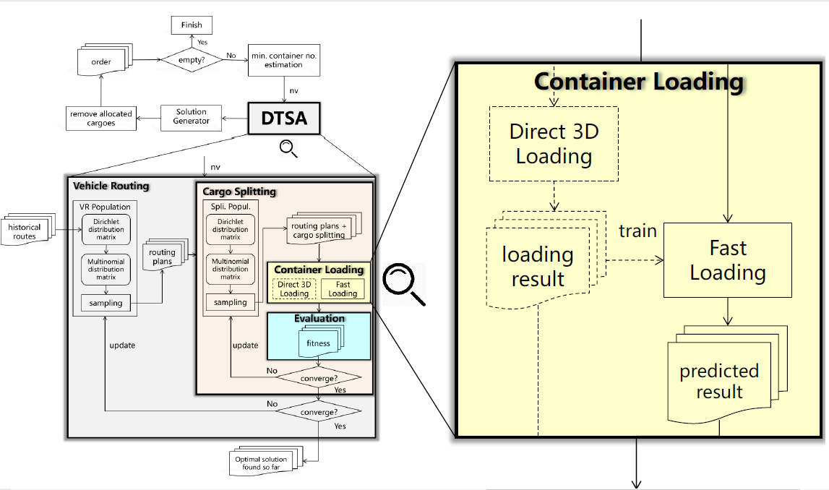
3. Container Loading:
Evaluate how these plans are good when loading them into containers
Evaluate fitness of container loading:
High volume utilization rate (rVOL)
High weight utilization rater(rWGH)
Two solutions:
Direct 3D loading
Eight practical 3D loading heuristics to generate exact loading
Fast loading
Make use of learning model (GBDT)

Slide 11

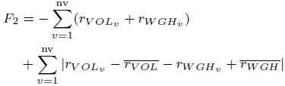
4. Solution Evaluation:
The transportation cost resulting from routing plan and its corresponding optimal cargo splitting can be measured in terms of:
Travel complexity of the vehicle
Number of used containers

Slide 12
Evaluation:
The test dataset is extracted from the historical delivery orders in 2017 where 30 delivery orders are sampled from each month. (360 delivery orders which differ in the number of cargoes, categories and collection points)
Compared algorithm with SGA, DPSO, TS
Used four major multi-objective fitness assignment method: NSGA, SPEA, Indicator based selection, MOEA

Slide 13
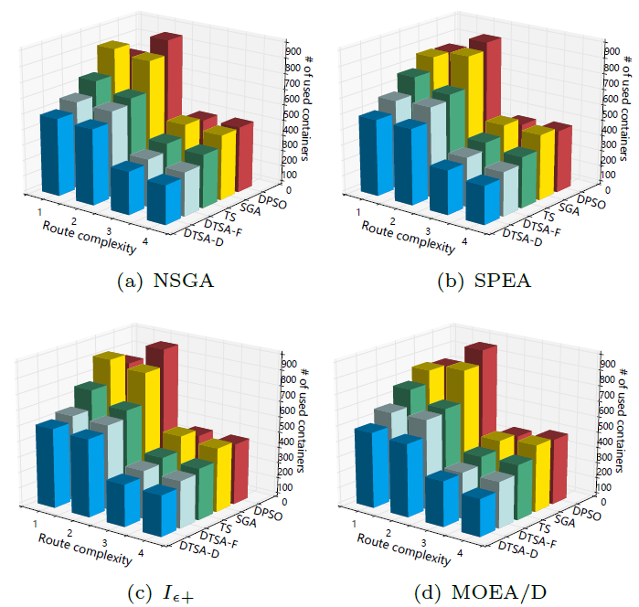
Optimization Performance:

Slide 14
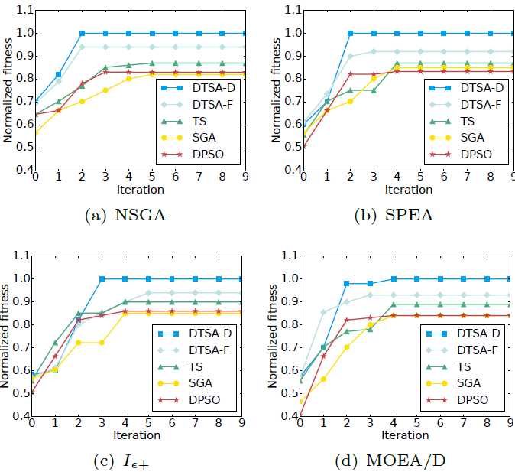
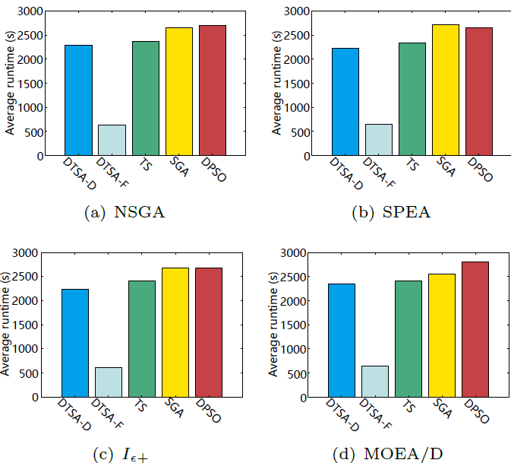
Efficiency Evaluation:
Convergence
Execution Time

Slide 15
Conclusion:
DTSA-D and DTSA-F outperform other benchmark algorithms in both effectiveness and efficiency
DTSA-D can save 12.7% more containers than DTSA-F with four times the time consumption. Considering the constraint of 15 minutes for processing and optimizing each delivery order, DTSA-F was recommended over DTSA-D

Slide 16
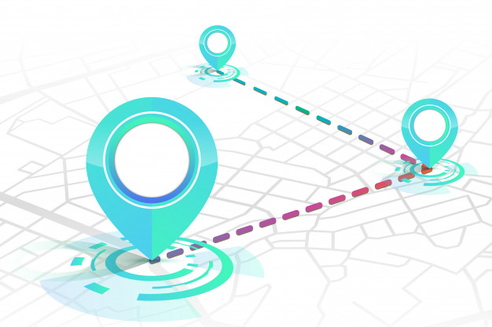
Thank You

