Slide 1

Psychographic Information
Goals/Aspiration
Behavioral Information
Regularly conducting periodic tests.
Identify potential health issues early through regular medical tests.
Optimize time management between work, family, and medical checkups.
Stay within budget while ensuring high-quality healthcare services.
Gain access to convenient at-home testing services if needed.
discuss test result and support services.
Buying Behavior: Prefers recommended and highly-rated medical labs.
Product Usage: long pregnancy period and after chekup
Technology Usage: facebook,whattsapp
Challenges/Pain Points
PregnantWoman
fast and accurate result with digital access.
High costs of comprehensive pregnancy test packages
Difficulty in keeping up with frequent checkups due to work or household responsibilities
Long waiting times at medical labs
Anxiety about test results and the impact on the baby.
Background & Demographics
Age :28:35
Location :damaitta
Gender:female
Education:University Graduate
Profession:Employee / Homemaker
Marital Status:Married
Income:Middle to Upper Middle Class
Childern:First-time mother or has previous children
Motivations & Influences
Doctor’s recommendations for periodic testing.
Desire for reassurance about the baby’s health.
labs Fear of complications or undetected issues.
Recommendations from other mothers.
Online reviews and testimonials about lab services.
Media Consumption:
Pregnancy blogs, health podcasts, and medical news.
Social media groups for expecting mothers.
YouTube videos on pregnancy wellness and nutrition.
Personality Traits
Balanced; enjoys social interactions but prefers privacy in medical matters.
Risk Tolerance: Cautious, prioritizes accuracy and reliability over convenience.
Decision-Making Style: Research-driven; seeks recommendations from doctors and trusted sources.
Values & Beliefs
Health and safety come first, both for herself and her baby.Prefers accuracy and quality in medical testing over low cost.Believes in scientific and medical advancements for pregnancy care.
Lifestyle
Regularly follows pregnancy and parenting pages,bolgs,Engages in prenatal yoga or light exercise.

Slide 2

Psychographic Information
Goals/Aspiration
فقدان الوزن بطريقة صحية ومراقبة تأثيرئ النظام الغذائي على صحته.
التأكد من أن فقدان الوزن لا يسبب له نقصًا في الفيتامينات أو المعادن الأساسية.
تجنب أي مضاعفات صحية قد تنجم عن اتباع حمية غذائية قاسية.
متابعة التحاليل الطبية لضمان سلامة وظائف الجسم أثناء فقدان الوزن
Behavioral Information
يفضل المعامل القريبة من منزله أو مكان عمله.
يبحث عن تقييمات جيدة من العملاء السابقين. يفضل المعامل التي تقدم نتائج سريعة ودقيقة. يفضل المعامل التي تقدم عروضًا أو باقات تحاليل بأسعار مناسبة
يفضل المعامل التي توفر إمكانية سحب العينة من المنزل.
يفضل المعامل التي تتيح ارسال الكتروني للنتائج
mr:Ahmed
Challenges/Pain Points
j
عدم معرفته بأهمية بعض التحاليل التي يجب إجراؤها أثناء الرجيم.
البحث عن معمل تحاليل يقدم خدمات موثوقة بأسعار مناسبة.
عدم توافر الوقت الكافي للذهاب إلى المعمل بسبب ضغط العمل.
الخوف من نتائج التحاليل التي قد تشير إلى مشاكل صحية غير متوقعة
Background & Demographics
Age :35
Location:damitta
Gender:male
Education:Bachelor of Arts and Education
Profession:Office Worker
Marital Status :married
Income :8000
Children:2
Motivations & Influence
السوشيال ميديا: يتابع صفحات معامل التحاليل على فيسبوك وإنستجرام. مواقع البحث: يبحث عن أفضل المعامل القريبة منه على جوجل. نصيحة الطبيب أو أخصائي التغذية: يعتمد على توصية الأطباء بشأن المعمل الموثوق. تجارب الأصدقاء والعائلة: يثق في آراء من قاموا بإجراء التحاليل سابقًا.
Personality Traits
يؤمن بأهمية التغير للحصول علي صحة جيدة
يفضل الحلول الصحية المستدامة
Values & Beliefs
الحصول علي معلومات موثوقة من الأطباء والمتخصصين قبل اتخاذ أي قرارات تتعلق بصحته
يفضل المعامل التي تقدم استشارات وتفسيرات مبسطة للنتائج
Lifestyle
يفضل البقاء في المنزل بعد العمل ويقضي معظم وقته مع عائلته
يبحث عن خدمات مريحة
مثل توصيل الأطعمة الصحية وخدمة سحب العينات من المنزل لإجراء التحاليل.

Slide 3
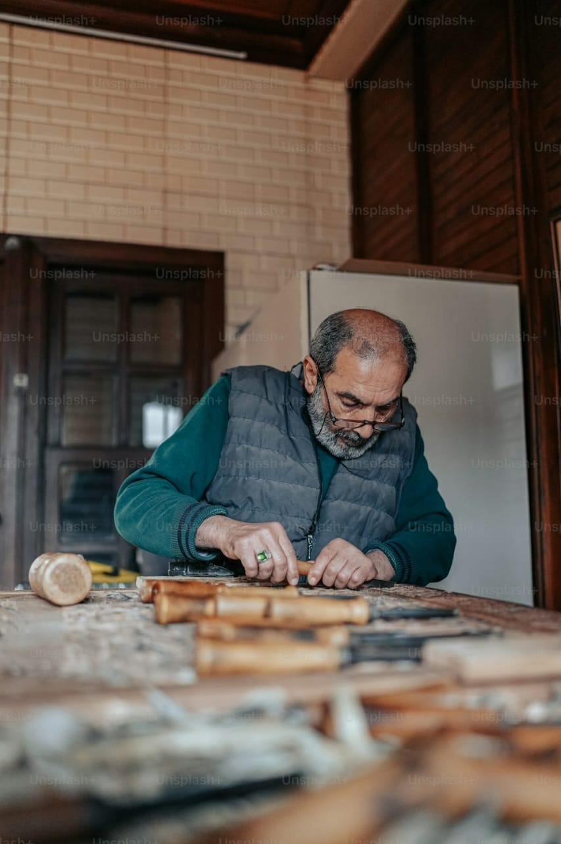
Psychographic Information
Goals/Aspirations What they aim to achieve personally and professionally.
Primary/secondary goals? Personal vs professional goals? Top metrics they track? Motivations?
Behavioral Information
Buying Behavior: بيأخد قرار الشرا بناء على الخدمه اللى هيتلاقاها و مدى احتياجه ليها
Product Usage: بيحتاج يحلل كل 6 شهور تحليل سيوله و تحليل وظائف كبد وكلى كل من 6 شهور لسنه
Technology Usage: whatsapp, facebook
محتاج معمل تحاليل يحسن التعامل مع المرضى و لا ينتظر وقت كبير
نفسه فى معمل تحاليل يفكره بمواعيد التحاليل الدورية و يشرحله نتائجها بطريقه بسيطه و يقدم ليه النصايح
عاوز معمل تحاليل يثق فى النتائج بتاعته ويعتبره صديق العائله علشان يبعت أحفاده يعملوا تحاليل صوره دم ويطمن عليهم باستمرار
أسعاره مناسبه و بيعمل باقات للأسر أو خصومات
معمل التحاليل يبعتله النتايج على الواتساب لأنه مش بيحب الخروج كثيرا
Ebrahim El said
Challenges/Pain Points What does this person struggle with in relation to meeting goals? What serves as a roadblock for this person’s success? Problems they need solutions for.
Background & Demographics Job? Career path? Family? Lifestyle? Spending habits? Age? Income? Location? Gender identity?
عنده مرض السكرى و الضغط و مشاكل فى القلب و بينسى يعمل تحاليل المتابعه لوظائف الكبد والكلى والسيولة
لا يحب الانتظار
Motivations & Influences
Motivators: احتياجه للخدمه اللى هيشتريها مقابل سعرها
Influences: (friends, family(
Media Consumption: Preferred media channels (facebook, whatsapp).
Age : 60
Location دمياط القديمه:
Gender :male
Education تعليم متوسط :
Profession نجار
Marital Status : married
Income : 8000
Childern : 3 married
Personality Traits
اجتماعى و بيحب يجرب أشياء جديده وعندما يجرب خدمه وتعجبه بيحب يكمل معاهم
Values & Beliefs
يهتم بصحته و صحة أحفاده و عائلته
Lifestyle
يحب مقابلة أحفاده و الحكى معهم و يحب لعب الطاولة و مقابلة أصدقاؤه على القهوه

Slide 4

Psychographic Information
Goals/Aspirations
Looks for a reliable lab that provides accurate and fast results for his father and runs by experienced doctors who offer professional medical advice.
Prefers convenient services like home sample collection and digital result delivery and digital payment like vodafone cash and instapay
Wants clear, easy-to-understand explanations of test results.
Ensures his father’s health by arranging regular medical tests.
Behavioral Information
Buying Behavior: Prefers labs recommended by doctors and friends. online Prefers digital payments
Product Usage: Requires regular tests for his father, including diabetes, thyroid, kidney and liver function, and heart screenings.
Technology Usage: mobile, whatsapp, facebook, Instagram, youtube
Omar Osama
Challenges/Pain Points
His demanding job leaves little time to accompany his father for medical tests.
Worries about his father’s health and seeks trustworthy, efficient service.
Struggles to understand some medical terminologies in test reports.
Concerned about overpriced or unreliable lab services.
Background & Demographics Job? Career path? Family? Lifestyle? Spending habits? Age? Income? Location? Gender identity?
Motivations & Influences
Motivators: Wants the best care for his father with minimal efforts.
Influences: doctor recommendations, friends, family, reviews
Media Consumption: Preferred media channels face book, you tube, Instagram, medical websites for senior healthcare insights.
Age: 40
Location: dammietta
Gender: male
Education: Bachelor's degree in Engineering
Profession: Petroleum Engineer
Marital Status: married
Income: 15000
Childern: 3
Personality Traits
Prefers quick, direct solutions that save time and effort.
Feels a duty to care for his father but struggles with time constraints due to work.
Doesn’t trust services easily and prefers recommendations and reviews before making a decision.
Values & Beliefs
Prioritizes his family and his father’s well-being and seeks the best possible care with minimal hassle.
Lifestyle
Spends long hours at work, go to the gym.
Tech-Savvy & Digital Consumer

Slide 5

Psychographic Information
Goals/Aspirations What they aim to achieve personally and professionally.
Primary/secondary goals? Personal vs professional goals? Top metrics they track? Motivations?
Behavioral Information
Buying Behavior: بتأخد برأى اصحابها و أقاربها والريفيوهات من الفيسبوك علشان تشترى او تدفع تمن خدمه
Product Usage: محتاجه تحلل لابنها سكر تراكمى كل ٦ شهور مع متابعه اى تحاليل اخرى خاصه بالمرض
Technology Usage: بتستخدم واتساب أساسى و فيسبوك و انستجرام و يوتيوب
نفسها فى مكان بيعرف يتعامل مع الأطفال و عندهم خبره فى سحب عينات الأطفال لأن ابنها محتاجه تحلله سكر تراكمى كل ٦ شهور
دقه النتائج و أسعار مخفضه و متابعه باقى التحاليل الخاصه بحالته مثل تحاليل الدهون وصوره الدم
مكان يقدر يقارن ليها نتايج التحاليل بالتحاليل السابقه
حد يطمنها على صحه ابنها و تلاقى جيم مناسب للأطفال و يعطيها نصايح للتغذيه
Reem khaled
Challenges/Pain Points What does this person struggle with in relation to meeting goals? What serves as a roadblock for this person’s success? Problems they need solutions for.
Background & Demographics Job? Career path? Family? Lifestyle? Spending habits? Age? Income? Location? Gender identity?
خايفه من مضاعفات مرض السكرى
ازاى تشجعه انه يقلل السكريات و يفهم طبيعه مرضه و ضروره التزامه بالدواء و يمارس رياضه
خايفه يحصله غيبوبة سكر فى مكان يكون بعيد عنها زى المدرسه
توعيه زملائه فى المدرسه بعدم تناول الحلويات أمامه
Motivations & Influences
Motivators:خوفها على صحه ابنها
Influences: بتتأثر بقراءتها و رأى عائلتها وأصدقائها وريفيوهات
Media Consumption: Preferred media channels (whatsapp,facebook, podcasts,blogs, Instagram, youtube)
Age: 38
Location: دمياط القديمة
Gender: female
Education: تجارة
Profession: house wife
Marital Status: married
Income of her husband: 7000
Childern: 1 has 10 years old and diagnosed recenraly with diabetes, he likes chocolate and obese
Personality Traits
شخصيه اجتماعية و بتأخد برأى الريفيوهات وتجارب الناس خصوصا فى الأشياء اللى تخص عائلتها
Values & Beliefs
الأولوية لعائلتعا وخصوصا ابنها الوحيد
Lifestyle
بتحب القراءة و الخروج و الطبيخ.

Slide 6

Psychographic Information
Goals/Aspirations
Behavioral Information
Maintain her health and undergo regular medical tests for her chronic diseases( auto immune disease) in trusted lab, accurate results, professional team
Rely on home services for convenience espiceally in cold weather and to avoid transportation issues
Lab sends her results on whatsapp and gives her advice
Buying Behavior: Prefers medical services that come to her home
Relies on doctors’ recommendations or friends’ experiences when choosing labs
Willing to pay extra for comfort and excellent customer service
Product Usage: Needs regular lab tests to monitor chronic conditions
Technology Usage: mobile, whatsapp. facebook
Nadia Ahmed
Challenges/Pain Points
Difficulty moving around due to respiratory allergies as she is asthmatic and beside that she dosent like going out in cold weather
Rely on her children and they are always busy in their work and life so she wants home services
Background & Demographics Job? Career path? Family? Lifestyle? Spending habits? Age? Income? Location? Gender identity?
Motivations & Influences
Motivators: Her Convenience and the ability to get tests done at home.
Reduce visits to hospitals and medical centers as much as possible.
Her fear from disease complication
Influences: Doctors’ recommendations, Friends and family experiences, reviews, the lab’s reputation and service quality
Media Consumption: Television, WhatsApp and Facebook
Age: 65
Location: Dammietta
Gender: female
Education: bachelor of engineer
Profession: retired
Marital Status : widowed
Income: 7000
Childern: 4 married
Personality Traits
Prefers routine and relies on previously tried services
Seeks comfort and personal care in medical services
Prefers dealing with service providers who respect her privacy and treat her kindly
Values & Beliefs
Values comfort and personal attention
Prefers reputable and trustworthy medical services
Lifestyle
Spends most of her time at home, especially in winter and enjoys watching religious and social TV programs

