Slide 1

Psychographic Information
Goals/Aspiration
Behavioral Information
Regularly conducting periodic tests.
Identify potential health issues early through regular medical tests.
Optimize time management between work, family, and medical checkups.
Stay within budget while ensuring high-quality healthcare services.
Gain access to convenient at-home testing services if needed.
discuss test result and support services.
Buying Behavior: Prefers recommended and highly-rated medical labs.
Product Usage: long pregnancy period and after chekup
Technology Usage: facebook,whattsapp
Challenges/Pain Points
PregnantWoman
fast and accurate result with digital access.
High costs of comprehensive pregnancy test packages
Difficulty in keeping up with frequent checkups due to work or household responsibilities
Long waiting times at medical labs
Anxiety about test results and the impact on the baby.
Background & Demographics
Age :28:35
Location :damaitta
Gender:female
Education:University Graduate
Profession:Employee / Homemaker
Marital Status:Married
Income:Middle to Upper Middle Class
Childern:First-time mother or has previous children
Motivations & Influences
Doctor’s recommendations for periodic testing.
Desire for reassurance about the baby’s health.
labs Fear of complications or undetected issues.
Recommendations from other mothers.
Online reviews and testimonials about lab services.
Media Consumption:
Pregnancy blogs, health podcasts, and medical news.
Social media groups for expecting mothers.
YouTube videos on pregnancy wellness and nutrition.
Personality Traits
Balanced; enjoys social interactions but prefers privacy in medical matters.
Risk Tolerance: Cautious, prioritizes accuracy and reliability over convenience.
Decision-Making Style: Research-driven; seeks recommendations from doctors and trusted sources.
Values & Beliefs
Health and safety come first, both for herself and her baby.Prefers accuracy and quality in medical testing over low cost.Believes in scientific and medical advancements for pregnancy care.
Lifestyle
Regularly follows pregnancy and parenting pages,bolgs,Engages in prenatal yoga or light exercise.

Slide 2

Psychographic Information
Goals/Aspiration
Behavioral Information
Losing weight in a healthy way and monitoring the impact of the diet on his health.
Ensuring that weight loss does not cause a deficiency in essential vitamins or minerals.
Avoiding any health complications that may result from following a strict diet.
Tracking medical tests to ensure the body's functions remain safe during weight loss.
Prefers laboratories close to his home or workplace that provide fast and accurate results.
Looks for laboratories that offer affordable test packages or special offers.
Prefers laboratories that provide home sample collection services.
Prefers laboratories that offer electronic delivery of test results.
mr:Ahmed
Challenges/Pain Points
j
Not knowing the importance of certain tests that should be done during a diet.
Searching for a laboratory that offers reliable services at reasonable prices.
Lack of enough time to visit the lab due to work pressure.
Fear of test results that may indicate unexpected health issues.
Background & Demographics
Age :35
Location:damitta
Gender:male
Education:Bachelor of Arts and Education
Profession:Office Worker
Marital Status :married
Income :8000
Children:2
Motivations & Influence
Social Media:
Follows laboratory pages on Facebook and Instagram.
Search Engines:
Searches for the best nearby laboratories on Google.
Doctor or Nutritionist Advice:
Relies on doctors' recommendations for trusted laboratories.
Friends and Family Experiences:
Trusts the opinions of those who have previously undergone tests.
Personality Traits
Believes in the importance of change to achieve good health.
Prefers sustainable healthy solutions.
Values & Beliefs
Seeks reliable information from doctors and specialists before making any health-related decisions. Prefers laboratories that provide consultations and simplified explanations of test results.
Lifestyle
refers staying at home after work and spends most of his time with his family.
Looks for convenient services such as healthy food delivery and home sample collection for medical tests.

Slide 3
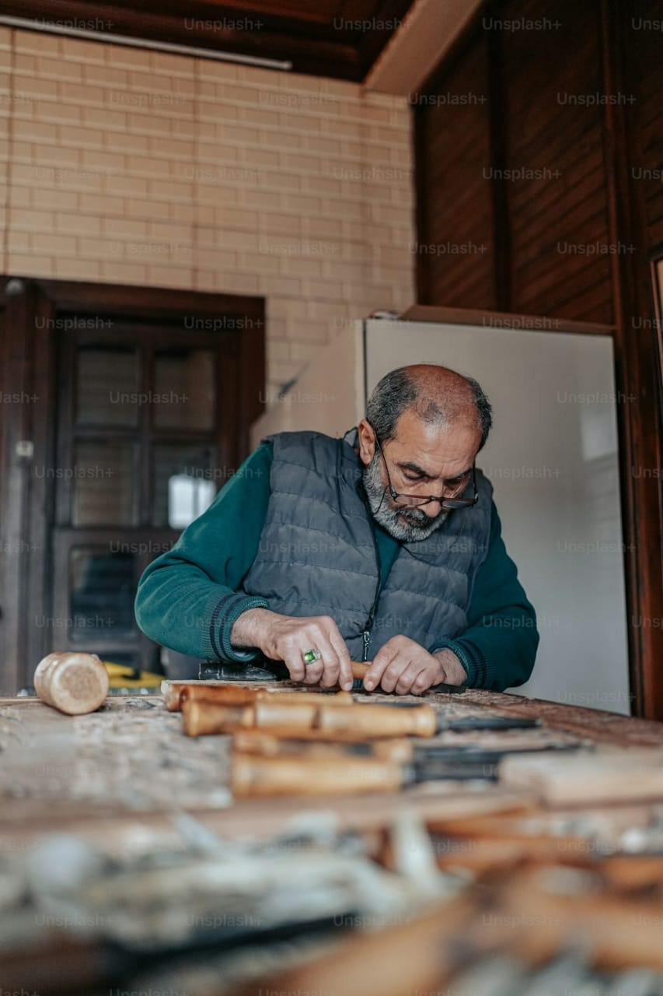
Psychographic Information
Goals/Aspirations
Needs medical lab :
with high accurate and reliable results to monitor diabetes progression and adjust treatment accordingly, respecpect customers and care about them, provide trusted advices and simple explanation of results
Needs regular reminders for necessary tests. Prefers the laboratory to offer special discounts for recurring customers and their families.
Prefers receiving test results digitally via whatsapp
Behavioral Information
Buying Behavior: Makes decisions based on the value for service and his level of need for it.
Product Usage: Needs to perform tests every six months, including routine tests and kidney function analysis.
Technology Usage: WhatsApp, Facebook.
Ebrahim El said
Challenges/Pain Points
Can not understand laboratory results.
Forgets the periodic times for his medical tests for monitoring his condition(diabetes, cardiac, hypertensive)
doesn't like going out frequently.
Cannot tolerate long waiting times.
Background & Demographics
Motivations & Influences
Motivators: his desire to monitor his health and the health of his family.
Influences: (friends, family)
Media Consumption: Preferred media channels (facebook, whatsapp).
Age : 60
Location : Dammietta
Gender: male
Education : intermediate education
Profession: merchant
Marital Status : married
Income : 8000
Childern : 3 married
Personality Traits
Does not like trying new things and when he tries a service and likes it, he becomes fully loyal to it.
Values & Beliefs
Values his health and cares deeply about his family.
Lifestyle
Spends more time with his family.

Slide 4

Psychographic Information
Goals/Aspirations
Looks for a reliable lab that provides accurate and fast results for his father and runs by experienced doctors who offer professional medical advice.
Prefers convenient services like home sample collection and digital result delivery and digital payment like vodafone cash and instapay
Wants clear, easy-to-understand explanations of test results.
Ensures his father’s health by arranging regular medical tests.
Behavioral Information
Buying Behavior: Prefers labs recommended by doctors and friends. online Prefers digital payments
Product Usage: Requires regular tests for his father, including diabetes, thyroid, kidney and liver function, and heart screenings.
Technology Usage: mobile, whatsapp, facebook, Instagram, youtube
Omar Osama
Challenges/Pain Points
His demanding job leaves little time to accompany his father for medical tests.
Worries about his father’s health and seeks trustworthy, efficient service.
Struggles to understand some medical terminologies in test reports.
Concerned about overpriced or unreliable lab services.
Background & Demographics Job? Career path? Family? Lifestyle? Spending habits? Age? Income? Location? Gender identity?
Motivations & Influences
Motivators: Wants the best care for his father with minimal efforts.
Influences: doctor recommendations, friends, family, reviews
Media Consumption: Preferred media channels face book, you tube, Instagram, medical websites for senior healthcare insights.
Age: 40
Location: dammietta
Gender: male
Education: Bachelor's degree in Engineering
Profession: Petroleum Engineer
Marital Status: married
Income: 15000
Childern: 3
Personality Traits
Prefers quick, direct solutions that save time and effort.
Feels a duty to care for his father but struggles with time constraints due to work.
Doesn’t trust services easily and prefers recommendations and reviews before making a decision.
Values & Beliefs
Prioritizes his family and his father’s well-being and seeks the best possible care with minimal hassle.
Lifestyle
Spends long hours at work, go to the gym.
Tech-Savvy & Digital Consumer

Slide 5
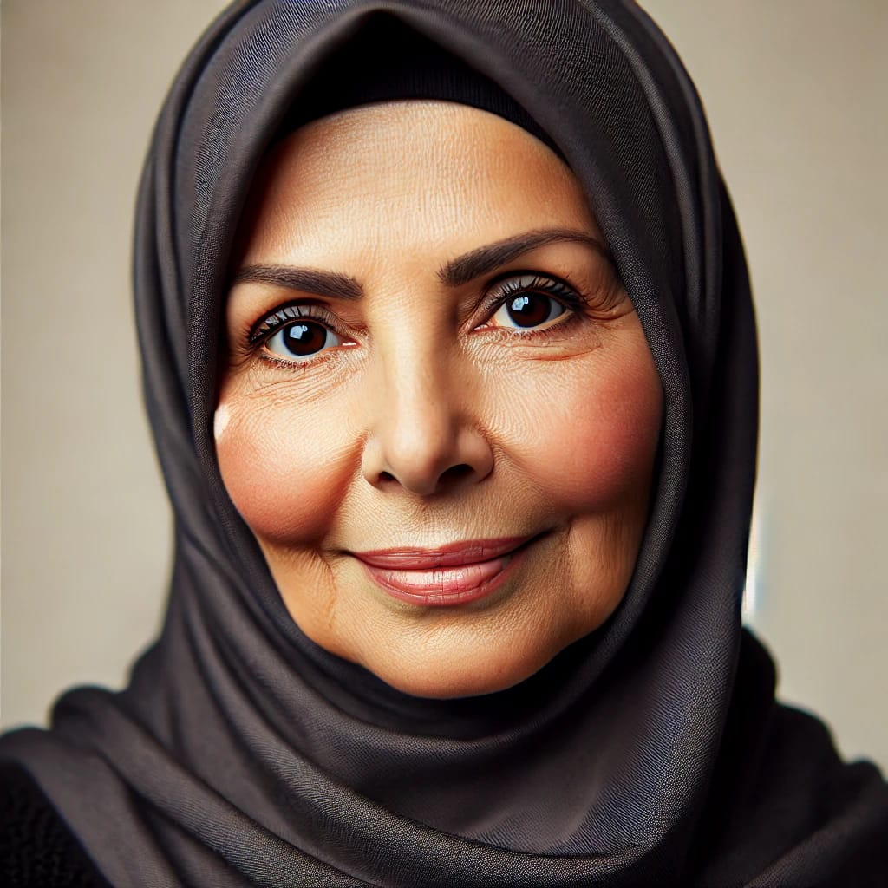
Psychographic Information
Goals/Aspirations
Behavioral Information
Maintain her health and undergo regular medical tests for her chronic diseases( auto immune disease) in trusted lab, accurate results, professional team
Rely on home services for convenience espiceally in cold weather and to avoid transportation issues
Lab sends her results on whatsapp and gives her advice
Buying Behavior: Prefers medical services that come to her home
Relies on doctors’ recommendations or friends’ experiences when choosing labs
Willing to pay extra for comfort and excellent customer service
Product Usage: Needs regular lab tests to monitor chronic conditions
Technology Usage: mobile, whatsapp. facebook
Nadia Ahmed
Challenges/Pain Points
Difficulty moving around due to respiratory allergies as she is asthmatic and beside that she dosent like going out in cold weather
Rely on her children and they are always busy in their work and life so she wants home services
Background & Demographics Job? Career path? Family? Lifestyle? Spending habits? Age? Income? Location? Gender identity?
Motivations & Influences
Motivators: Her Convenience and the ability to get tests done at home.
Reduce visits to hospitals and medical centers as much as possible.
Her fear from disease complication
Influences: Doctors’ recommendations, Friends and family experiences, reviews, the lab’s reputation and service quality
Media Consumption: Television, WhatsApp and Facebook
Age: 65
Location: Dammietta
Gender: female
Education: bachelor of engineer
Profession: retired
Marital Status : widowed
Income: 7000
Childern: 4 married
Personality Traits
Prefers routine and relies on previously tried services
Seeks comfort and personal care in medical services
Prefers dealing with service providers who respect her privacy and treat her kindly
Values & Beliefs
Values comfort and personal attention
Prefers reputable and trustworthy medical services
Lifestyle
Spends most of her time at home, especially in winter and enjoys watching religious and social TV programs

Slide 6
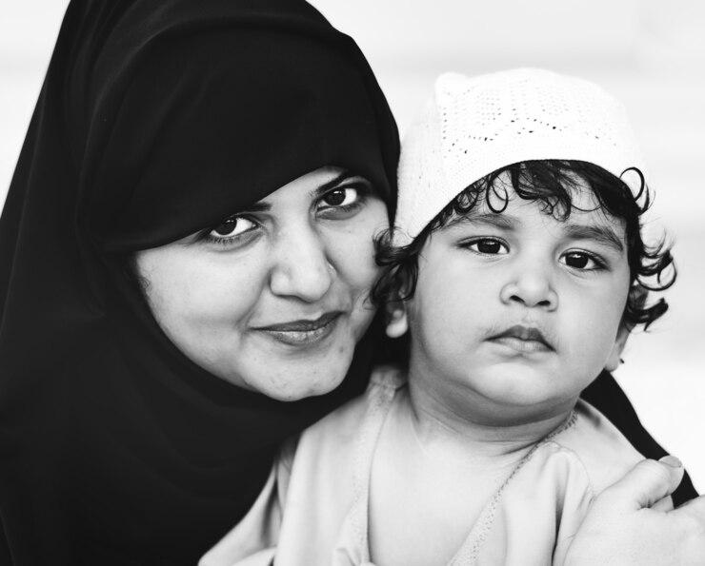
Psychographic Information
Behavioral Information
Consulting friends and family: Relies on the opinions of close ones before making a purchase decision or paying for a service.
Checking reviews on Facebook: Reads reviews and comments on Facebook to get feedback and opinions from others.
Ensuring quality: Prefers to confirm the quality of the service or product before paying, based on others' experiences.
Attraction to special offers: May be drawn to offers or discounts that provide healthcare services at affordable prices.
Product Usage:
She needs to perform tests for her child every 6 months, along with monitoring any other tests related to his health condition.
Technology Usage:
She uses WhatsApp primarily, along with Facebook, Instagram, and YouTube.
Finding a healthcare provider experienced in handling children’s blood samples.
Seeking affordable healthcare services for her child, including discounted prices for lab tests.
Finding a facility that offers a full range of child-specific health tests (e.g., lipid profile, blood count,HA1C).
Ensuring accurate, reliable test results for her child’s health and monitoring their condition over time.
Comparing current test results with previous ones for better health monitoring.
Goals/Aspirations
Reem khaled
Challenges/Pain Points
Lack of specialized places for drawing blood samples from children.
High costs of specialized tests and examinations.
Concern about the accuracy of results or the reliability of laboratories.
Difficulty in comparing current test results with previous ones.
Background & Demographics
Motivations & Influences
Motivators:
Her desire to ensure her child's health and provide the best possible healthcare for him.
Influences:
She is influenced by her family’s and friends' opinions, personal experiences, and reviews she reads online, especially on social media.
Media Consumption:
Preferred media channels (whatsapp,facebook, , Instagram, youtube)
Age: 38
Location: old damitta
Gender: female
Education:bcs.commerce
Profession: house wife
Marital Status: married
Income of her husband: 7000
Childern: 1 has 10 years old and diagnosed recenraly with diabetes, he likes chocolate and obese
Personality Traits
Responsible,Caring about her child's health,Detail-oriented and practicaL,Ambitious,Seeks reassurance and peace of mind
Values & Beliefs
Child's health comes first, affordable healthcare, importance of health knowledge, trust in experts, and emotional reassurance through reliable care.
Lifestyle
She focuses on caring for her family, keeps up with the latest medical information, strives for a balance between her personal life and caring for her child, and pays attention to health and proper nutrition.

