Slide 1
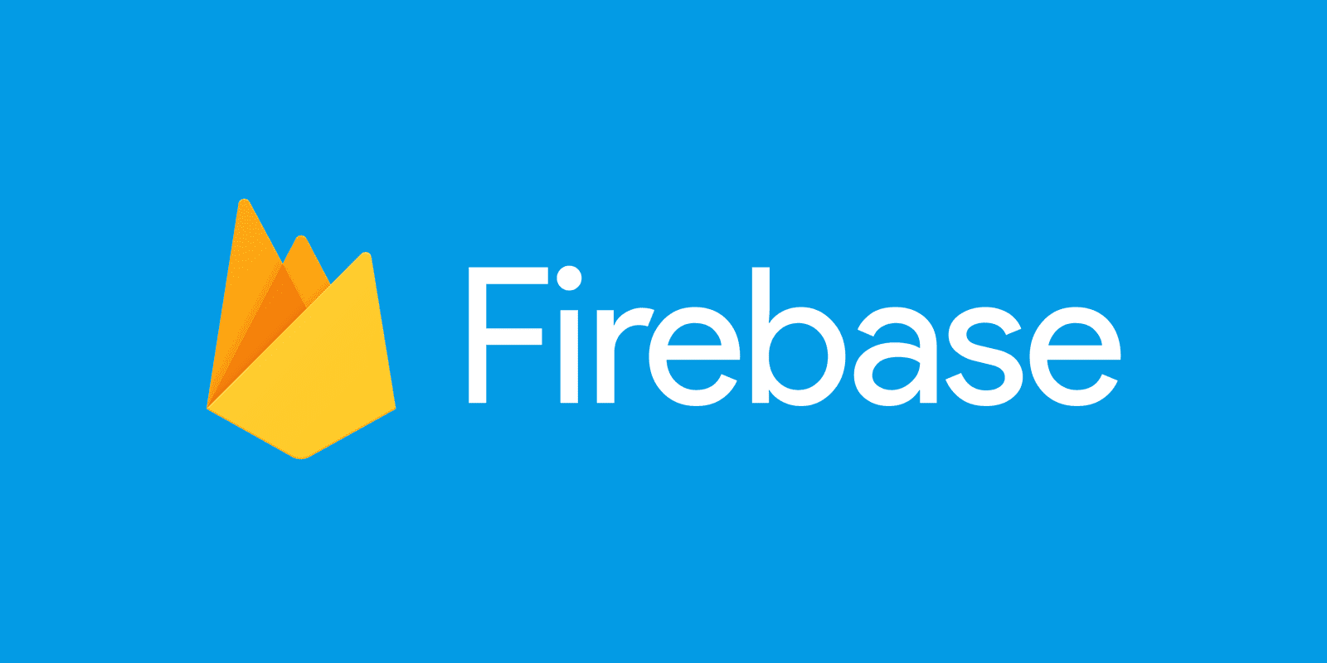

Slide 2

«Firebase is a mobile and web application platform with tools and infrastructure designed to help developers build high-quality apps»*
Notes:
For Apps to share and store data from a server is a bit complicated, So here is firebase, a platform developed by Google for creating mobile and web applications.
it’s a Cloud-hosted, NoSQL jSON like database that allows storing a list of objects in the form of a tree.

Slide 3
A set of tools which provides a full suite for app development
Ability to create applications with no server-side programming
Backend as a Service
Notes:
Firebase is a development platform known originally for its realtime database that’s still at its core a multi-node, key-value database optimized for synchronizing data, often between user machines or smartphones and centralized storage in the cloud. It’s designed to make life easier for developers by handling much of the pushing and pulling of data. That relieves app developers of the programming burdens associated with managing versions or locations. They can write the new bits to Firebase and the data will be consistent throughout the system.
is a Backend-as-a-Service (Baas). Backend-as-a-Service (BaaS) is a cloud service model in which developers outsource all the behind-the-scenes aspects of a web or mobile application so that they only have to write and maintain the frontend

Slide 4

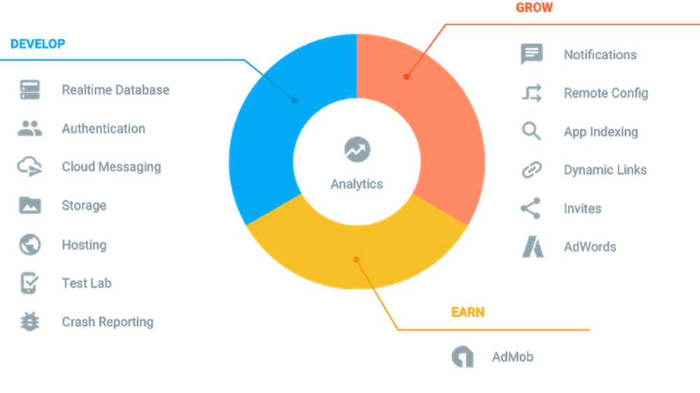
Notes:
a Backend-as-a-Service provides developers with a variety of tools and services to help them develop quality apps, grow their user base, make smart data driven decisions and earn profit.

Slide 5

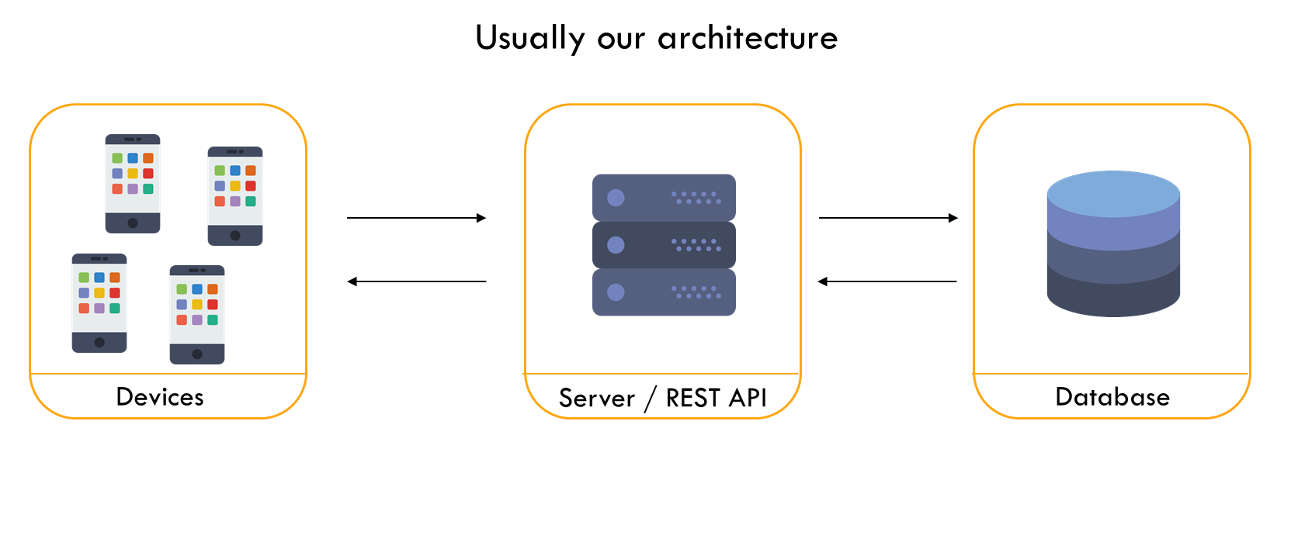
Notes:
When you’re looking to develop an application in the traditional method, there’s an inherent need to write codes for frontend and backend software. Firebase triumphs over traditional methods, as it allows you to develop applications without the need for backend codes.

Slide 6
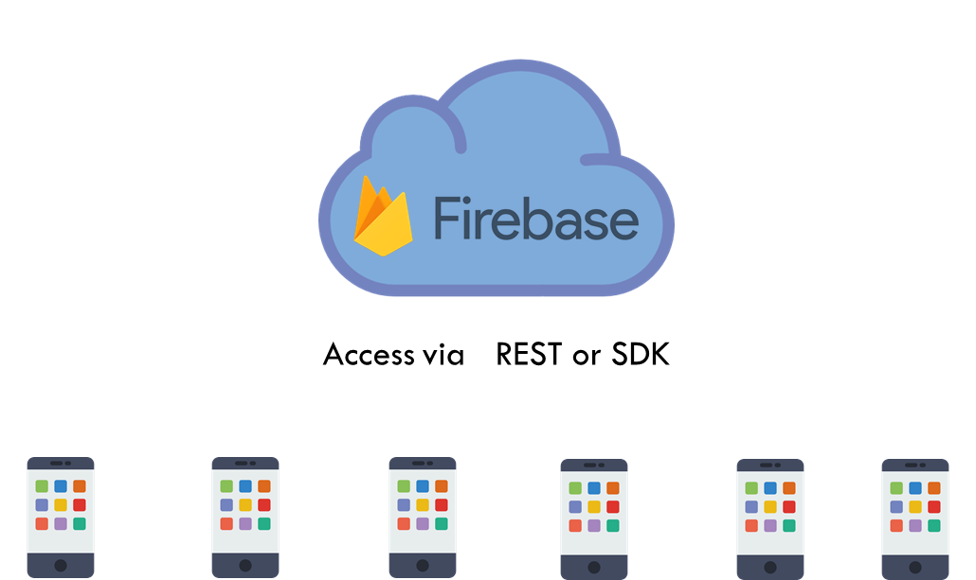
Notes:
But, using Firebase all the behind-the-scenes aspects of a web or mobile application are outsourced to it. Firebase provides you with backend Components that are hosted and maintained by Google over a cloud platform. After registration Firebase provides you with Client SDK’s to interact with the Backend services directly. This allows you to run clients apps without the need for any middleware between them.

Slide 7

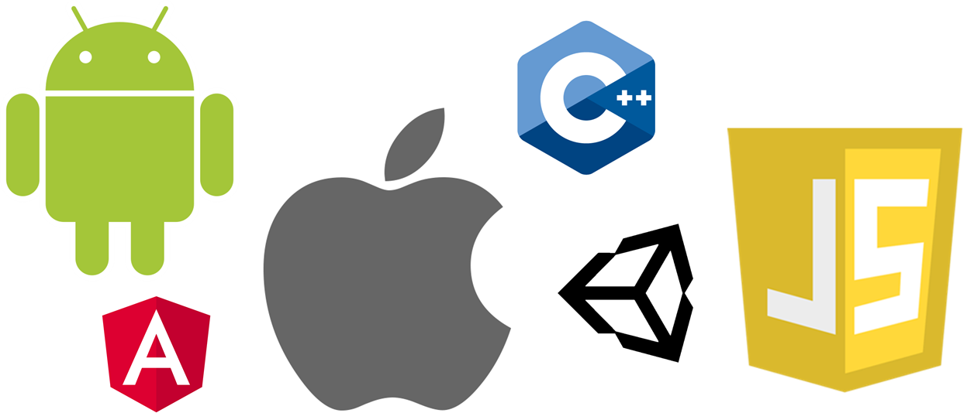

Slide 8

•Install or update Android Studio to its latest version.
•Make sure that your project meets these requirements:
•Targets API level 19 (KitKat) or higher
•Uses Android 4.4 or higher
•Uses Jetpack (AndroidX), which includes meeting these version requirements:
•com.android.tools.build:gradle v3.2.1 or later
•compileSdkVersion 28 or later

Slide 9
•Set up a physical device or use an emulator to run your app.
Note that Firebase SDKs with a dependency on Google Play services require the device or emulator to have Google Play services installed.
•Sign into Firebase using your Google account.

Slide 10

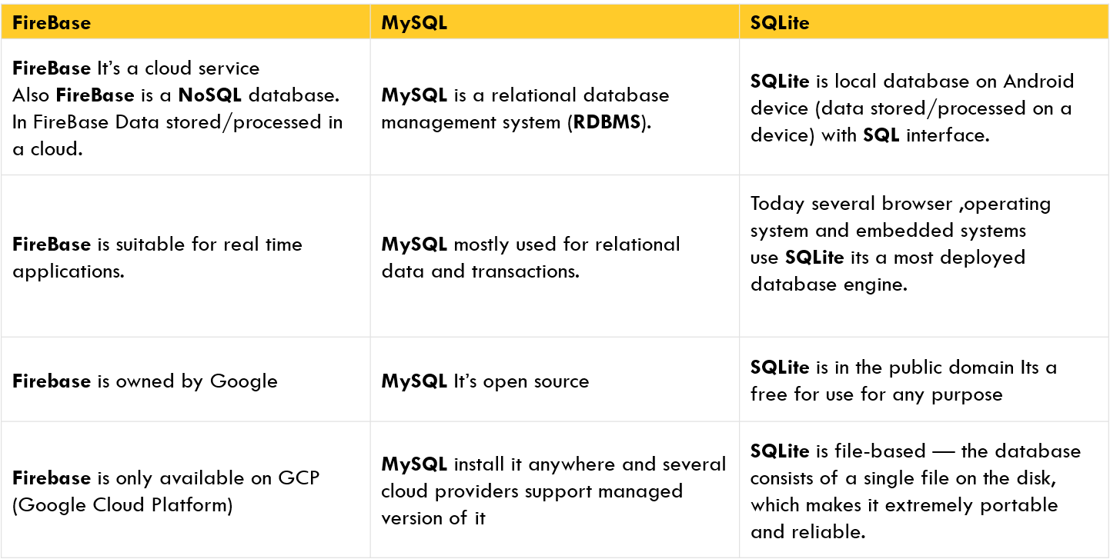
Notes:
As compared to firebase, which is a nosql database, my SQL and SQLite are relational databases.
Firebase is for real time usage, where as MySQL and SQLite are used for transactions most of the times.
Other than that firebase is owned by google so is only available at Google cloud platform, where as MySQL and SQLite are open source and in public domain, so can be install anywhere.

Slide 11

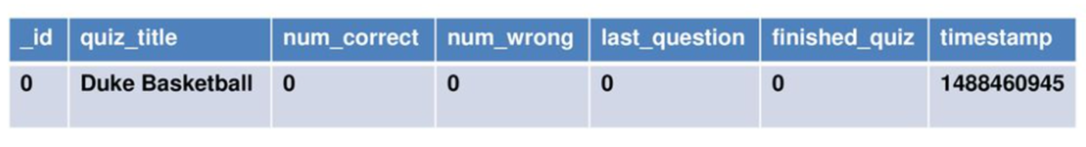
•MYSQL databases are stored as tables
Notes:
MySQL is relational in nature since all the data is stored in different tables and relations are established using primary keys or other keys known as foreign keys.

Slide 12
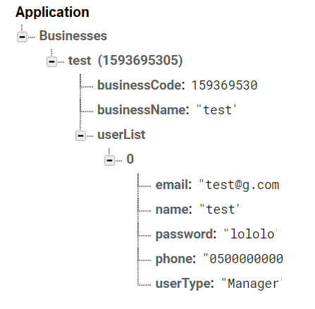
•Firebase databases are stored as a tree
•Access via keys (Strings) that map to values (Objects)
•Objects are stored in JSON format
Notes:
Firebase is one kind of NoSQL database. The Firebase database is just a big JSON object where you can store whatever you want inside. Unlike SQL there’s no schema for the database, no tables, no columns, it’s just a combination of key/value pairs and it gives us a tree like format.

Slide 13

Database options
Free for beginners
Community
Ease of integration

Slide 14

Data storage is inconvenient
Limited data migration
Android centered

Slide 15
Working Of Firebase
understand basic features of fire base
attach fire base to our android app
store data into firebase and how to retrieve that data into our application.

Slide 16
Features of firebase
Secure
authentication, or Real time database
improve app quality by monitor the performance of app.
Responsive
grow business ,user traffic , build business strategies.
Cloud messaging or notification.
Catch errors / app crashing

Slide 17
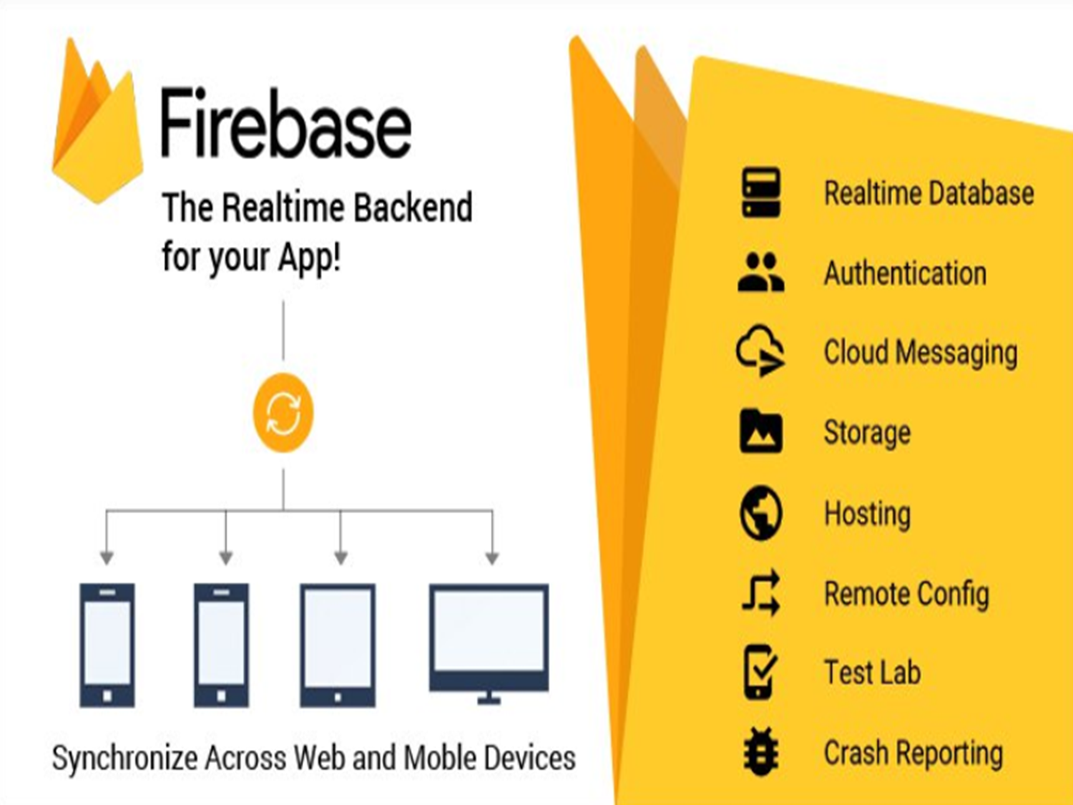

Slide 18
Attach firebase to android app
Two methods
Adding app to firebase console
Installing SDK

Slide 19
go to the firebase console https://firebase.google.com/
create a Firebase project
choose the platform to add Firebase
mention the package name
download the google-services.json file.
add the Firebase SDK

Slide 20
FIREBASE REALTIME DATABASE
Store query and sync data from a cloud.
Use firebase authentication to easily sign in users
Update data , stores data , notify all interested devices.
Store data in json tree structure, key-value pair in memory .
Optimized for offline use.
When ever user losses a connection the database sdk using a local cash. On the device to serve and store changes.
When user come online their local data will automatically synchronized.

Slide 21
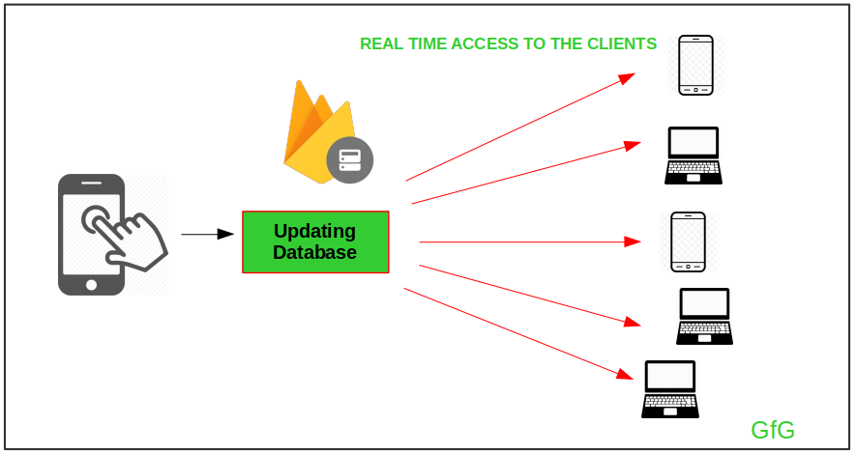

Slide 22
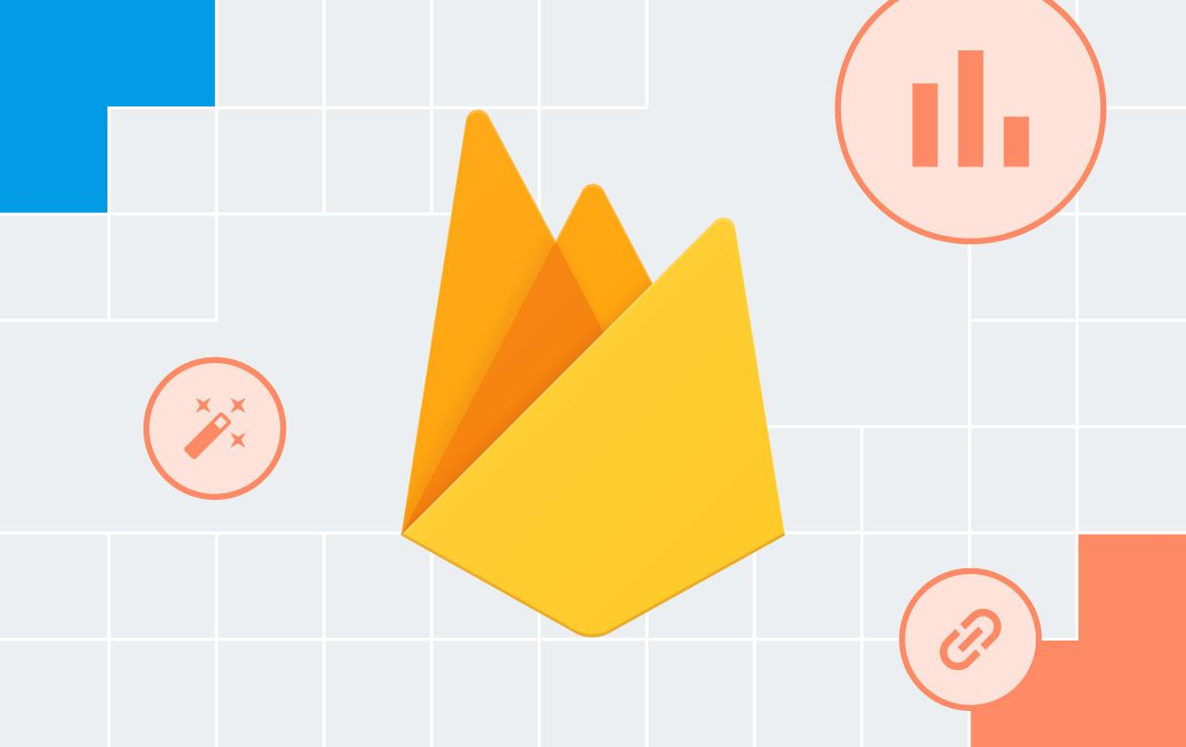
Add Firebase to your Android project
Two Options:
Add Firebase using the Firebase console
Add Firebase using the Firebase Assistant

Slide 23


Option 2: Add Firebase using the Firebase Assistant
Open Android Studio and create a project.
Select the option of tools in a menu bar and then click on Firebase
It will automatically open the assistant of firebase
Click on these two:-
It will automatically add the JSON file and will connect your app with firebase.

Slide 24

Cloud Storage for Firebase
Store and serve
content with ease

Slide 25
Store your users' photos and videos:-
Cloud Storage is designed to help you quickly and easily store and serve user-generated content, such as photos and videos.

Slide 26
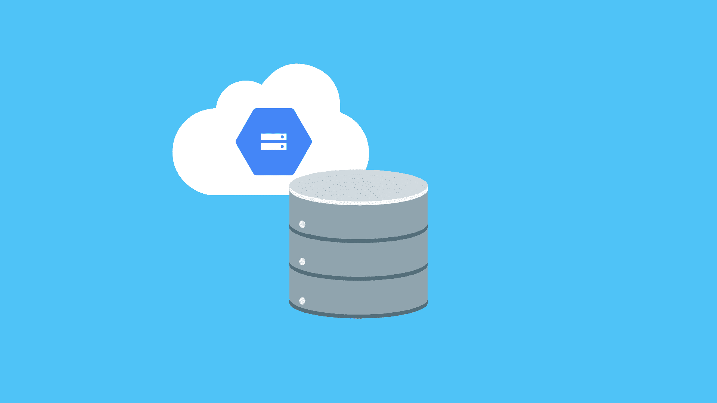
Build at Google scale:-
Infrastructure is built for when your app goes viral. Effortlessly grow from prototype to production using the same technology that powers apps like Spotify and Google Photos.

Slide 27

Robust uploads and downloads:-
Your users aren't always online, so we built the Firebase SDK for Cloud Storage with mobile connectivity in mind. It will automatically pause and resume your transfers as the app loses and regains mobile connectivity, saving your users time and bandwidth.

Slide 28
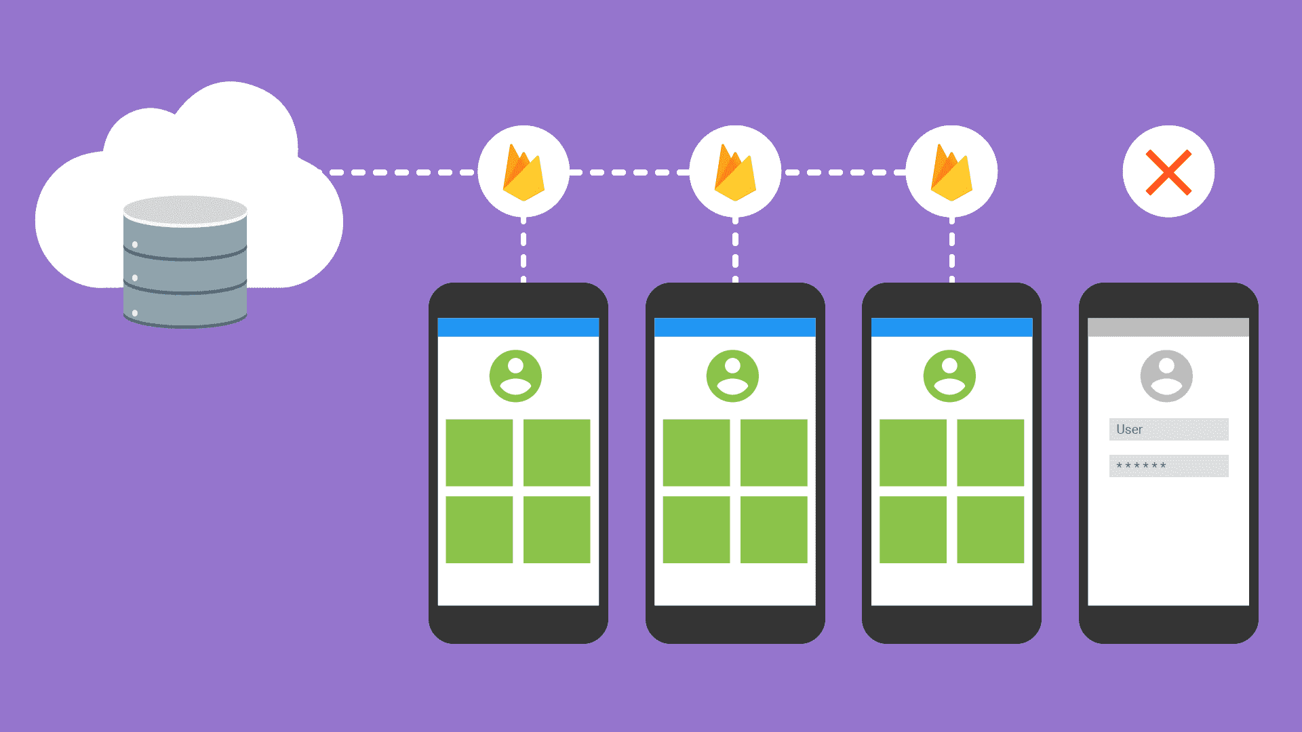
Strong user-based security:-
The Firebase SDK for Cloud Storage integrates with Firebase Authentication to provide simple and intuitive access control. You can use our declarative security model to allow access based on user identity or properties of a file, such as name, size, content type, and other metadata.

Slide 29

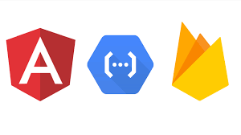
Firebase Integrations
React, AngularJs, Backbone.js, and Angular2 are some of the popular tools that integrate with firebase.

Slide 30
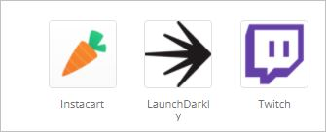
2595 companies reportedly use Firebase in their tech stacks, including Instacart, LaunchDarkly, and Twitch.

Slide 31
Why You Need a Firebase Alternative
Even though Firebase is all about great features, there are some downsides to using it. Here are some of them.
It has vendor lock-in
Slow queries
Not all its services are free to start
It runs entirely on Google Cloud
Only offers NoSQL databases
No options for Enterprise support or dedicated servers
Doesn’t offer GraphQL APIs as part of the standard setup
It’s a subdomain from Google so it doesn’t work in many countries
It’s not open source so it lacks flexibility and customization to adapt its code

Slide 32
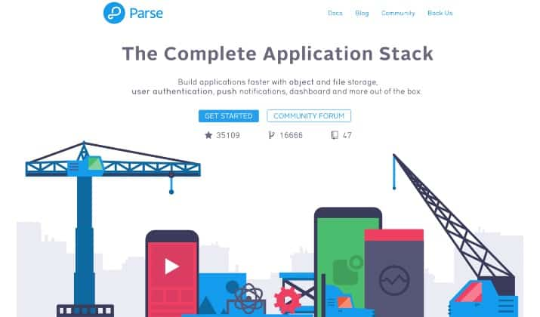
Parse
The features include a spreadsheet-like database, dashboard, push notifications, APIs, object and file storage, user authentication, and many more

Slide 33
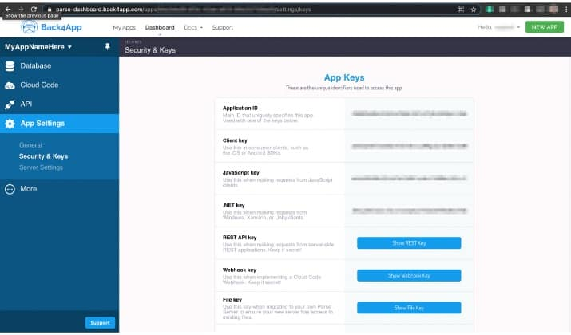
2) Back4App
The platform offers data storage, APIs (REST and GraphQL), cloud code functions, push notifications, authentication, and file storage. You can store and query relational data on the cloud, build relational data models in minutes, and make the app accessible over APIs.

Slide 34
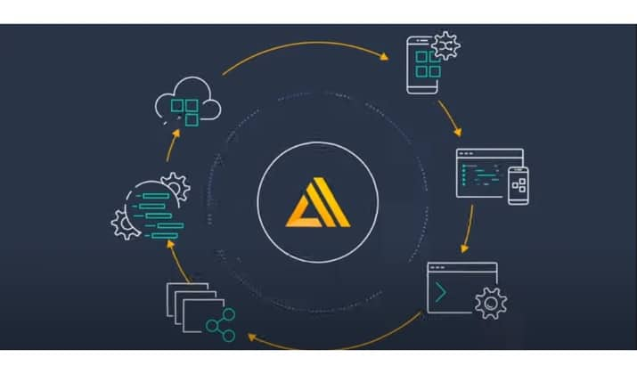
3) AWS Amplify
You can configure app backends and within minutes connect your app, deploy static web apps in a matter of clicks, and manage app content outside of the console.
many more..

Slide 35
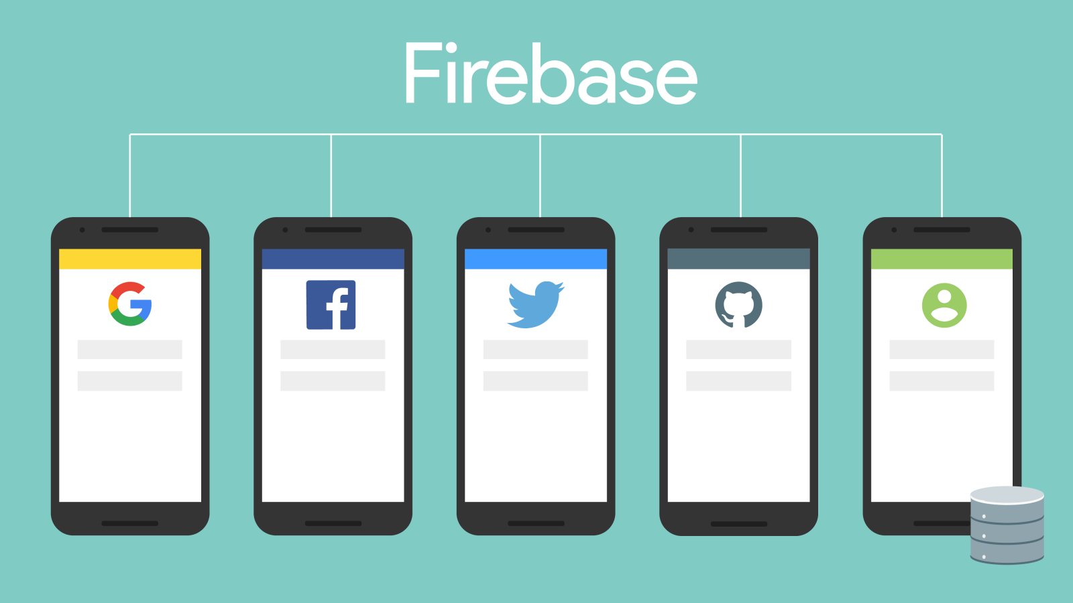

Slide 36
