Slide 1
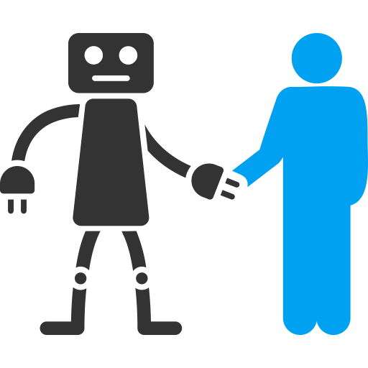










Human-aware motion planners
Safety = collision avoidance
Compliant controllers
Safety = low contact force
Collision avoidance OR safe impact

