Slide 1
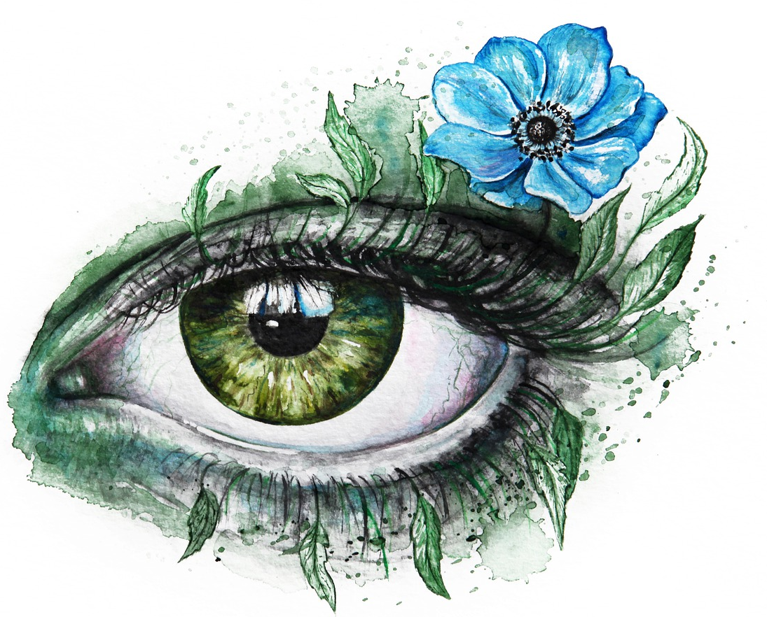
GAZE2022
4th International Workshop on Gaze Estimation and Prediction in the Wild

