Slide 1
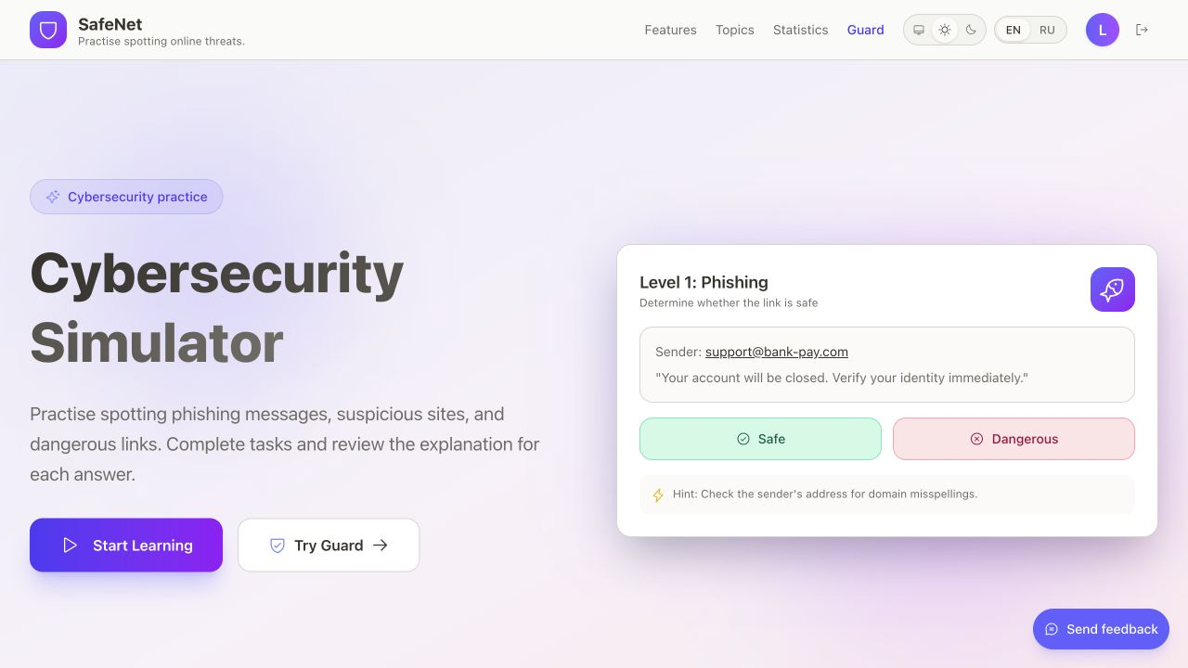
STUDENT PROJECT / SEPTEMBER 2026
Safe-Net
Cybersecurity practice.
URL warnings explained.
Volkov Artem Aleksandrovich
Learning web app · Guard extension · Local prototype
01
Notes:
Safe-Net is a local engineering prototype. This deck requests methodological feedback. It does not claim a deployed service, independent detection accuracy or a completed study. Presenter: Volkov Artem Aleksandrovich, high-school student. Local source commit 8d1b2dc. Evidence: docs/audits/LOCAL_VERIFICATION_2026-09-30.md. Repository: https://github.com/safe-net-org/Safe-Net

Slide 2
The research question
Can practice with explanations improve
recognition of unfamiliar phishing cues?
Proposed comparison
Interactive practice versus an equal-duration text lesson.
Assess new examples immediately and after a delay.
02
Notes:
Hypothesis only. No human study or learning-gain measurement has been conducted. Protocol: docs/RESEARCH_PROTOCOL_DRAFT.md.

Slide 3
How the system works
Learning web app
Guard extension
EN/RU courses and simulations
Local URL rules and explanations
Safe-Net
Learn a cue. Explain a warning.
Learning API
Shared rule engine
Auth and server-side grading
Web scanner and extension
PostgreSQL
Optional ML service
Per-user progress and certificates
Sanitized URL, opt-in model opinion
03
Notes:
The diagram shows actual components. The learning API persists progress in PostgreSQL. The web scanner and extension import guard-core directly. The optional Python service mirrors the rules and can add a model opinion. It is not a shared binary. Sources: docs/ARCHITECTURE.md; packages/guard-core/src; extension/src; server/src.

Slide 4
Inside the repository
client/
packages/guard-core/
Next.js web app: courses, tasks and URL scanner
TypeScript URL rules shared by web and extension
server/
ml-service/
NestJS API: accounts, grading and saved progress
Optional FastAPI service and third-party BERT
extension/
server/content/
WXT / Manifest V3: navigation and page checks
Versioned lessons and tasks, validated before seeding
Project author: Volkov Artem Aleksandrovich
04
Notes:
Actual directory responsibilities: client (Next.js), server (NestJS and Prisma), extension (WXT and Manifest V3), packages/guard-core (TypeScript), ml-service (FastAPI), server/content (versioned content). Project author/presenter: Volkov Artem Aleksandrovich. Third-party model attribution: ml-service/MODEL_CARD.md. AI assistance is described in the package README; this slide does not attribute upstream code or model training to the presenter.

Slide 5
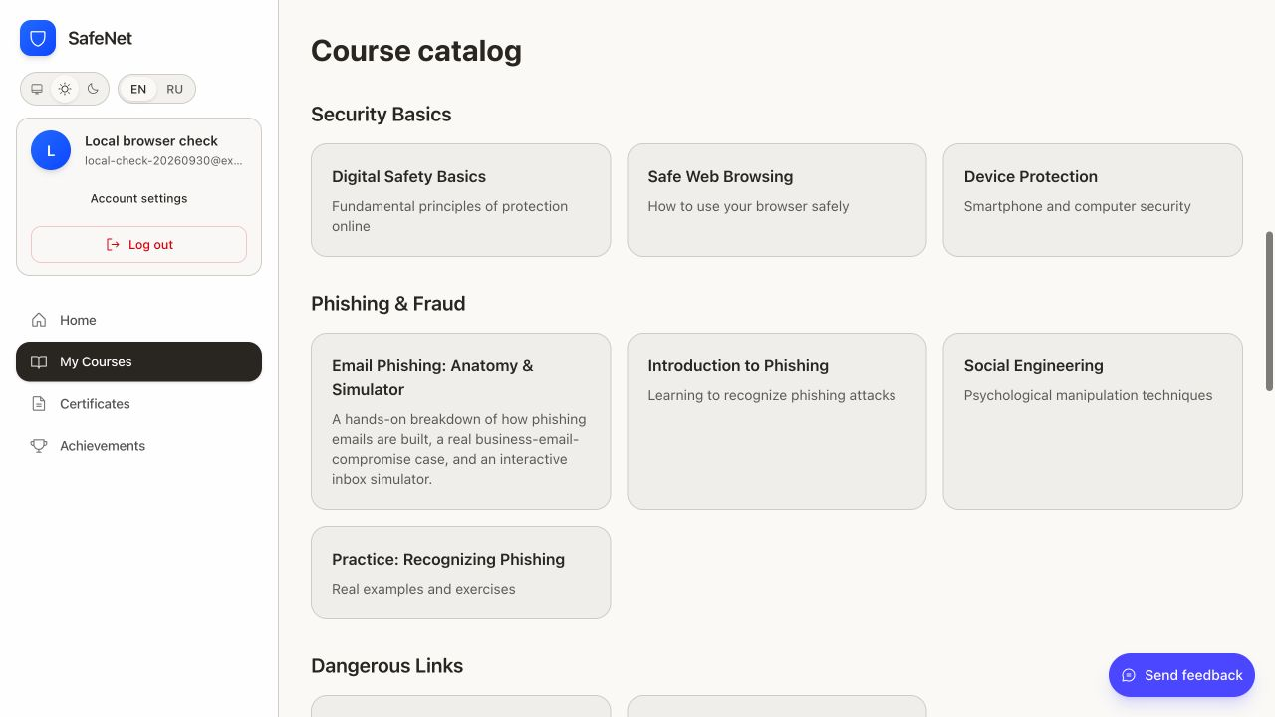
The learning experience
21 courses
27 lessons
163 tasks
21 final tests
English and Russian
Lessons, practice tasks,
progress and certificates.
Local demo account · 30 September 2026
05
Notes:
Local source commit 8d1b2dc. Evidence: docs/audits/LOCAL_VERIFICATION_2026-09-30.md. Repository: https://github.com/safe-net-org/Safe-Net The screenshot is a synthetic local learner completing the VPN course, not participant data. The correct answers were known for this engineering acceptance check. The 100% result measures the test flow, not learning improvement.

Slide 6
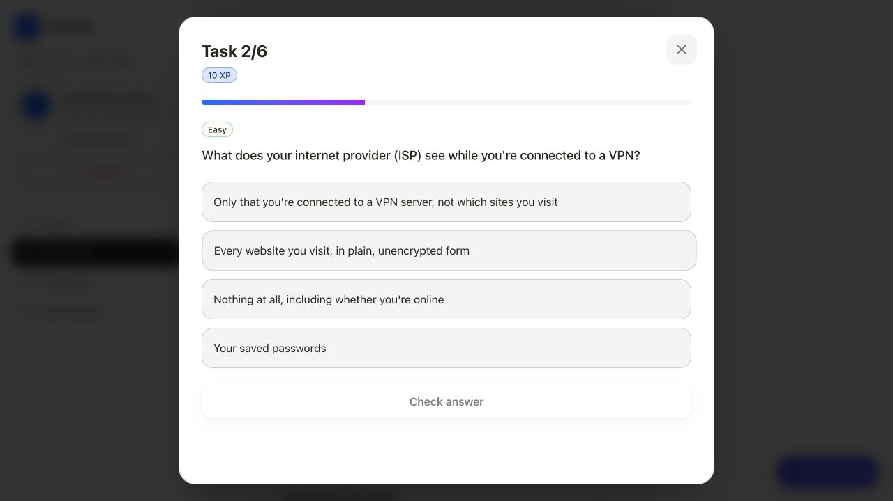
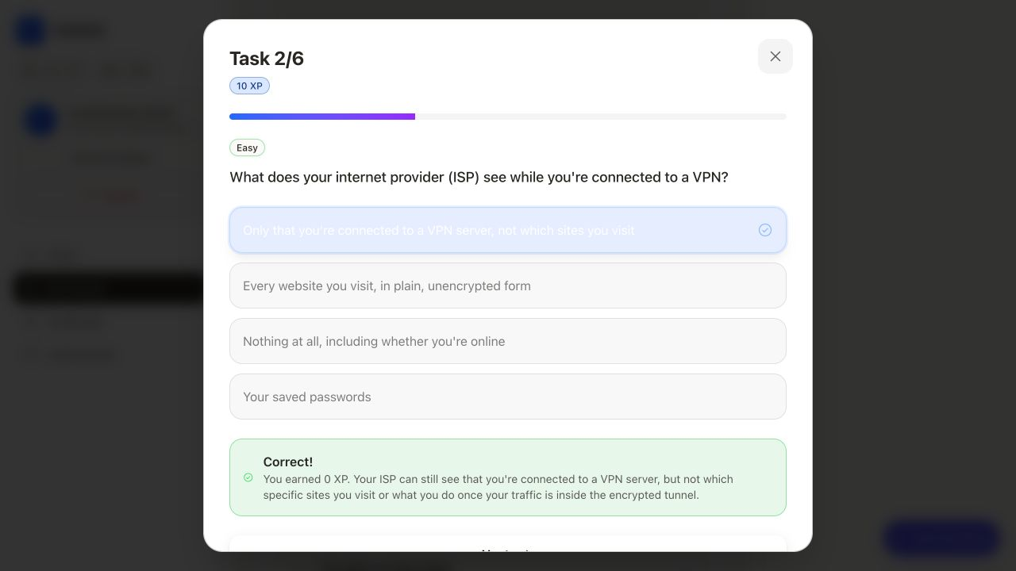
Practice, then an explanation
Answer a concrete question
Read the reason
Choose what an ISP can see
when traffic goes through a VPN.
Feedback explains the answer.
Repeating a task adds no XP.
06
Notes:
Screenshots from the synthetic local learner. The task had already been completed; answering it again awarded 0 XP. This is an engineering demonstration, not participant data or evidence of learning gains. Sources: client lesson/task dialog and server task-answer evaluator.

Slide 7
Server-side assessment
Learner selection
API evaluation
Saved result
Red flags in a safe simulation
Protected answer key
Progress, XP, feedback
A completed task belongs to the learner account
Database constraints prevent repeated XP and duplicate course certificates.
A fresh tab reloads progress from the server.
07
Notes:
The phishing simulator sends selected field/text spans. The API evaluates answers against an answer key excluded from the learner payload. Completion and XP awards persist per user. Sources: server/src/learning/answers/task-answer.evaluator.ts; server/src/learning/services/progress.service.ts; tools/test-http-integration.cjs. Diagram is an illustrative flow, not a screenshot.

Slide 8
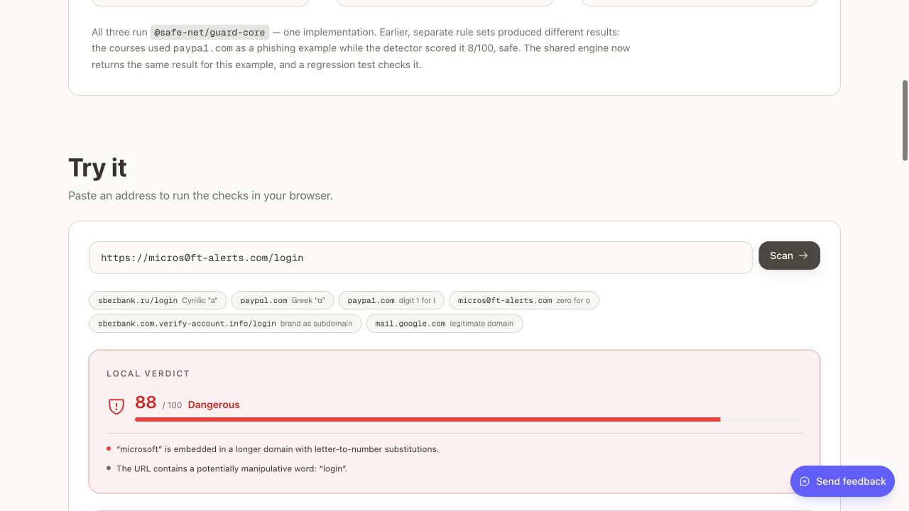
Guard: the reasons behind a warning
88 / 100
Dangerous
Brand spelling changed
“o” replaced by zero
Suspicious URL wording
“login” in the path
A rule score is a warning policy, not a probability of phishing.
08
Notes:
Actual local scanner screenshot, 30 September 2026. Input https://micros0ft-alerts.com/login; score 88, danger, brand_token_leet and suspicious_word. Sources: packages/guard-core/src/model/score.ts and src/lib/url-analyzer.ts. A synthetic illustration, not an independently labelled benchmark. The example is scored as text; it is not visited.

Slide 9
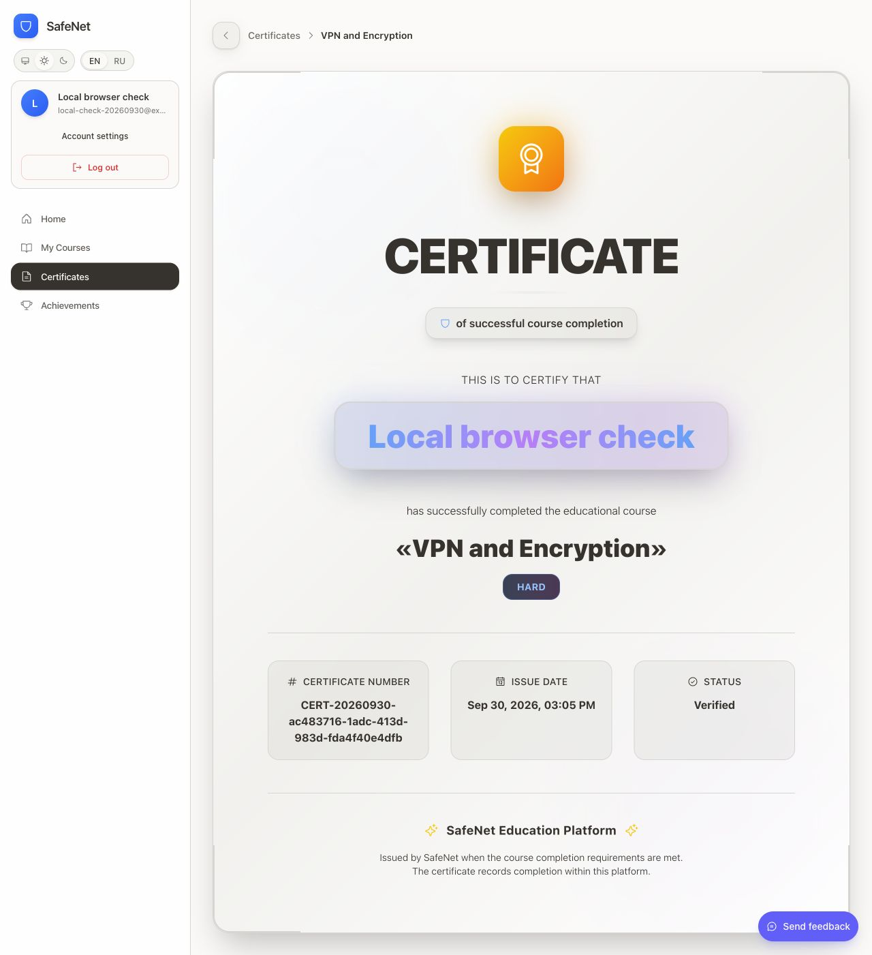
Progress and course completion
Saved per account
Completed tasks and tests
Course progress and XP
One certificate per course
Demo completion
VPN and Encryption
6 tasks · 8 test questions
95 XP · 1 certificate
This is a platform completion record.
09
Notes:
Actual certificate for a synthetic local learner. Certificate belongs to the user account and records completion within SafeNet, not professional accreditation. API constraints prevent duplicate certificates. The score and certificate are acceptance-flow evidence, not a study outcome. Sources: server learning services; local verification record.

Slide 10
Privacy and model boundaries
Default: local rules
Optional: model opinion
The browser can score URLs without
sending them to the ML service.
Explicit opt-in sends a sanitized URL
to the configured endpoint.
What remains in the optional request
Hostnames and paths still reveal information.
The BERT checkpoint comes from a third party.
Independent model evaluation remains open.
10
Notes:
Sources: extension/src/shared/lib/url-privacy.ts; extension/src/shared/i18n/messages.ts; ml-service/MODEL_CARD.md; packages/guard-core/src/model/blend.ts. Default local rule analysis. Optional model endpoint receives scheme, host, port, path and query names; removes credentials, query values and fragment. Host and path can still be sensitive. Upstream checkpoint is ealvaradob/bert-finetuned-phishing pinned to fa8fb73a007174c410ab7160d4e4c6e6b8d998d4. No claim that Artem trained BERT.

Slide 11
Engineering evidence
98
30
API regression tests
URLs in the rule parity corpus
Local builds and package checks passed
HTTP checks covered auth, grading and concurrency
Mailpit received EN/RU account emails
11
Notes:
Local source commit 8d1b2dc. Evidence: docs/audits/LOCAL_VERIFICATION_2026-09-30.md. Repository: https://github.com/safe-net-org/Safe-Net Counts are engineering checks, not scientific results. The 30 curated URLs test TypeScript/Python rule parity, not real-world accuracy. All configured local checks passed before these presentation-only files were created.

Slide 12
Current scope and remaining checks
Research outcomes
Release acceptance
No measured learning gains
No independent detection accuracy
No user study yet
Chrome installation and behavior
External inbox delivery and hosted CI
Accessibility and broader browser coverage
Current scope: a working local prototype
Suitable for technical feedback and study-design review.
12
Notes:
No participants recruited, no human outcome dataset, no independent detector benchmark. Remaining release checks documented in FIX.md and docs/EVIDENCE_AND_LIMITATIONS.md. Local SMTP capture does not prove delivery to an external inbox. Installed Chrome extension behavior and hosted CI remain unverified.

Slide 13
Proposed learning-transfer study
Baseline
Learning
Immediate
Delayed
Unseen item bank A
Practice or text lesson
Unseen item bank B
Unseen item bank C
Primary outcome
Change in balanced accuracy on delayed, unfamiliar examples
Also report phishing recall, benign false alarms and attrition.
Separate item banks reduce memorization of repeated examples.
13
Notes:
Design proposal, not approved or conducted research. Source: docs/RESEARCH_PROTOCOL_DRAFT.md. Random assignment and equal duration. Distinct domains and templates across baseline, immediate and delayed item sets. Delayed interval and sample size need justification before collection. Prefer an adult pilot with appropriate review/consent before minors. Freeze exclusions, missingness handling and primary outcome.

Slide 14
Next step: evaluate the detector
Detector experiment
Error analysis
Build a versioned, independently labelled
URL set with source-separated splits.
Compare rules, optional model and blend.
Report false positives by attack family
and language.
Deliverable
An evaluation script, documented dataset procedure
and a short report that explains failure cases.
14
Notes:
Suggested independent detector experiment, not an existing result. Distinguish detector evaluation from the learner study. Public dataset release depends on licensing, safety and privacy. Do not publish live malicious links or personal information. All future outcome numbers must derive from actual analysis.

Slide 15
Feedback requested
How should I distinguish learning transfer
from memorizing familiar phishing cues?
Which assessment design would make a small pilot credible?
Would error analysis or a learning study be the more useful next step?
Volkov Artem Aleksandrovich / High-school student
15
Notes:
This is a request for narrow methodological feedback, not a request for a recommendation, endorsement, admissions support or guaranteed supervision. Repo link is source entry point, not a claim that unpublished local fixes are visible on GitHub. Local source commit: 8d1b2dc.

