Slide 1

Image based Real-time passenger vehicle unsafe overcrowded detection using Deep Learning
Group Members
Abdullah Aamir (22P-9235)
Hamza (22P-9222)
Mustafa (22P-9221)
Project Supervisor
Sir. Fazlebasit

Slide 2
Introduction
Unsafe public transport is a major safety issue in South Asia & Africa.
Passengers often:
Sit on rooftops
Hang dangerously outside vehicles
Leads to: Accidents, fatalities, traffic chaos
Current monitoring: Manual & inconsistent
Automated, Real time detection to support traffic enforcement.

Slide 3
Motivation
If we do not build this project:
Unsafe practices continue unchecked.
More accidents & preventable deaths.
Manual monitoring remains inefficient.
Violations continues with added corruption.
With Smart System:
Smarter enforcement.
Safer public transport.
Reduced accidents & loss of life.
Automated system, reduces need to appear physically.

Slide 4
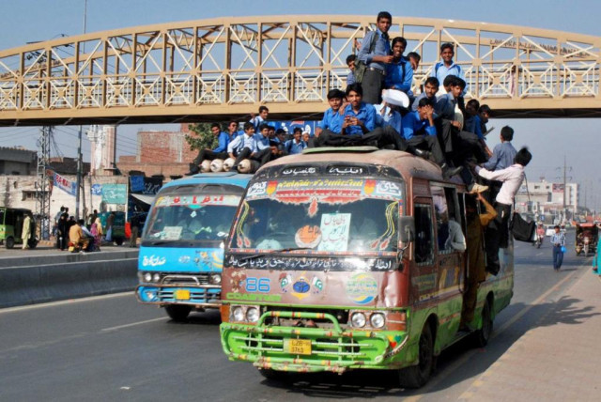
Problem Statement
South Asian & African public transport = dangerously overloaded vehicles
No automated detection system for unsafe passenger behaviors.
Authorities lack real-time alerts & evidence-based enforcement tools.

Slide 5
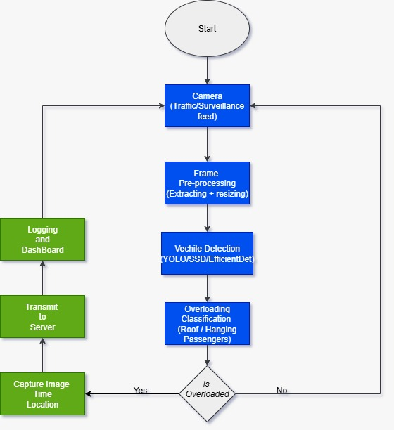
Solution
AI-based system using traffic/CCTV cameras
Detects:
Vehicles such as bus, suzuki, chingchi.
Roof passengers
Hanging outside
Generates:
Real-time alerts for traffic police
Violation logs with evidence (image/video)
Dashboard with stats

Slide 6
Scope of the project
Scope:
Dataset collection (custom dataset in Pakistan)
Dataset Annotation
AI detection model training
Classify three types of vehicles (suzuki, bus, chingchi)
Real-time violation classification
License plate detection and sending it to authorities
Dashboard for authorities
Count number of people

Slide 7


Goals
Improve road safety via AI automation
Provide traffic police with scalable monitoring tools
Build first annotated dataset of unsafe transport
Deliver a working prototype with dashboard

Slide 8
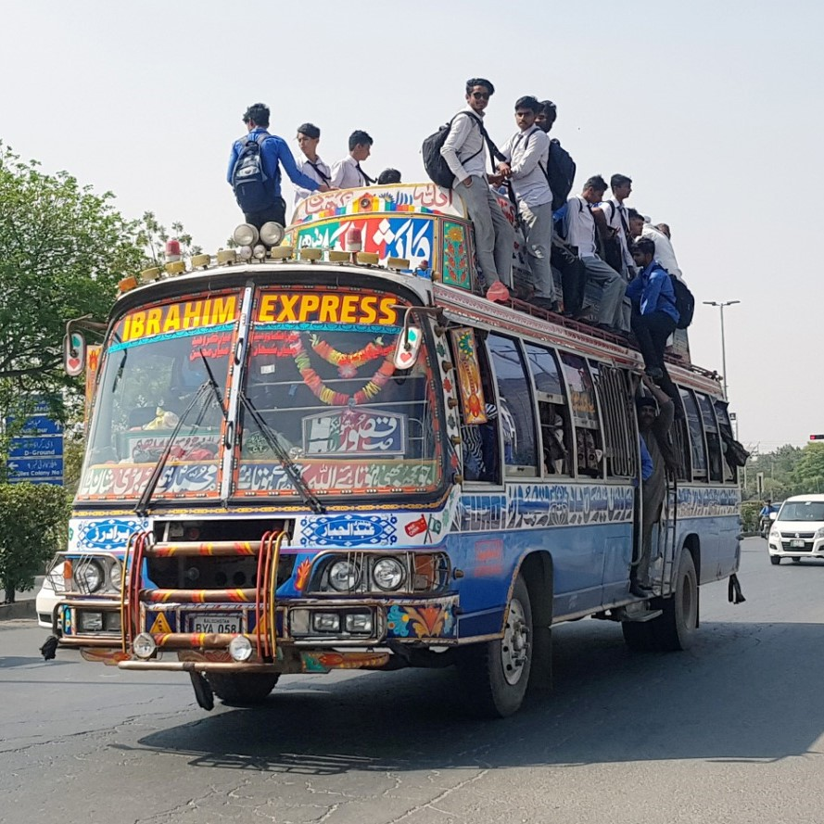
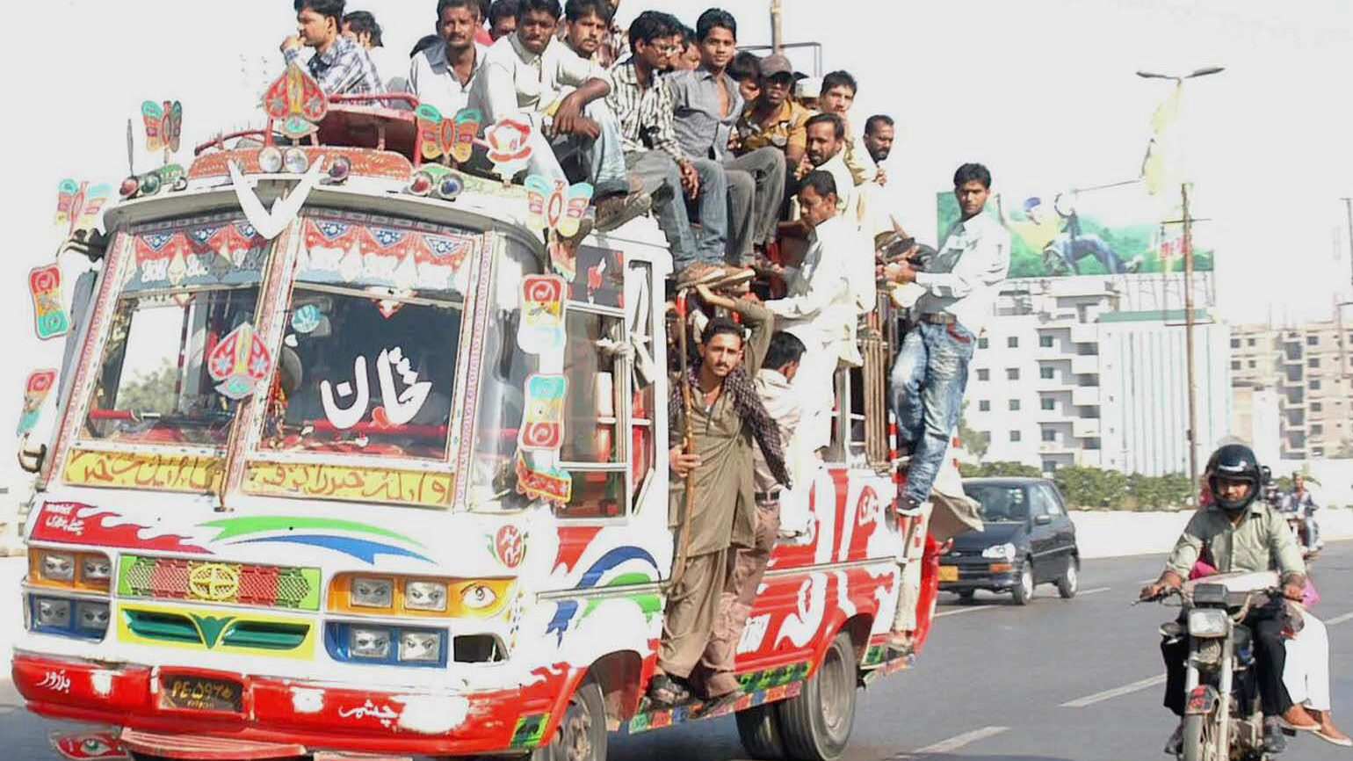
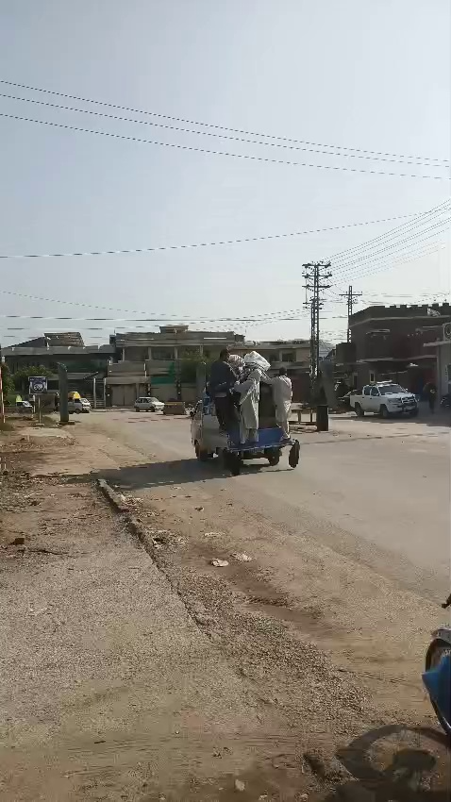
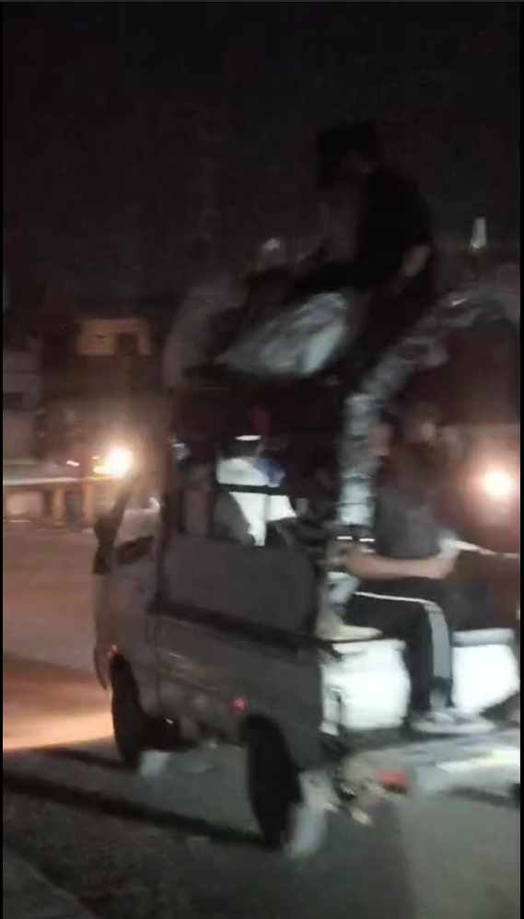
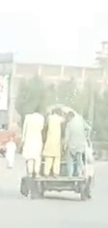
Dataset
Aspect | Details
Total Images (Planned) | 5,000 – 6,000 labeled images
Vehicle Types | Suzuki pickups, Buses, Chingchi
Scenarios Covered | - Normal vehicles (not overloaded) - Overloaded vehicles (roof passengers, Passengers hanging outside, Back/side overloaded vehicles)
Data Sources | Custom street collection, CCTV footage, Online repositories, Crowdsourced images
Annotation | Bounding boxes for vehicles and passengers
‹#›

Slide 9
Objectives
FYP-I (Semester 1):
Dataset collection & annotation
Model selection & initial training
Basic detection prototype
FYP-II (Semester 2):
Real-time detection pipeline
Dashboard development
Alerts & evidence logging
Final testing & evaluation

Slide 10
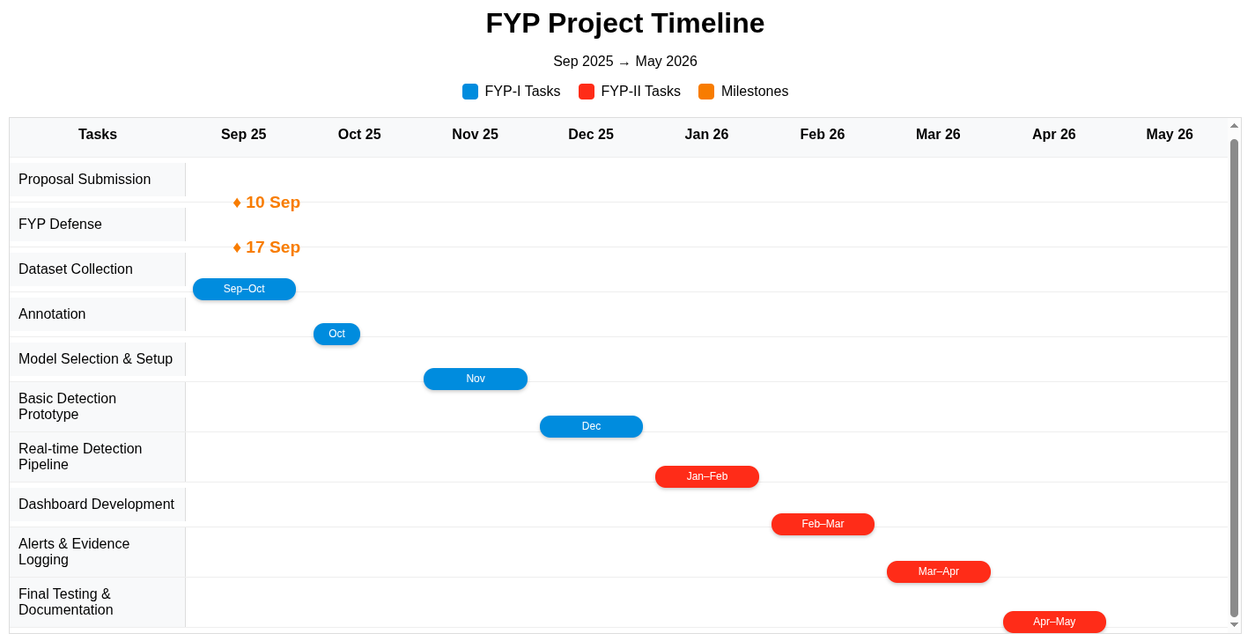

Slide 11
Expected Result
AI system detects unsafe behaviors in real-time
Dashboard displays:
Violation counts
Captured evidence (images/videos)
Custom dataset for research & scalability

Slide 12
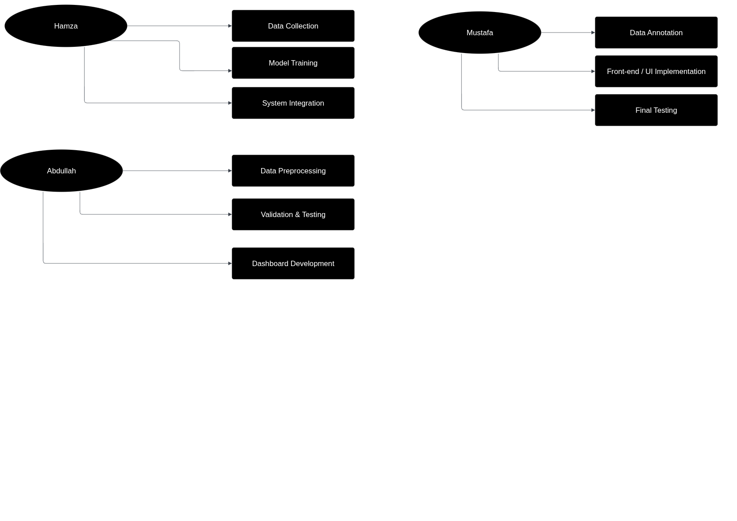
Team Work
ABDULLAH
Data Preprocessing
Model Validation & Testing
Dashboard Development
MUSTAFA
Data Annotation
Front-end / UI Implementation
Final System Testing
HAMZA
Data Collection
Model Training
System Integration

Slide 13
References
[1] The Express Tribune, “Action Sought Against Overloaded Public Transport,” March 15, 2023. Available: https://tribune.com.pk/story/2406116/action-sought-against-overloaded-public-transport
[2] The Nation (Pakistan), “Plan Finalised to Enforce Ban on Passengers Sitting on Rooftops of Vehicles,” June 11, 2025. Available: https://www.nation.com.pk/11-Jun-2025/plan-finalised-to-enforce-ban-on-passengers-sitting-on-rooftops-of-vehicles
[3] World Bank / IRU, “Pakistan Seeks International Expertise and Standards to Curb Road Accidents,” June 25, 2025. Available: https://www.iru.org/news-resources/newsroom/pakistan-seeks-international-expertise-and-standards-curb-road-accidents
[4] A. Hussain, S. Ahmed, “Public Transport Safety and Accident Causation in South Asia: An Empirical Review,” Journal of Transport and Safety Studies, 2022, pp. 67–85. DOI: 10.1016/j.jtss.2022.104512
[5] The Southern Eye (Zimbabwe), “Public Transport Overloading Increases Road Accidents,” 2024. Available: https://www.newsday.co.zw/southerneye/local-news/article/200028837/public-transport-overloading-increases-road-accidents
[6] K. Ofori Asiamah, “Africa Must Build a More Robust Public Transport System,” Citi Newsroom (Ghana), June 2024. Available: https://citinewsroom.com/2024/06/africa-must-build-a-more-robust-public-transport-system-ofori-asiamah

