Slide 1

Image based Real-time vehicle unsafe passenger behavior detection using Deep Learning
Group Members:
Abdullah Aamir (22P-9235)
Hamza (22P-9222)
Mustafa (22P-9221)
Project Supervisor
Mr. Fazlebasit

Slide 2
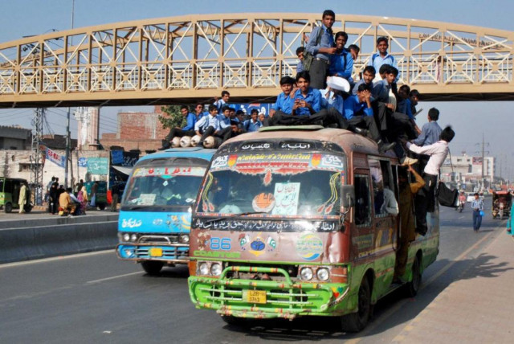
Introduction
Unsafe public transport is a major safety issue in South Asia & Africa.
Passengers often:
Sit on rooftops
Hang dangerously outside vehicles
Leads to: Accidents, fatalities, traffic chaos
Current monitoring: Manual & inconsistent
Automated, Real time detection to support traffic enforcement.

Slide 3
Project Objectives
Collect and annotate a custom dataset of public transport vehicles with unsafe behavior.
Train deep learning models to detect and classify vehicles, passengers (on roof, hanging), and license plates.
Develop a backend system for processing video streams and logging violations.
Build a dashboard for traffic authorities to visualize violations and hotspot areas.
Enable real-time alerts for enforcement authorities

Slide 4

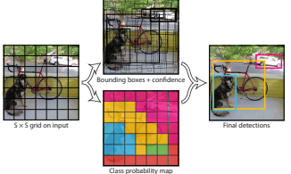
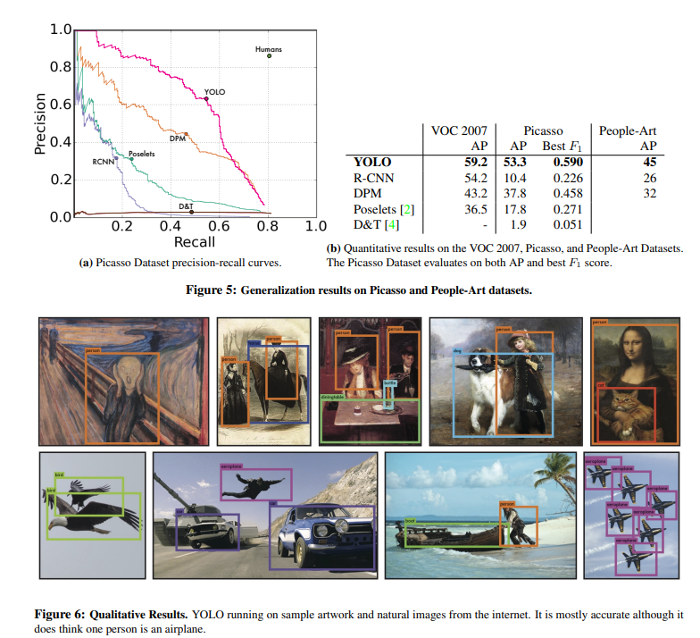
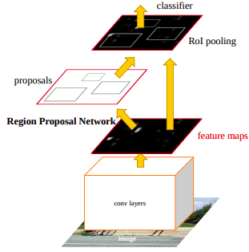
Literature Review
Sr | Author | Methodology | Key Findings | Gaps
1 | Redmon et al. (2016) | Introduced YOLO (You Only Look Once), treating object detection as a single regression problem on a grid system for real-time, single-pass detection. | Achieved significantly faster real-time performance than prior two-stage detectors while maintaining competitive accuracy. Unified architecture. | Struggled initially with small objects, dense object clusters, and precise localization compared to two-stage methods.
2 | Ren et al. (2015) | Proposed Faster R-CNN, integrating a Region Proposal Network (RPN) directly into the CNN to generate object proposals efficiently within a two-stage detection framework. | RPN dramatically increased the speed of region proposal compared to methods like Selective Search, enabling near real-time high-accuracy detection. Set accuracy benchmarks. | Remained slower than single-stage detectors like YOLO due to its two-stage nature (proposal then classification).
YOLO:
Faster R-CNN:
https://arxiv.org/pdf/1506.02640
https://arxiv.org/pdf/1506.01497

Slide 5
Literature Review
Sr | Author | Methodology | Key Findings | Gaps
3 | Prastyo et al. (2024) | Developed an automatic passenger counting system for public buses using CNN YOLOv8 to detect and count passengers in real-time. | Achieved high accuracy (0.82 confidence) with a front camera, but lower accuracy (0.76) with a rear camera due to object overlap. | System accuracy is highly dependent on camera placement; object overlap in certain views (e.g., rear camera) reduces performance.
4 | Usama, Hafeez Anwar & Saeed Anwar (2025) | Proposed a toll collection framework using YOLO (v2-v11, incl.Nano) for vehicle type recognition, LPR localization & reading. Created novel 10k image dataset addressing local challenges (decorations, occlusions) | Large YOLOv5/v8/v11 achieved ∼99% mAP@0.5. Nano variants achieved high mAP (97–98%) suitable for edge devices (Raspberry Pi tested). Addressed specific Pakistani vehicle/plate variations | Focused on toll context; dataset size may limit generalization. Primarily tested specific YOLO versions.
https://international.arteii.or.id/index.php/IJIES/article/view/121
https://link.springer.com/article/10.1007/s10044-025-01443-8

Slide 6
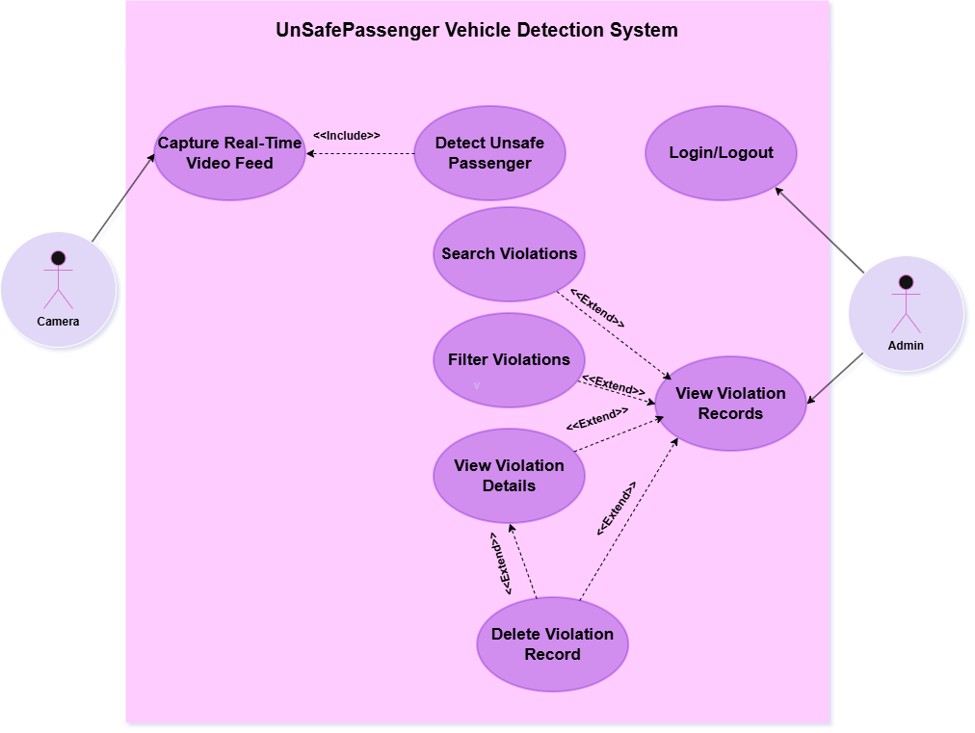
Use-Case Diagram

Slide 7
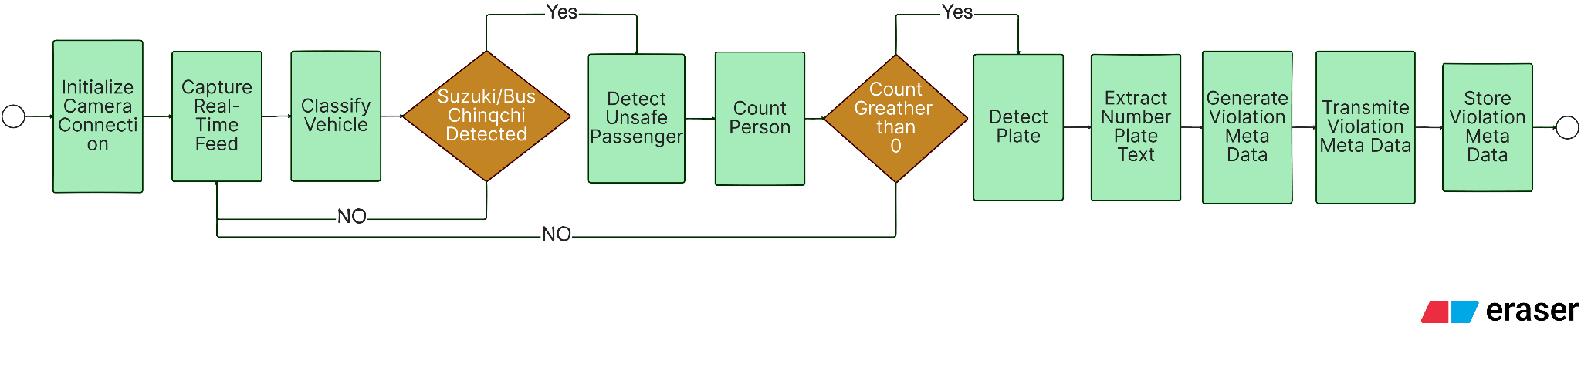
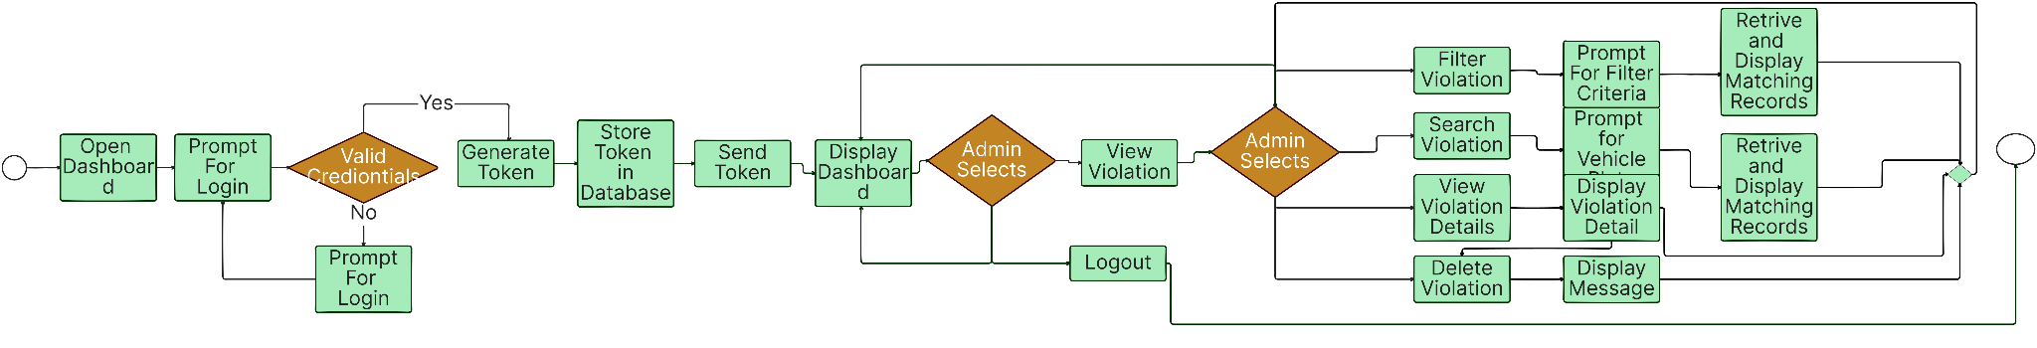
Activity Diagram
Camera:
Admin:
Display
Message

Slide 8

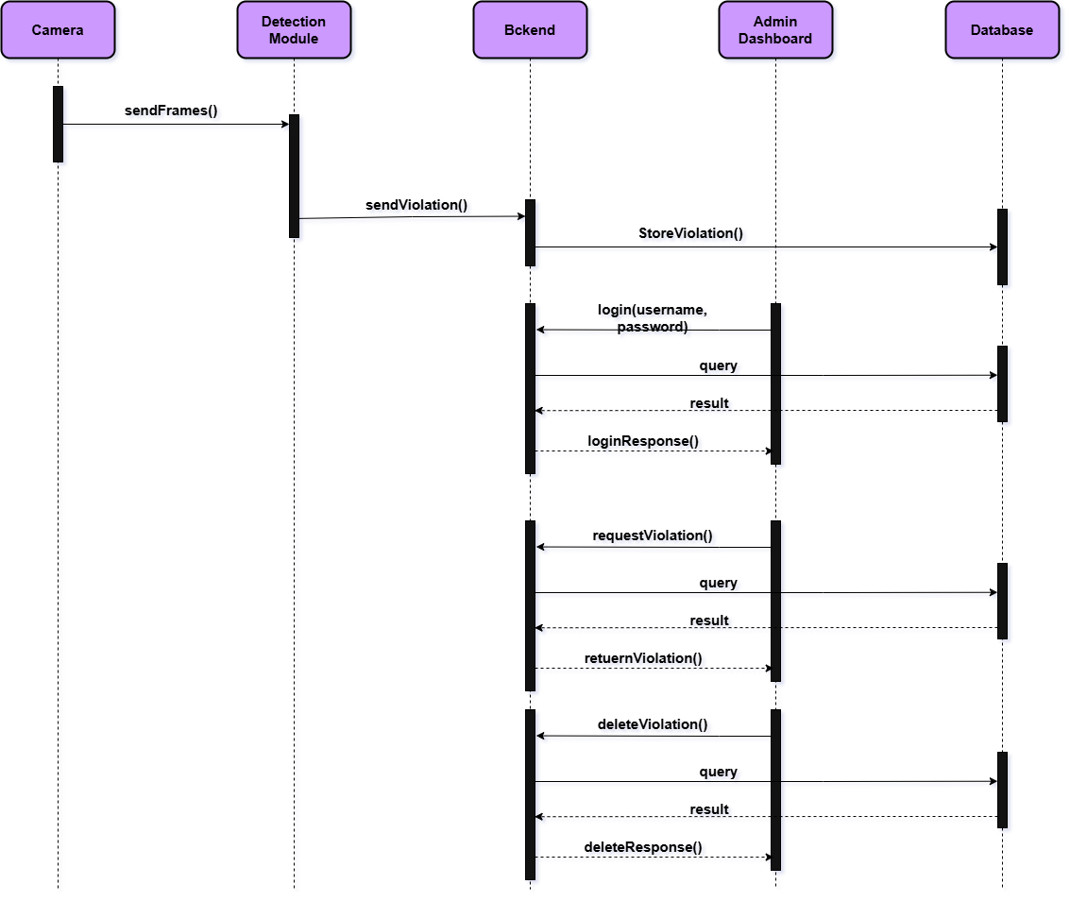
Sequence Diagram

Slide 9

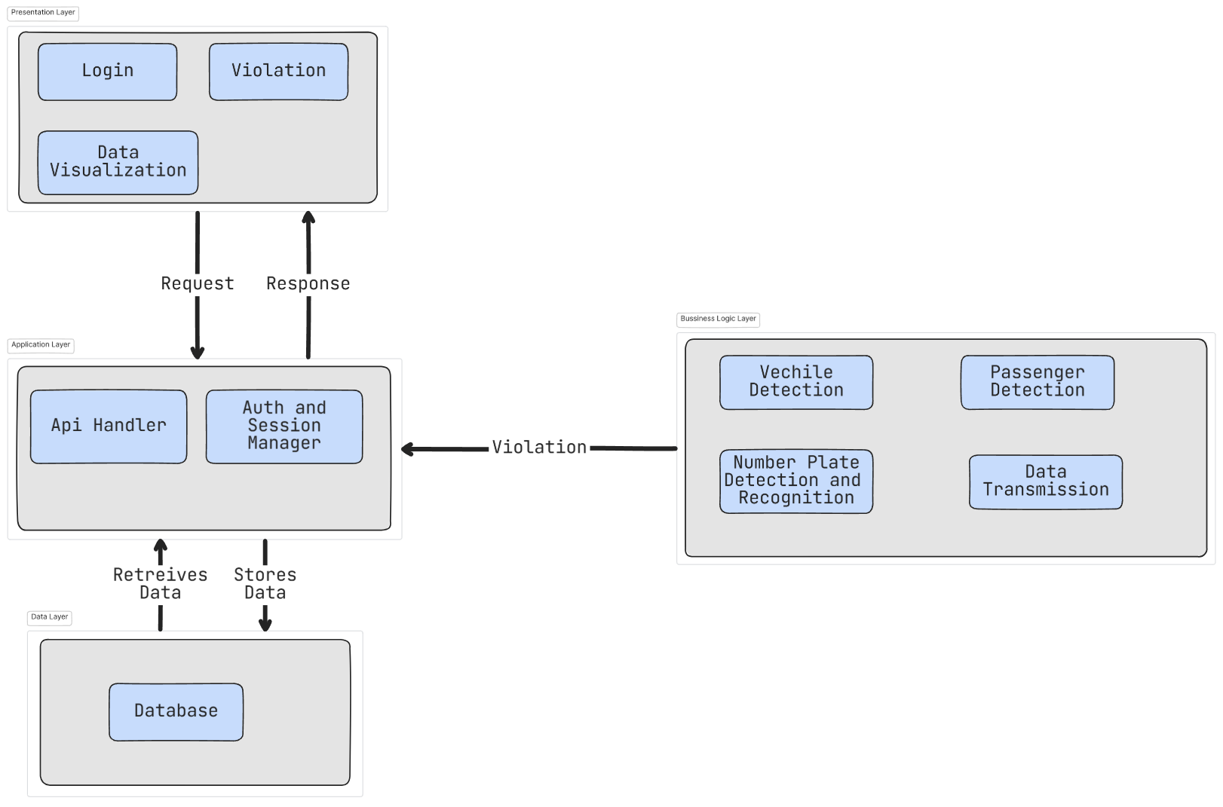
System Architecture Diagram

Slide 10
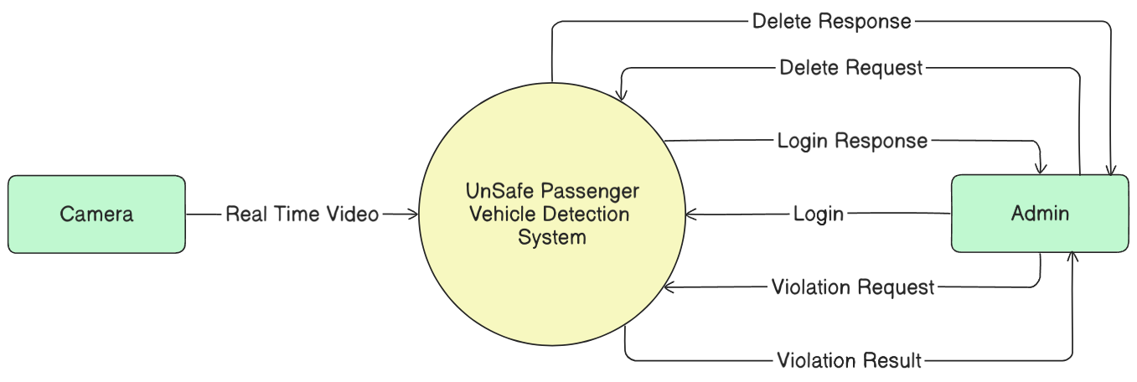
DFD Diagram Level 0

Slide 11
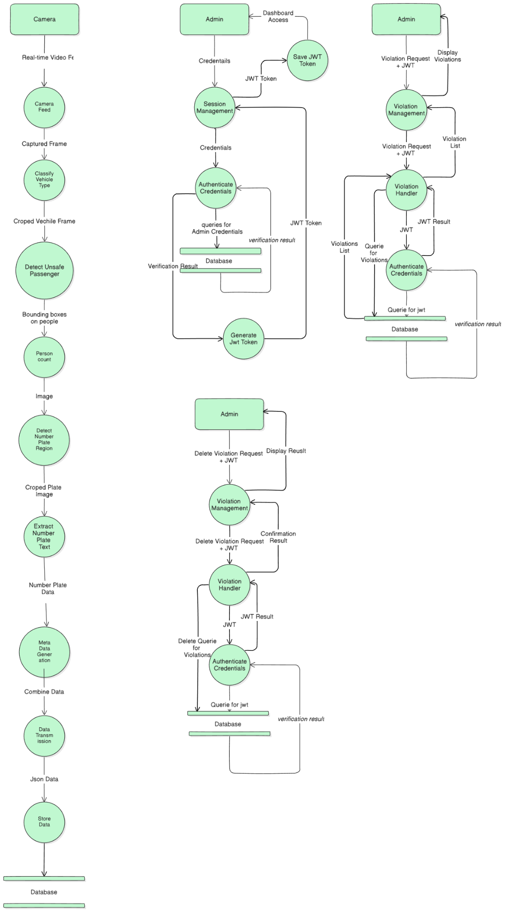
DFD Diagram Level 1

Slide 12
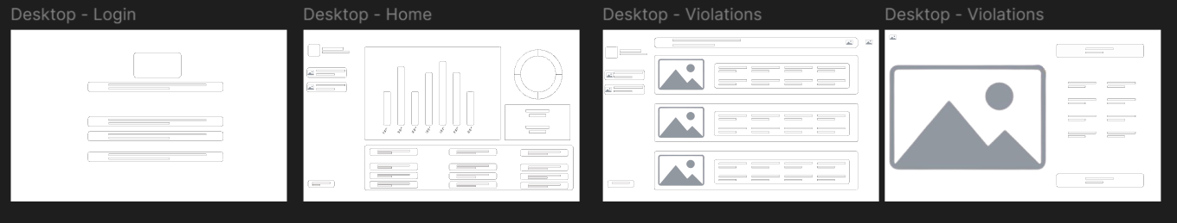
Wireframe

Slide 13
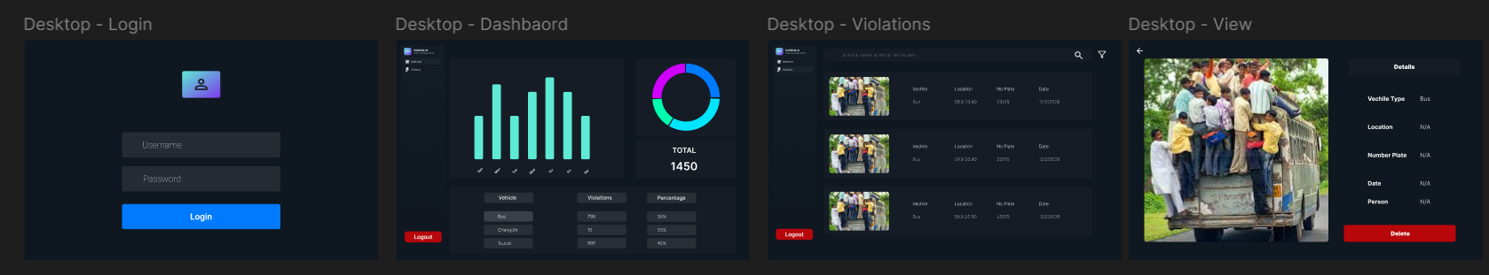
UI (Overview)

Slide 14
Sample test cases
Test ID | Description | Test Steps | Expected Result
TC-01 | Violation: Bus Overcrowding | 1. Input a video segment showing a bus with 3 people detected as 'Passenger_Unsafe'. | 1. System classifies vehicle as 'Bus'. 2. System identifies 'Unsafe Condition'. 3. System logs violation with person count >= 3.
TC-02 | LPR Success | 1. Use video from TC-01 where the bus plate 'ABC-123' is clearly visible. | 1. Violation logged (as per TC-01). 2. LPR module processes the frame. 3. Violation record in DB includes plate_number 'ABC-123'.
TC-03 | LPR Failure (Obscured) | 1. Input video of Chingchi with unsafe passengers, but plate is muddy/unreadable. | 1. System classifies as 'Chingchi'. 2. System identifies 'Unsafe Condition'. 3. Violation logged with person count > 0. 4. Violation record in DB indicates plate_number as 'unreadable' or NULL.
TC-04 | No Violation: Normal Suzuki | 1. Input video of a Suzuki pickup with passengers only inside the cabin. | 1. System classifies vehicle as 'Suzuki'. 2. No 'Passenger_Unsafe' detected. 3. No 'Unsafe Condition' flagged. 4. No violation record created.
TC-05 | Dashboard Search | 1. Ensure violations from TC-01/TC-02 exist. 2. Access dashboard, log in. 3. Search for plate 'ABC-123'. | 1. Login successful. 2. Search results display the violation record(s) corresponding to TC-01/TC-02.
TC-06 | Dashboard Filter | 1. Ensure violations for Bus (TC-01) and Chingchi (TC-03) exist. 2. Access dashboard, log in. 3. Filter by Vehicle Type: 'Bus'. | 1. Login successful. 2. Filtered list shows TC-01 violation but not TC-03 violation.

Slide 15
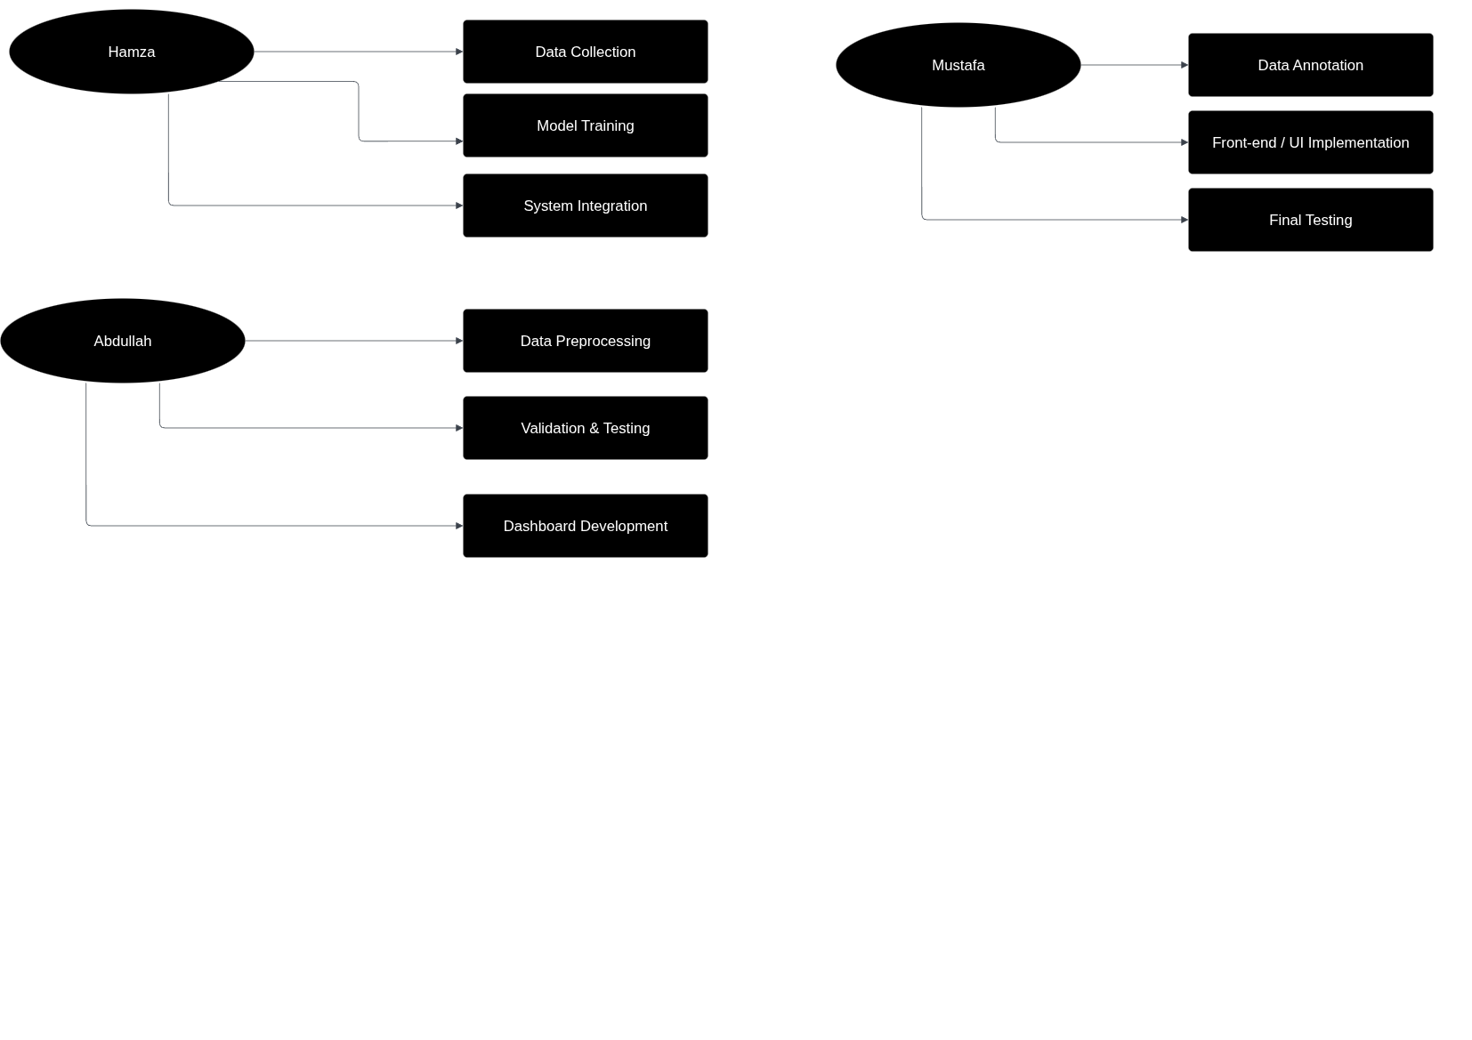
Team Work
ABDULLAH
Data Preprocessing
Model Validation & Testing
Dashboard Development
MUSTAFA
Data Annotation
Front-end / UI Implementation
Final System Testing
HAMZA
Data Collection
Model Training
System Integration

Slide 16
Future Work
Pose Estimation (skeletons for passenger counting from inside view).
Behavioral Safety Analysis (helmets, seatbelts, footboard hanging).
Explainable AI (XAI) for transparent decision-making.
Edge AI with Federated Learning (on-camera processing).
Predictive Modeling (heatmaps of violations).

