Slide 1
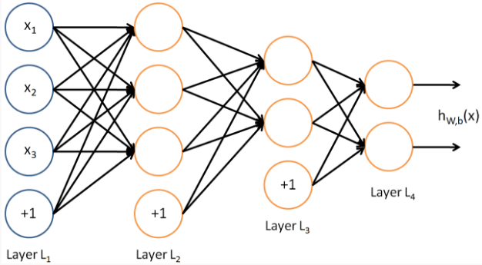
input NN
Fault
Localization
important
weights
combined experts
positive and negative
examples
Concolic
Execution
(SPF)
repair constraints
Constraint
Solving
(Z3)

