Slide 1


BDSA209 · DATA STRUCTURES & ALGORITHMS · SEMESTER PROJECT
FloodWatch
Flood hazard reporting & safe route recommendation
Hash table · FIFO queue · Binary min-heap · Dijkstra's algorithm
Team members
[Add team member names and index numbers]
November 2026
Notes:
Introduce the team and the project: FloodWatch turns community flood reports into verified road closures and the shortest safe route across the city. Everything you'll see is built on four data structures and algorithms we implemented ourselves in Python.

Slide 2



When streets flood, people need three answers fast
Where is it flooded?
Which roads still work?
Where can I reach safety?
Reports are scattered across calls, chats and social media — there is no single trusted picture.
The usual shortest route may pass straight through flood water. Driving into floods is a leading cause of flood injuries.
The nearest shelter is useless if every road to it is closed — or if the shelter itself is flooded.
Our solution: residents report flooding at their GPS location → an admin verifies in arrival order → verified floods close nearby roads in a graph of Ghana's real road network → our Dijkstra finds the shortest open route, reroutes live, and steers people to the nearest reachable safe place.
Notes:
Why it matters: time and trust. Routes over open roads avoid the trial-and-error of driving into flooded streets; verification stops one false report from closing a road for everyone.

Slide 3




Concept: four structures turn reports into safe routes
Hash table
FIFO queue
Stores every report by ID with separate chaining — instant lookup.
Admin verification in arrival order — fair, O(1) per step.
Binary min-heap
Graph + Dijkstra
Hands Dijkstra the closest unvisited place in O(log n).
Locations = vertices, roads = weighted edges; skips closed roads.
Notes:
Walk the pipeline left to right. A report is stored in the hash table and enqueued. The admin dequeues the oldest report and verifies it; its road joins the closed-road set. Dijkstra, driven by our min-heap, then computes the shortest route using only open roads.

Slide 4
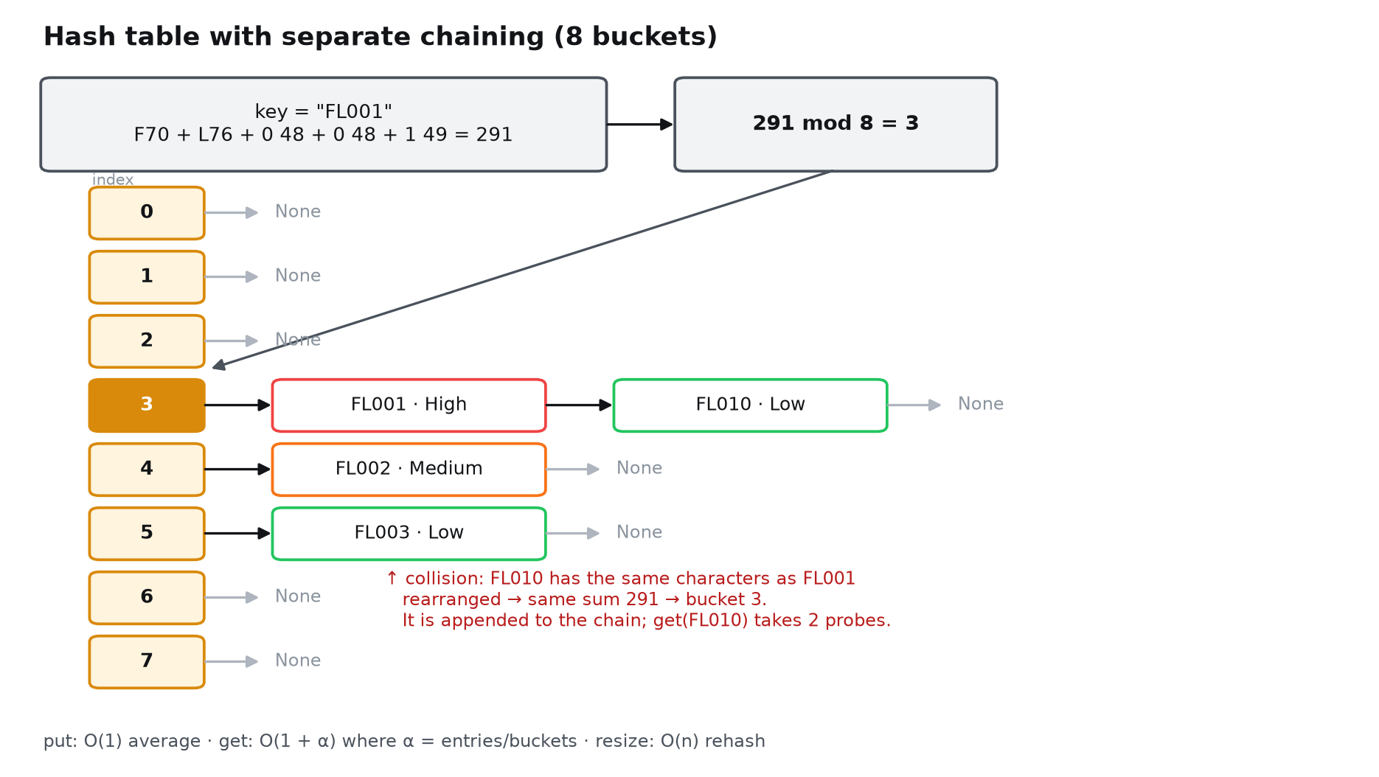
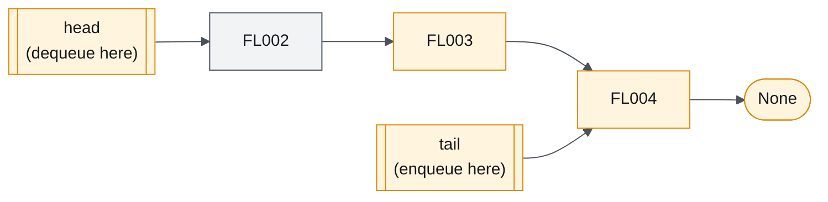
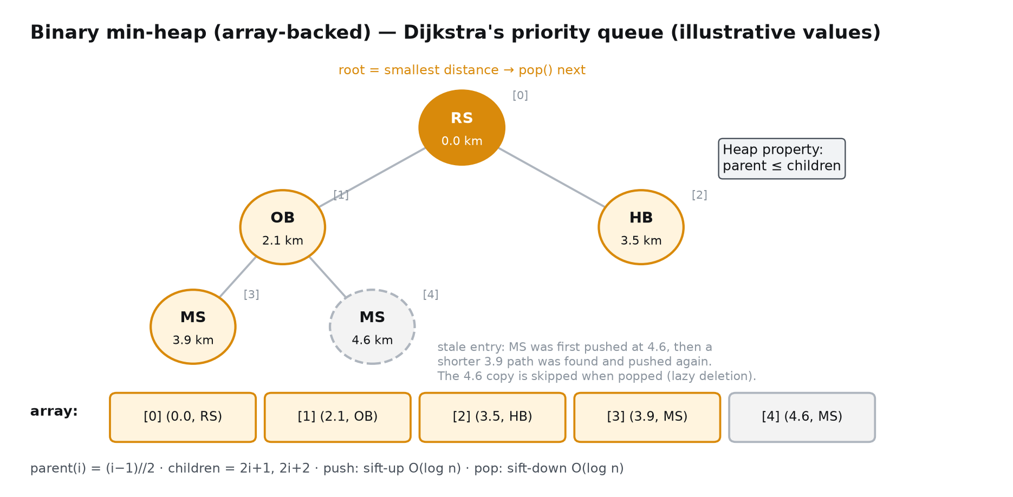
Data structures: what we built and why
FIFO queue — singly linked list
Head & tail pointers: enqueue and dequeue are O(1). A Python list.pop(0) would be O(n).
Hash table — separate chaining
Hash = Σ character codes mod buckets. Collisions append to the bucket's chain, so it never fills and deletes are simple.
Binary min-heap — array-backed
Push/pop O(log n). Lazy deletion replaces decrease-key.
Notes:
Hash: FL001 sums to 291, 291 mod 8 = 3. FL010 has the same characters so it collides into bucket 3 and is chained. Queue: linked list because Python list.pop(0) shifts every element. Heap: array representation, children at 2i+1 and 2i+2; we push a node again when we find a shorter distance and skip stale copies when popped. Road graph uses an adjacency list because road networks are sparse.

Slide 5
Algorithm design: Dijkstra over open roads
Dijkstra(G, closed, s, g):
dist[v] ← ∞ for all v; dist[s] ← 0
heap.PUSH(0, s)
while heap not empty:
(d, u) ← heap.POP() # closest
if d > dist[u]: continue # stale
if u = g: break # early exit
for (u→v, km, road) in G[u]:
if road ∈ closed: continue # flooded
if d + km < dist[v]: # relax
dist[v] ← d + km; prev[v] ← u
heap.PUSH(dist[v], v)
rebuild path g → s via prev[]
Operation | Structure | Time
Submit report | Hash put + enqueue | O(1) avg
Lookup by ID | Hash get | O(1 + α)
Verify next | Queue dequeue | O(1)
Heap push / pop | Binary heap | O(log n)
Shortest route | Dijkstra + heap | O((V+E) log V)
Evacuation | Dijkstra × shelters | O(S·(V+E) log V)
Worked example (demo city)
Riverside → Hillcrest with RS-MS and HJ-HC closed
RS → Old Bridge → Market Sq → HC = 6.9 km
6 nodes settled · 8 heap pushes · ~14 min at 30 km/h
Why not BFS? Roads have different lengths. Why not Bellman-Ford? No negative weights — O(V·E) is unnecessary.
Notes:
Each edge is relaxed at most once, each relaxation is one O(log V) heap push, so Dijkstra is O((V+E) log V). The early exit stops as soon as the destination is settled. The worked example matches the app and our automated test.

Slide 6
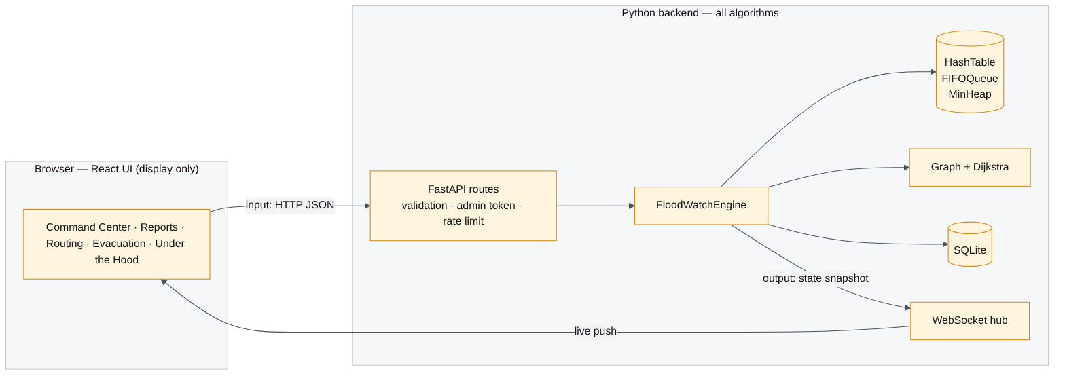





Implementation: Python core, live web interface
structures.py
graph.py
engine.py · store.py
HashTable, MinHeap, FIFOQueue, binary search — written from scratch
Adjacency list + Dijkstra with step trace — one function for both maps
Rules: submit, verify, close roads, evacuate · SQLite persistence
geo.py
build_ghana_graph.py
main.py · web UI
Ghana map: spatial hashing, flood zones, safe point, live reroute
OpenStreetMap → 45,928 junctions, 76,620 km of road
FastAPI input & validation; React + Leaflet only display results
Notes:
Language: Python 3 for all algorithms and data structures, as required. Input -> process -> output: main.py validates input, engine.py and structures.py process, and the web interface only displays results. The Ghana map reuses the exact same dijkstra() and HashTable - only the data is real. The original Tkinter version is included as an all-Python fallback.

Slide 7

Testing: 46 of 46 automated tests pass
46/46
24
200
tests passing
edge-case tests
random graphs cross-checked
Data structures: 1-bucket table (all collide) · empty-table lookup · remove mid-chain & queue tail · heap vs Python heapq on 2,000 values
Routing: Start = destination · isolated start · every road closed · unknown place · detour around a closed shortcut
Correctness proof-by-test: Dijkstra matched an independent reference on 200 random graphs for every destination — every path step uses an open road
Application: Invalid input rejected (422/400) · admin-only actions (401) · two reports on one road · IDs never reused · state survives restart
Real Ghana network: Accra→Kumasi valid path · verify flood → reroute → resolve restores · flooded destination → safe point · start inside a flood
Notes:
All 37 tests run in under a second with pytest. Highlight the randomised check: we compared our Dijkstra against an independent implementation on 200 random graphs — distances matched for every destination. Full results table is in docs/TEST_REPORT.md.

Slide 8


Performance: the heap and queue scale as Big-O predicts
33.6× faster
151 ms
28 buckets used
Heap vs naive Dijkstra at 5,000 locations (15.5 ms vs 522 ms)
Accra → Tamale (564 km) on Ghana's real network: 45,928 junctions, same Dijkstra
Char-sum hash on 2,000 FLxxxx IDs, even with 4,001 buckets: 55 probes per lookup. Fix: polynomial hash
Notes:
Honest observations: below about 100 locations the naive version is just as fast because the heap has overhead - the heap pays off as the city grows. Same for the queue: list.pop(0) wins at 1,000 items, loses badly at 100,000 (22x). On the real Ghana network a city trip settles about 600 junctions in 4 ms; Accra to Tamale settles 38,000 in 151 ms. Key finding: our simple char-sum hash only ever produces 28 distinct buckets for IDs like FL0001 because the digits always sum to a narrow range. Fine at demo scale, but a polynomial hash is the recommended fix.

Slide 9
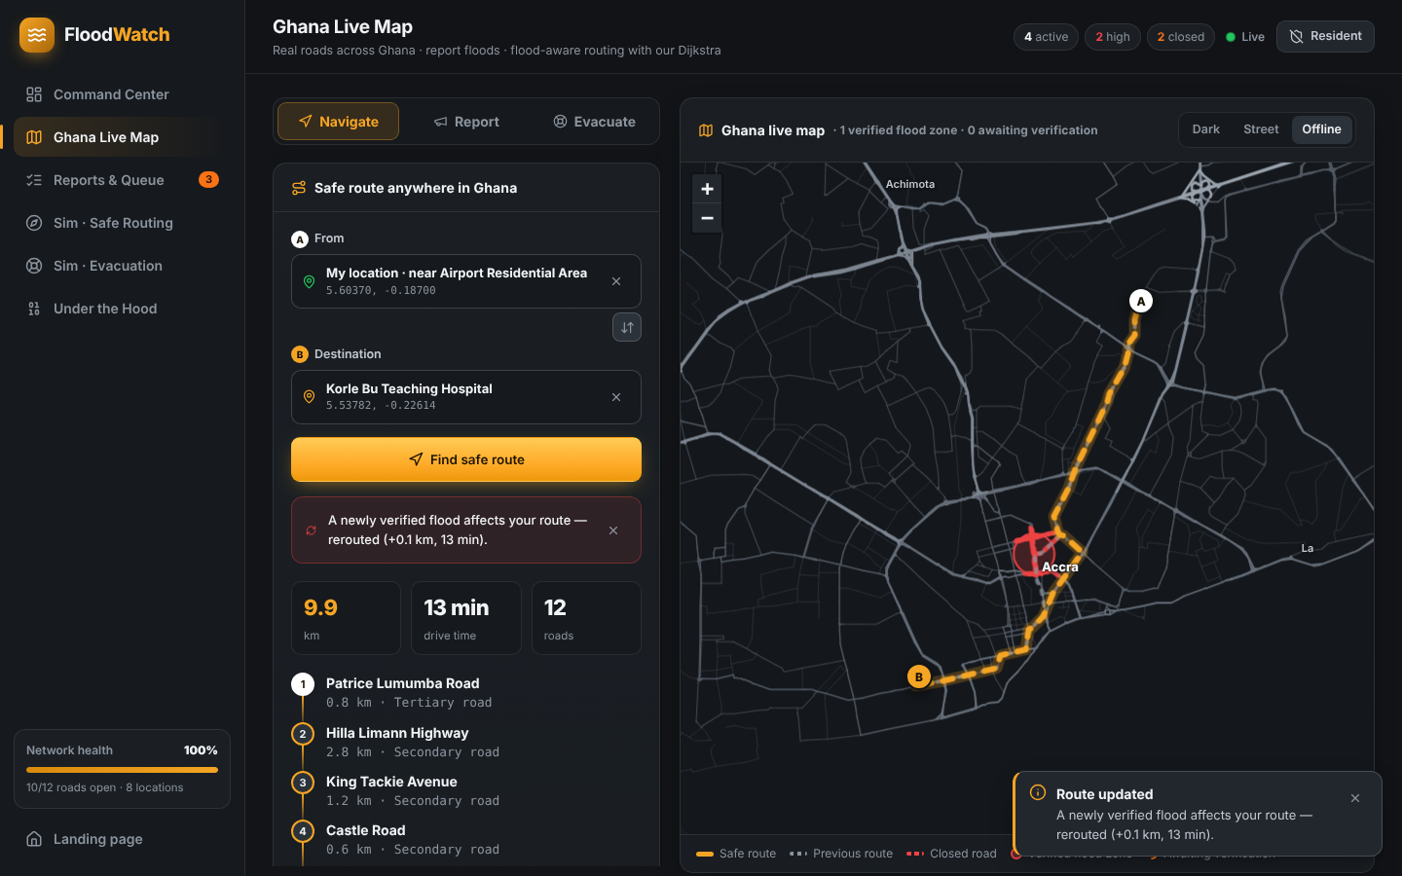
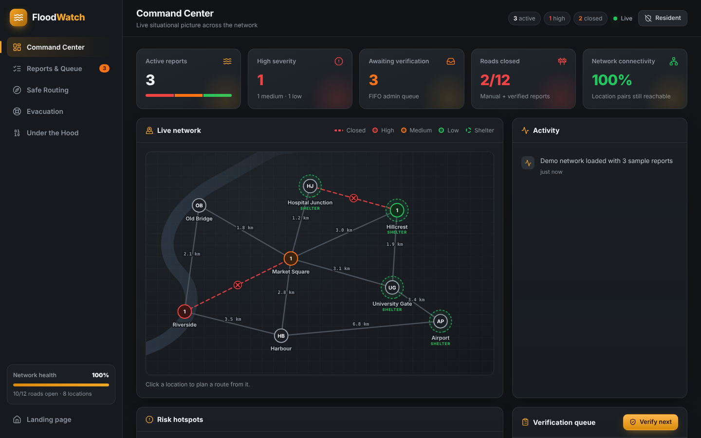
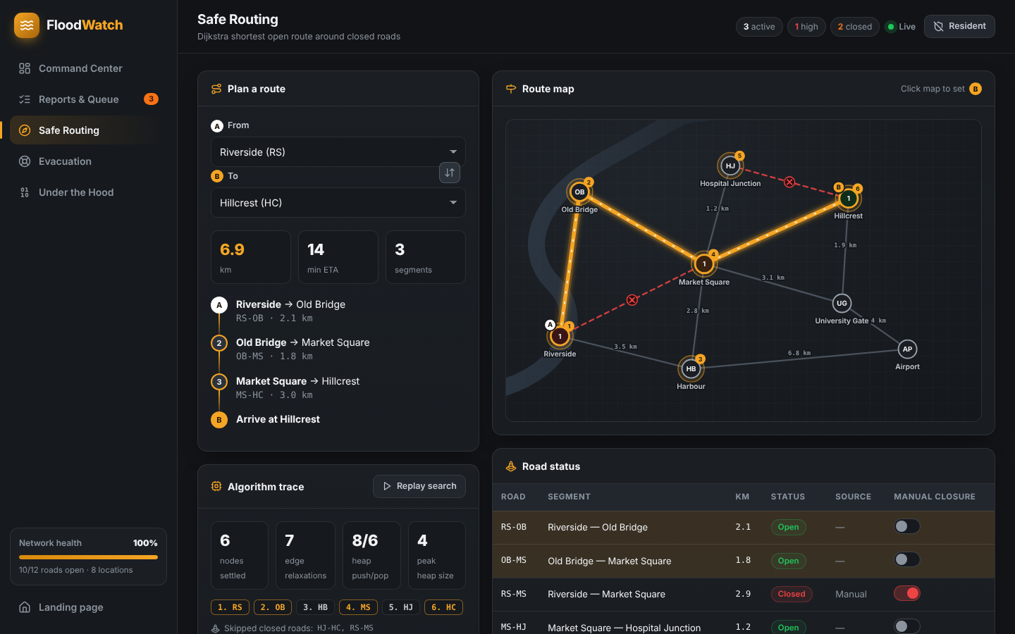
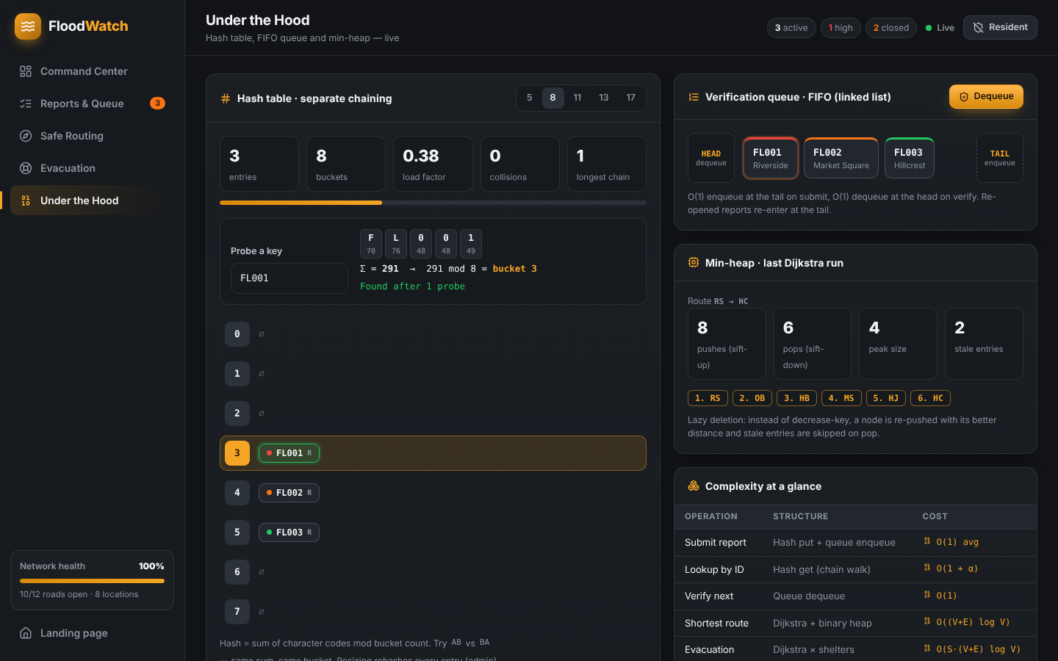
Demo: the working application
Ghana Live Map
Command Center
real roads, live reroute
KPIs & activity
Simulation
Under the Hood
animated Dijkstra
live hash table & queue
Notes:
Switch to the live demo: on the Ghana map, route from My location to Korle Bu; report a flood on that route, verify it as admin and watch the route change live. Then show the simulation's Dijkstra replay and the hash-table probe. If the Wi-Fi is weak, press Offline on the map.

Slide 10

Conclusion & future improvements
What we delivered
Next steps
A working flood-reporting and routing system built on our own hash table, queue, min-heap and Dijkstra
Correctness shown by 46 passing tests incl. 200 randomised graphs
Efficiency measured: heap Dijkstra 33.6× faster at 5,000 locations
Real Ghana road network (76,620 km): GPS reporting, flood-aware routing, live rerouting
Polynomial hash for reports — already used for the map indexes; add auto-resize
A* search — straight-line heuristic to settle fewer nodes
Residential streets — full street detail for Accra & Kumasi
Flood depth weights — slow roads instead of only open/closed
SMS / USSD reporting — for residents without smartphones
Thank you — questions?
Notes:
Close with the measured hash finding as an example of analysis leading to an improvement. Likely questions: why separate chaining (no tombstones, never full), why lazy deletion (simpler than decrease-key, same Big-O), why a linked list for the queue (O(1) dequeue), why Dijkstra not BFS (weighted roads).

