Slide 1
CHAPTER 5 Logistic Regression
Maryam Bashir
Lecturer Computer Science
GPGC

Slide 2
Classifiers
This section focuses on the process of choosing a classifier. Classification involves mapping your data points into a finite set of labels or the probability of a given label or labels. We’ve already seen some examples of classification algorithms, such as Naive Bayes and k-nearest neighbors (k-NN), in the previous chapters. Table 5-1 shows a few examples of when you’d want to use classification: Table 5-1. Classifier example questions and answers
“Will someone click on this ad?” 0 or 1 (no or yes)
“What number is this (image recognition)?” 0, 1, 2, etc.
“What is this news article about?” “Sports”
“Is this spam?” 0 or 1 “Is this pill good for headaches?” 0 or 1
From now on we’ll talk about binary classification only (0 or 1).

Slide 3
The big picture is that given data, a real-world classification problem, and constraints, you need to determine:
1. Which classifier to use
2. Which optimization method to employ
3. Which loss function to minimize
4. Which features to take from the data
5. Which evaluation metric to use

Slide 4
Let’s talk about the first one: how do you know which classifier to choose?
One possibility is to try them all, and choose the best performer.
This is fine if you have no constraints, or if you ignore constraints. But usually constraints are a big deal—you might have tons of data, or not much time, or both.
This is something people don’t talk about enough. Let’s look at some constraints that are common across most algorithms.

Slide 5
Runtime
Say you need to update 500 models a day. That is the case at M6D, where their models end up being bidding decisions. In that case, they start to care about various speed issues.
First, how long it takes to update a model, and
second, how long it takes to use a model to actually make a decision if you have it.
This second kind of consideration is usually more important and is called runtime.
Some algorithms are slow at runtime. For example, consider k-NN: given a new data point in some large-dimensional space, you actually have to find the k closest data points to it.
In particular, you need to have all of your data points in memory.

Slide 6
Linear models, by contrast, are very fast, both to update and to use at runtime. As we’ll see in Chapter 6, you can keep running estimates of the constituent parts and just update with new data, which is fast and doesn’t require holding old data in memory.

Slide 7
You
One underappreciated constraint of being a data scientist is your own understanding of the algorithm.
Ask yourself carefully, do you understand it for real? Really? It’s OK to admit it if you don’t.
You don’t have to be a master of every algorithm to be a good data scientist.
The truth is, getting the best fit of an algorithm often requires intimate knowledge of said algorithm.
Sometimes you need to tweak an algorithm to make it fit your data.
A common mistake for people not completely familiar with an algorithm is to overfit when they think they’re tweaking.

Slide 8
Interpretability
You often need to be able to interpret your model for the sake of the business.
Decision trees are very easy to interpret.
Random forests, on the other hand, are not, even though they are almost the same thing.
They can take exponentially longer to explain in full.
If you don’t have 15 years to spend understanding a result, you may be willing to give up some accuracy in order to have it be easier to understand.
For example, by law, credit card companies have to be able to explain their denial-of-credit decisions, so decision trees make more sense than random forests. You might not have a law about it where you work, but it still might make good sense for your business to have a simpler way to explain the model’s decision.

Slide 9
Scalability
How about scalability? In general, there are three things you have to keep in mind when considering scalability: 1. Learning time: How much time does it take to train the model? 2. Scoring time: How much time does it take to give a new user a score once the model is in production? 3. Model storage: How much memory does the production model use up? Here’s a useful paper to look at when comparing models: An Empirical Comparison of Supervised Learning Algorithms, from which we’ve learned:

Slide 10
Simpler models are more interpretable but aren’t as good performers. • The question of which algorithm works best is problemdependent. • It’s also constraint-dependent.

Slide 11
M6D Logistic Regression Case Study
Brian and his team have three core problems as data scientists at M6D: 1. Feature engineering: Figuring out which features to use and how to use them. 2. User-level conversion prediction: Forecasting when someone will click. 3. Bidding: How much it is worth to show a given ad to a given user? This case study focuses on the second problem. M6D uses logistic regression for this problem because it’s highly scalable and works great for binary outcomes like clicks.

Slide 12
Click Models
At M6D, they need to match clients, which represent advertising companies, to individual users. Generally speaking, the advertising companies want to target ads to users based on a user’s likelihood to click. Let’s discuss what kind of data they have available first, and then how you’d build a model using that data. M6D keeps track of the websites users have visited, but the data scientists don’t look at the contents of the page. Instead they take the associated URL and hash it into some random string. They thus accumulate information about users, which they stash in a vector. As an example, consider the user “u” during some chosen time period:
u = < &ltfxyz, 123, sdqwe, 13ms&gtg

Slide 13
This means “u” visited four sites and the URLs that “u” visited are hashed to those strings. After collecting information like this for all the users, they build a giant matrix whose columns correspond to sites and whose rows correspond to users, and a given entry is “1” if that
user went to that site. Note it’s a sparse matrix, because most people don’t go to all that many sites.

Slide 14
To make this a classification problem, they need to have classes they are trying to predict. Let’s say in this case, they want to predict whether a given user will click on a shoe ad or not. So there’s two classes: “users who clicked on the shoe ad” and “users who did not click on the shoe ad.” In the training dataset, then, in addition to the sparse matrix described, they’ll also have a variable, or column, of labels. They label the behavior “clicked on a shoe ad” as “1,” say, and “didn’t click” as “0.” Once they fit the classifier to the dataset, for any new user, the classifier will predict whether he will click or not (the label) based on the predictors (the user’s browsing history captured in the URL matrix).

Slide 15
Now it’s your turn: your goal is to build and train the model from a training set. Recall that in Chapter 3 you learned about spam classifiers, where the features are words. But you didn’t particularly care about the meaning of the words. They might as well be strings. Once you’ve labeled as described earlier, this looks just like spam classification because you have a binary outcome with a large sparse binary matrix capturing the predictors. You can now rely on well-established algorithms developed for spam detection.

Slide 16
You’ve reduced your current problem to a previously solved problem! In the previous chapter, we showed how to solve this with Naive Bayes, but here we’ll focus on using logistic regression as the model. The output of a logistic regression model is the probability of a given click in this context. Likewise, the spam filters really judge the probability of a given email being spam. You can use these probabilities directly or you could find a threshold so that if the probability is above that threshhold (say, 0.75), you predict a click (i.e., you show an ad), and below it you decide it’s not worth it to show the ad. The point being here that unlike with linear regression—which does its best to predict the actual value—the aim of logistic regression isn’t to predict the actual value (0 or 1). Its job is to output a probability.

Slide 17
Although technically it’s possible to implement a linear model such as linear regression on such a dataset (i.e., R will let you do it and won’t break or tell you that you shouldn’t do it), one of the problems with a linear model like linear regression is that it would give predictions below 0 and above 1, so these aren’t directly interpretable as probabilities.

Slide 18
The Underlying Math
So far we’ve seen that the beauty of logistic regression is it outputs values bounded by 0 and 1; hence they can be directly interpreted as probabilities. Let’s get into the math behind it a bit. You want a function that takes the data and transforms it into a single value bounded inside the closed interval 0,1 . For an example of a function bounded between 0 and 1, consider the inverse-logit function shown in Figure 5-2.

Slide 19
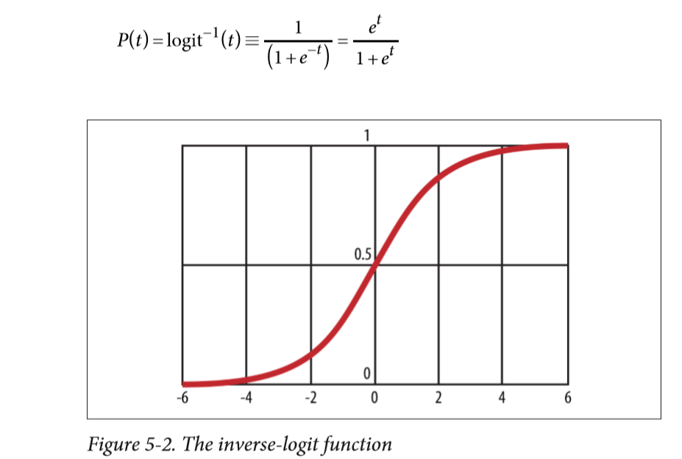

Slide 20
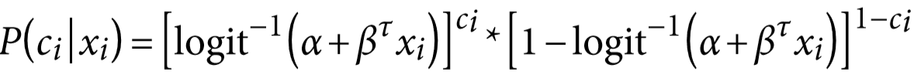
Note when t is large, e−t is tiny so the denominator is close to 1 and the overall value is close to 1. Similarly when t is small, e−t is large so
the denominator is large, which makes the function close to zero. So that’s the inverse-logit function, which you’ll use to begin deriving a logistic regression model. In order to model the data, you need to work with a slightly more general function that expresses the relationship between the data and a probability of a click. Start by defining:
Here ci is the labels or classes (clicked or not), and xi is the vector of features for user i. Observe that ci can only be 1 or 0, which means that if ci=1, the second term cancels out and you have:

Slide 21
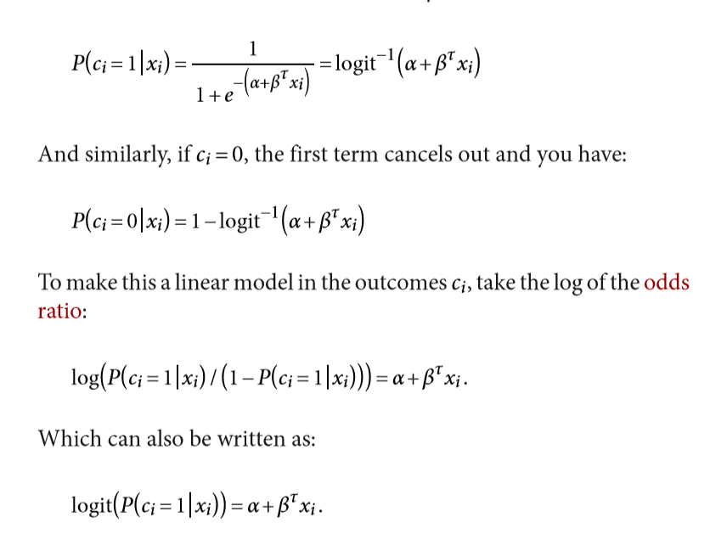

Slide 22
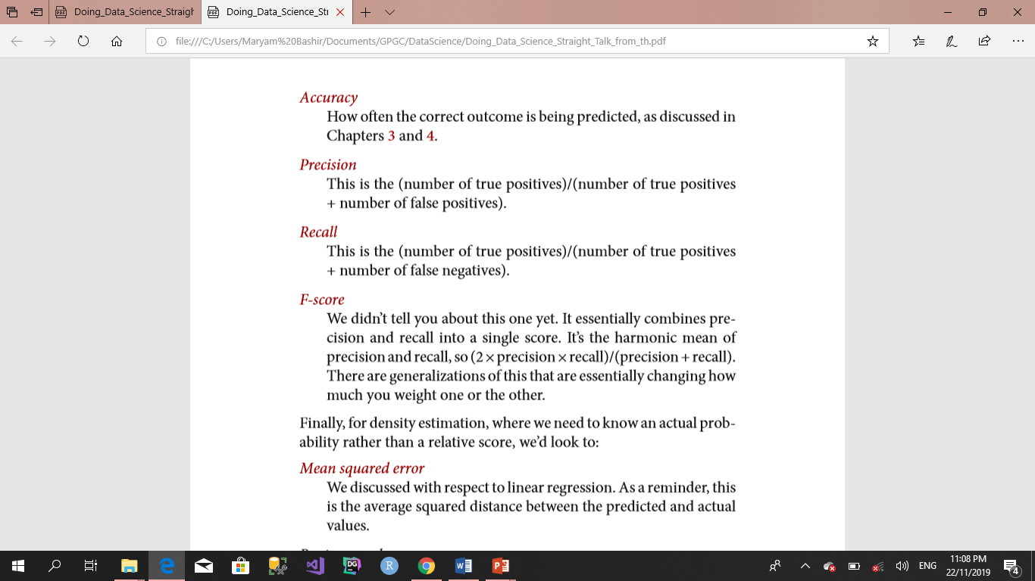
You have several options for how you’d then evaluate the quality of the model

