Slide 1
Yellowfin Overview

Slide 2
Yellowfin
Established 2003
Australian Based with an growing International Partner Base
Over 400 direct customers (80% offshore), 1000’s indirect and 200k end users globally
Customers include 20 of worlds Top 30 Telco’s, Aust 4 major banks and largest utility company in the world.
MIS Magazine Global 100 Strategic Vendor list

Slide 3
Yellowfin
Yellowfin, a business intelligence platform, is a single integrated solution developed for companies across varying industries and scaling sizes.
This system is customizable to suit businesses in accounting, advertising, agriculture, banking, insurance, manufacturing, media, marketing, food and beverage, engineering, retail, technology and several other fields.
Key functionalities include dashboards and scorecards, predictive analytics, online analytical processing, query and reporting writing and performance management. Yellowfin offers filtering capabilities that can be updated in real time.

Slide 4
Yellowfin
Yellowfin is a completely web-based platform that deploys on-premises and in the cloud via the Amazon and Azure marketplaces based on the bring your own license (BYOL) model. The suite consists of the following integrated modules: Yellowfin Signals, Yellowfin Present, Yellowfin Data Discovery, Yellowfin Dashboards and Yellowfin Data Prep.

Slide 5
Yellowfin
Sharing information with colleagues and stakeholders is an offered to facilitate discussions and embed directly into the company intranet. Yellowfin provides many different chart types, and users can toggle between them.
This platform is browser agnostic and is accessible from desktops as well as mobile devices.

Slide 6
Yellowfin Dashboard
Assemble creative, on brand infographic and actionable dashboards on a flexible, free-form canvas with your dashboard builder. Yellowfin dashboards provide support for multiple types of content objects including reports, filters, interactive buttons, images, text, shapes and icons, along with support for custom coded widgets to incorporate any functionality directly into the dashboard.
Yellowfin Dashboard has a bilateral editor that provides support for visual design and editing, so you can simply drag and drop objects, as well Code Mode, that allows developers to edit dashboard code.

Slide 7
Dashboard Objects
Reports
Filters
Filter linking
Filter groups
Dashboard filter bookmarks
Default filter values
Text
Graphics
Images
Blueprint & Quick Charts
Code Widgets
Action Buttons

Slide 8

























Clients

Slide 9
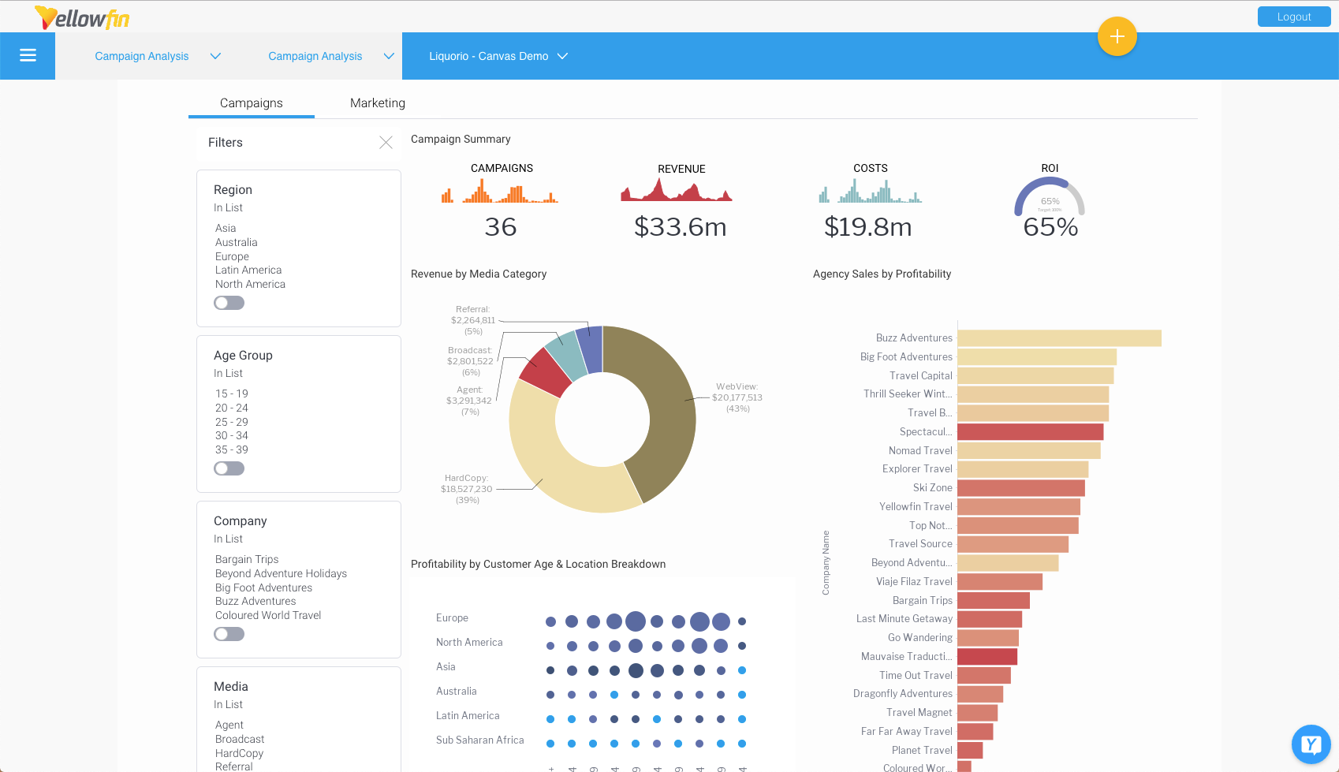
Screenshot - Dashboard

