Slide 1
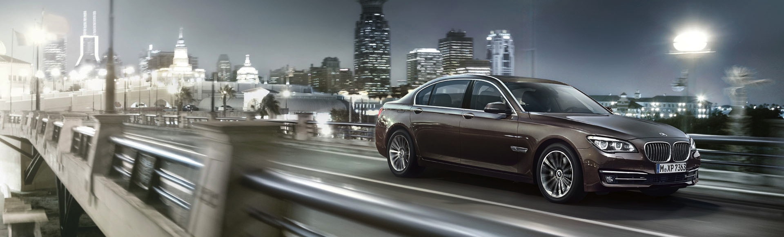
EN-CN-3, 2012-08-03
BMW-tongji nfc project proposal.
ConnectedDrive Lab China.

Slide 2
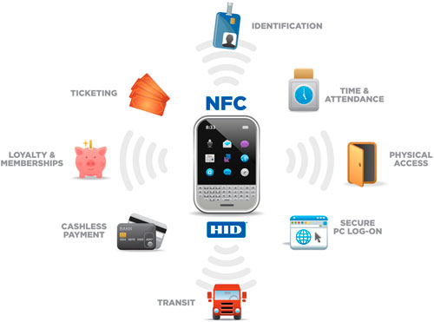
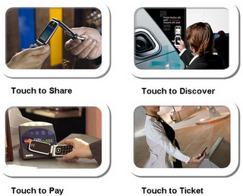
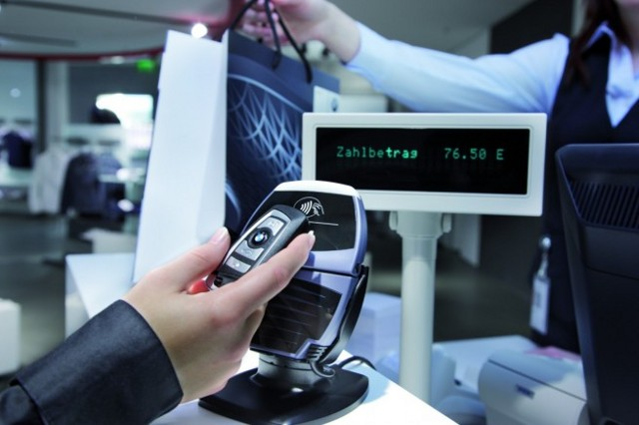
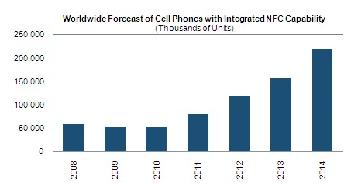
Nfc technology.
NFC interactions require no more than a simple touch!
Uses of NFC include:
Instant payments and coupon delivery using your handset
Marketing and exchange of information such as schedules, maps, business card
Transferring images, posters for displaying and printing
Social media e.g. Like on Facebook, Follow on Twitter via NFC smart stickers in retail stores
Ticketing systems for public transport
… …
by iSupply

Slide 3
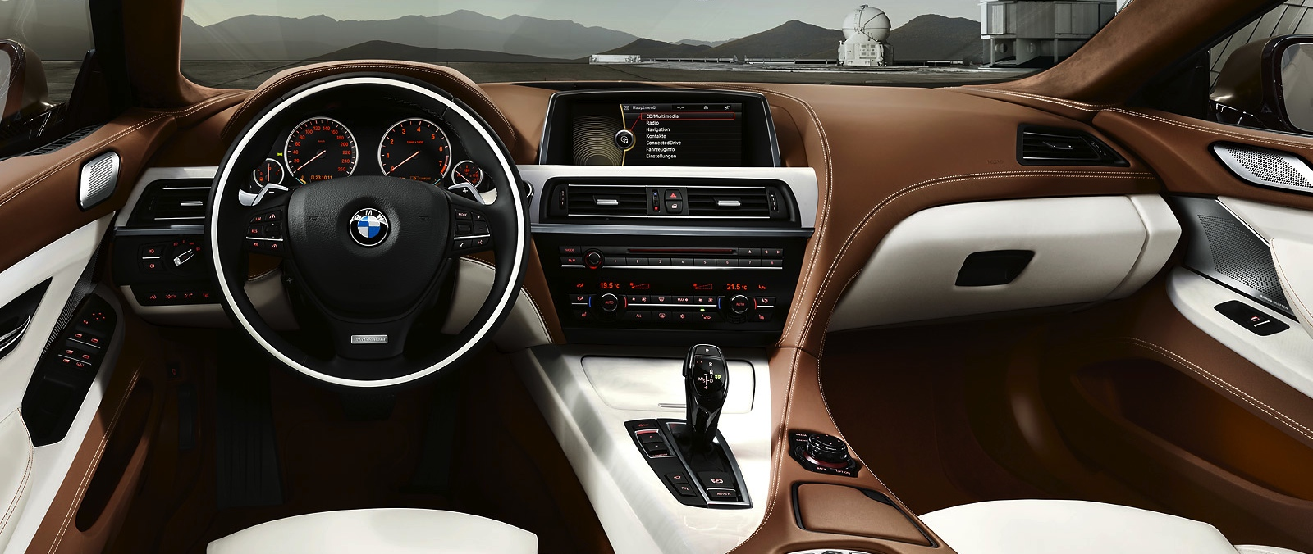
nfc in the car.
Potential use cases:
Driver identification & personalization
- Car access
- Send welcome message
- Set seat position, comfort preferences
- Personal music selection
- Email, contacts, calendar and SNS accounts
Data exchanges
- CE devices to retrieve car data like fuel level, mileage, car location, navigation destination, service data ..
- Car to read info from smart tags, then open image, web link ..
Function activation
- Enable Bluetooth / WiFi connection
- Intelligent tutorials
- Directly call someone, navigate to somewhere
NFC car key
- Car location, user preference storage

Slide 4
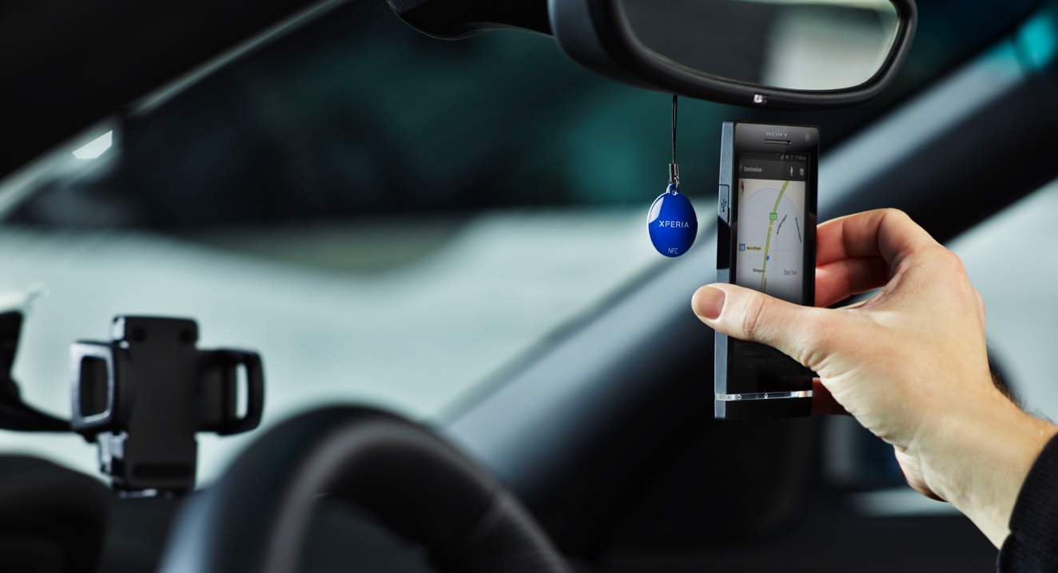
The assignment.
Task:
Create an app which connects the car and CE devices via NFC and develop meaningful use cases.
Resource:
- Tongji students: 1 or 2 teams, each team 5~6 people
- 1 Tongji professor as mentor
- 1 BMW mentor
- Use BMW open lab
Timeline:
TBD

