Slide 1

Automated Expression cassette planning
Dec 7, 2021
Josh Jackson, CS 6760

Slide 2


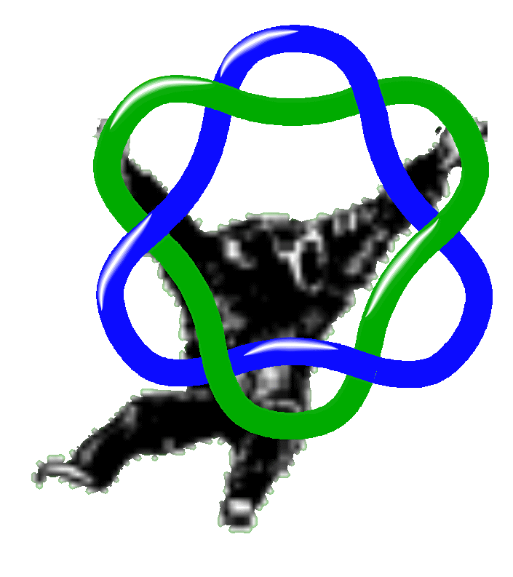
Why Automate the Process?
Benchling is clunky
Process seems ripe for automation

Slide 3
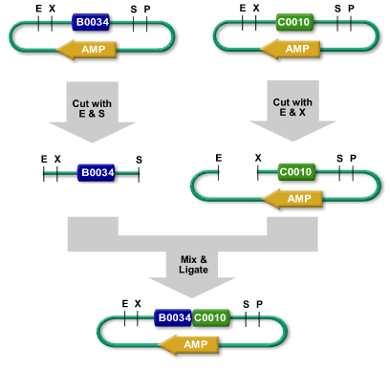
BioBrick Assembly
Notes:
EcoRI XbaI
SpeI PstI

Slide 4
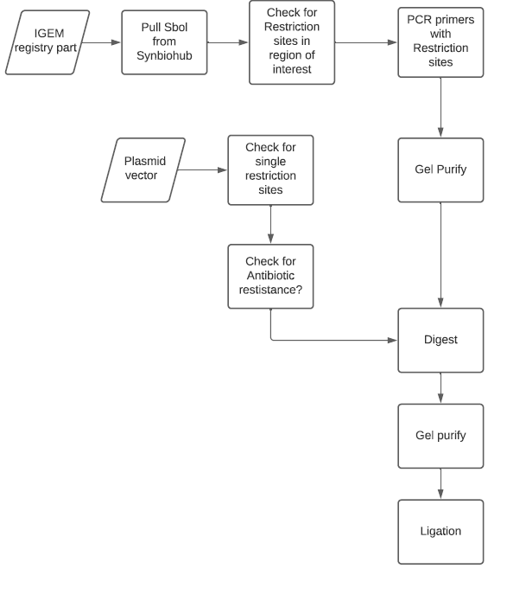
Project Map

Slide 5


Project Map

Slide 6
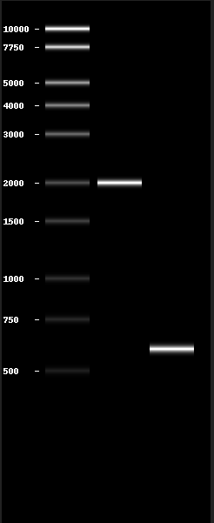
Python Libraries
BioPython
Built to deal with genomic sequences
Huge number of functions
Documentation is more developed
Pydna
Tagline is “Clone with Python”
Documentation is limited
Gel images
Found bug

Slide 7
Future Directions
Ligation
Screen for CcdB
Define User Input
Documentation
Better Error handling
Add Gibson Cloning methodology

