Slide 1
Examples of PowerPoint graphics & components
Marcus Boberg
marcus.Boberg@Safespring.com

Slide 2

Agenda
Agenda item one
Agendaitem two
Sub-item one
Subitem two
Agenda item three

Slide 3




Horizontal icon and text box
Heading Text that follows, this can be two rows long but not longer than three.
Heading Text that follows, this can be two rows long but not longer than three.
Heading Text that follows, this can be two rows long but not longer than three.
Heading Text that follows, this can be two rows long but not longer than three.

Slide 4
Example of technical graphics
INTERNET
REMOTE WORKERS / VPN
INTERNAL IT / CLIENTS
PRIVATE CLOUD
ROUTER
PRIVATE OPENSTACK
VM
VM
VM
VM
VM
VM
VM
VM
VM
HYPERVISOR
HYPERVISOR
HYPERVISOR
FW
FW
FW
CEPH

Slide 5



Vertical icon and text box
Compliance and Security
We provide a secure, GDPR-compliant cloud environment, ensuring businesses confidently leverage technology with advanced data protection measures.
Openness and Interoperability
We champion open standards and collaborative tech, offering open-source-based cloud services with standard APIs to promote innovation and prevent vendor lock-in..
Sovereignty, Local Empowerment
We offer sovereign cloud services tailored to local laws, enabling businesses to confidently harness cloud benefits while respecting jurisdictional autonomy.

Slide 6
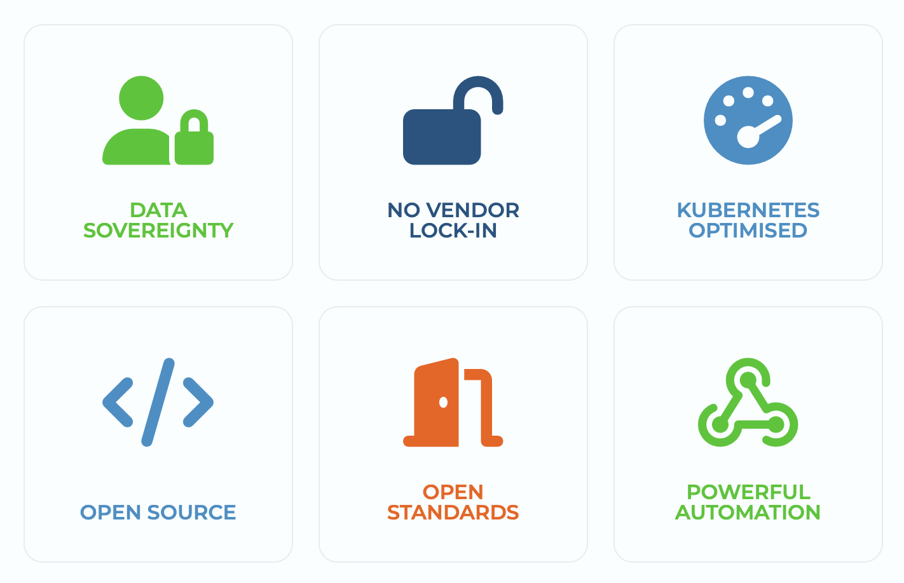
Icons and small text (2x3 or 1x3)

Slide 7
Waterfall graphics
Board-Strategy meeting
Every six months. Outcome is strategic plan for addressing market. Output Goto market plan, sales strategy doc.
Quarterly Sales plans
Target markets, activities
Monthly project plan
Sales plans including campaigns for selected markets.
Weekly meeting
Follow up and calibration in weekly sales meeting

