Slide 1
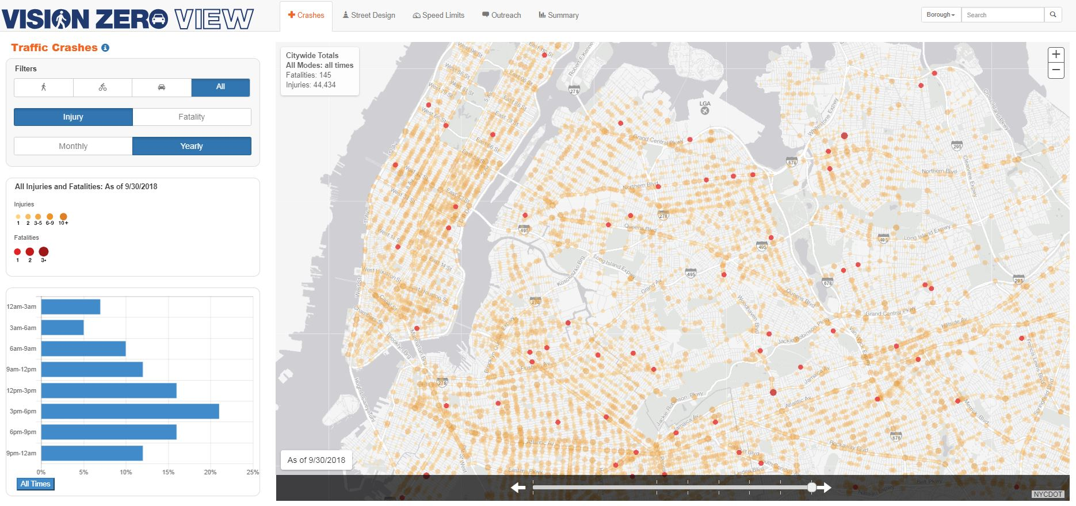
Crash data at NYC DOT
October 2018

Slide 2
OUTLINE
Crash data
1 | Overview
2 | Mapping
3 | Pitfalls
4 | Use cases
nyc.gov/dot

Slide 3
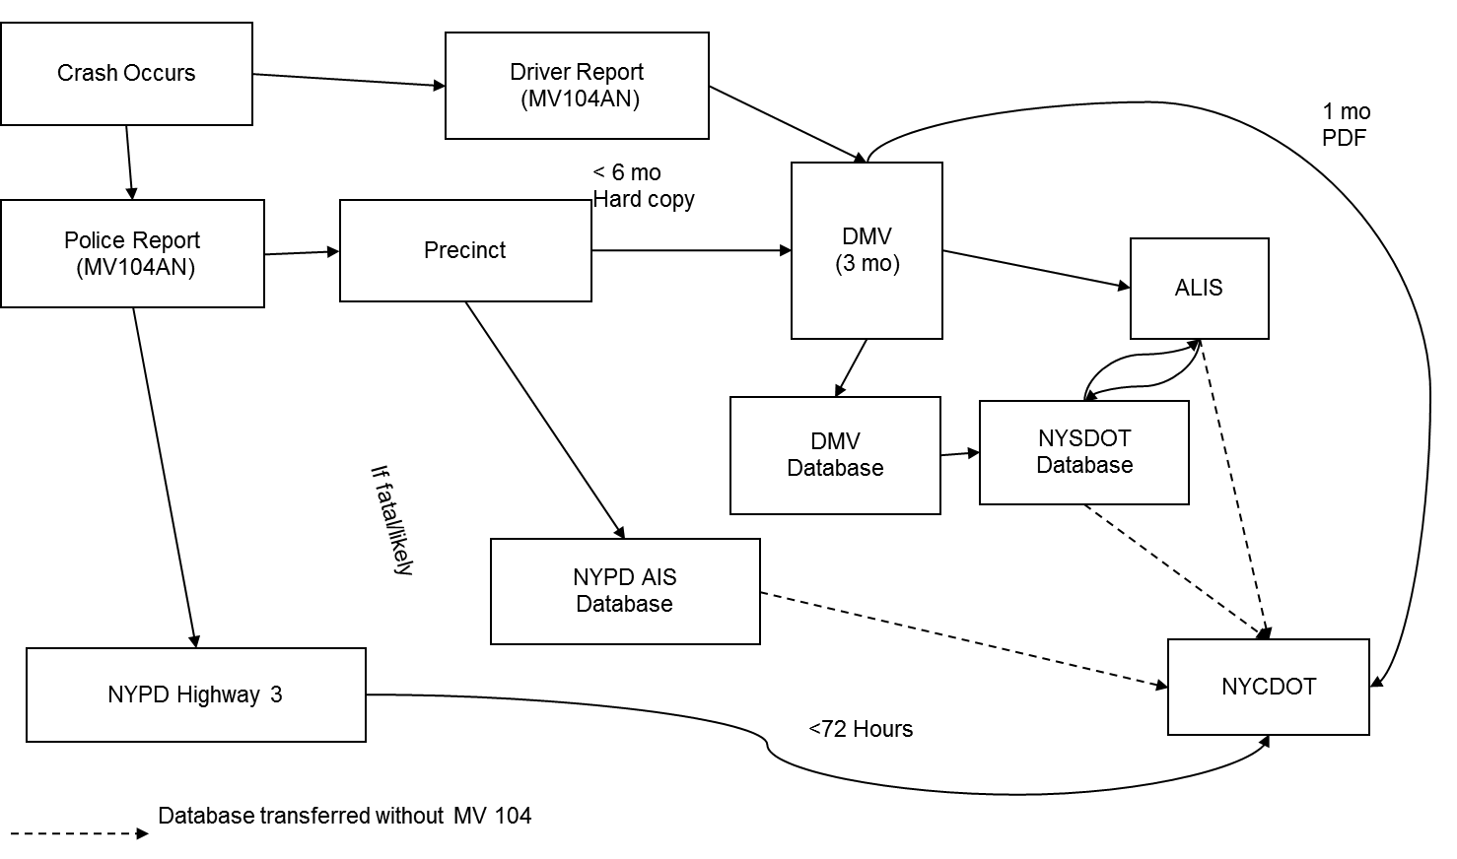
overview
Crash data flow
Primary datasets (NYPD & NYSDOT)
do not agree on basic info
Do not share ID#s

Slide 4
Common problems
Location reporting
Accuracy
Completeness

Slide 5
NYSDOT
Pros
Cons
Severity
NYSDOT does QA and Geocoding
Includes most of MV104 Report
Can be linked to MV104
Accessible via Safety Data Viewer (depending on need)
Includes motorist reports
Includes registration info from DMV (ex. TLC)
Data 1-2 years behind
Schema design
Unmapped cases
High volume of unknowns
Errors
Includes motorist reports

Slide 6
NYPD TAMS
Pros
Cons
Updated daily
Consistent 1998-2016
some details added (after requested) +/- 2015 – present
Can request MV104 from NYPD using ID# (2016 – present)
Available in open data
Has license plate
Will end in 2019
2016-2018 is temp solution from FORMS data
Limited fields
All crashes mapped to intersection
Mapping issues
Mapped to street network at the time of the crash (not the current map)

Slide 7
NYPD FORMS
Pros
Cons
Updated daily
Modified when errors are found
Full MV104 report data
Includes midblock locations
Severity can be calculated
Includes Non-MV bike crashes
Includes coordinates and address info
Has license plate
Only available from 2016
Only reliable from 2017
Requires reverse geocode
Includes midblock locations
Geographic errors
Mapped to street network at the time of the crash (not the current map)
Includes uninvolved people
Includes Non-MV bike crashes
Issue resolution may require DOITT, NYPD, IBM, and IBI

Slide 8
Mapping – all data
Crash location descriptions are insufficiently specific (all data sets)
Problematic locations
Parks
Highways & ramps
Bridges
Street network changes
Intersection crashes are related to the intersection node as well as all related segments

Slide 9
Common pitfalls
Using wrong (or mixed) versions of street network
Mixing NYPD and NYSDOT data
Using KSI where data is not available in both NYSDOT and Fatality data
Severity ambiguity with more than 1 victim (NYSDOT)
Taxi/livery is a registration type not a vehicle type
Not accounting for unknowns (ex. Exactly midnight in crash time)
Collision type for bike/ped crashes
X/Y vs. ST_X/ST_Y
Exclude = 0
Make sure field / value is used at appropriate frequencies prior to use
NYPD mapping pre/post 2016
FORMS victim table includes non-injured people (registrants, witnesses, etc)

Slide 10
Typical uses
Before / after (NYPD)
Ranking (NYSDOT + Fatality)
VZ priority info (NYSDOT + Fatality)
Project / program analysis (SIP, Bikes, trucks etc)
Research studies (seniors, left turn, etc)
Press requests

Slide 11
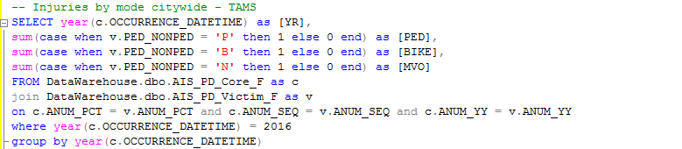

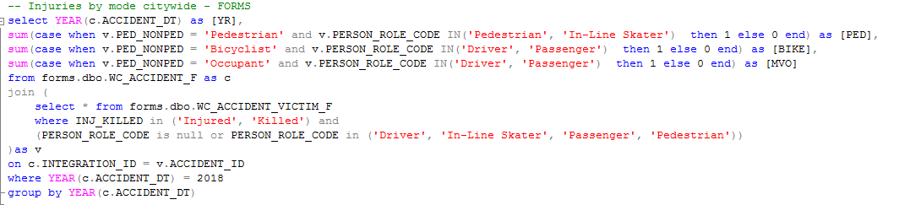

Basic queries
Injuries by mode (citywide) - NYPD

Slide 12
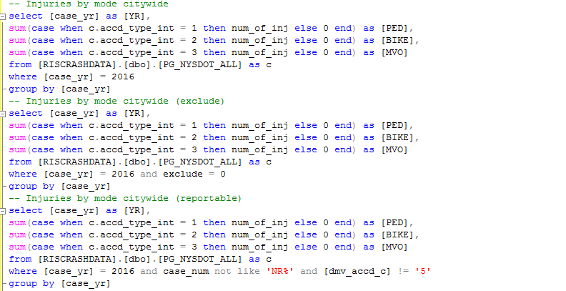
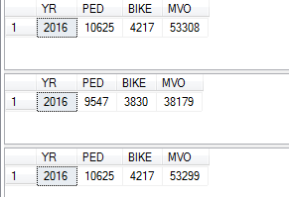
Basic queries
Injuries by mode (citywide) - NYSDOT

Slide 13
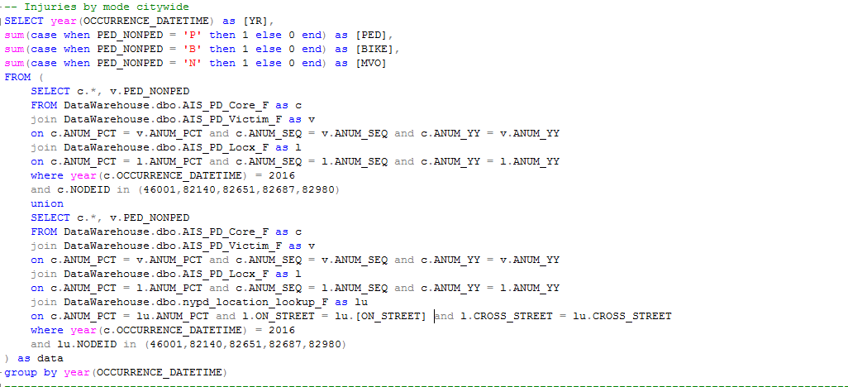

Basic queries
Injuries by mode at intersection – NYPD TAMS

Slide 14
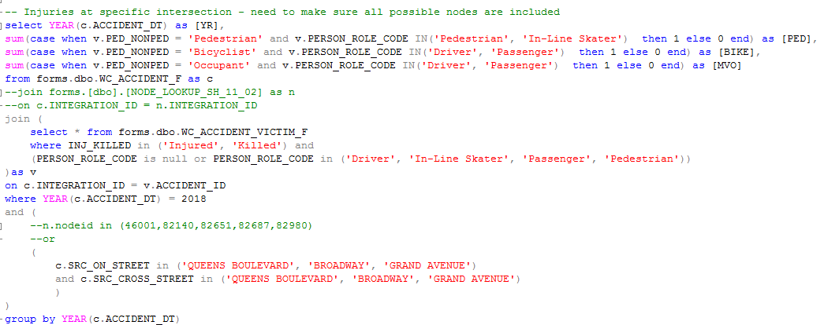

Basic queries
Injuries by mode at intersection – NYPD FORMS

Slide 15
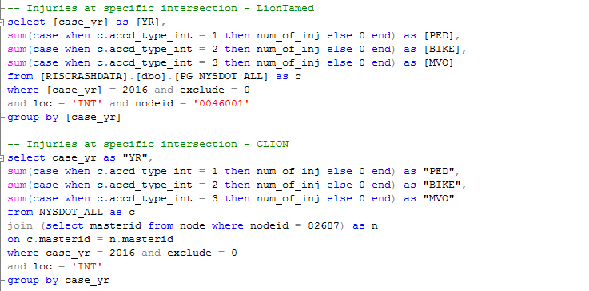


Basic queries
Injuries by mode at intersection - NYSDOT

Slide 16
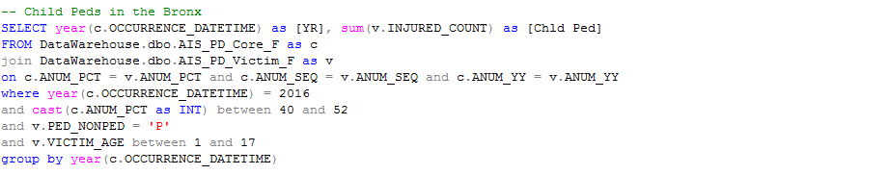

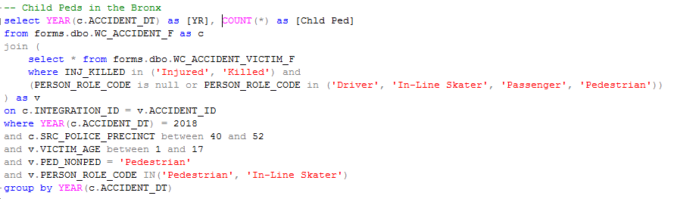

Basic queries
Child Ped injuries in the Bronx - NYPD

Slide 17
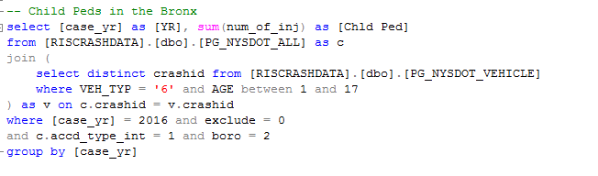

Basic queries
Child Ped injuries in the Bronx - NYSDOT

Slide 18
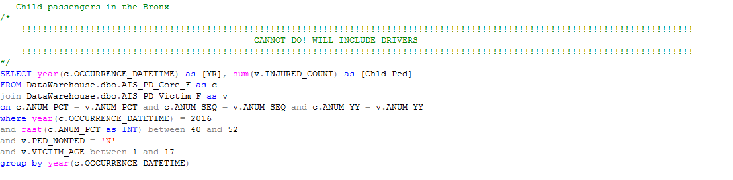

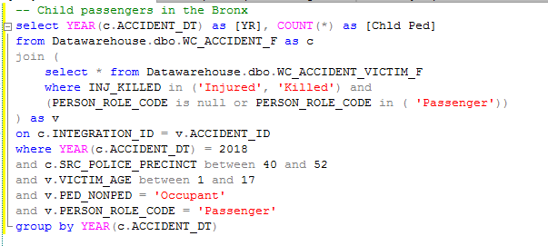

Basic queries
Child Passengers injuries in the Bronx - NYPD

Slide 19
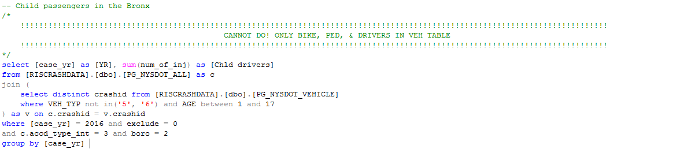

Basic queries
Child Passengers injuries in the Bronx - NYSDOT

Slide 20





Thank you!
Questions?
NYCDOT
nyc_dot
nyc_dot
NYCDOT

