Slide 1
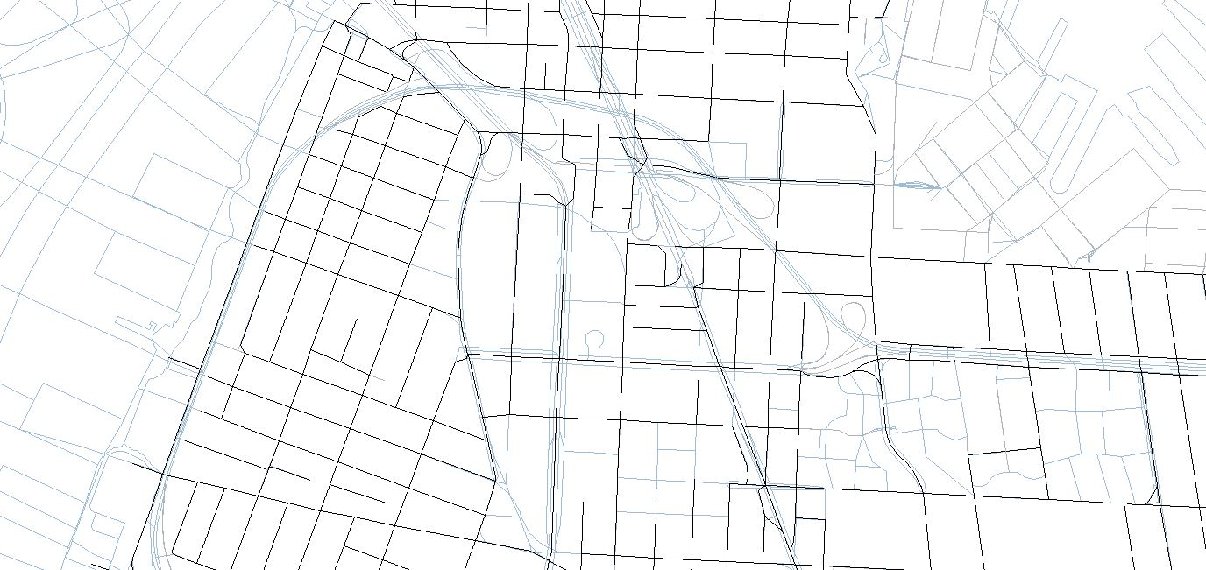
Street networks at NYC DOT
October 2018

Slide 2
OUTLINE
Crash data
1 | Overview
2 | Differences
3 | Pitfalls
4 | Use cases
nyc.gov/dot

Slide 3


overview
LION
Quarterly updates from DCP
Standard street network for NYC
Most City data relates to LION
Lion Tamed
Annual updates from SAM
Used in SDV
Cannot be related to standard LION
Designed for crash data
Excludes highways
CLION
Annual updates from SAM
LION + additional columns (can join to LION)
Based on D releases of LION

Slide 4
Differences
CLION
LION Tamed
Preserves roadbed and centerline
Updated programmatically
Allows for connections that cannot be physically represented
Counts and totals require some planning
More susceptible to LION errors
Centerline only
Updated manually
Limited to what can be physically represented
Simple counts and totals
More distant related locations need to be manually included

Slide 5
What is lion tamed
Generated from lion centerline (version 9?)
Originally intended to create full blocks
Manually updated and curated in an attempt to match the geographic precision in the crash data
This should be the default for crash analysis until the SDV switches to CLION

Slide 6
What is clion
Programmatically generated from D version of LION
Intended to mimic the functionality of Lion Tamed while preserving the relationship to LION and other geographic datasets
Generates common ID numbers for related nodes / segments, based on:
Street names
Proximity
Connectivity

Slide 7
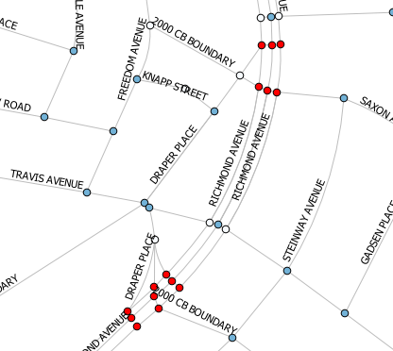
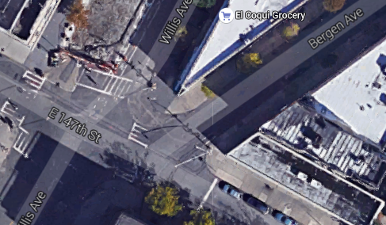
CLION Problem
Richmond Ave and Draper Pl
Any one of 15 nodes
Similar names
Broadway and 73rd St
3rd Ave and 49th Street
Locations that are too close together cannot be distinguished in the data
E 147 St at Willis Ave and E 147 St at Bergen Ave

Slide 8
Cluster intersection
Build simplistic understanding of an intersection
Set of unique street names i.e. (Broadway, 79th Street)
Create a new dictionary
Street name key = ordered set of names stored as string
{Street name key : [list of nodes that are intersections and have matching street name set]}
Give all nodes for each street name set a master ID#

Slide 9
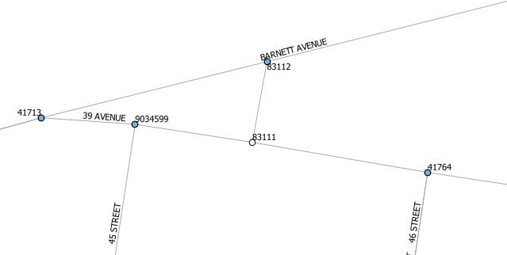
Cluster Intersections (example)
Cluster intersections example
{
“39 AVENUE - BARNETT AVENUE”:
[41713, 83112],
“39 AVENUE - 45 AVENUE”: [9034599],
“39 AVENUE - 46 AVENUE”: [41764]
}

Slide 10
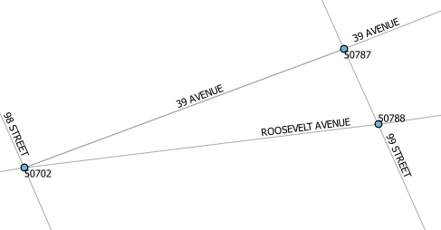
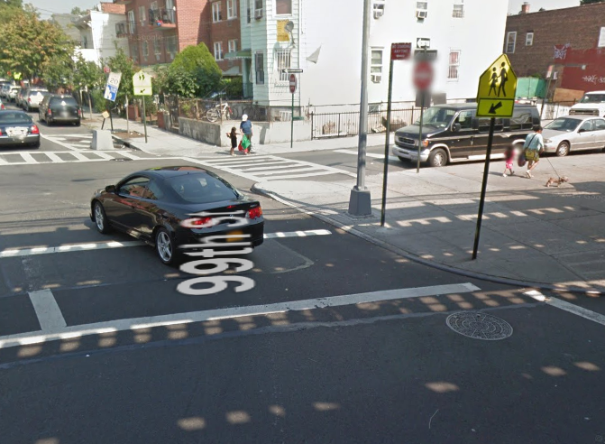
Refine Intersection Clusters
If nodes are in different police precincts and are too far apart, the clusters are split
Intersections that are too close to each other are indistinguishable in most data and are often grouped in the conceptual model

Slide 11
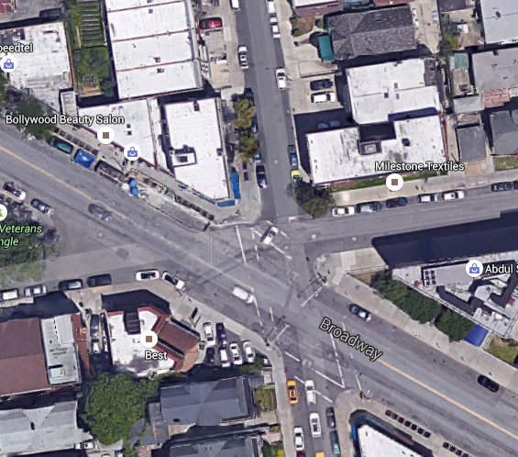
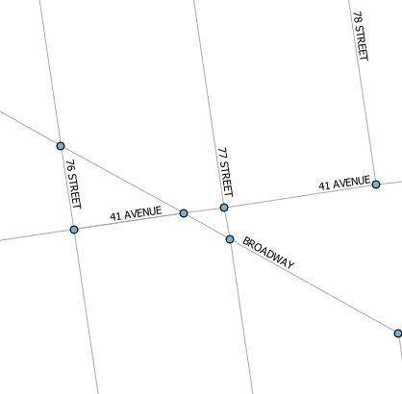
Small Triangles
Streets that intersect forming a triangle are often conceptually a single intersection

Slide 12
MFT
Full blocks are created using the MasterIDs (intersection to intersection)
A block is collection of segments with shared From / To Masterids => MFT

Slide 13
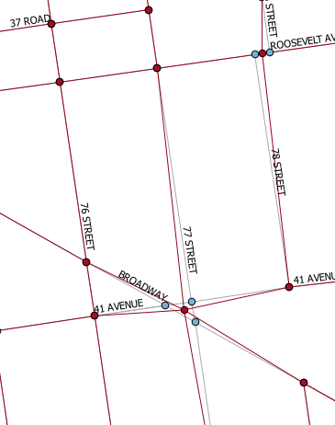
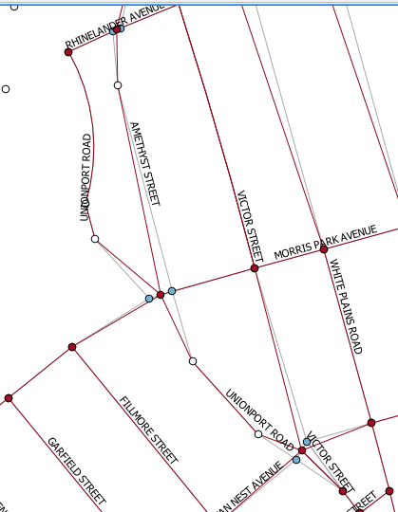

Slide 14
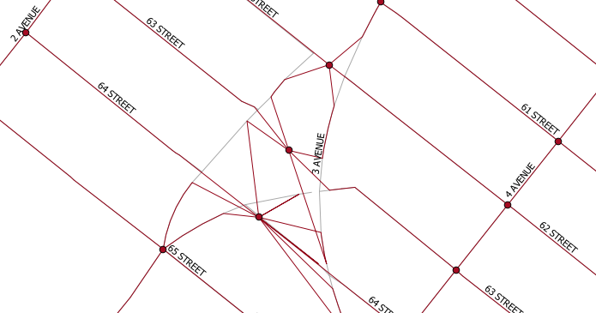

Slide 15
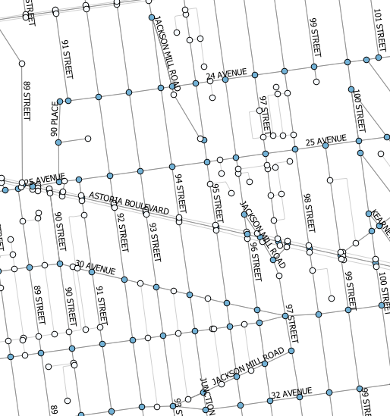

Slide 16
Common pitfalls
Not limiting RB_LAYER
Using only segment or node (not MFT or MasterID)
May not match SDV
Mapping data related to masters
Failing to think critically about the way the data might relate to the street network

Slide 17
When to use which
Is the analysis crash only or does it relate to other non-crash data (ex bus lanes)?
Is this a follow-up to an existing analysis?
Is there likely to need intersection (or block) level lists?

Slide 18
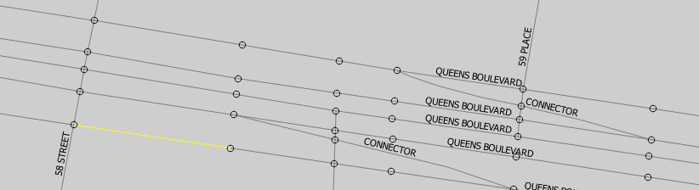
Basic queries

Slide 19

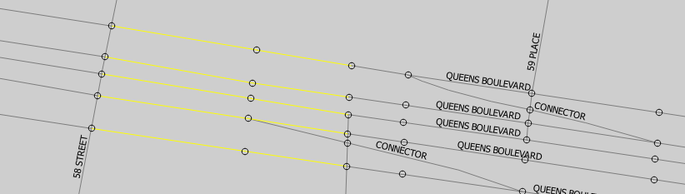
Basic queries

Slide 20
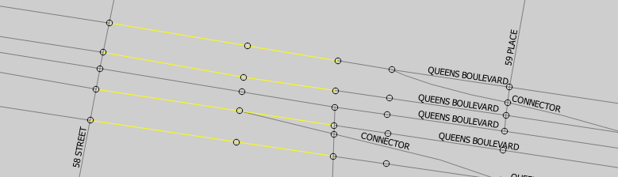
Basic queries

Slide 21

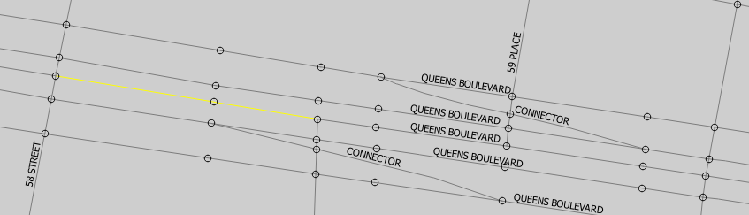
Basic queries

Slide 22

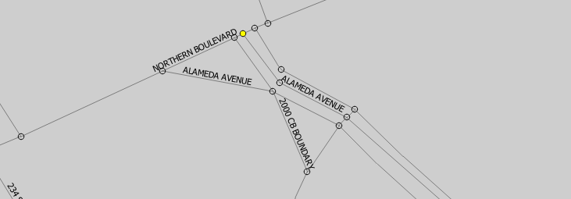
Basic queries

Slide 23

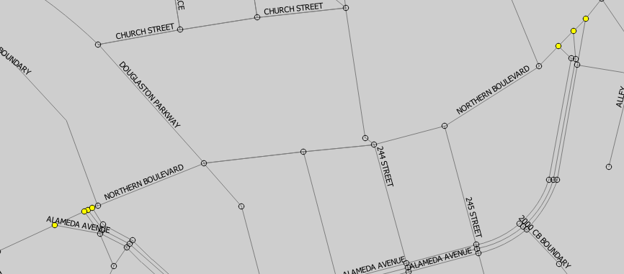
Basic queries

Slide 24
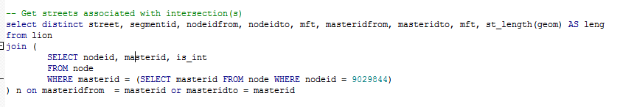
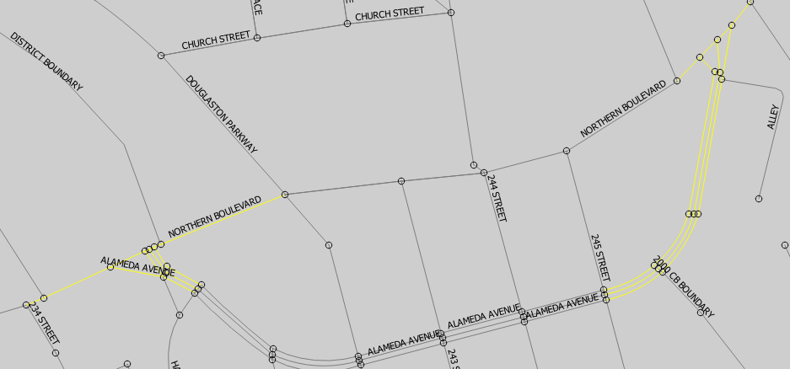
Basic queries

Slide 25





Thank you!
Questions?
NYCDOT
nyc_dot
nyc_dot
NYCDOT

