Slide 1
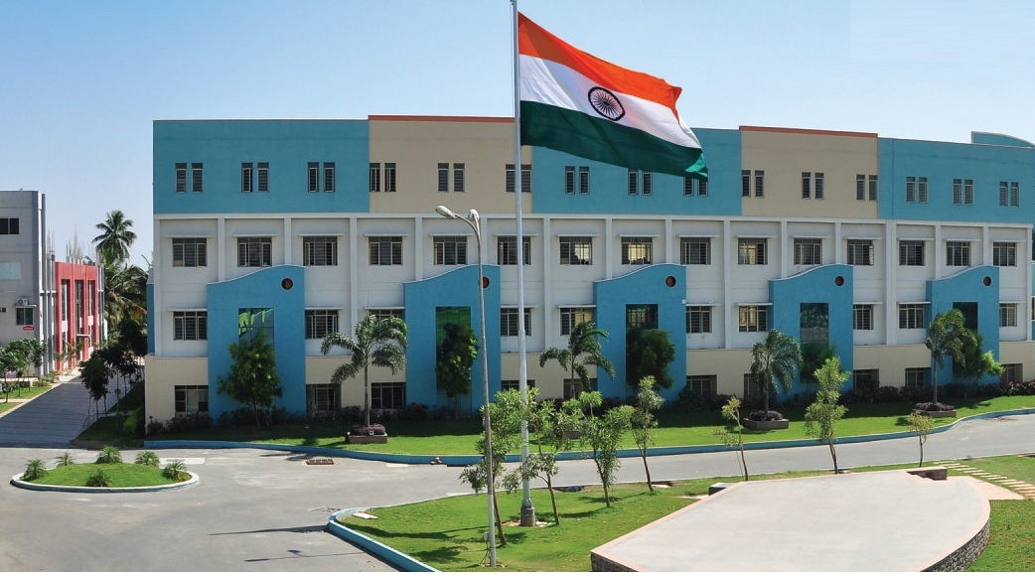
SRI ESHWAR COLLEGE OF ENGINEERING academic year: 2018-19 department: computer science and engineering section: c
FINAL YEAR PROJECT REVIEW – 0
Date of review:04-01-2019

Slide 2
WOMEN SAFETY PATROLLING ROBOT
Batch Members
1.SUVATHI.V
2.TAMIL SELVAN.M
3.VANDHANA.M
4.VANDHANA.S

Slide 3
Presentation Outline
Abstract
Literature Survey
Objective
Expected Outcome
Execution Plan

Slide 4
Abstract
Safety is a big concern in major parts of the world. The basic concept of patrolling robots is to safeguard a particular measured physical area using sensor equipments. Using the concept of Internet Of Things, a robot is built with cameras and sound sensors. The robot patrols around a pre-defined path and detects any potential mysterious activity beyond a particular time thus eliminating the fear of robbery at night or any part of the day.

Slide 5
Literature Survey
Lady Daiana O. Maia, Vandermi J. da Silva, vRicardo E.V. de S. Rosa,Jose P. Queiroz-Neto & Vicente F. de Lucena(2009),“An experience to use robotics to improve Computer Science learning”, IEEE Frontiers in Education Conference.
Zachary Henkel, Peggy Doerschuk & Judith Mann(2009), “Exploring computer science through autonomous robotics”, IEEE Frontiers in Education Conference.

Slide 6
Literature Survey
Michel Siguenza, Diego Guillen, Dante Arroya & Francisco Cuellar(2017), “Mobile robots development: A case study from robotics competitions and course projects”, IEEE International Conference on Electronics, Electrical Engineering & Computing.
Joan Oliver, Ricardo Toledo & Elena Valderrama(2010), “A learning approach based on robotics in Computer Science and Computer Engineering”, IEEE EDUCON 2010 Conference.

Slide 7
Objectives
Safeguard a particular facility.
Provide security using face recognition and motion detection.
Detect any potential threats using sound detection at night.
Alert the facility on account of any malicious movement.

Slide 8
Introduction
Safety is a big concern in our everyday lives.
We propose a security patrolling robot using Rasberry PI.
The system uses cameras and mic mounted on robotic vehicles for securing any premises.
The robotic vehicle moves at particular path and is equipped with camera and sound sensors.
The system uses a IR based pre-defined path to patrol any area.
It monitors each area to detect any problem using cameras and also has the ability to monitor sound

Slide 9
Introduction (Cont’d..)
It detects any movement beyond a period of time
It alerts the entire facility when it accounts any particular threat.
Provide a fully autonomous security robot that operates tirelessly and patrols large on its own to secure the facility.

Slide 10
Expected Outcome (or) Results and Discussion
Fully working patrolling robots to safeguard a particular facility.
Perform face recognition.
Handle motion detection.
Monitor sound in the area.
Move in a designated track.

Slide 11
Work Schedule
Attending Online courses in Udemy every project hour.
Implementation of project as a group every Friday and Saturday.

Slide 12
Queries?

