Slide 1
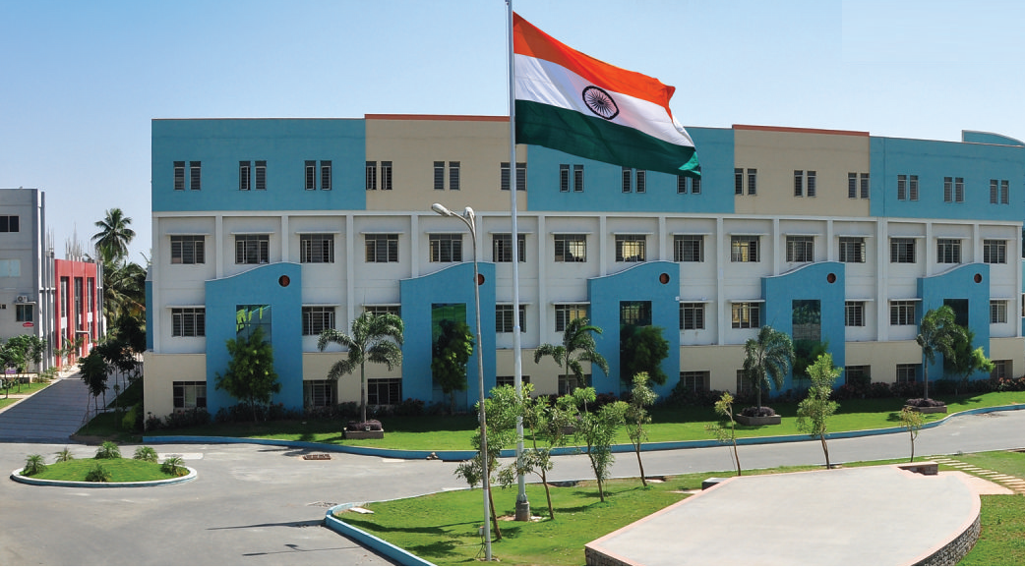
SRI ESHWAR COLLEGE OF ENGINEERING academic year: 2018-19 department: computer science and engineering section: c
FINAL YEAR PROJECT REVIEW – 1
Date of review:25-01-2019

Slide 2
SMART SURVEILLANCE USING RASPBERRY PI
Batch Members
1.SUVATHI.V
2.TAMIL SELVAN.M
3.VANDHANA.M
4.VANDHANA.S

Slide 3
Presentation outline
Abstract
Objective
Components and Requirements
Motivation
Existing Resources
Phases
Conclusion

Slide 4
Abstract
Safety is a big concern in major parts of the world. The basic concept of the project is to safeguard a particular measured physical area using security camera. Using the concept of Internet Of Things, a surveillance camera is built with raspberry pi zero and the raspberry pi camera module. It alerts the user whenever there is an intrusion immediately thereby preventing any inconveniences.

Slide 5
Objectives
Safeguard a particular facility.
Provide security using face recognition and object detection.
Alert the facility on account of any malicious movement.

Slide 6
Hardware Components
Raspberry pi zero wireless
Raspberry pi camera module
GSM module
SD Card

Slide 7
Software Components
Raspbian lite
OpenCV

Slide 8
Motivation
To provide secured facility which is under constant watch.
To alert the user on account of any possible intrusion.
Safeguard the facility under owner’s absence.
Prevent emergencies.

Slide 9
Existing Resources
Surveillances are better known for capturing the present activity of a facility and even live streaming.
The proposed system is to alert the user at THAT time of any intrusion by making a call or sending a mail when intrusion occurs.
The owner knows better about the happening around their facility.

Slide 10
Phases
Phase 1: Install Raspberry Pi in 64 bit system
Phase 2: Create a database with authorized faces.
Phase 3: Install Open CV using Python to detect objects.

Slide 11
Conclusion
Thus rather than acting out after something bad has happened or just be constantly paranoid about what may occur. This proposes a better option to be constantly vigilant.

Slide 12
Queries?

