Slide 1
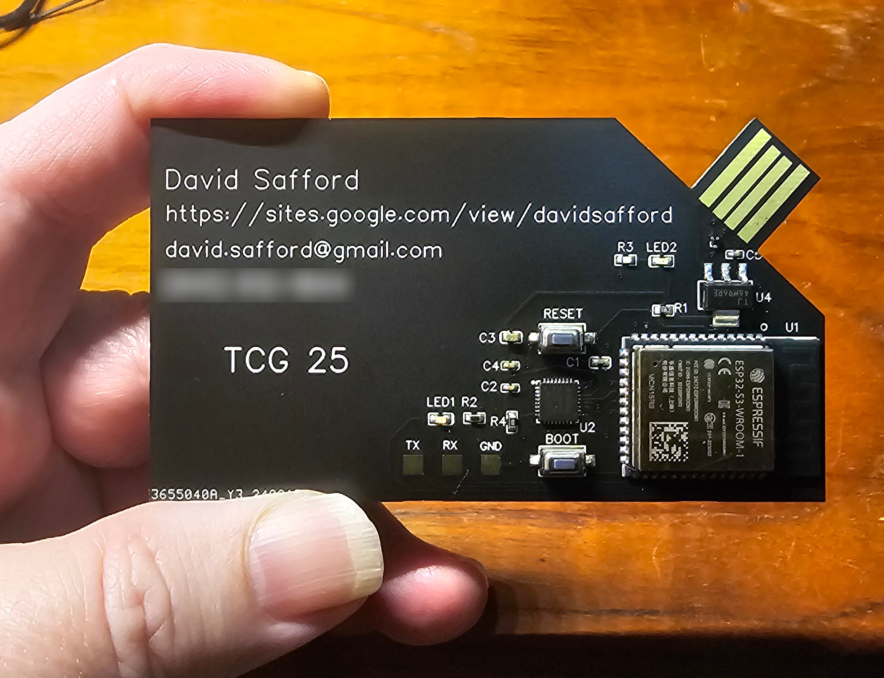
A Trusted Business Card:
Demonstrating Supply Chain Defenses
ESP32
Infineon TPM
How do you know that your new device is authentic and untampered?

Slide 2





Supply Chain Attacks
Hardware
Vendor
Software
Vendor
Hardware
Vendor
. . .
1
Device
Vendor
2
3
4
End User

Slide 3


Supply Chain Defense with TPM
Endorsement
Key Certificate
TPM
Vendor
Hardware
Vendor
Software
Vendor
. . .
Platform
Certificate
Device
Vendor
The end user can verify:
Authenticity of TPM
Authenticity of device
Authenticity of firmware
Attestation
End User

Slide 4
Demonstration
Verification Report for Trusted Business Card at /run/media/dave/0021-1F61/ESP/
Verifying Endorsement Key Certificate from Infineon
EK.CRT verification: /run/media/dave/0021-1F61/ESP/EK.CRT: OK
Verifying that the Card's EK.DER matches the EK certificate
EK created on card matches EK from Infineon Certificate
Verifying platform cert against EK and CA certs
Attribute certificate is valid.
Verifying Attestation Key Certificate from Dave
AK.CRT verification: /run/media/dave/0021-1F61/ESP/AK.CRT: OK
Verifying that the Card's AK.DER matches the AK certificate
AK created on card matches AK from AK Certificate
Verifying vendor signature binding AK and EK:
Verified OK
Verifying TPM_QUOTE
Decrypting quote with AK
Quoted data matches pcr10 data
Hash of quoted data matches decrypted signature
Verifying RIM Signatures
Verifying rim for CARD.JPG - Signature Verified Successfully
Verifying rim for SAFFORD.PDF - Signature Verified Successfully
Verifying event log:
PCR 10 SHA256: 3F8D95BFE924C9A5033C1B3D840A2B32365DB0481ACC8E8C4A7ECF5B3590450B MATCHES
Verifying that current challenge file was used.
Correct challenge file was used.
Writing a new random challenge. Reset the card for it to be measured.
Verifying flash image - press boot-reset on the card
press enter when ready
Reading flash. This should take about one minute...
Files fw/flash.img and out.bin are identical

Slide 5
Detail Slides

Slide 6
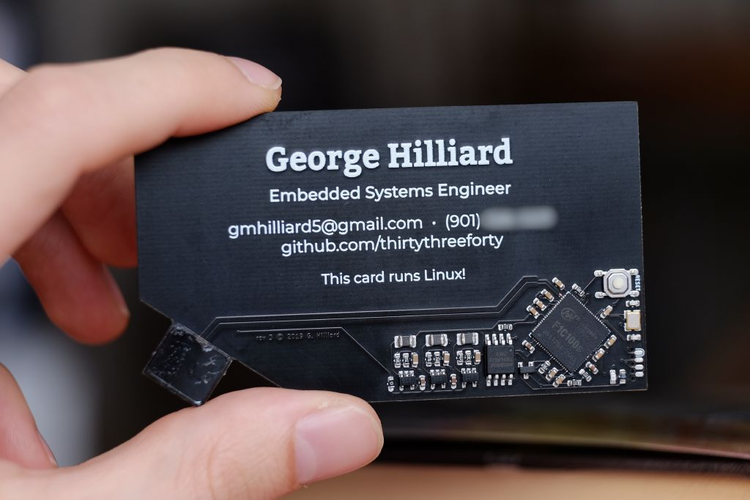
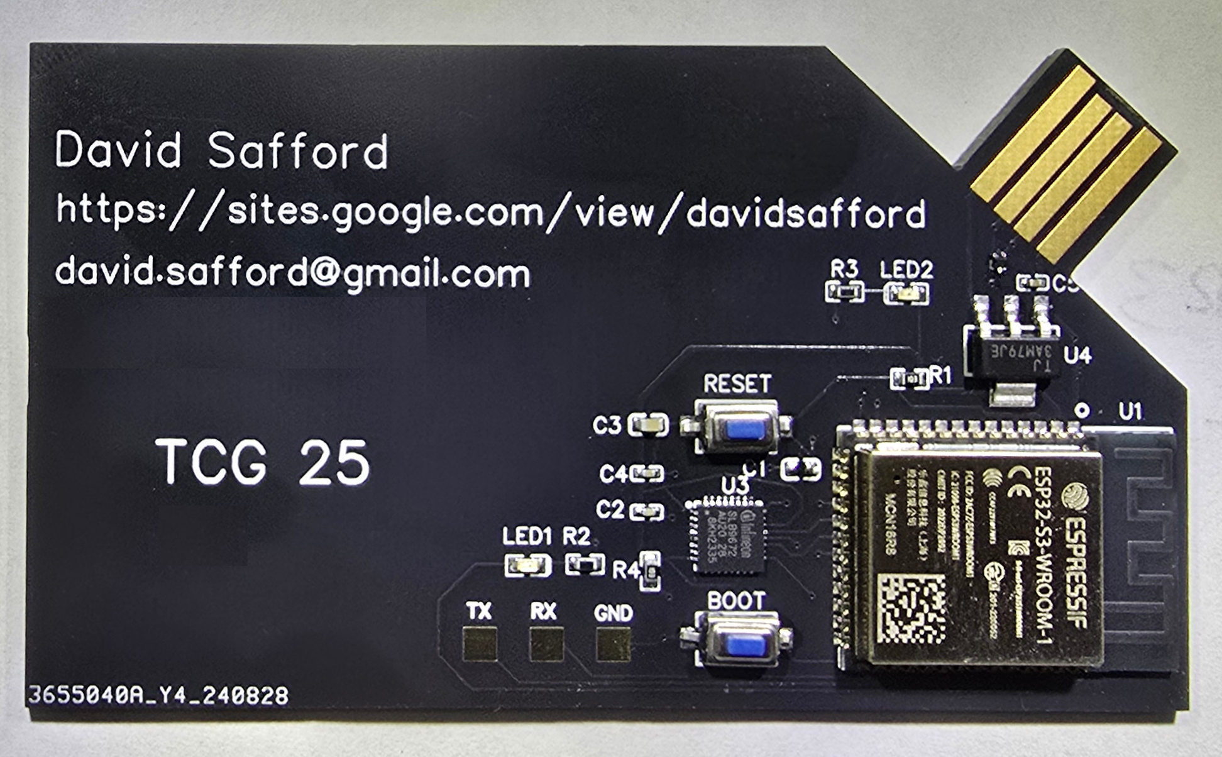
Why a Trusted Business Card?
To celebrate TCG’s 25th
To demonstrate full supply chain protection on an inexpensive IoT device
  Supply chain of embedded electronics is now critical
  It’s the cheapest, smallest, simplest, easiest
  supply chain demonstration for TCG.
It’s an Arduino development board
  Learn how to write arduino sketches
It’s an esp32 development board
  Learn esp-idf command line build and flash tools
It’s a TPM development board
  Prototype new and interesting TPM applications

Slide 7
Supply Chain Attacks
1: Attacking the upstream hardware and software supply vendors
  Solarwinds
  Xzutils
  Supermicro
2: Attacking the transportation/shipping from suppliers to device vendor
3: Attacking the device vendor
  Hamas pagers (counterfeit vendor)
  Counterfeit devices
4: Attacking the transportation/shipping from device vendor to user
  Targeted firmware insertion during shipping

Slide 8
TBC – A simple example
Hardware
  ESP32-S3
    32bit dual core
    16mb flash
    8mb PSRAM
    efuse based
    secure boot*
  Infineon TPM
Firmware
  Application
  WolfTPM/WolfSSL
  WolfTPM HAL
  tinyusb
  FreeRTOS
  esp-idf bsp
Software
  certify/verify scripts
  Openssl
  Paccor
  certgen/cel_verify C
100% Open Hardware and Open Source
*not activated on demo cards, so you can play

Slide 9
Application Functionality
USB-MSC: VFAT thumb drive to serve resume, certs and log
USB-ACM: Firmware loading and debug over serial
Full Supply chain attestation
  Endorsement Key Cert
  Platform Cert
  Attestation Key Cert
WolfTPM provides full TPM stack on the card,
Measured boot and runtime
CEL-IMA-TLV attestation with signatures in RIM

Slide 10
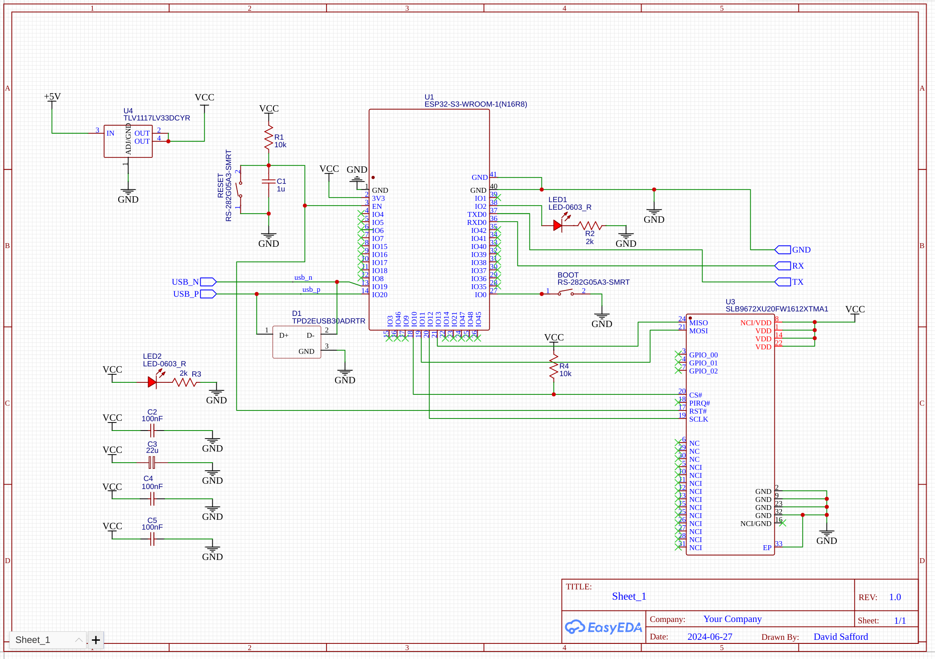

Slide 11
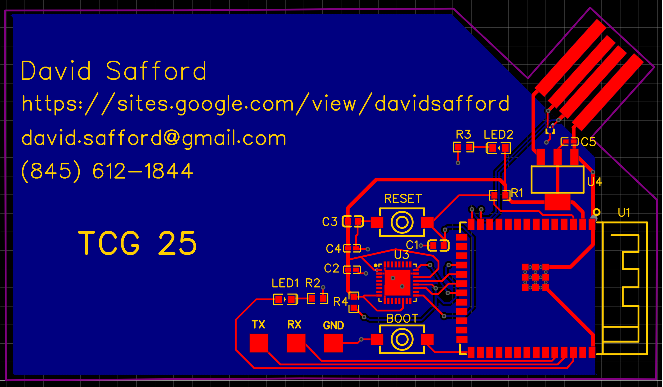

Slide 12
BOM Cost (qty 1)
PCB (jclpcb.com) $3
Esp32 $4
TPM $5
Everything else $3
            Total $15

Slide 13
Detailed BOM (Digikey)
Schematic ID | Manufacturer ID | Digikey ID | Description
U1 | ESP32-S3-WROOM-1-N16R8 | 1965-ESP32-S3-WROOM-1-N16R8CT-ND | ESP32S3
U2 | SLB9672AU20FW1613XTMA1 | 448-SLB9672AU 20FW1613XTMA1CT-ND | TPM
D1 | TPD2EUSB30ADRTR | 296-28153-1-ND | ESD Diode Pair
U4 | TLV1117LV33DCYR | 296-28778-1-ND | 3.3V regulator
Led1, Led2 | QTLP601CRTR | 1080-1407-1-ND | Led, red
Boot, Reset | RS-282G05A3-SMRT | CKN10384CT-ND | Switch, tactile
R1, R4 | RMCF0603JT10K0 | RMCF0603JT10K0CT-ND | RES 10K
R2, R3 | ERJ-3EKF2001V | P2.00KHCT-ND | RES 2K
C1 | CL05A105KP5NNNC | 1276-1076-1-ND | CAP CER 1UF 10V
C2, C4, C5 | CL05B104KA5NNNC | 1276-6720-1-ND | CAP CER 0.1UF 25V
C3 | CL10A226MQ8NRNC | 1276-1193-1-ND | CAP CER 22UF 6.3V

Slide 14
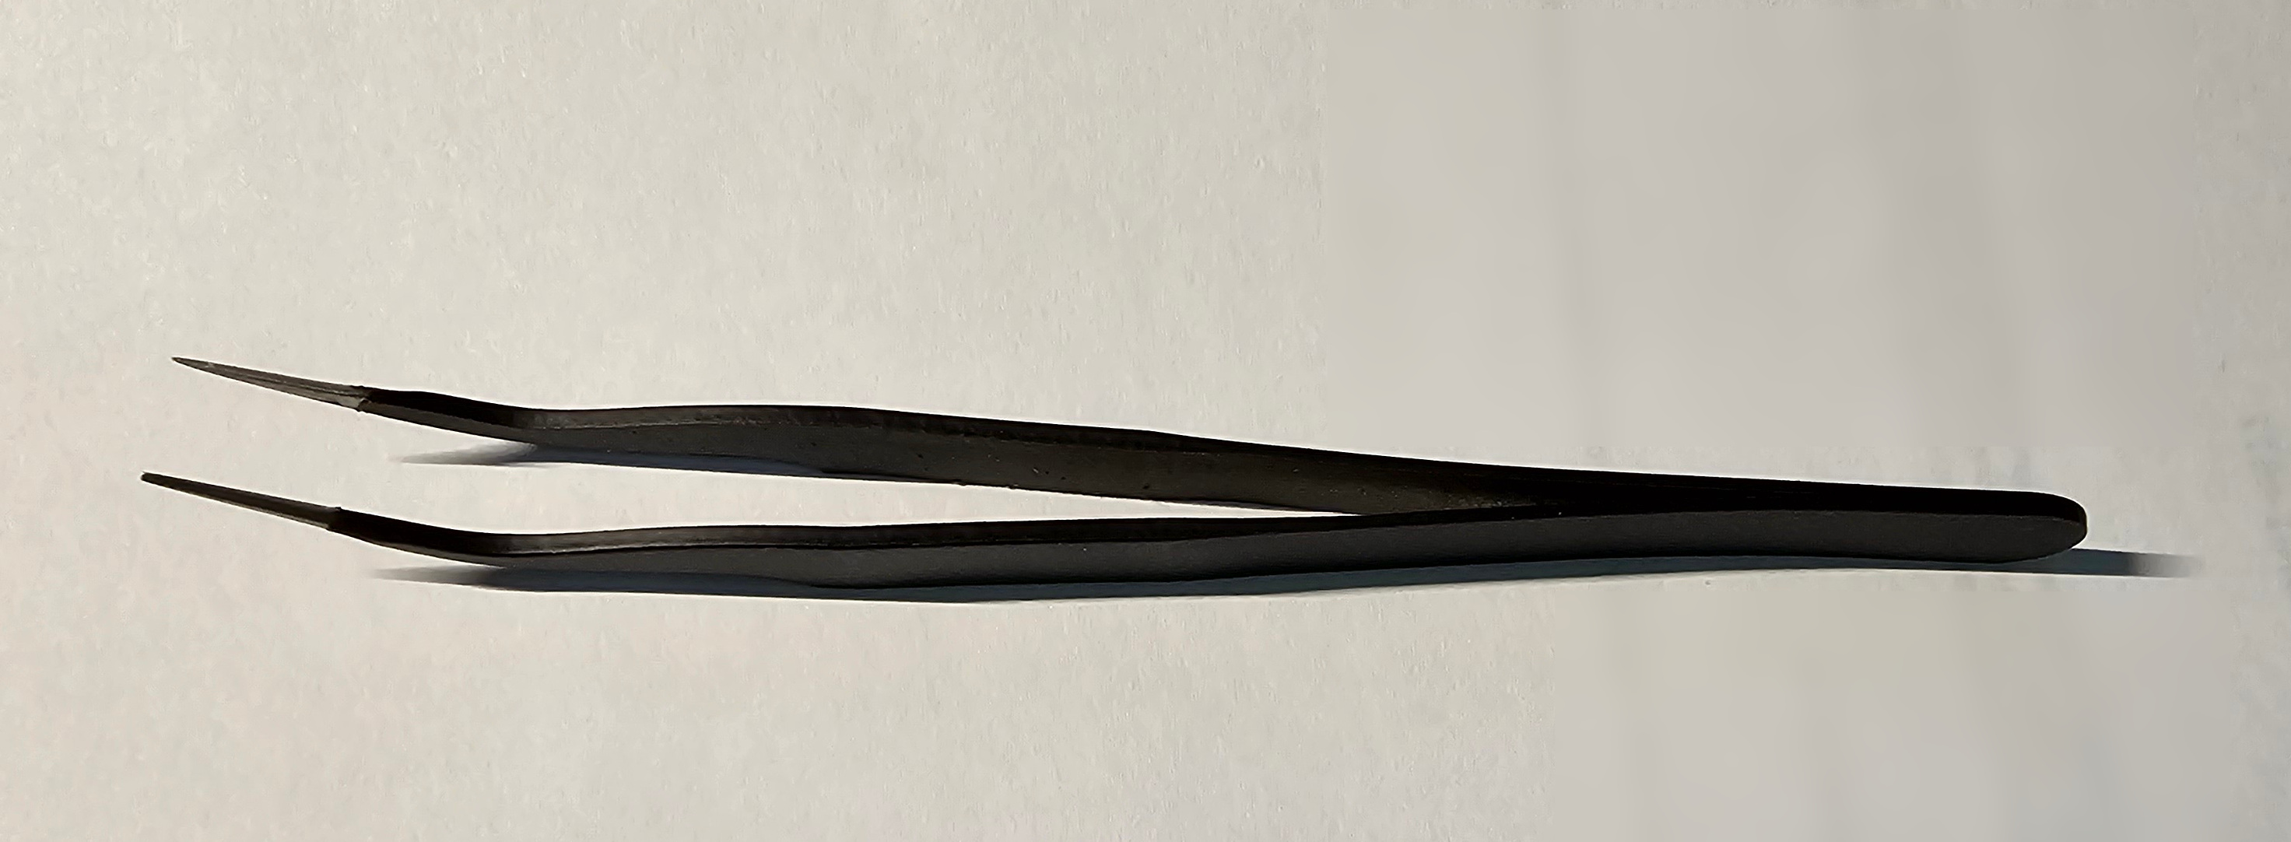
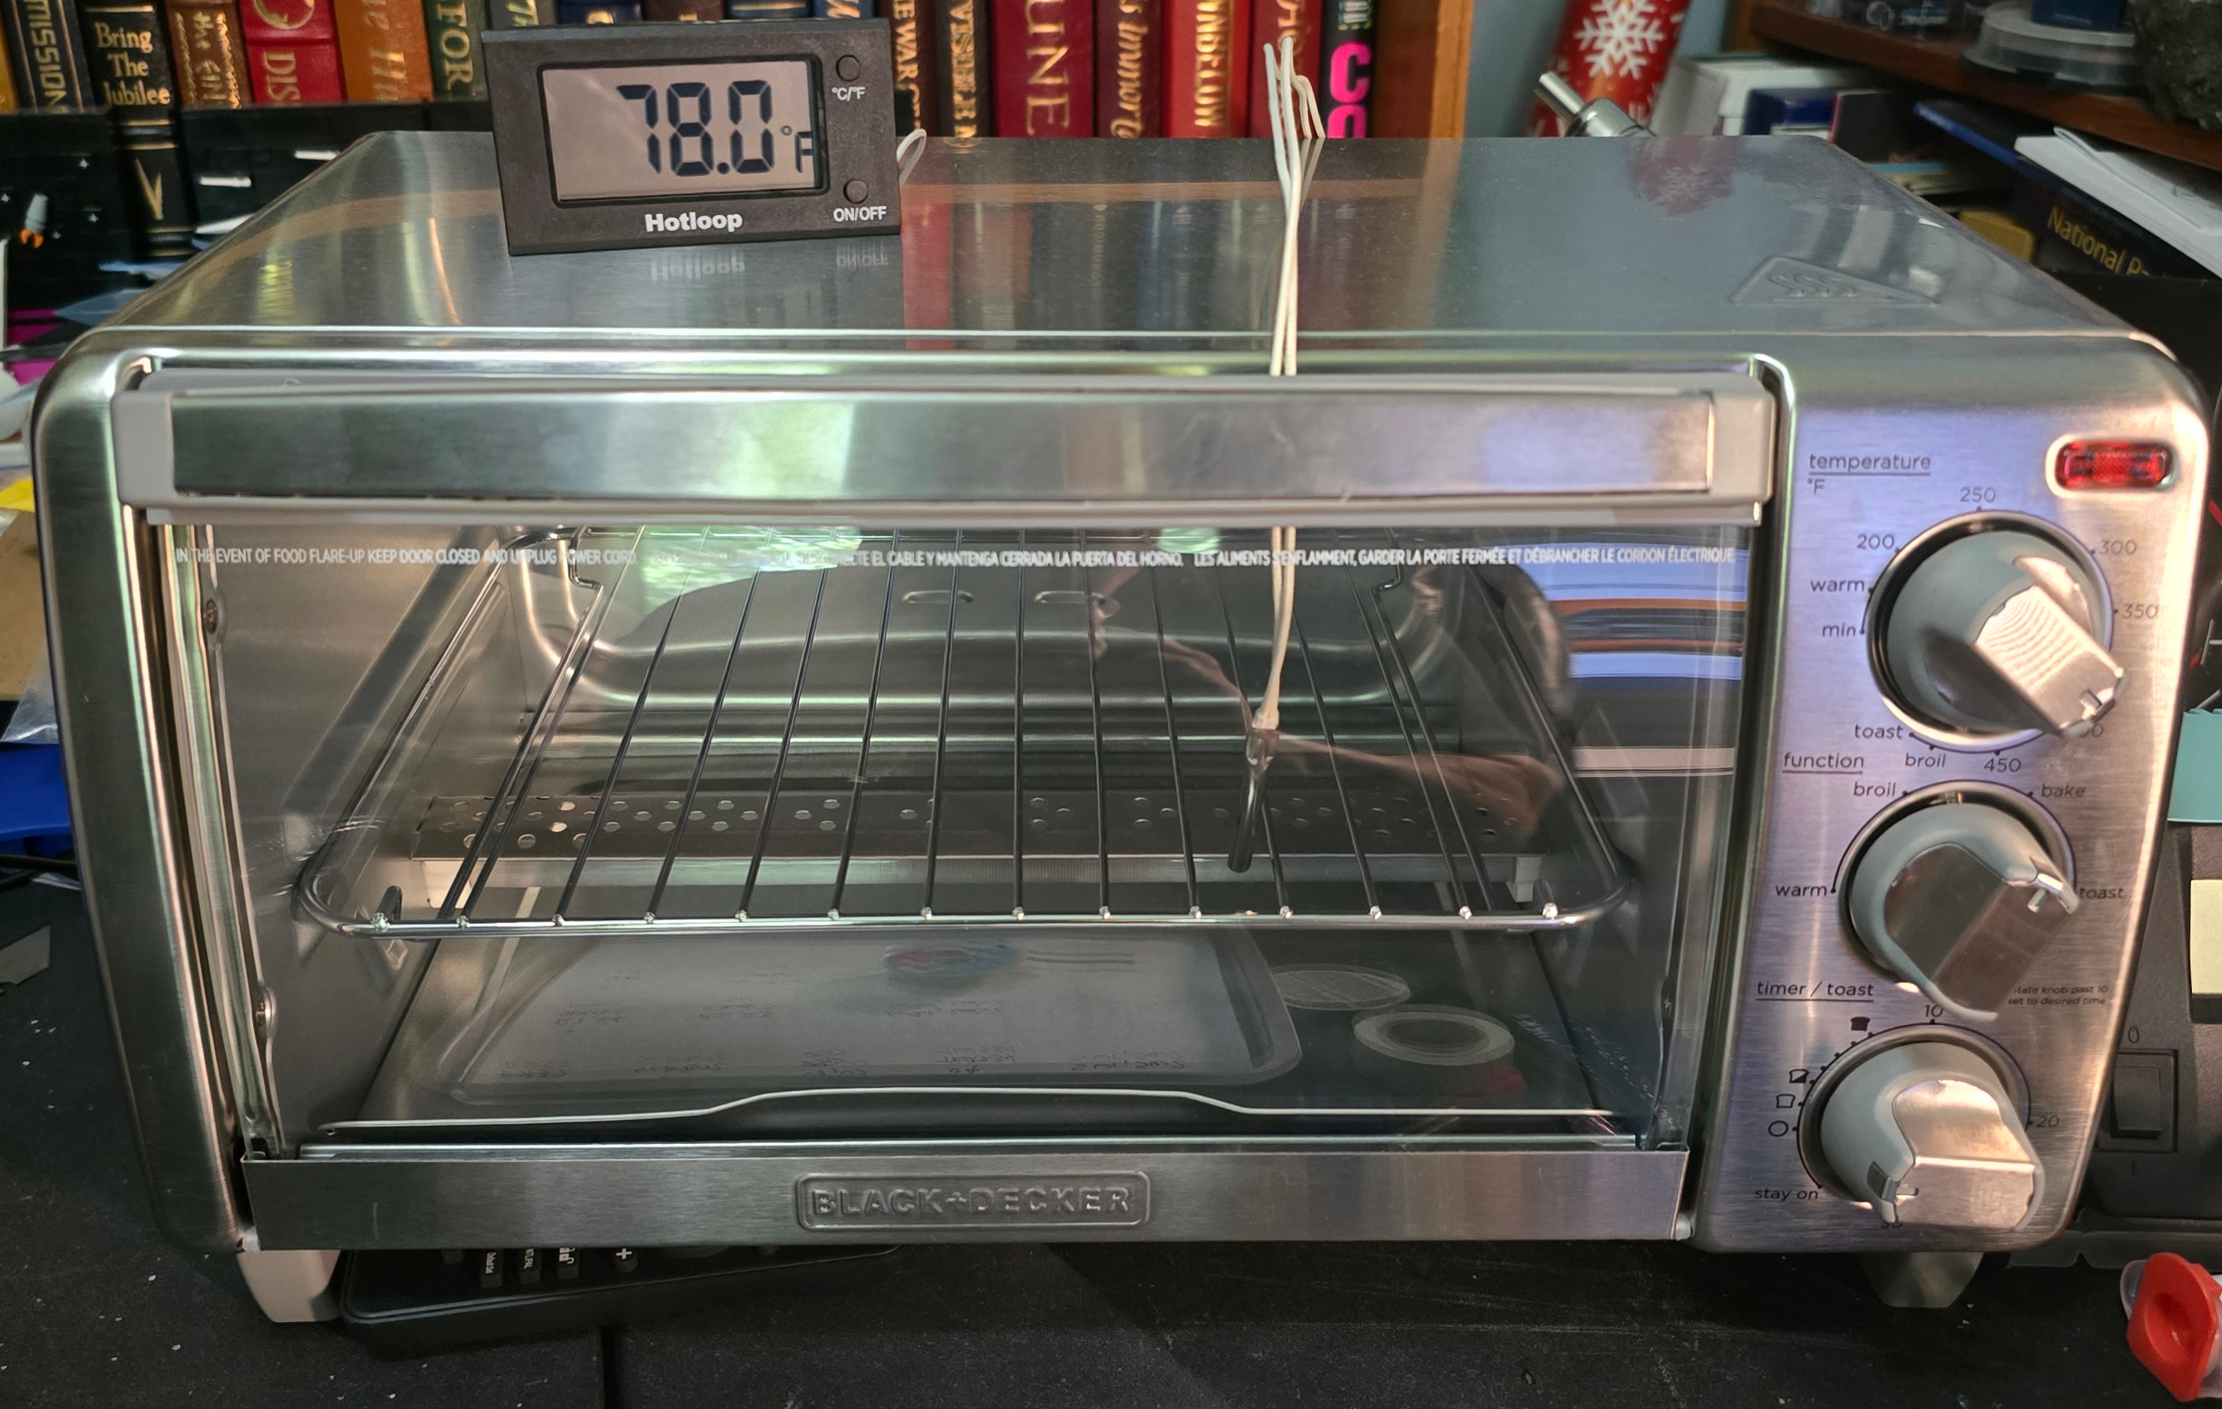
The High Cost of Assembly
Precision
Placement
Device ($2)
Reflow
Station
($49)

Slide 15
Warning
I used leaded solder paste for assembly.
Try not to lick the front of the card.

Slide 16
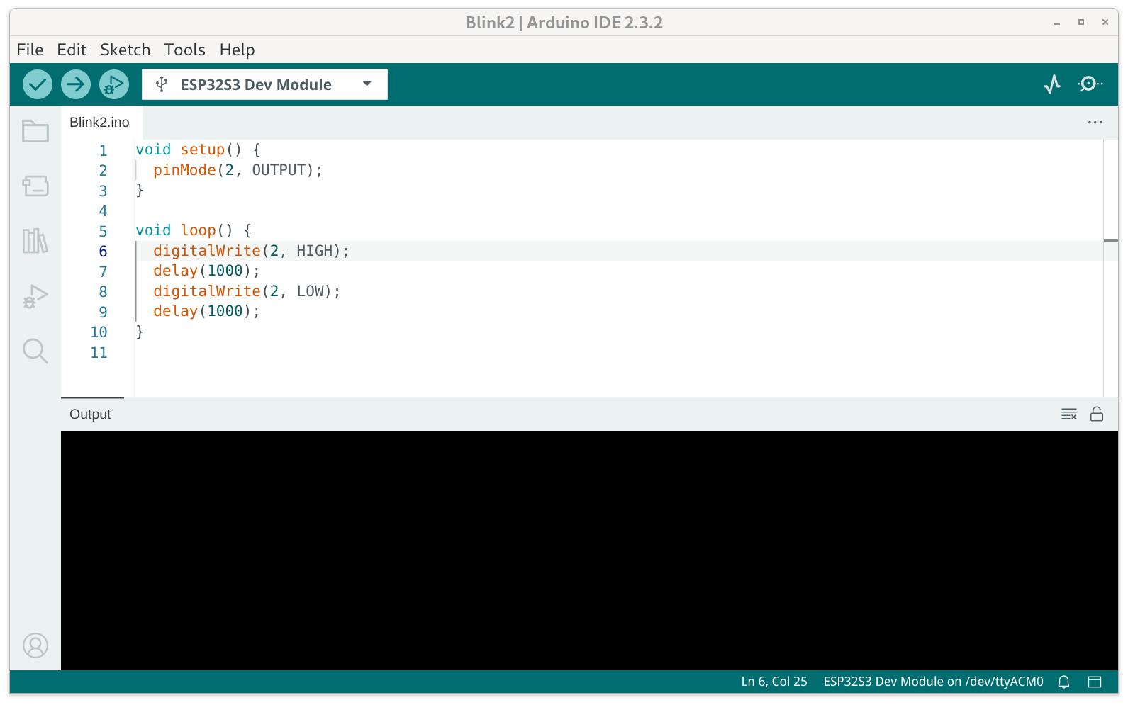
Learn Arduino Programming

Slide 17
Espressif build tools
idf.py set-target esp32s3
idf.py menuconfig
idf.py build
idf.py -p /dev/ttyACM0 flash monitor

Slide 18
Espressif ROM mode tools
Esptool read/write flash
Espefuse read/write efuse
Espsecure sign/verify bootloader/app images
These are enabled with hardware (boot button)
and are independent from any firmware in flash

Slide 19
ESP32 Secure boot
The good news:
  Fully supported and documented in esp-idf
  Based on efuse in chip, so serves as hardware RoT
The bad news:
  Once SB is enabled, you can no longer read flash or efuse through ROM tools.
  This makes supply chain verification difficult.
  You can tell secure boot is enabled, but not who signed it.
Workaround:
  Ship with SB disabled, so end user can provably enable SB.

Slide 20
Keys and Certificates
Infineon OPTIGA(TM) RSA Root CA 2 (Root for EK.CRT)
Infineon OPTIGA(TM) TPM 2.0 RSA CA 065 (intermediate for EK.CRT)
safford_ca.com.pem (Self-signed root for AK.CRT and PLATFORM.CRT)
EK.DER, EK.CRT (signed by Infineon)
AK.DER, AK.CRT – issued based on verification of EK, signed by Dave
PLATFORM.CRT binds EK to Platform description, signed by Dave
Verifying a Quote with AK proves:
  Talking to Infineon certified TPM
  Platform characteristics, including EK and AK certified by Dave

Slide 21
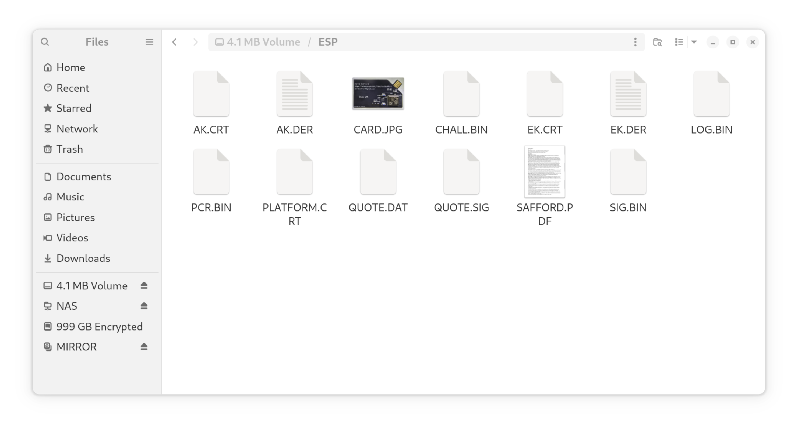
TBC appears as a flash drive

Slide 22
Files on the card
EK.DER - Endorsement Key (public)
EK.CRT - Endorsement Key Certificate, signed by Infineon
PLATFORM.CRT - Platform Certificate, signed by Safford, binds EK.CRT to platform
AK.DER - Attestation Key (public)
AK.CRT - Attestation Key Certificate, signed by Safford
SIG.BIN - Signature by Safford, binding AK.DER to EK.DER
CHALL.BIN - Challenge from verifier that will be included in Quote
PCR.BIN - PCR values, anchoring Event Log
QUOTE.DAT - Data actually Quoted by TPM
QUOTE.SIG - Output of TPM Quote
LOG.BIN - Event Log
CARD.JPG - Image of card
SAFFORD.PDF - Resumé

Slide 23
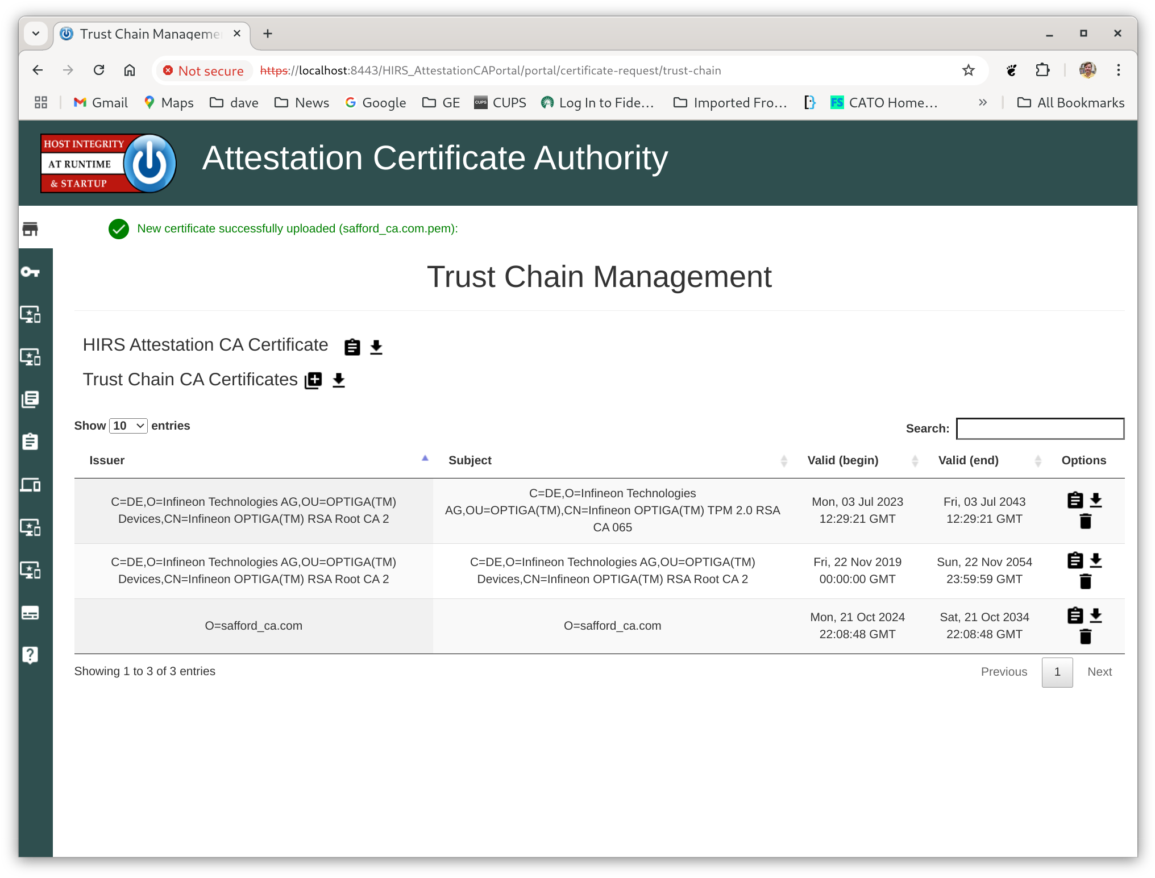

Slide 24
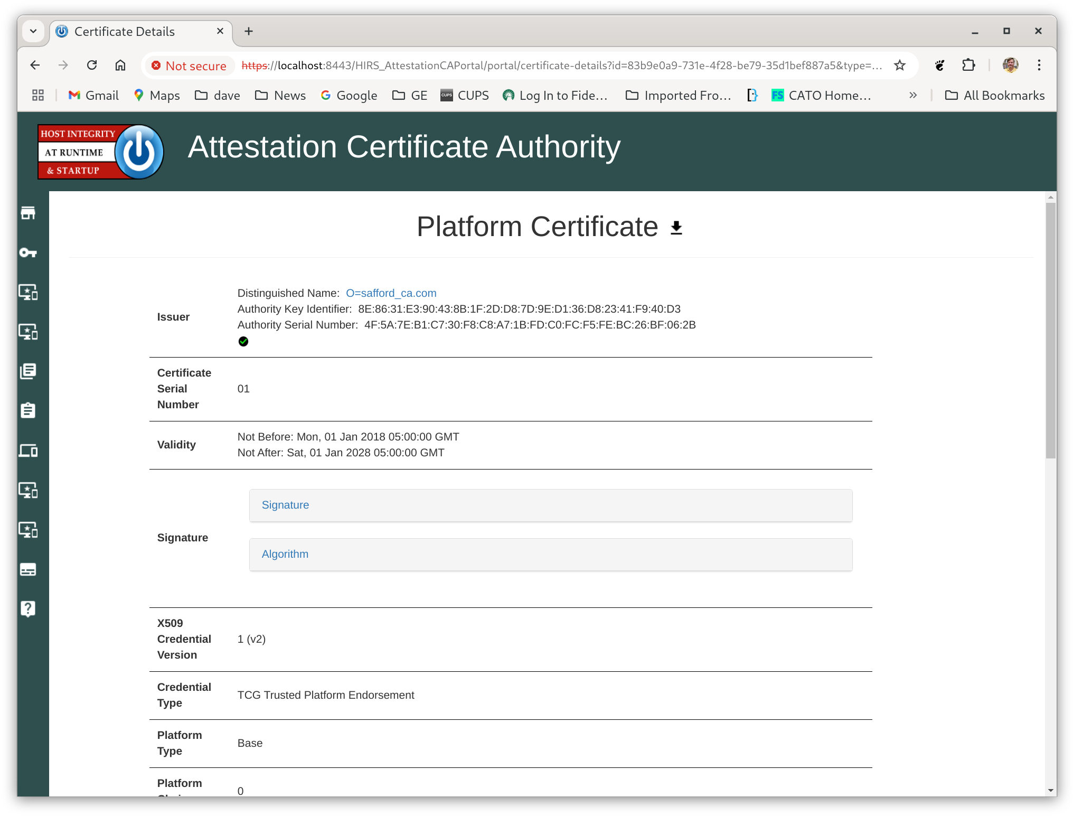

Slide 25
Verifying the TPM_Quote
QUOTE.SIG
decrypt.dat
SHA256(QUOTE.DAT)
QUOTE.DAT
SHA256(PCR.BIN)
PCR.BIN
(PCR-10)
AK.DER
SHA256
SHA256
Normally we could do this entire check with tpm2_checkquote utility, but it cannot handle the raw data blobs from WolfTPM, so we have to do these checks manually with openssl.

Slide 26
Example Quote Verification
Decrypting QUOTE.SIG with AK
Decrypted data:
00000000 30 31 30 0d 06 09 60 86 48 01 65 03 04 02 01 05 |010...`.H.e.....|
00000010 00 04 20 ea ca a1 c3 4b d9 9c b3 63 af 60 5f db |.. ....K...c.`_.|
00000020 2b 0b 99 65 e0 93 2e 55 92 28 70 4f fd 16 e8 57 |+..e...U.(pO...W|
00000030 f1 a0 66 |..f|
sha256 of QUOTE.DAT
00000000 ea ca a1 c3 4b d9 9c b3 63 af 60 5f db 2b 0b 99 |....K...c.`_.+..|
00000010 65 e0 93 2e 55 92 28 70 4f fd 16 e8 57 f1 a0 66 |e...U.(pO...W..f|
QUOTE.DAT
00000000 ff 54 43 47 80 18 00 22 00 0b e1 27 0c 17 cb b3 |.TCG..."...'....|
00000010 2f 04 60 27 27 5e 1c 07 be 9b 44 6e 80 76 e4 7d |/.`''^....Dn.v.}|
00000020 27 32 64 f7 02 a3 59 d9 28 0b 00 00 00 00 00 00 |'2d...Y.(.......|
00000030 17 67 73 9e 27 9f e7 c0 94 6e df a3 01 ad bb dd |.gs.'....n......|
00000040 1c 87 f7 a5 06 00 00 00 01 00 0b 03 00 04 00 00 |................|
00000050 20 32 d4 a6 27 37 ff 00 e2 90 01 06 26 8f 90 40 | 2..'7......&..@|
00000060 df dc 45 6e 5e 01 85 d3 87 2f 3f 0b 4b 4b e6 bf |..En^..../?.KK..|
00000070 89 |.|
hashed PCR.BIN
00000000 32 d4 a6 27 37 ff 00 e2 90 01 06 26 8f 90 40 df |2..'7......&..@.|
00000010 dc 45 6e 5e 01 85 d3 87 2f 3f 0b 4b 4b e6 bf 89 |.En^..../?.KK...|
PCR.BIN
00000000 a4 84 07 20 57 9f a9 c1 71 ac b2 26 f8 39 82 db |... W...q..&.9..|
00000010 9d 9f c1 0f 67 32 ad 08 f6 86 08 4b 33 81 c2 01 |....g2.....K3...|

Slide 27
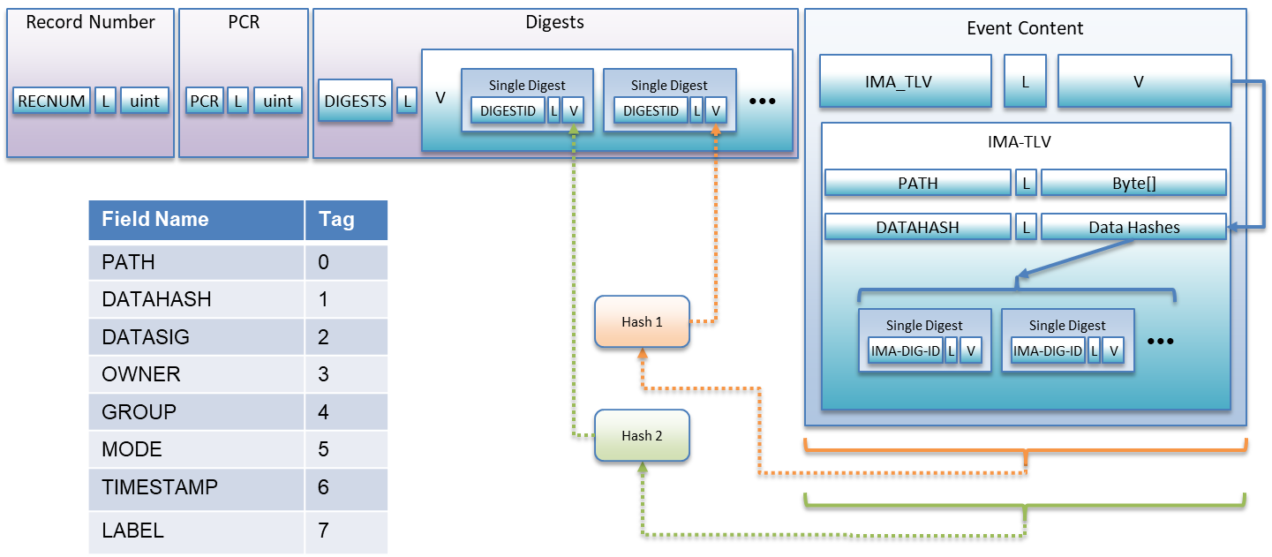
CEL_IMA_TLV
An example of how to do measurement safely
  Entire content field, including types and lengths are measured

Slide 28
Example Card Verification
Verification Report for Trusted Business Card at /run/media/dave/0021-1F61/ESP/
Verifying Endorsement Key Certificate from Infineon
EK.CRT verification: /run/media/dave/0021-1F61/ESP/EK.CRT: OK
Verifying that the Card's EK.DER matches the EK certificate
EK created on card matches EK from Infineon Certificate
Verifying platform cert against EK and CA certs
Attribute certificate is valid.
Verifying Attestation Key Certificate from Dave
AK.CRT verification: /run/media/dave/0021-1F61/ESP/AK.CRT: OK
Verifying that the Card's AK.DER matches the AK certificate
AK created on card matches AK from AK Certificate
Verifying vendor signature binding AK and EK:
Verified OK
Verifying TPM_QUOTE
Decrypting quote with AK
Quoted data matches pcr10 data
Hash of quoted data matches decrypted signature
Verifying RIM Signatures
Verifying rim for CARD.JPG - Signature Verified Successfully
Verifying rim for SAFFORD.PDF - Signature Verified Successfully
Verifying event log:
PCR 10 SHA256: 3F8D95BFE924C9A5033C1B3D840A2B32365DB0481ACC8E8C4A7ECF5B3590450B MATCHES
Verifying that current challenge file was used.
Correct challenge file was used.
Writing a new random challenge. Reset the card for it to be measured.
Verifying flash image - press boot-reset on the card
press enter when ready
Reading flash. This should take about one minute...
Files fw/flash.img and out.bin are identical

Slide 29
Example Attestation Verification
Verifying Measurement log from Quote
PCR 10 SHA256: A4840720579FA9C171ACB226F83982DB9D9FC10F6732AD08F686084B3381C201 MATCHES
SEQ 0 PCR 10 CEL_CONTENT_IMA_TLV
Filename /data/esp/safford.pdf
Filehash: D0471A5C5E9F00A0A2E761924C6AFF6EB966E8A468822E9016D0DED8751E18F2
Entire Content TLV Verified by digest
File Hash Verified by signed RIM
SEQ 1 PCR 10 CEL_CONTENT_IMA_TLV
Filename /data/esp/card.jpg
Filehash: 8D5C6DB2635740A84188CDE92D8A8CD56E5F16175F8992C59033B6FBB998AF66
Entire Content TLV Verified by digest
File Hash Verified by signed RIM
SEQ 2 PCR 10 CEL_CONTENT_IMA_TLV
Filename /data/esp/chall.bin
Filehash: 063F1995CA9EF8471D7F40992E27BD075A04E04F4F6EBA270E1CDBE2FC7CAAF6
Entire Content TLV Verified by digest

Slide 30
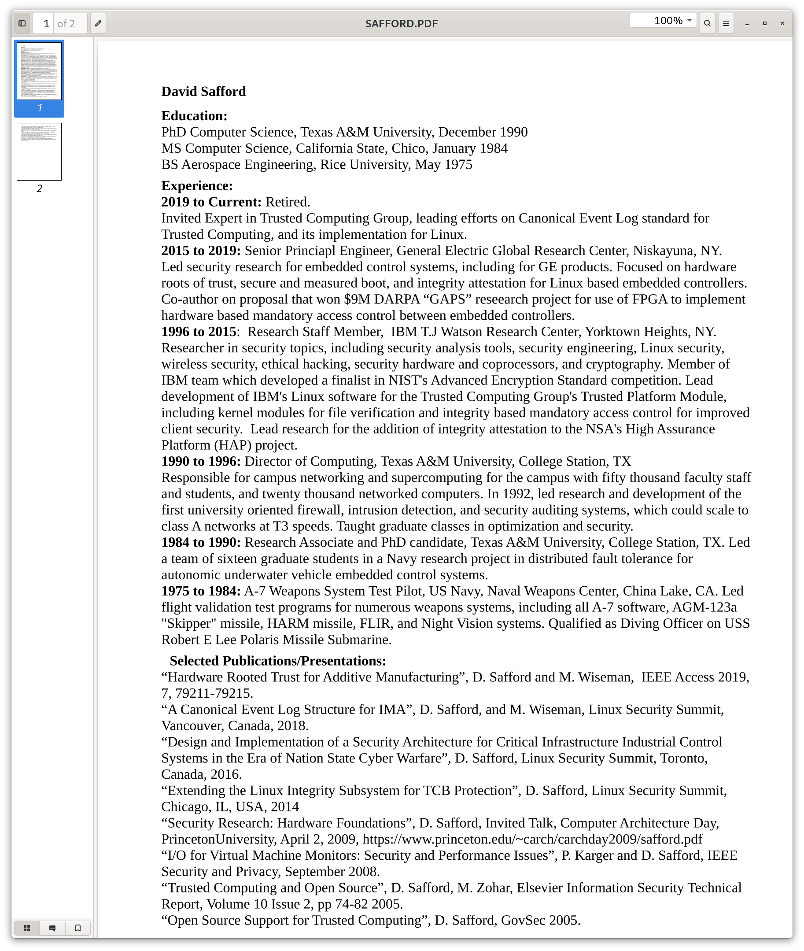
The validated Files

Slide 31
Lessons Learned
Interesting Use Case
  Goal is to prove authenticity of card
  No “users” on card
    No privacy concern
  Don’t want to set owner auth
  CA/vendor/Privacy CA can all be one
  Verify AK on card with Quote
  With Esp32, you have to verify images before
  enabling secure boot

