Slide 1
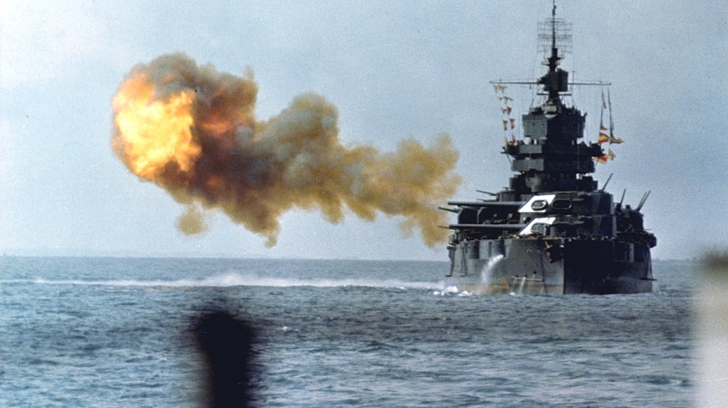
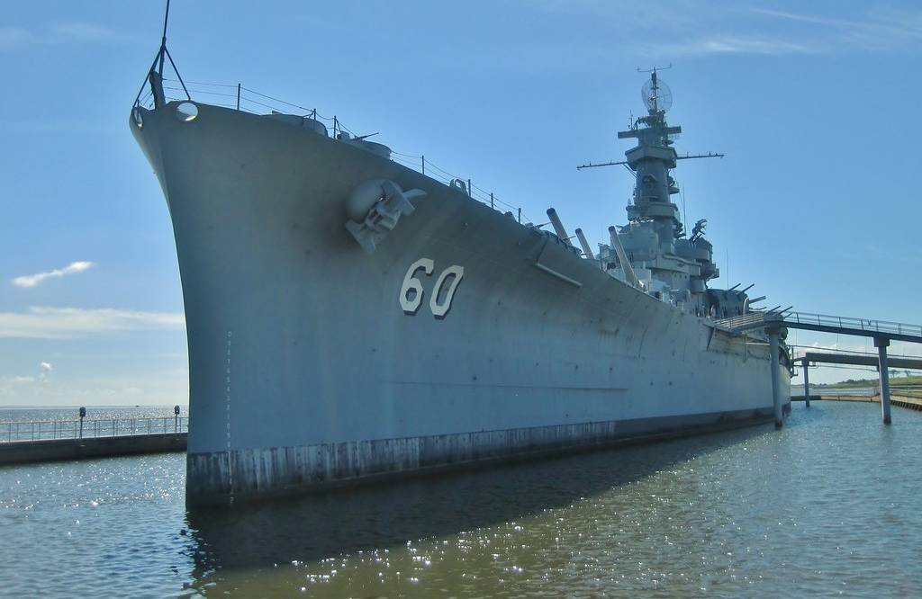
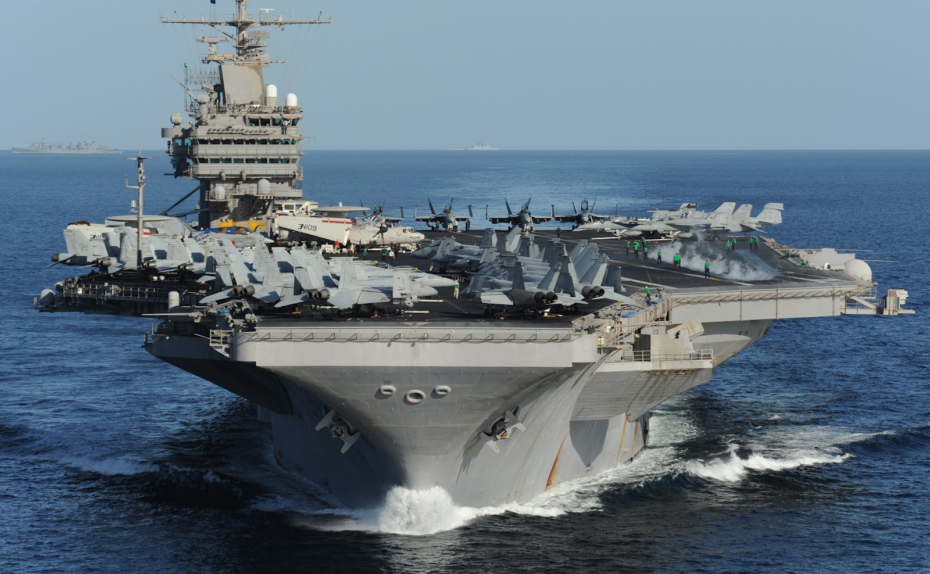
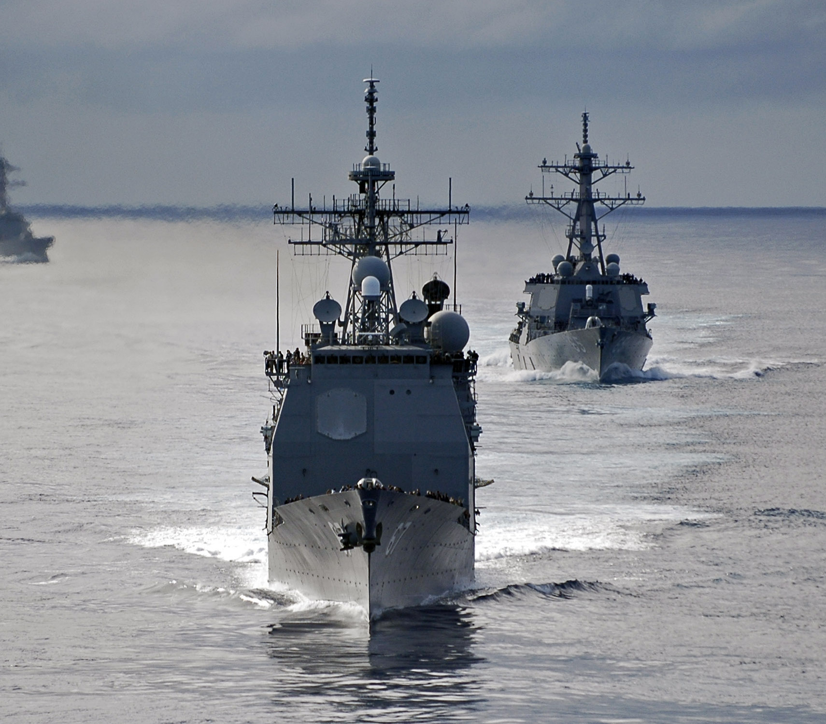
Battleships!!!
Twymun Safford
CPSC 230 – Final Project

Slide 2
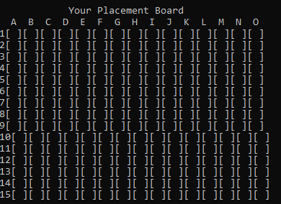
What is Battleships?
Battleships is a C++ implementation of the board game by a similar name
This program is simulated with a simple AI that the player needs to defeat in the game
Both the computer AI and player arrange their fleet on 15 x 15 grids (225 total squares) – each ship in the fleet has a different size and a different amount of hit points
The player and computer take turns targeting each other’s fleet
The player or computer wins when they sink the opposition’s entire fleet!

Slide 3
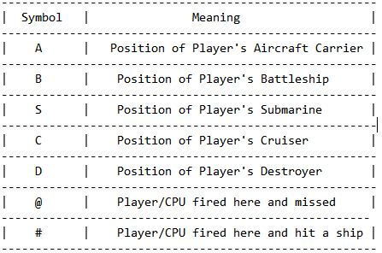
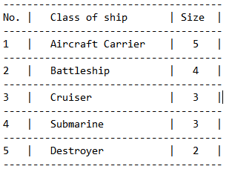
Quick SYMBOLS/SHIP Guide

Slide 4

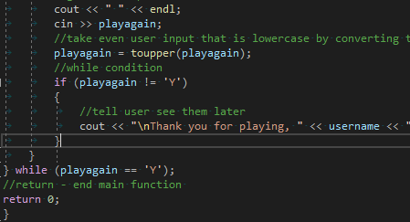
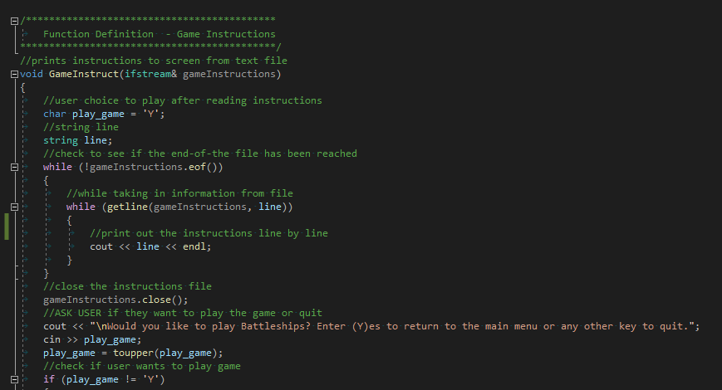
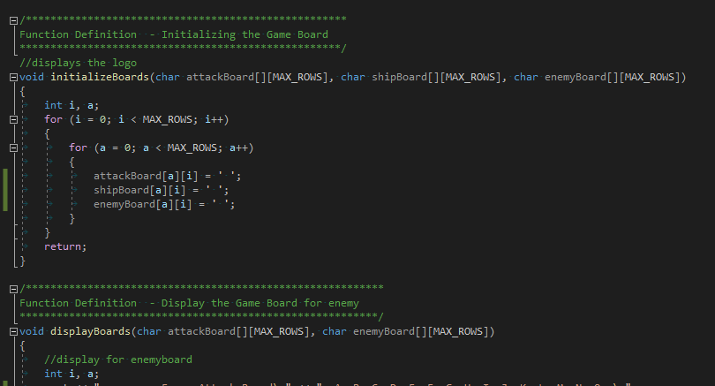
Program Structure
Main – Switch cases:
Game instructions – GameInstruct function
Playing the game – various functions
Quitting the game – from main

Slide 5
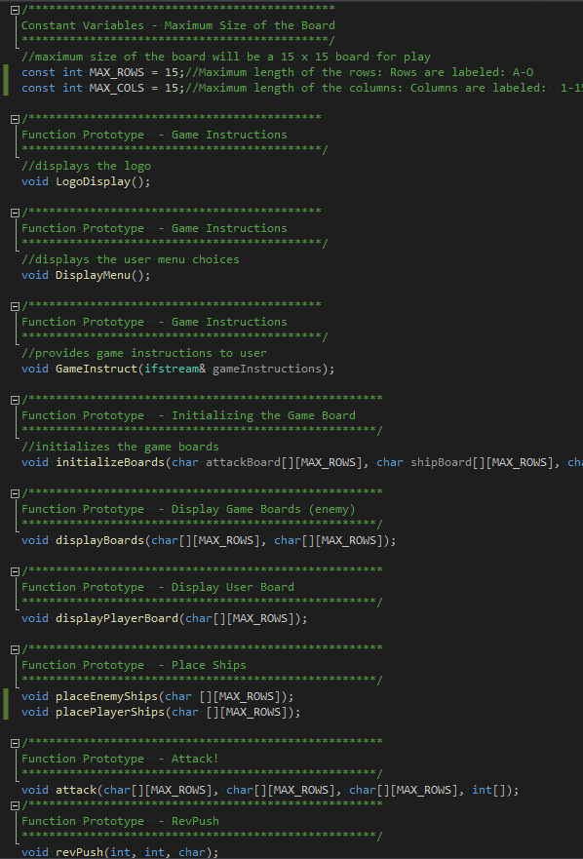

LOADS OF FUNCTIONS!!!
17 different functions – mostly void functions to:
Display logos and menu
Initialize the game boards for user and computer
Allow for ship placement
For attacking and placing markers for ships, misses, and hits
2 functions – for character to integer conversion

Slide 6
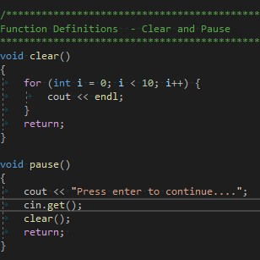
CODING CHALLENGES
Restricted by not using techniques and functions not covered in class – header files, had to define my own functions to simulate clearing the board or for pausing for example (aesthetic)
Generating a semblance of an AI system
Had to determine the best ways for board generation, warship placement (original approach was enumeration which I still intend on attempting to use)
Coordinating getting the different function calls within functions or within main – organization/debugging

Slide 7
GAMEPLAY STRUCTURE
Player will be prompted through the coding algorithm to choose whether to place their ships randomly or to place their ships manually – then the CPU will randomly generate positions for the AI ships
If the player during manual placement selects an invalid column, they will be informed and prompted to select another move
Error checking and statements used to check CPU’s ship placement and place them
CPU makes the first attack – then the player attacks
Assess if CPU/player made a hit or missed – marked on board in either case
Gameplay continues until player or CPU wins
Working on implementing quit case

Slide 8
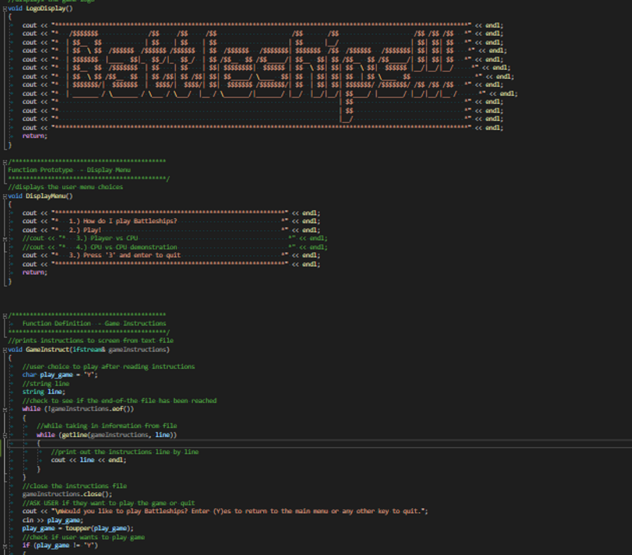
GAME INSTRUCTIONS AND LOGO

Slide 9
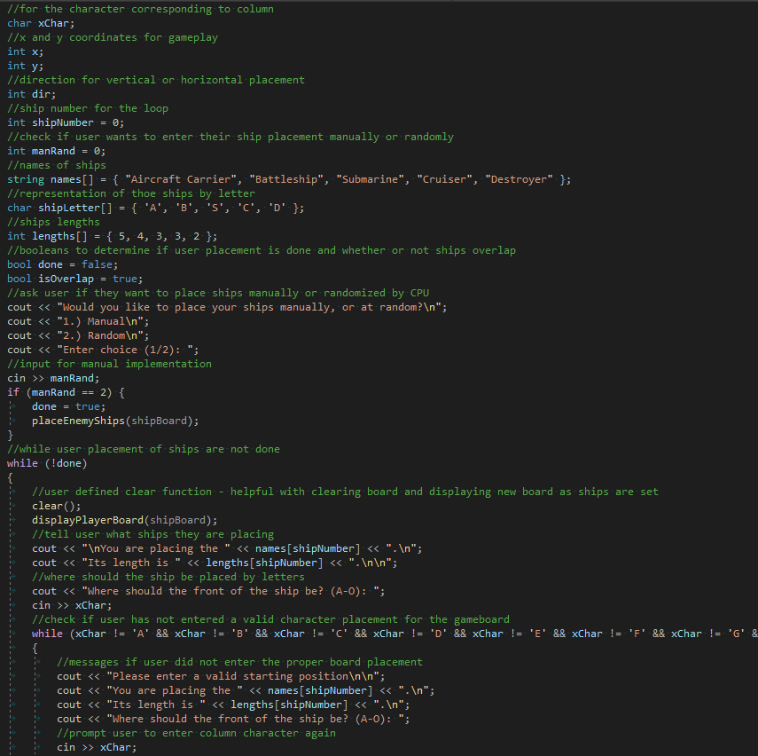
BOARD INITIALIZATION (ERROR CATCHING)

Slide 10
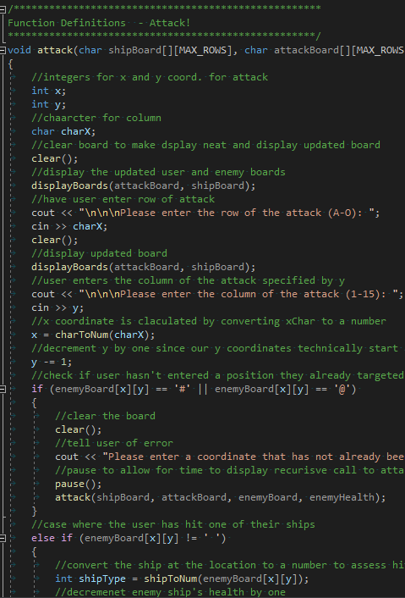
ATTACKING

Slide 11
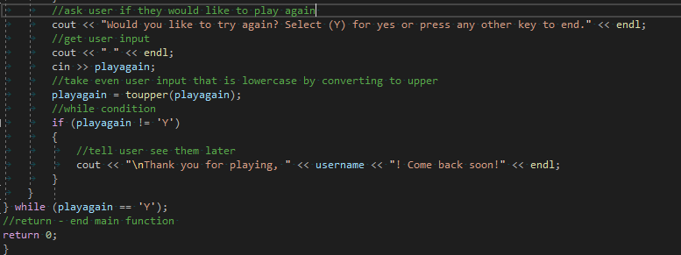
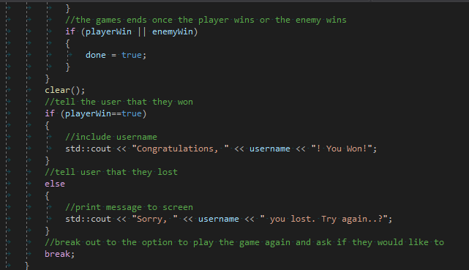
WIN/LOSE Conditions

Slide 12
CURRENT IMPROVEMENTS/FUTURE GOALS
Current improvements:
Improving the comments on the functions – inserting pre-conditions/post-conditions in the code
Consider ways to improve code efficiency – particularly for enemy AI and structure of attacking algorithm
Pause on reading instructions from text file
Chapter 10 will eventually be covered – convert some of the functions to classes?
Implement statement of which user ship was hit
Future goals:
Find a way to make the game a 2-player game: current options are only player vs AI
Possibly implement a scoring system with the capacity to store user account information and scores to file

