Slide 1

#ImWithData

Slide 2

Project Goals
Busy People → Quick connection to local, issue-specific political action
Mechanism for relevant political actions and messages to grow from the grassroots

Slide 3






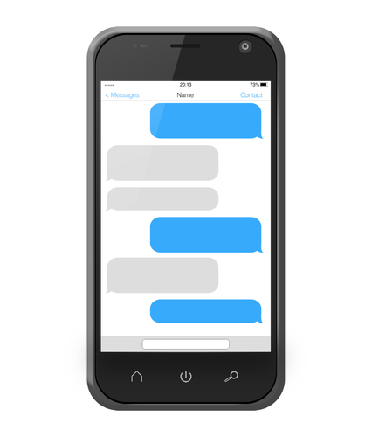


Explored and Selected Data Sources (for MVP)
MVP

Slide 4
Twitter Data Exploration
Actionable
“Don't forget to donate accordingly to https://t.co/pSpQmWIGV1. The AARP spends more than $7 million/yr lobbying fed gvt. to protect Medicare”
“Say NO to Trumpcare and YES to the Affordable Care Act https://t.co/5P7pVy5coM “
“Remove health-care subsidies for Members of Congress and their families - Sign the Petition! https://t.co/nBQHNwKbRq via @Change”
Not Actionable
“@ConleyU @StephenKing we can't control who they choose to donate to. should people/kids die/go hungry if they didn't get healthcare/funds?”
“@SenSanders Medicare is not free and neither is Medicaid. "Give me ------- or give me -----! When I worked in my first 11 years I had none!”
“And everyone there is screaming: "Give him a chance!", #morons https://t.co/LemLpU3llm”
16,634 Tweets manually flagged as actionable or not actionable
15.7% are actionable by our standards

Slide 5
Sample Actionability Criteria
Actionable
Has an Issue and an Action
Has active verbs (i.e. Sign, Donate)
Starts with the active verb or “Please”
Has a date in the future
Has a location (city, state, or URL)
Has a legislator (name or handle)
Has a phone number
Not Actionable
Only has an Issue
Has passive verbs
Starts with possessives & passives
Has a date in the past
Starts with @ reference
Has profanity
Lots of hashtags and @ mentions

Slide 6
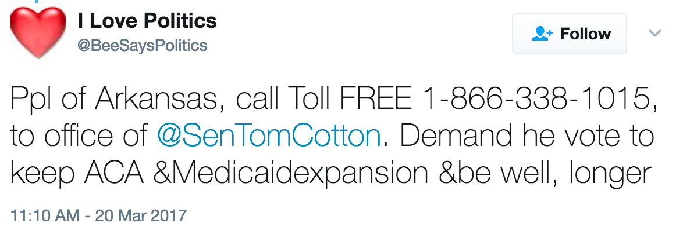
Tweet Information Extraction
PhoneNumbers Module extracts phone numbers for easy action
Logstash searches Twitter API for keywords related to relevant issues, such as healthcare
Regexes extract cities, states, legislators, legislator twitter handles, and URLs
Textblob Perceptron Tagger identifies parts of speech for sentences with calls to action. Spacy NER Tagger assists with date extraction.
Current Classifier? No Classifier → Manual Scoring
Compared to Bi-Directional LSTM Language Modeling Approach

Slide 7
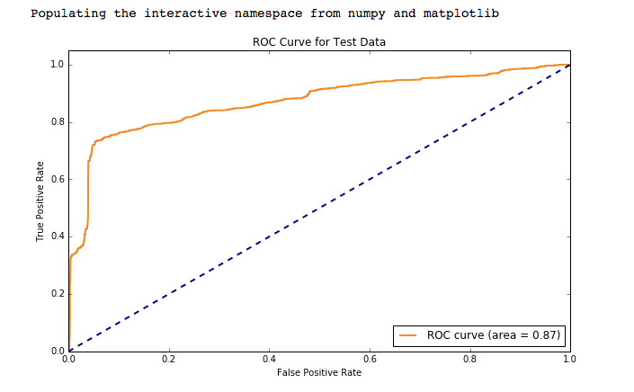
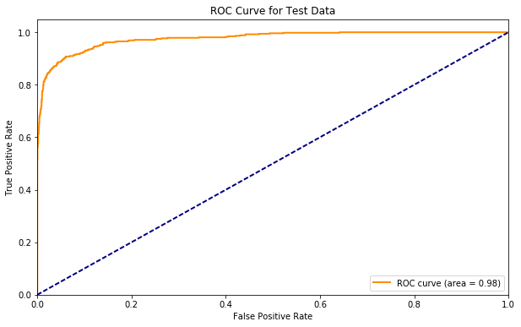
Actionability Model ROC/AUC
Manually Coded Actionability Model
Bi-Directional LSTM Actionability Model
Actionability Scores normalized to probabilities between 0 and 1
test n=16,634
LSTM outputs probabilities between 0 and 1
test n=3,327
Notes:
Talk about the tradeoffs between using one model or another

Slide 8
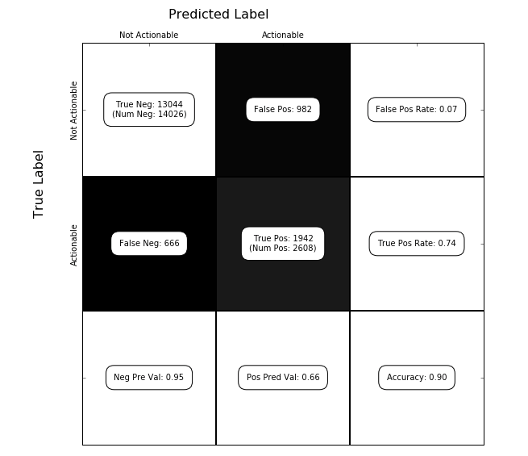
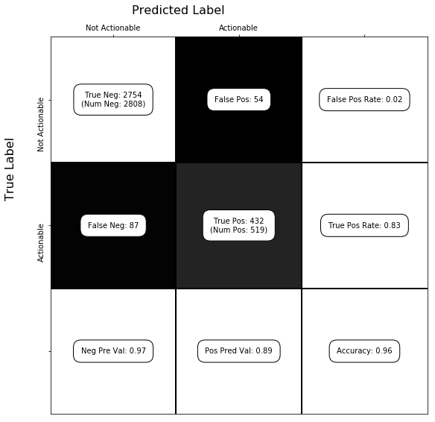
Actionability Model Accuracy
Manually Coded Actionability Model
Bi-Directional LSTM Actionability Model
Actionability Scores normalized to probabilities between 0 and 1;
Accuracy Threshold for Pred = 1 is .9
test n=16,634
Accuracy Threshold for Pred = 1 is .6
test n=3,327

Slide 9
Stages of Message Filtering
Monitor
Issues
Topical?
Twitter API tracks keywords → Logstash
Query Issues + Actions
Relevant?
ElasticSearch scores as highly relevant
Score Actionability
Actionable?
Scores highly on Actionability model
Remove Fuzzy Duplicates
Original?
Use EditDistance to Filter Repeats/RTs
Rate Message Quality (Users)
Representative?
Highly rated messages move up

Slide 10
Other Data Sources Utilized
Meetup → Iteratively Query API for Events/Groups by City/State and Issue
Townhall Project → Direct CSV from Org
Legislators → Sunlight API, VoteSmart API
Indivisible → Automated Google Search for Groups by City/State

Slide 11


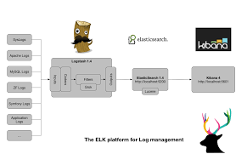
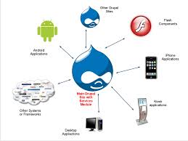
System Architecture
User Feedback
Data Sources
ELK Stack
Scoring, Filtering, and Deduplication
Drupal Front
Daily ETL

Slide 12




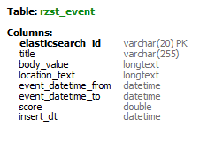
ElasticSearch -> Drupal
Daily Queries
Field Selection
.CSV
Daily Transform-Load
Actionability Model
Schema Merging
{ _index: ‘healthcare_17.03.29’,
_type:
‘twitter’,
_hits: …..
}
Publisher Selects Content
Notes:
Cron-scheduled python module that queries, filters, and transforms Elasticsearch data.
A QueryETL class that parses data according to the ES document type (_type)
Queries a list of related keywords for yesterday’s index for each issue.
Twitter data is run through the actionability model
Stores data temporarily in AWS S3
Loading class that reads stored s3 data and other .csv sources.
.csv sources are infrequent or one-time only
Merges fields to match Events table
Appends data to Drupal MySQL Events Table

Slide 13

We Do Things Differently
Current Solutions
Top-Down (Orgs/Leaders)
One Issue per Day
National
They tell us what to say
You know where to look
Bottom-Up (Grassroots)
Your Issues, Everyday
National, State, & Local
We help you choose
We look on your behalf

Slide 14
User Feedback
“There is nothing out there like this.”
Suggested Improvements
Mobile First
Make the actions very easy to take
Positive reinforcement
Get people hooked on taking political actions
How many actions have I taken? Which actions have I taken?
Improve the Social Experience
How many people in my area have taken these actions? Who has taken these actions?
Share/Amplify the actions you’re taking on the site
Highlight Impact
What has been the impact of my actions on a political outcome?
Tell success stories
Index each location on it's own for SEO purposes
rzst.us/iowa-city and rzst.us/cedar-rapids etc.

Slide 15





Impact
Individual
Political Energy
Habit Formation
Consuming
Collaborating
Collective

Slide 16
Next Steps
Improve recommendation engine and filtering based on user feedback and usage data
Increase visibility into elected officials and their contact information
Allow users to track their actions using dataviz
Connect users taking actions in the same locations

