Slide 1
DS-6306 Doing Data Science Project 1
Safi Muhammad
Muhammads@smu.edu

Slide 2
Exploratory Data Analysis (EDA)
DDSAnalytics has been hired by Frito Lay to identify factors related to employee attrition

Slide 3
EDA – Description of Dataset
Dataset is provided by Frito Lay
36 columns, 870 rows
No missing data

Slide 4
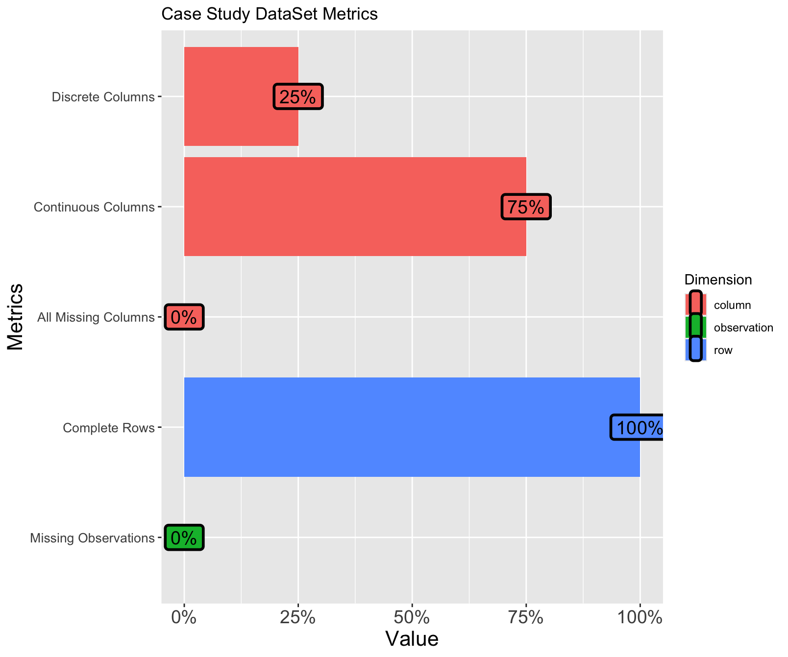
EDA – Summary of dataset

Slide 5
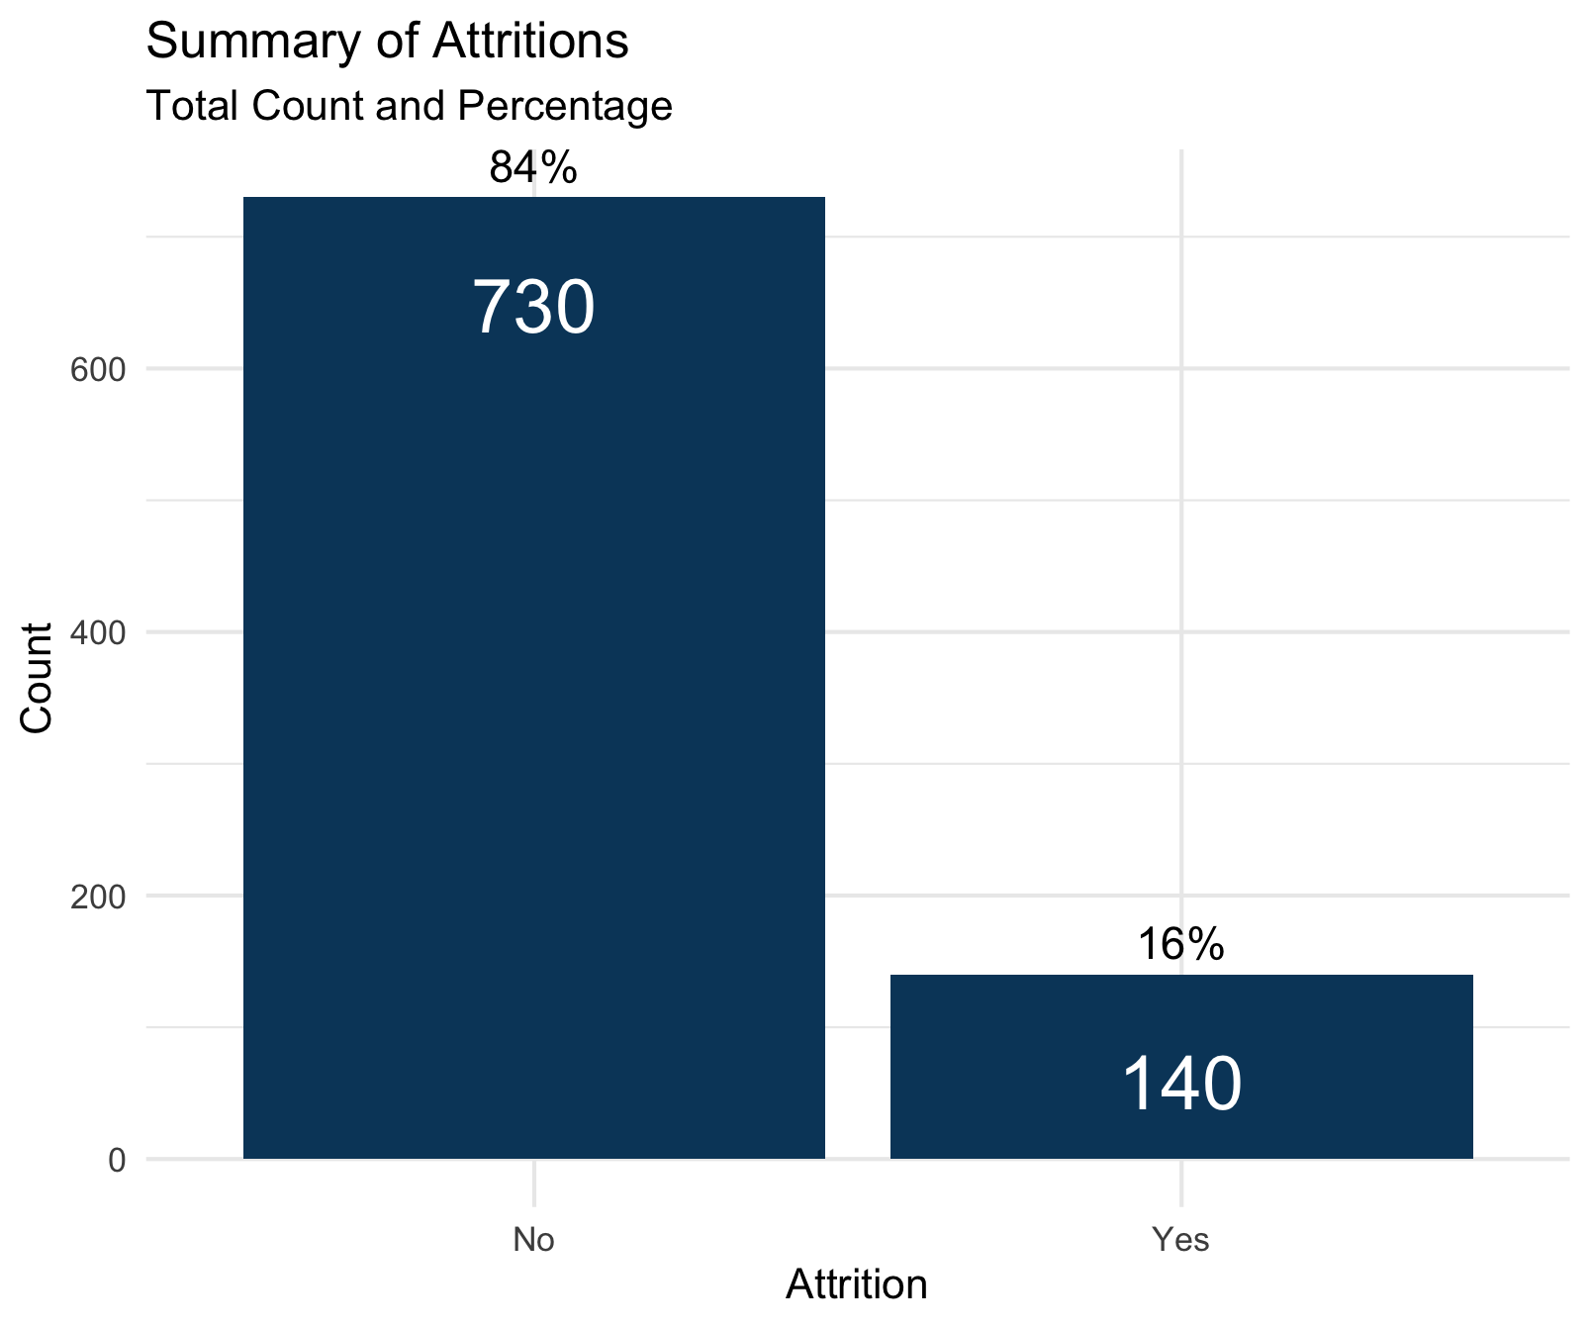
EDA – Summary of Attritions

Slide 6
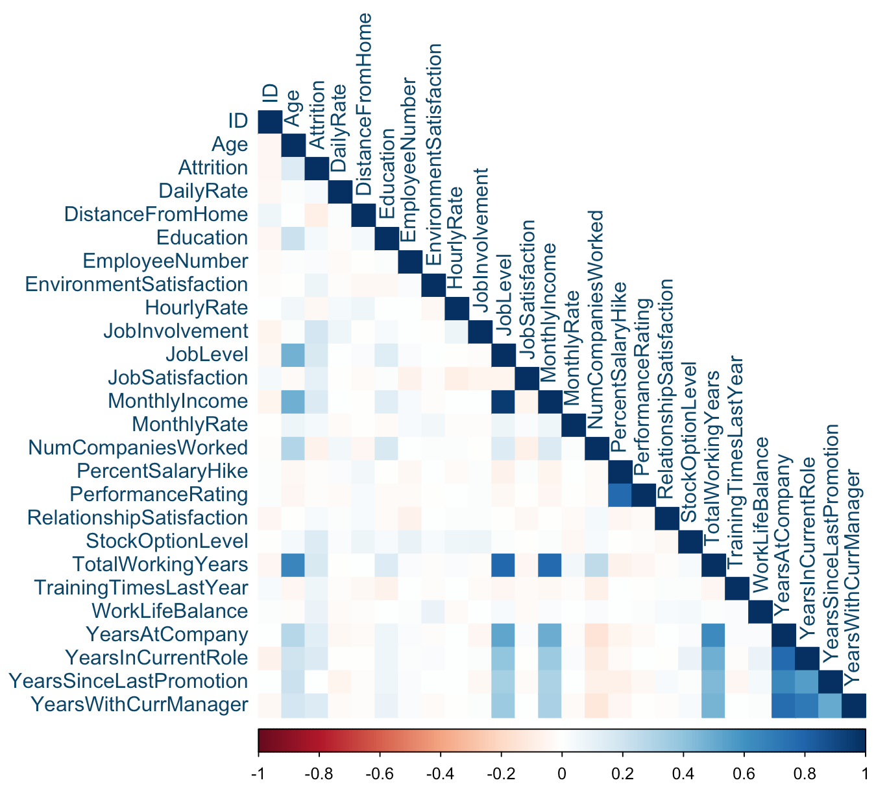
EDA – Correlation between variety of the features
Feature Correlation

Slide 7
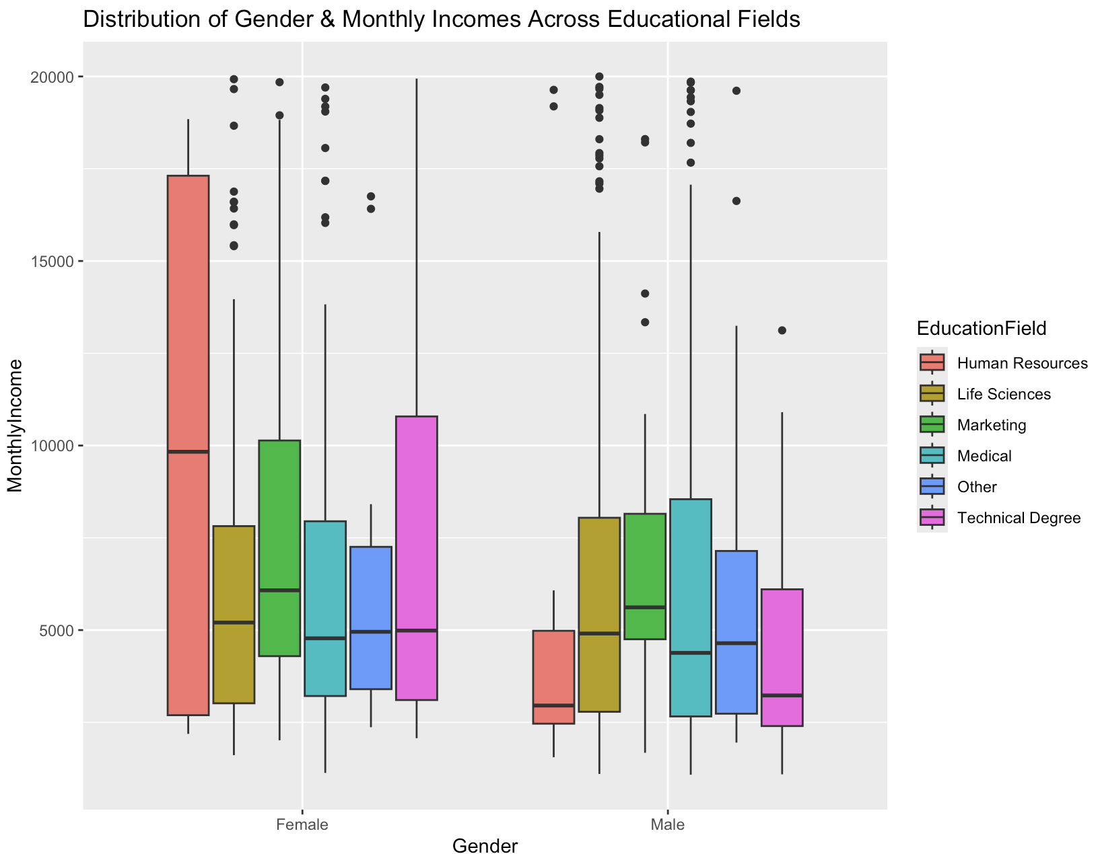
EDA – Plot of Gender, Monthly Incomes and Education Field

Slide 8
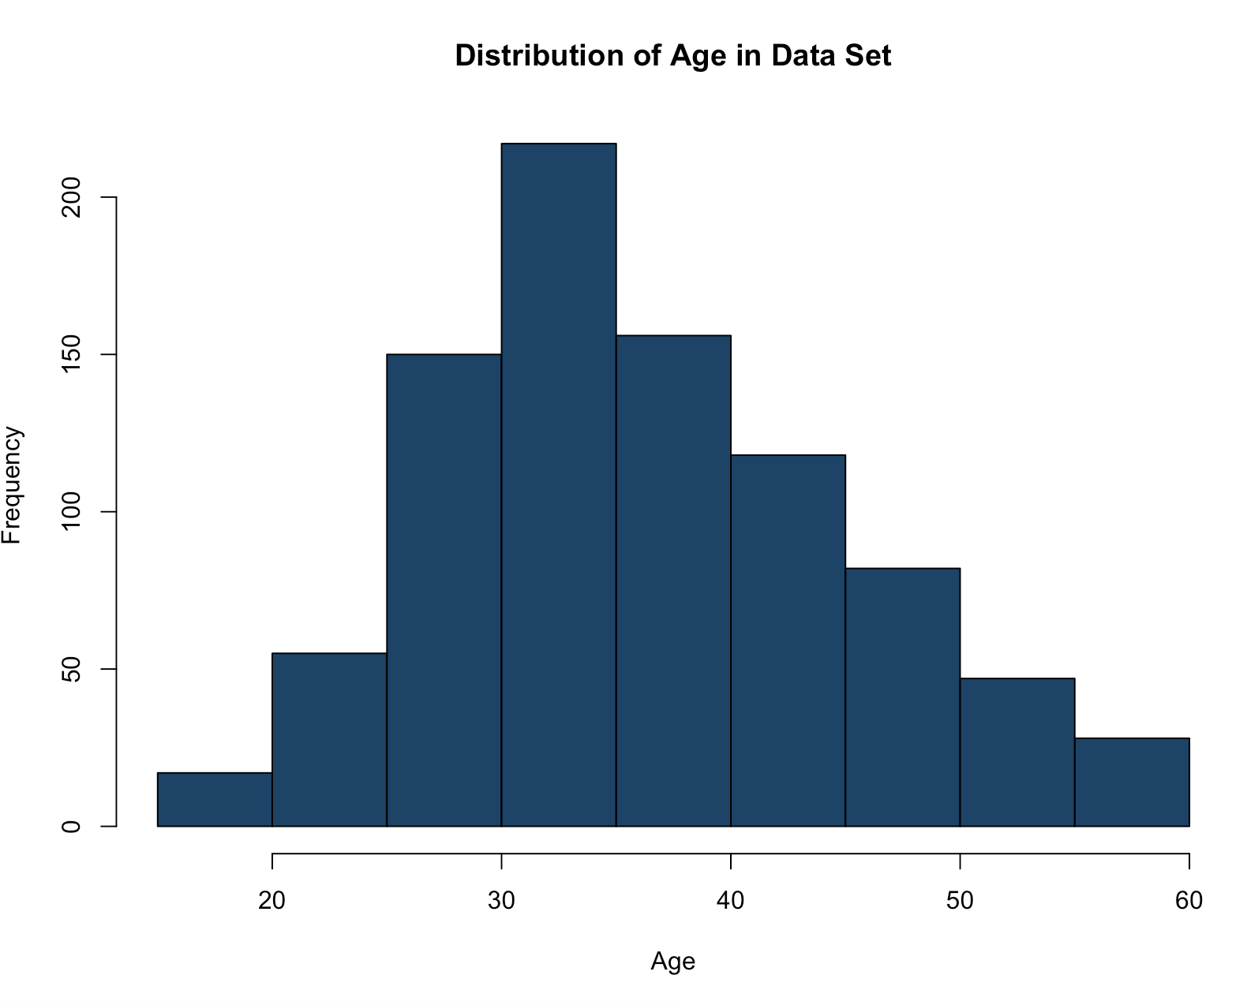
EDA – Histogram of Ages found in dataset

Slide 9
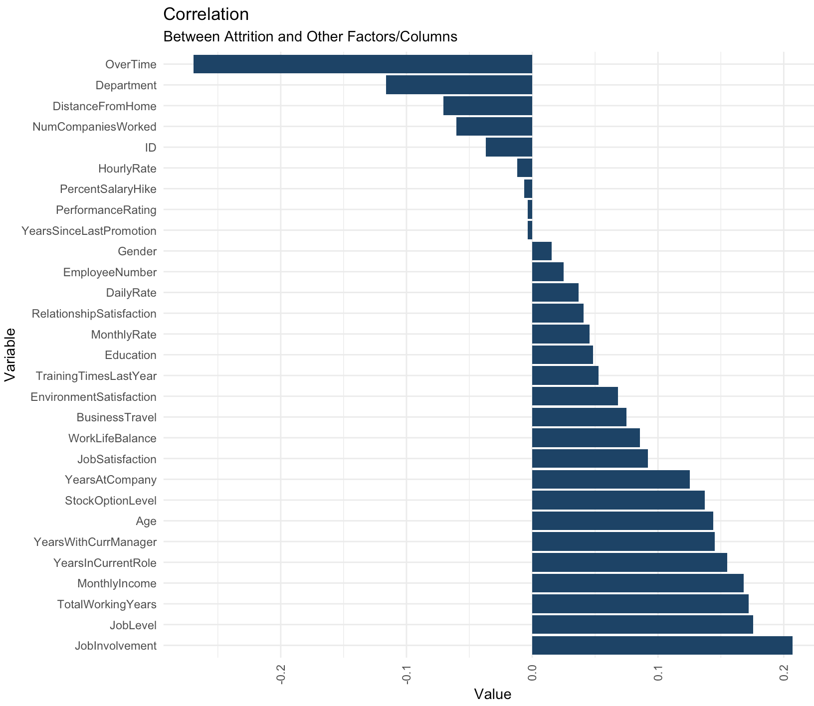
EDA – Correlation between Attrition and other features

Slide 10
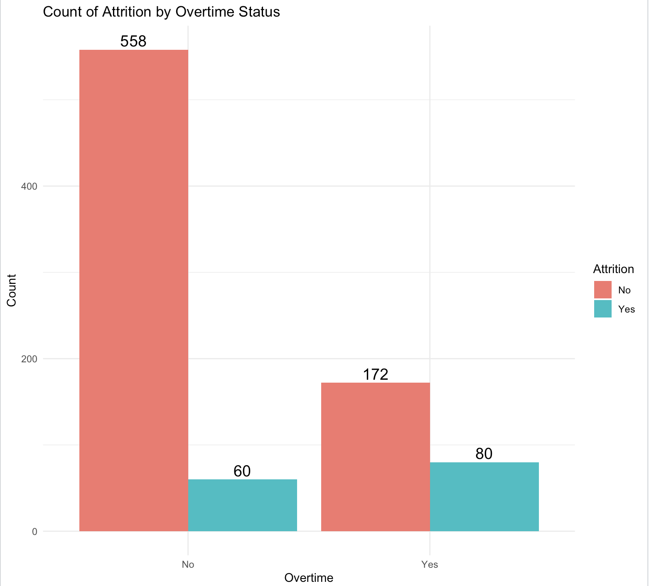
EDA – Correlation between Attrition and OverTime

Slide 11
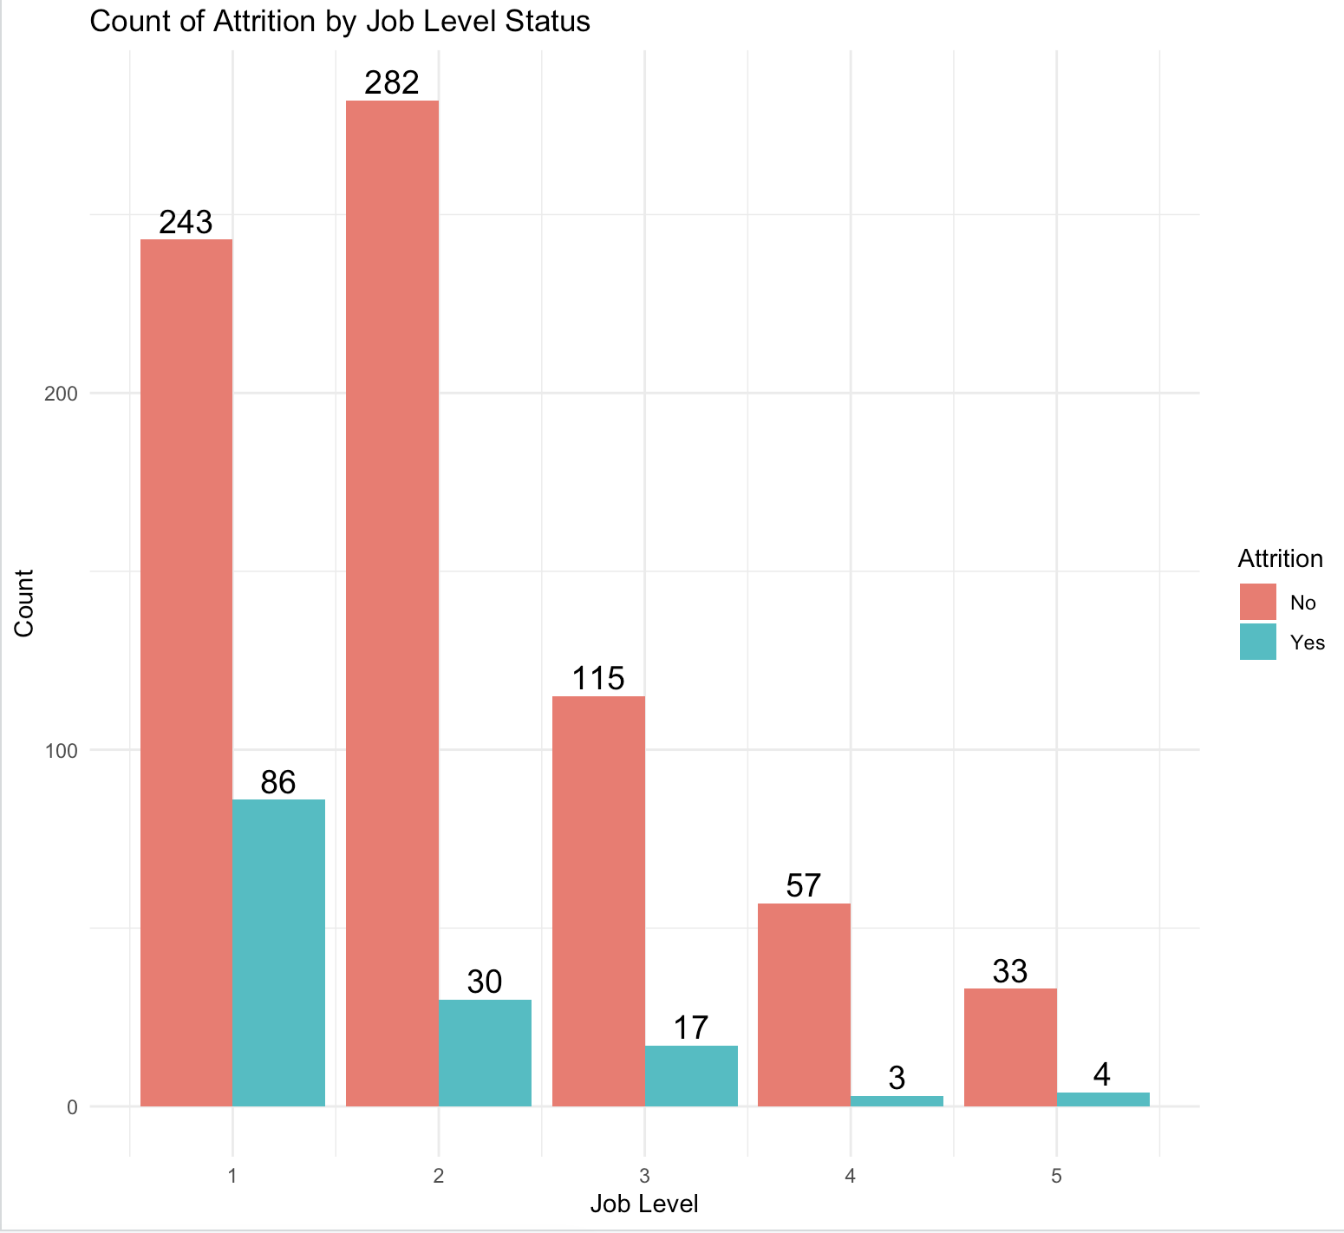
EDA – Correlation between Attrition and Job Level

Slide 12
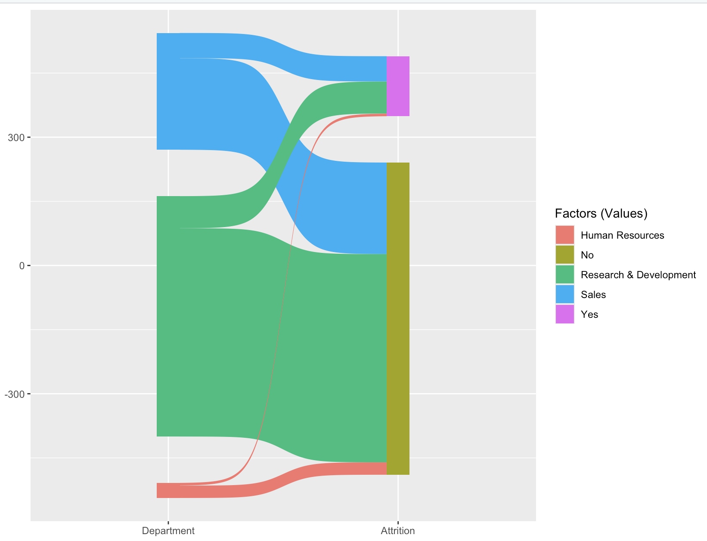
EDA – Sankey Plot of Departmental Attrition Flow

Slide 13
K-NN Model Factors Used MonthlyIncome YearsInCurrentRole YearsAtCompany PerformanceRating TotalWorkingYears YearsWithCurrManager PercentSalaryHike JobLevel
K=7 (70/30 split) | [Actual] Yes | [Actual] No
[Predicted] Yes | 3 [TP] | 10 [FP]
[Predicted] No | 38 [FN] | 210 [TN]
Metrics | Value
Accuracy | 0.8161
Positive Class | “Yes”
Sensitivity | 0.07317
Specificity | 0.95455

Slide 14
Naïve Bayes Model
 | [Actual] Yes | [Actual] No
[Predicted] Yes | 28 [TP] | 38 [FP]
[Predicted] No | 18 [FN] | 177 [TN]
Metrics | Value
Accuracy | 0.7854
Positive Class | “Yes”
Sensitivity | 0.6087
Specificity | 0.8233

Slide 15
Cost Analysis
 | [Actual] Yes | [Actual] No
[Predicted] Yes | 28 [TP] | 38 [FP]
[Predicted] No | 18 [FN] | 177 [TN]
Metrics | Value
Accuracy | 0.7854
Positive Class | “Yes”
Sensitivity | 0.6087
Specificity | 0.8233
Average Monthly Income | $6,390
Average Yearly Income | $76,680
Average cost to find replacement | 2x Average Yearly Income
Attrition Cost | (TP + FN) * $153360 = $7,054,560
Incentive Cost | FP * $200 = $7600
Total Cost | $7,062,160
Total Cost including TN | $7,097,560

Slide 16
https://github.com/safi26/CaseStudy1DDS

Slide 17
Thank You

