Slide 1

Prediction of Remaining Useful Life (RUL) of turbofan engine Safia Babikir Bashir
Notes:
This is the slide where you actually SAY your 1-2 sentence elevator pitch. Engage your audience!!

Slide 2
Outline
Problem
Solution
Data
EDA
Model
Demo

Slide 3
Problem
The turbofan engine is a pivotal component of the aircraft.
Engine components are susceptible to degradation over the life of their
operation, which affects the reliability and performance of an engine.
Proper maintenance is crucial for the longevity and performance of a turbofan engine
Notes:
Specify what Problem is being solved, and ensure that everyone is in agreement as to Why that’s a problem.

Slide 4
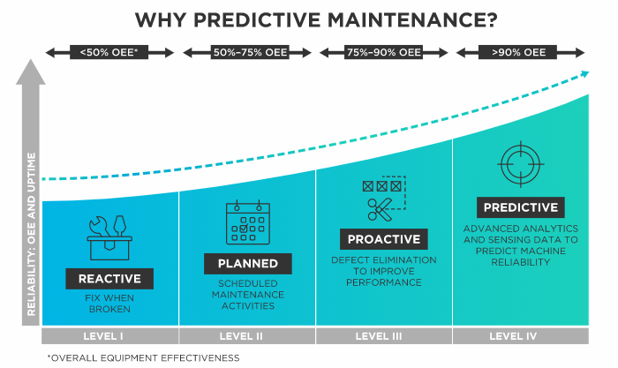
Type of Maintenance

Slide 5
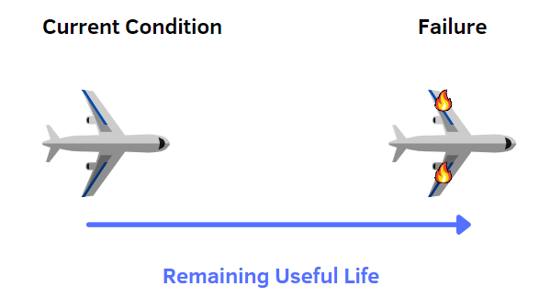
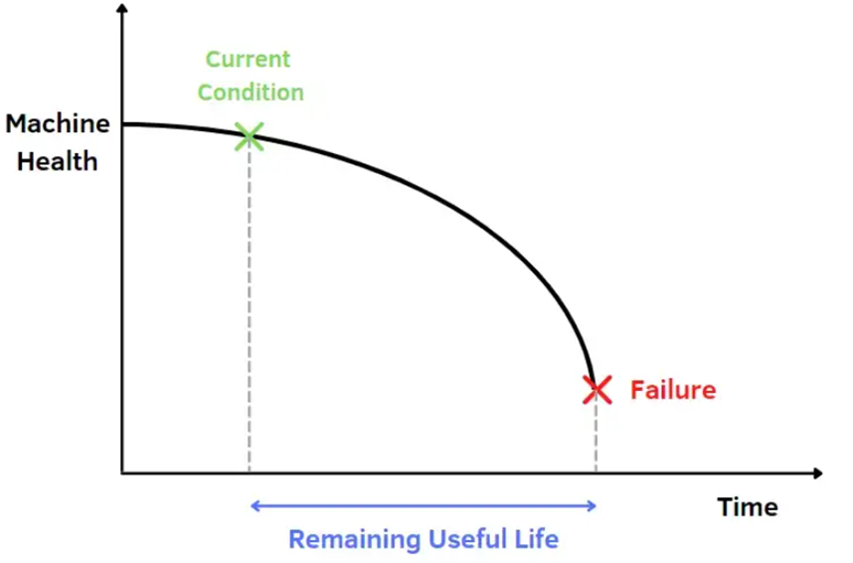
RUL

Slide 6
Solution
The main objective of this project is to develop an ML predictive model that can predict how many time steps remain until the engine fails based on sensor information describing the engine's present and past performance.
By using the proposed ML model, an engine operator could direct maintenance toward engines at risk of failure, which will improve the maintenance routine's efficiency and, most importantly, increases reliability.
Notes:
Specify what Success looks like, and for what Audience.

Slide 7
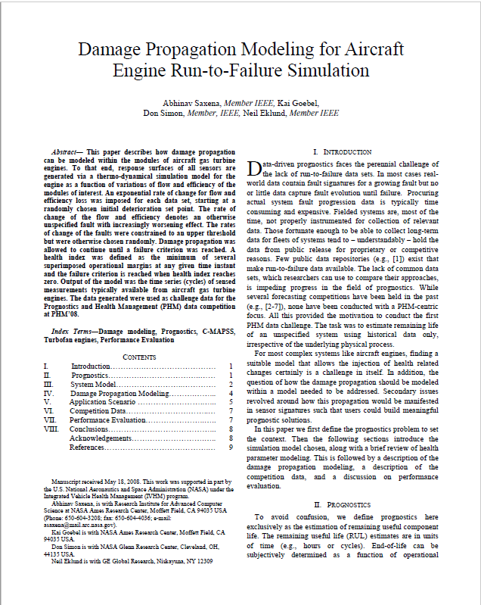
Data
Turbofan Engine Degradation Simulation Data Set" from NASA is used.
The Dataset is developed by NASA to study engine degradation. It is simulated in Simulink (a toolbox of MATLAB).

Slide 8
Data
The dataset contains the following information:
Engine unit number
Time, in cycles
Three operational settings
21 sensor readings

Slide 9
Data
Computing RUL: Training data set
I observed that the RUL data is not provided for the training set
It is important to calculate the RUL since it will serve two purposes:
It will serve as target variable for our supervised machine learning models
It will serve as our X-axis while plotting sensor signals, allowing us to easily interpret changes in the sensor signals as the engines near breakdown.
Notes:
Observe that there is no RUL data provided for training set. Do we need that? In fact, we can calculate RUL values from training data itself. Remember that training data contains run to failure data of all engines.
Engine 1 fails after 192 cycles. So at the first cycle of engine 1, its RUL is 191. After cycle 2, its RUL is 190 and so on. As it fails after 192 cycles, at 192nd cycle, its RUL is 0. This type of degradation model is called linear degradation model. From the start of the cycle it decreases gradually to 0 at the last cycle.

Slide 10
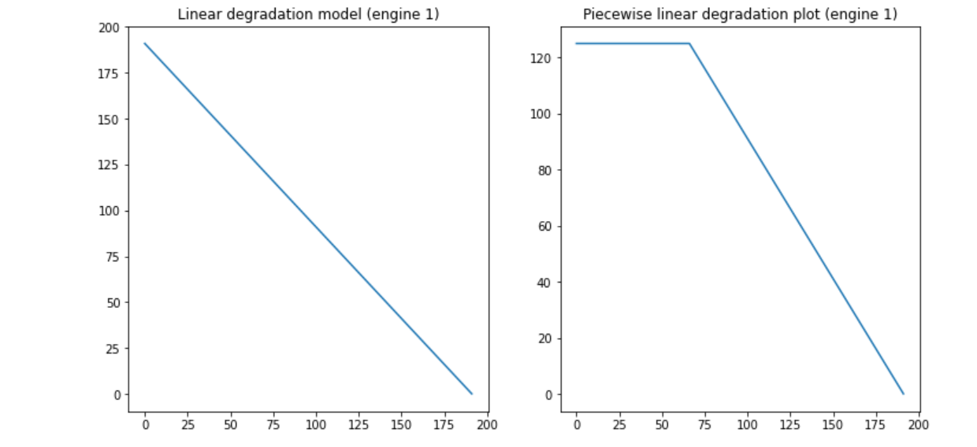
Exploratory Data Analysis(EDA)
Computing RUL: Training data set
Notes:
Apart from linear degradation model, there is another degradation model called piecewise linear degradation model that is also widely used. In this model, at the beginning (for a number of cycles), RUL is assigned to a fixed number. The fixed number is called early RUL. When RUL value reaches early RUL, from there on RUL follows a linear degradation model.

Slide 11
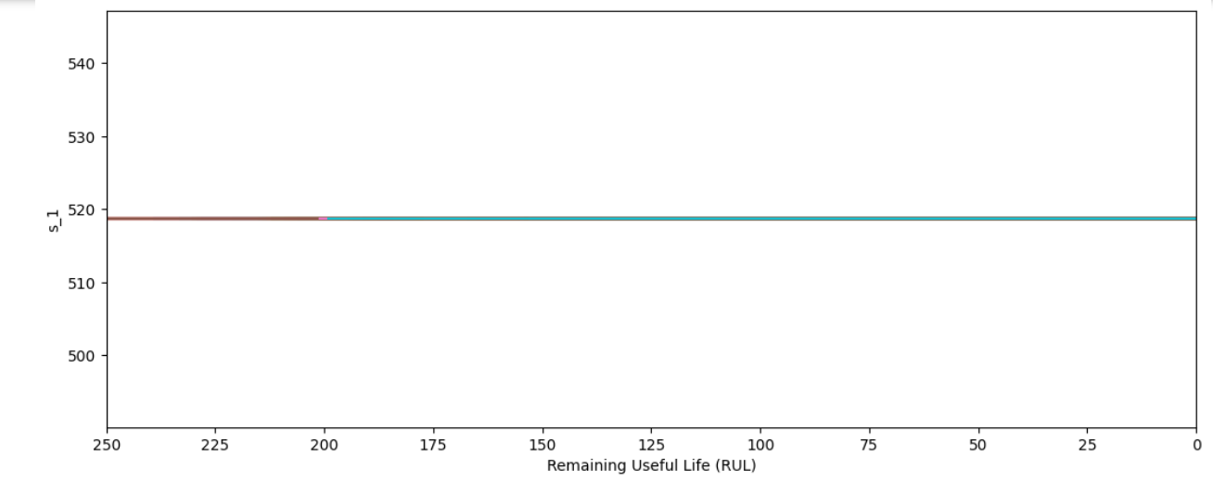
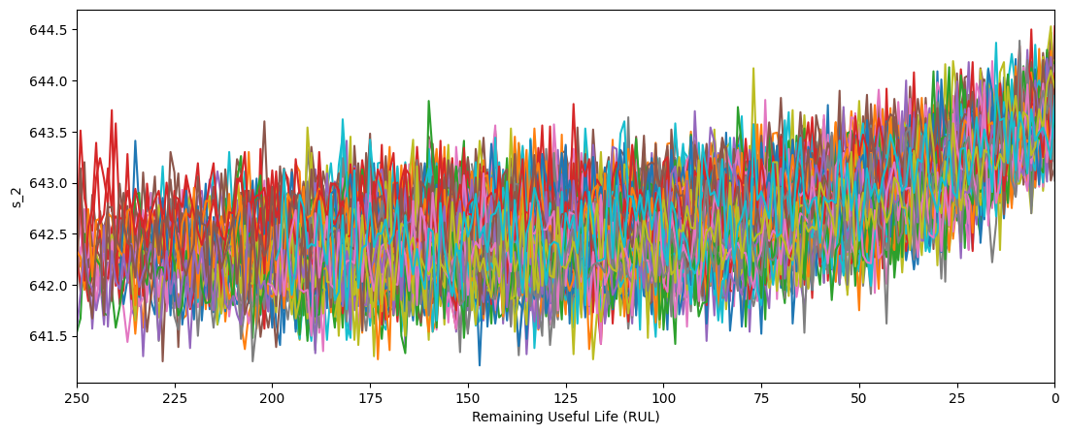
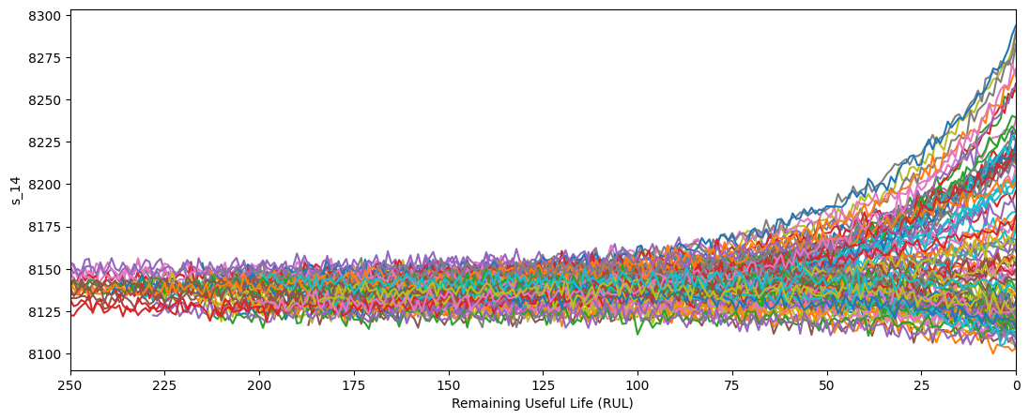
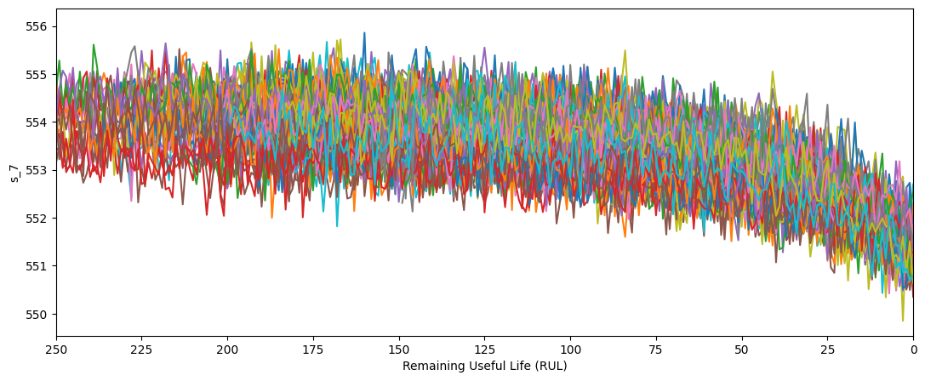
Exploratory Data Analysis(EDA): Sensors Selection

Slide 12
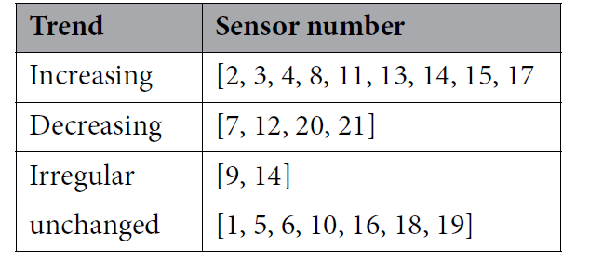
EDA: Sensors Selection

Slide 13
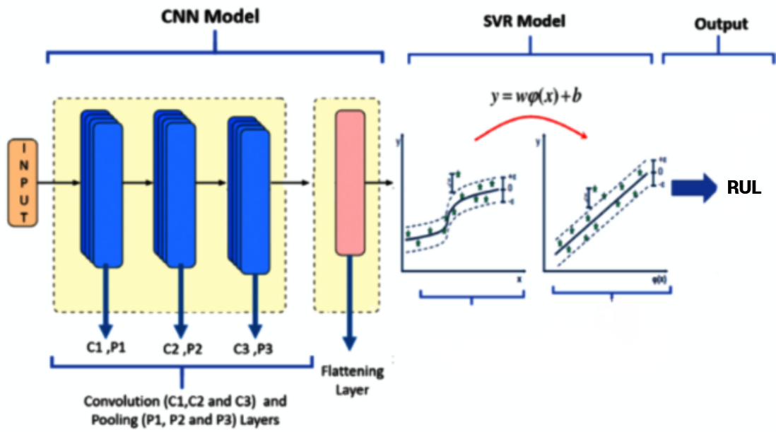
Proposed model : CNN+SVR

Slide 14
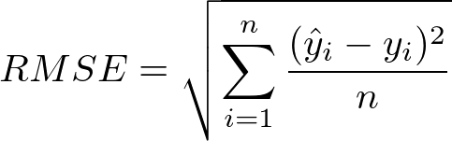
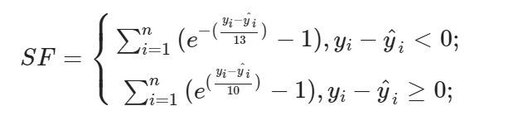
Metrics
The score and root mean square error (RMSE) are the two commonly used evaluation metrics for the NASA dataset; these are defined as follows :
Notes:
The RMSE is used to measure the deviation of the predicted value from the truvalue. The smaller the RMSE value, the closer the true value is to the predicted value. In actual conditions, the positive or negative difference between the predicted and true values has a significant impact on the subsequent maintenance and work guarantee. Advanced prediction allows for timely repair before failure; however, premature prediction leads to
unnecessary waste. Furthermore, lagging prediction leads to more significant consequences, and not predicting the failure in time creates a safety hazard. As the RMSE does not reflect the true magnitude between the predicted and true values, the introduction of a score increases the penalty for lagged predictions, with lower scores indicating better predictions
Remaining Useful Life Prediction of Aeroengines Based on
Multi-Head Attention Mechanism
Lei Nie,
Scoring function (SF): RMSE has the same punishment for early prediction and later prediction in terms of prediction. Different from RMSE, the scoring function is more inclined to early prediction (RUL predicted value is less than the actual value) than later prediction. The scoring function applies larger punishment for overestimated value and smaller punishment for underestimated value. The scoring function is calculated as follows:
.

Slide 15
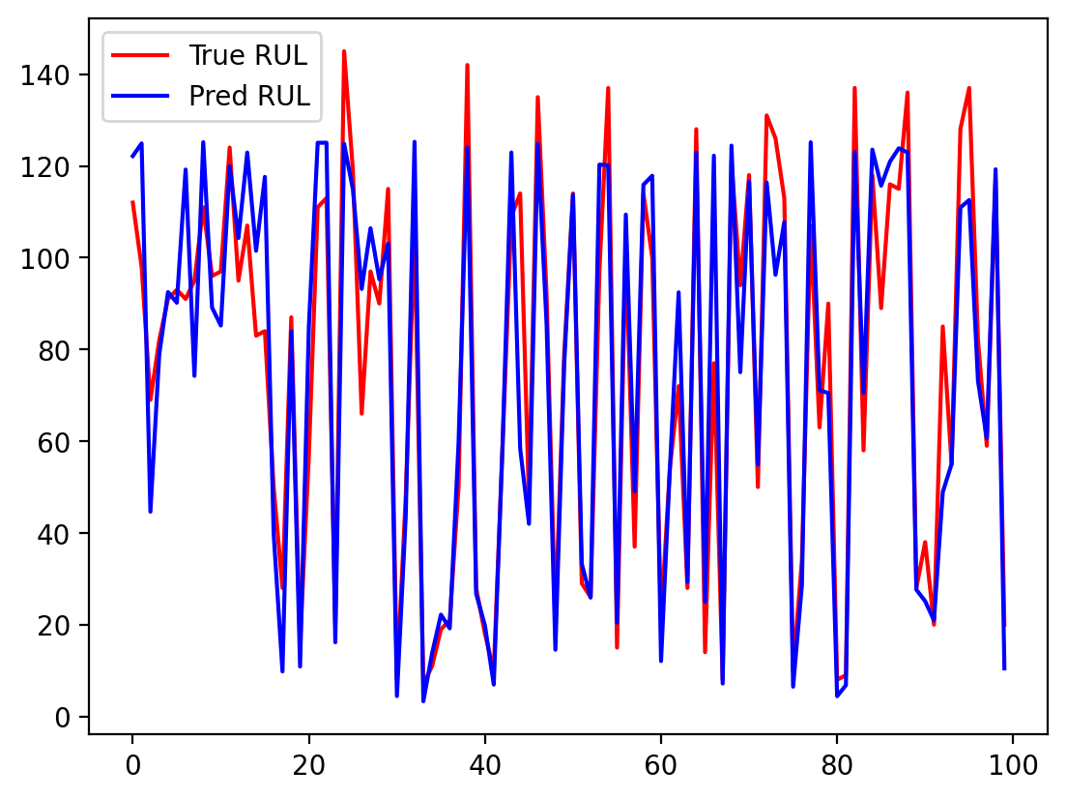
Results:

Slide 16
Results:
Model | RMES | Score
SVR [1] | 20.96 | 15886
CNN[1] | 18.45 | 2056
CNN+SVR | 14.9 | 424
[1] G. Sateesh Babu, P. Zhao, and X.-L. Li, "Deep convolutional neural network based regression approach for estimation of remaining useful life," in Database Systems for Advanced Applications: 21st International Conference, DASFAA 2016, Dallas, TX, USA, April 16-19, 2016, Proceedings, Part I 21, 2016, pp. 214-228: Springer.

Slide 17

DEMOE:

