Slide 1
Performance Evaluation of In-network Packet Retransmissions using Markov Chains
Runa Barik, Michael Welzl, Peyman Teymoori, Safiqul Islam, Stein Gjessing
ICNC 2020
Kona, Hawaii

Slide 2
Overview
Idea and contributions
LOOP
  applications
  analysis
Observations
Future work

Slide 3
Idea
The famous end to end paper [1] suggests that functions placed at low levels of a system may be redundant or of little value when compared with the cost of providing them at that low level
One of the cornerstones of the Internet Design
  Strictly avoiding placing application specific functions in the network.
[1] J .H. Saltzer, D. P. Reed, and D. D. Clark, “End-to-end Arguments in System Design,” ACM Trans. Comput. Syst., vol. 2, no. 4, Nov. 1984.
Notes:
Their example begins with a file transfer and it concludes with the finding that reliability must be carried out end-to-end in any case, and that it is therefore pointless to try to implement it inside the network.
It has been one of the cornerstones of the Internet design; strictly avoiding placing application specific functions in the network.
We posit that it is now worthwhile to give such retransmissions a new consideration. We are not contradicting with the end to end
Argument:
when packets are frequently dropped on path segments with a very short round-trip time (RTT), and when the end-to-end RTT is very long, retransmissions from on-path relays do help—they can get packets to the receiver faster, reducing latency.

Slide 4
Idea
Retransmission of packets inside the network on a segment of an end-to-end path
  especially when packets are frequently dropped on path segments with a very short round-trip time (RTT), and the end-to-end RTT is very long
Similar techniques: Automatic Repeat Request (ARQ) in wireless links
  but it is a result of the separate development of Internet standards and link layer standards
Notes:
ARQ: local retransmissions that reduce the packet loss probability for the end-to-end control loop. 802.11 Access Points (APs) usually have configurable retry limits to specify how often the AP should try to re-send a frame in case of failure; 7 is a common default value for short frames.

Slide 5
Our Contribution
We consider only retransmission, not ordering
Questions to answer: given the end-to-end RTT, the RTT on a path segment, and the packet loss probabilities of the various parts of an end-to-end path,
  how long should a system ideally store packets for retries?
  how large is the potential benefit from in-network retransmission?
We never delay packets
Notes:
Ordering: We make this decision to keep our model simple, but it could obviously be extended to also capture ordering. It could always be
Extended to capture reordering. Out of order packets are always problematic for TCP; assumes: a re-ordering degree of 3 packets or more indicates congestion. Mechanisms like RACK lets TCP interpret time instead of sequence numbers is robust against acknowledgements.

Slide 6
Our Contribution
We introduce a stochastic model that describes the relationship between packet drop probabilities in different path segments, RTT, and buffer size.
We investigate the influence of a local loss recovery mechanism: caching packets in an intermediate node and loss detection before packets being arrived at the destination using the above model.
  We derive the impact of each parameter on the system behavior.

Slide 7
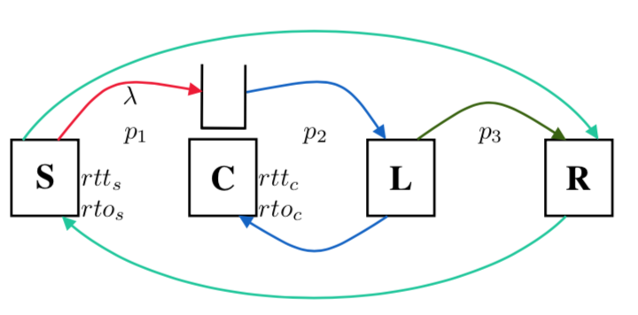
Local Optimizations On a Path (LOOP)
We utilize a cache and a loss detector at the start and the end of the path segment with high packet loss:
  sender S emits packets with rate λ
  cache C additionally stores a copy of packets
  loss detector L confirms reception of each packet
  C retransmits if timer rto_{c} expires
  R acknowledges packets to S
p_{i}: packet loss probability in segment i
LOOP architecture
Notes:
packets traverse a cache C and a loss detector L. Both just forward packets that they receive,
ACKs from L arrive at C after rttc. If they do not arrive for a certain packet within a timeout rtoc, they are retransmitted.
Introducing a cache and a loss detector divides the path into three segments, and there is a certain loss probability on each of the path segments—p1, p2 and p3.

Slide 8
Applications of LOOP
This closely matches IETF LOOPS
  tunnel mode: C encapsulate packets in addition to caching
  transparent mode: C caches packets together with a hash identifier that is calculated from immutable header fields
Recursive Internetworking Architecture (RINA)
  evaluating retransmissions in stacked layers with different scopes
Information-Centric Networking (ICN)
  R²T: a close proposal in ICN
Notes:
Local Optimizations on Path Seg- ments”, is a proposal to form a Working Group, whose first formal “Birds of a Feather” (BoF) meeting was held at the 105th IETF meeting in Montreal, Canada, in July 2019. The envisioned operation of a LOOPS system,
Tunnel Mode: so that they can carry necessary LOOPS information such as sequence numbers (LOOPS promises not to examine the header of transport protocols, and therefore needs its own sequence number space).
Additional considera- tions for LOOPS include the possible use of Forward Error Correction (FEC) on the path from C to L instead of plain retransmission, avoidance of congestion by limiting the rate at which C retransmits packets when it sees that the delay growth at C-L path.
Ours is a subset of loops: we are just simply caching and forwarding packets; not considering ordering and FEC. That’s why call our mechanisms LOOP.
Proposal for local retransmission exists in ICN, which relies on caching.

Slide 9
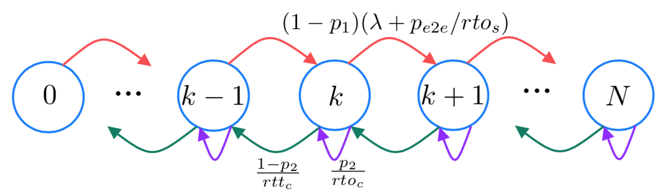
LOOP Analysis
We use a Continuous-Time Markov Chain (CTMC) with finite states
Cache can be modelled as an M/D/1/N queuing model
  Poisson arrival
  deterministic service time
  N: buffer size
Notes:
We assume that S transmits packets at a rate following a Poisson distribution.

Slide 10

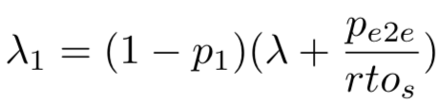
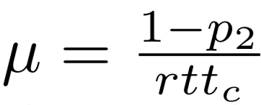
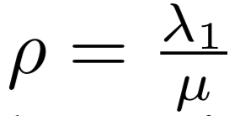
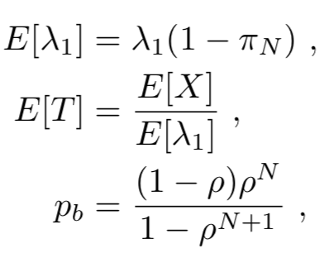
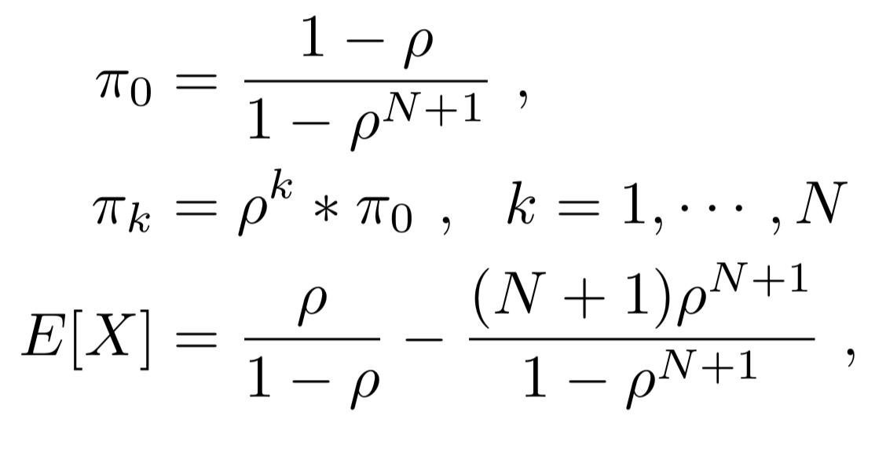
Solving the CTMC
E2E packet drop prob.:
Arrival rate at the cache:
The M/M/1/N equivalent:
Service rate
Load at C
Notes:
Assuming the lost packets in between C to L to be recovered by LOOP, the end-to-end packet-loss probability measured by S is pe2e
Thus the total arrival rate of packets that grows the cache is given by Lamda1
Service rate: The incoming packets at C are cached and forwarded. Once
these packets reach L, L acknowledges them, and when the
acknowledgements arrive at C, C removes them from the CACHE:
To obtain the steady state probabilities, this model follows M/M/1/N queuing model:
πk is the steady state probability of state k
E[X] is the expected number of packets in the cache, E [λ1 ] is the expected arrival rate for caching (caching rate), and E [T ] is the expected waiting time of packets in the cache. Pb is the blocking probabilites!

Slide 11
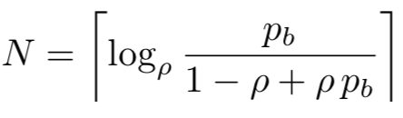
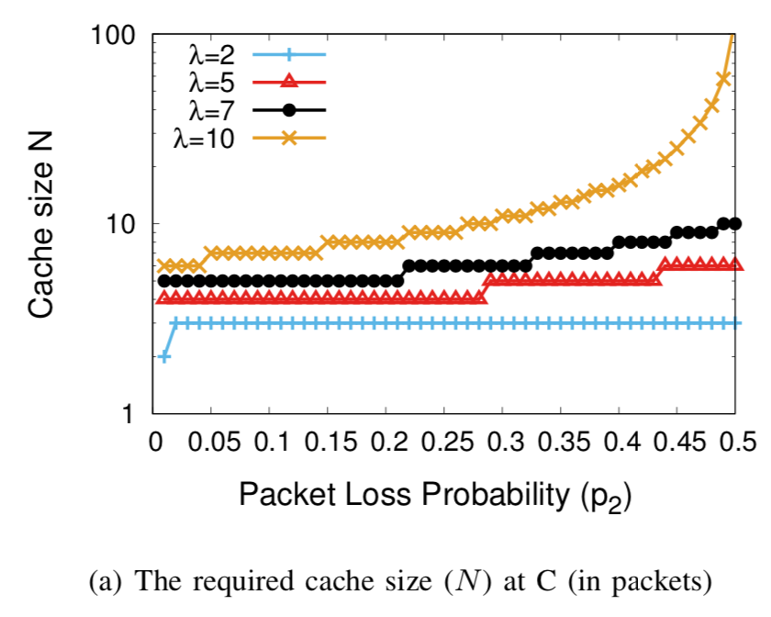
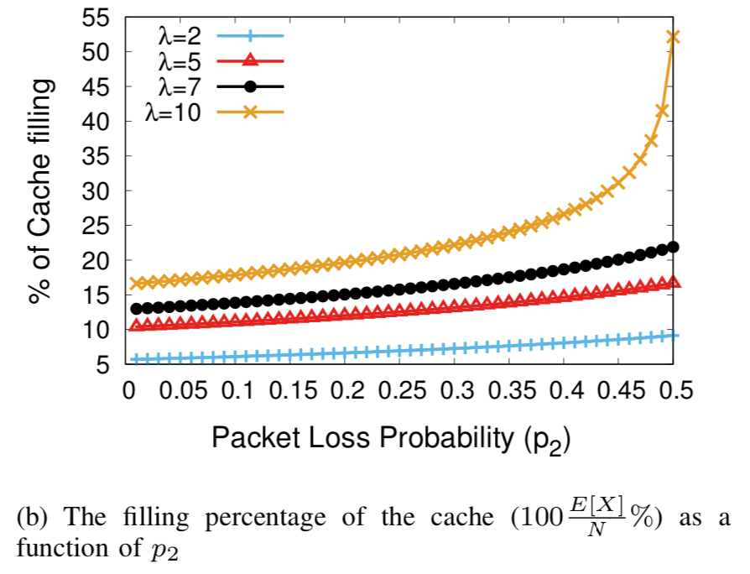
Cache Size
As a Function of p₂ and p_{b}
p1 = 0.01, p3 = 0.01, rtts = 0.1, rtos = 0.2, rttc = 0.05, rtoc = 0.1, initial pb = 0.01
Notes:
Then for different values of p2 and λ, we compute the cache size N as shown in Fig. 3(a). The figure indicates that with larger values of p2, larger cache sizes will be required to maintain the desired blocking probability. A higher arrival rate also needs a larger cache size. The cache size difference is larger as p2 grows.
in all of our performance evaluation, we investi- gate the full range of loss ratios from 0 to 1 only to obtain a better understanding of the system;
The link between C and L will be wired connection where loss ratio about 0.5 is not expected.
Fig. 3(b) plots the filling percentage of the cache, i.e. 100E[X]/N%
A larger arrival rate also increases the number of cached packets. Again, we can observe that higher values of p2 affect higher rates more, meaning that the difference becomes larger.

Slide 12
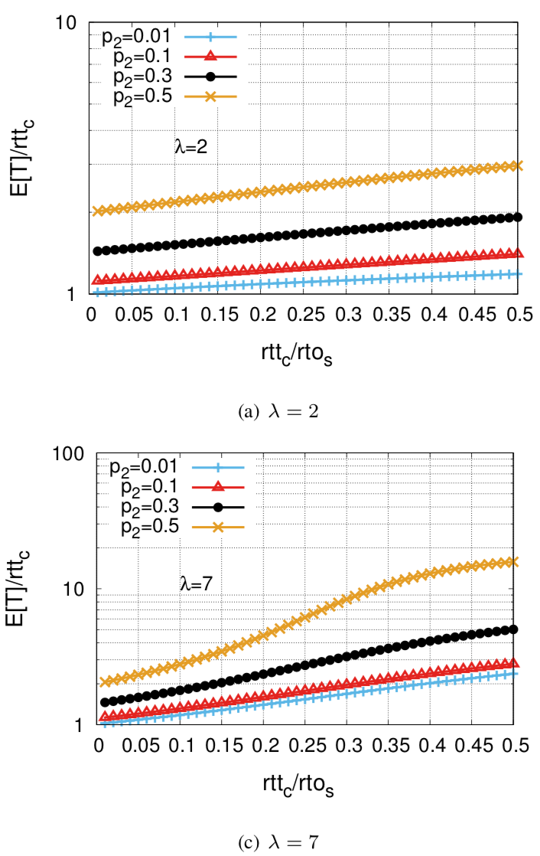
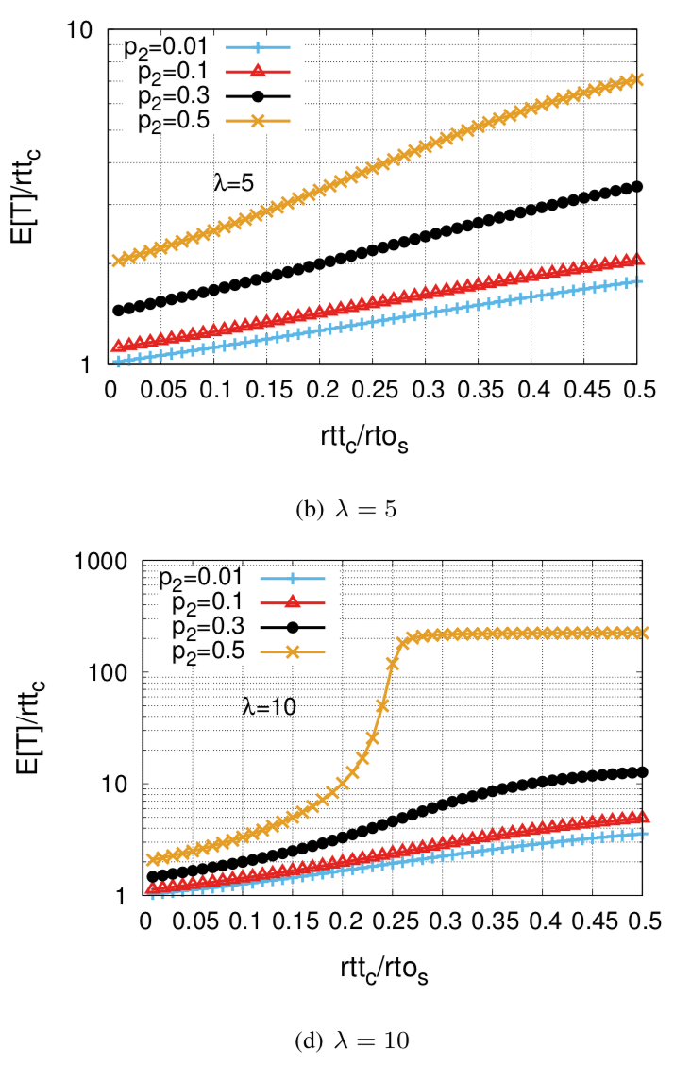
Effects of rtt_{c}
p1 = 0.01, p3 = 0.01, rtts = 0.1, rtos = 0.2, initial pb = 0.01
Notes:
To evaluate how rttc affects the
caching time, we vary rttc/rtos in the range [0.0,0.5] and
compute the expected waiting time of packets at C.
When λ = 10 and p2 = 0.5, the plot is flattened after the ratio 0.25 because the cache is fully utilized and excess packets are not cached, the expected waiting time does not increase.

Slide 13
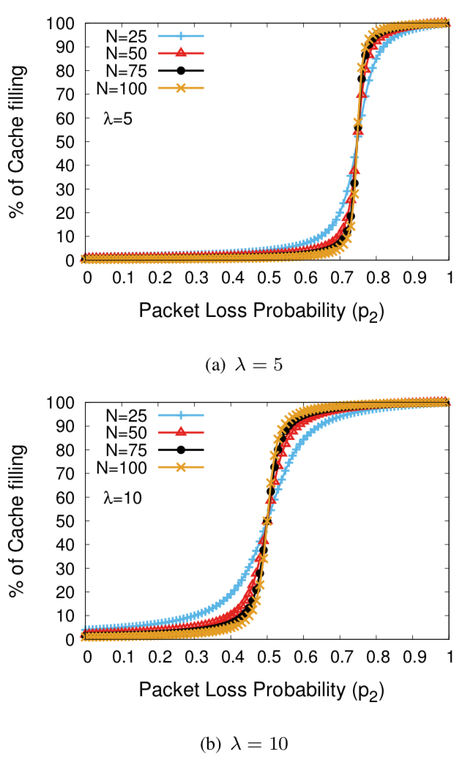
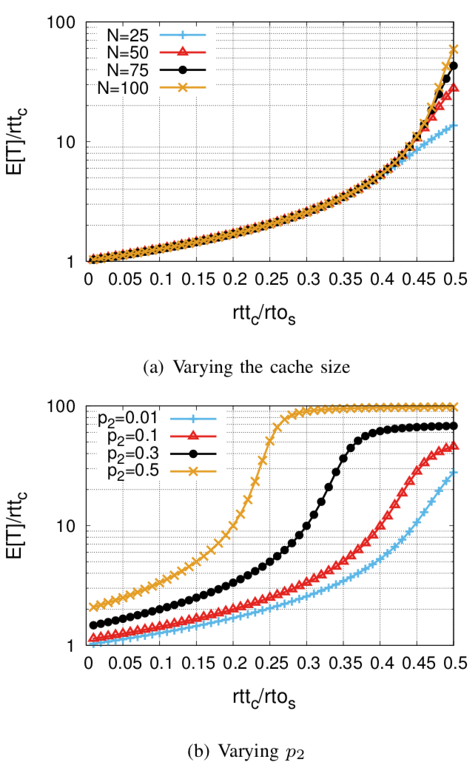
Fixed Cache Size Independent of p₂ and p_{b}
p1 = 0.01, p3 = 0.01, rtts = 0.1, rtos = 0.2, rttc = 0.05, rtoc = 0.1, initial pb = 0.01
Notes:
In this analysis, we do not obtain the cache size based on p2 and pb. Instead, we set N to some fixed values and then, we analyze the model for different values of λ, p2, and rttc/rtos.
Fig. 5 presents the filling percentage of the cache by varying p2 for a set of N and λ. A larger value of p2 fills the cache faster than a smaller one. Higher arrival rates have larger impacts in filling the cache. From the figures, we observe that the cache is almost empty up to a certain value of p2. However, small increments of p2 can seriously affect the percentage after that. This implies that the increase is not linear, and one can expect almost full utilization with a slight change of p2.
The other finding from these figures is that the cache size does not play a significant role when p2 exceeds a certain value because the arrival rate and also the service rate are fixed, and the cache, irrespective of its size, will become almost fully utilized after a short time. This explains why the plotted lines for different values of N are similar.
Fig. 6(a) shows that the maximum cache size has the least
impact on the waiting time as all the lines overlap. A smaller value of rttc favors a smaller waiting time.
b) that a smaller value of p reduces the waiting time. We also
observe that when rttc/rtos ≤ 0.25, for moderate p2 values, the waiting time is less than twice of rttc.

Slide 14
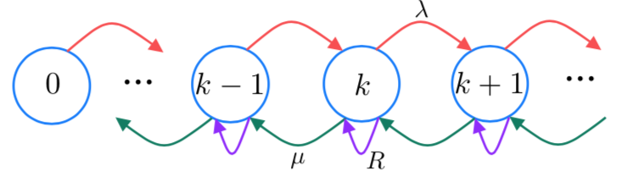
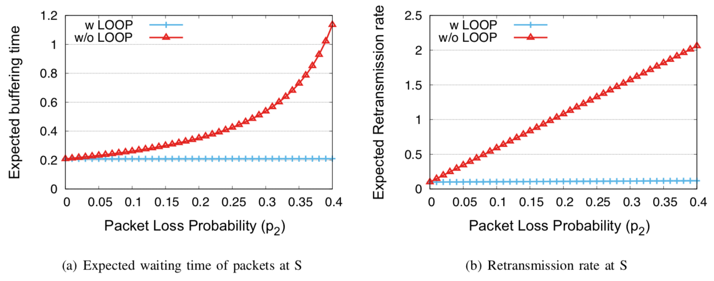
End-System Analysis
Buffer could be modelled as an M/D/1/∞ queue
λ = 5, p1 = 0.01, p3 = 0.01, rtts = 0.1, rtos = 0.2, initial pb = 0.01
Notes:
Fig. 7 where the Markov chain has an infinite number of states. In the absence of LOOP in the network (i.e. S is solely responsible for retransmitting lost packets), the packet-loss probability between C and L, p2, appears at the sender side.
The difference
between the two cases are: in networks with LOOP, S sees
a packet loss probability of p2 pb between C and L whereas
without LOOP, S gets a packet loss probability of p2 from that 1
segment.
Fig. 8(a) plots the expected waiting time of packets at the sender, i.e. the queuing time for different values of packet-loss probability p2 with and without LOOP in the network. We set λ = 5 and p2 varies up to 0.4; this assures the buffer at C is not saturated to be able to compare the two cases.
Without LOOP, the waiting time at S increases with increasing p2. Similarly the retransmission rate E[R] also increases linearly with an
increase in p2 as shown in Fig. 8(b). However, the increase in these two metrics due to the increase in p2 is negligible; this is the reason why the plots belonging to the LOOP analysis seem almost invariant in these figures, confirming the importance of such systems in the network compared to end-to-end systems.

Slide 15
Observations
Non-linearity dependence between filling the cache and the packet loss probability
Cache size has the least impact on its utilization:
  irrespective of the size, it can be fully utilized by higher packet loss probabilities
With LOOP: lower retransmission rate and expected caching time at S than without LOOP being deployed in the network
Notes:
1_ which means that a small increment in the packet loss probability above a certain value in LOOP can significantly affect the percentage of cache filling.
2) A higher value of RTT increased the packet caching time while the configured cache size has the least impact on it
3) With LOOP in the network, an end-system gets a smaller retransmission rate and expected caching time for packets than without LOOP being deployed in the network.

Slide 16
Future Work
Trade-offs involved in re-sequencing
Using NACKs
Sequence of or even nested loops
Notes:
we plan to extend our model such that it describes the trade-offs involved in such re-sequencing.
our model is limited to positive ACKs and timeouts—how will it change if we use NACKs that indicate holes in the sequence number space before a timeout would fire?
these loops could be used in sequence or even nested (such considerations have, in fact, al- ready been brought forward in the IETF LOOPS proposal
Because of the additional load produced by LOOP, there will also need to be some form of congestion control between C and L, and a way to avoid “hiding” congestion from the end systems.

Slide 17
Thank you!
OCARINA” project (http://www.mn.uio.no/ifi/english/ research/projects/ocarina/

