Slide 1


Presentation
DBS-Project
„Wahlinformationssystem“
Stefan Fritsch, Tabea Schmidt
25.01.2016

Slide 2
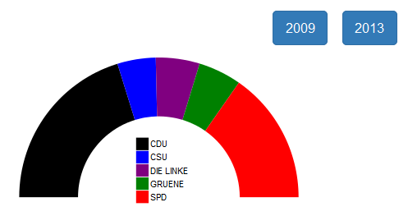
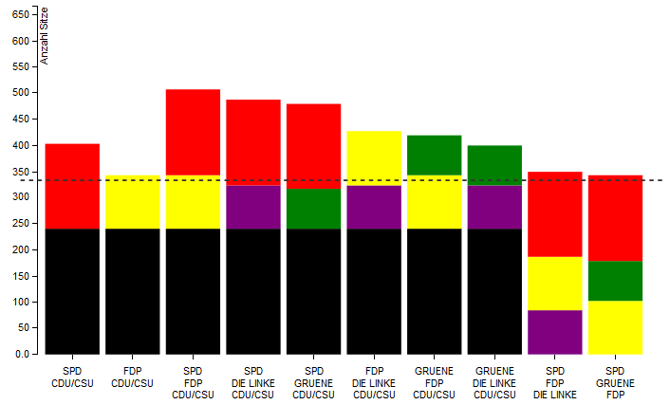
System features
Visualization of all analyses
Q1 – Q7
All information is displayable
by election year
Easy but secure voting process
Coalition diagram
(up to 3 parties)

Slide 3
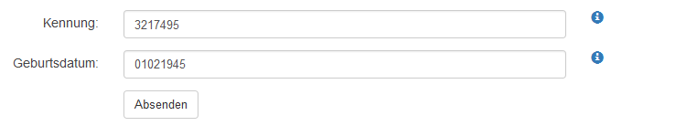
Voting process
Data privacy
Prevention of election fraud
The token and date of birth are not correlated
Every token can only be used once
Generating the token
The token is generated as an ascending numeric sequence

Slide 4
Benchmark

