Slide 1
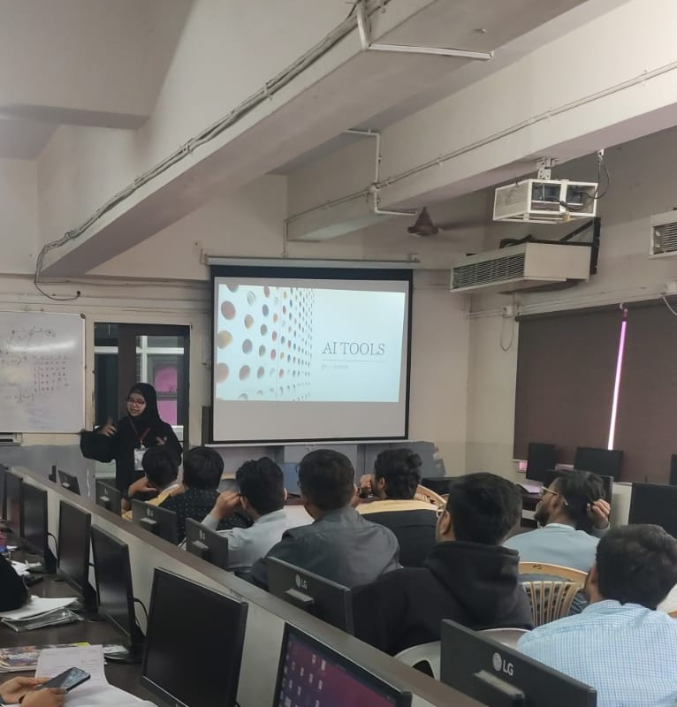
TECHBLOOM
In the room.
Poona College of Arts,
Science and Commerce
Camp, Pune
31 January 2025
01
Notes:
Cover photograph: AI Tools session, Poona College of Arts, Science and Commerce, Camp, Pune, 31 January 2025, 8:40 a.m. The GPS stamp has been cropped off.

Slide 2
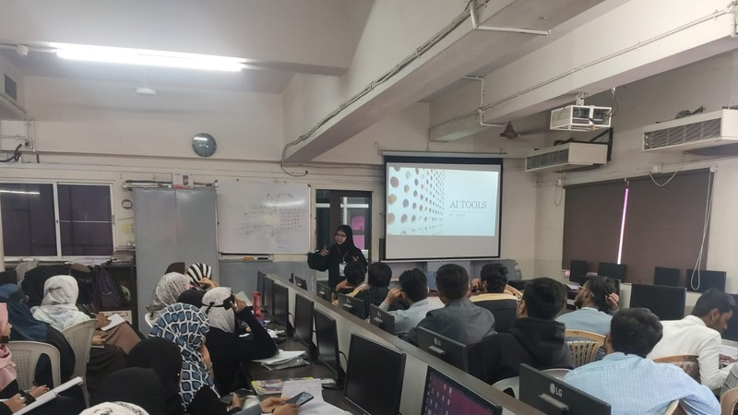
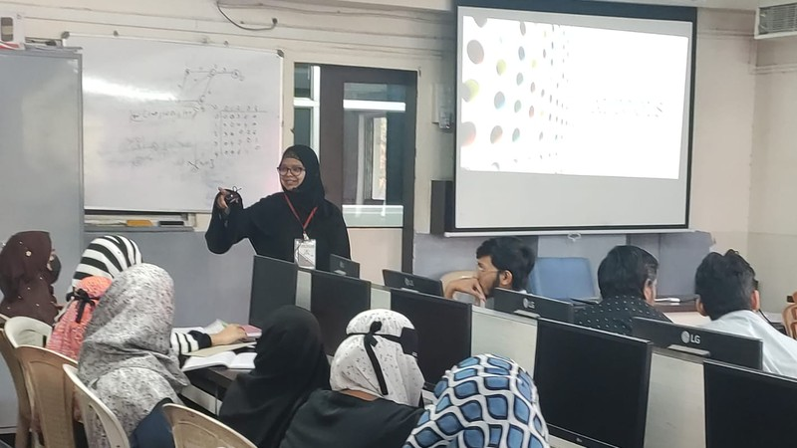
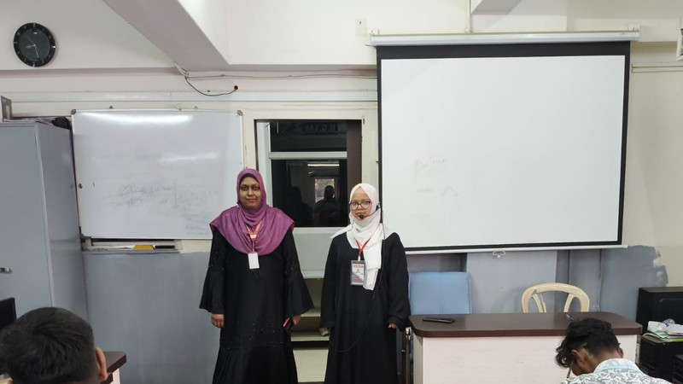
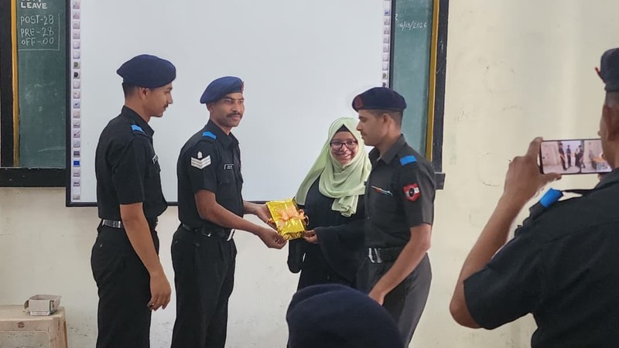
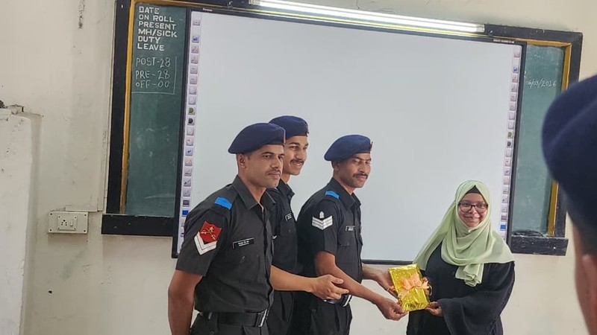
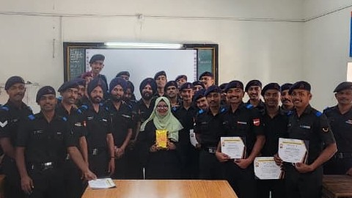
THE PICTURES
Six frames
from two mornings.
01
31 January 2025
AI Tools on the projector. Poona College of Arts, Science and Commerce, Camp.
02
3 February 2025
Two facilitators in a computer laboratory in Pune.
03
One more room
A gold-wrapped gift, then certificates held up with the group.
02
Notes:
31 January time on the photograph is 8:40 a.m. The following frame, at the whiteboard, is 8:41 a.m. The 3 February laboratory frame is 8:26 a.m. The gift and group photographs do not carry a readable date, so they are not given one.

Slide 3
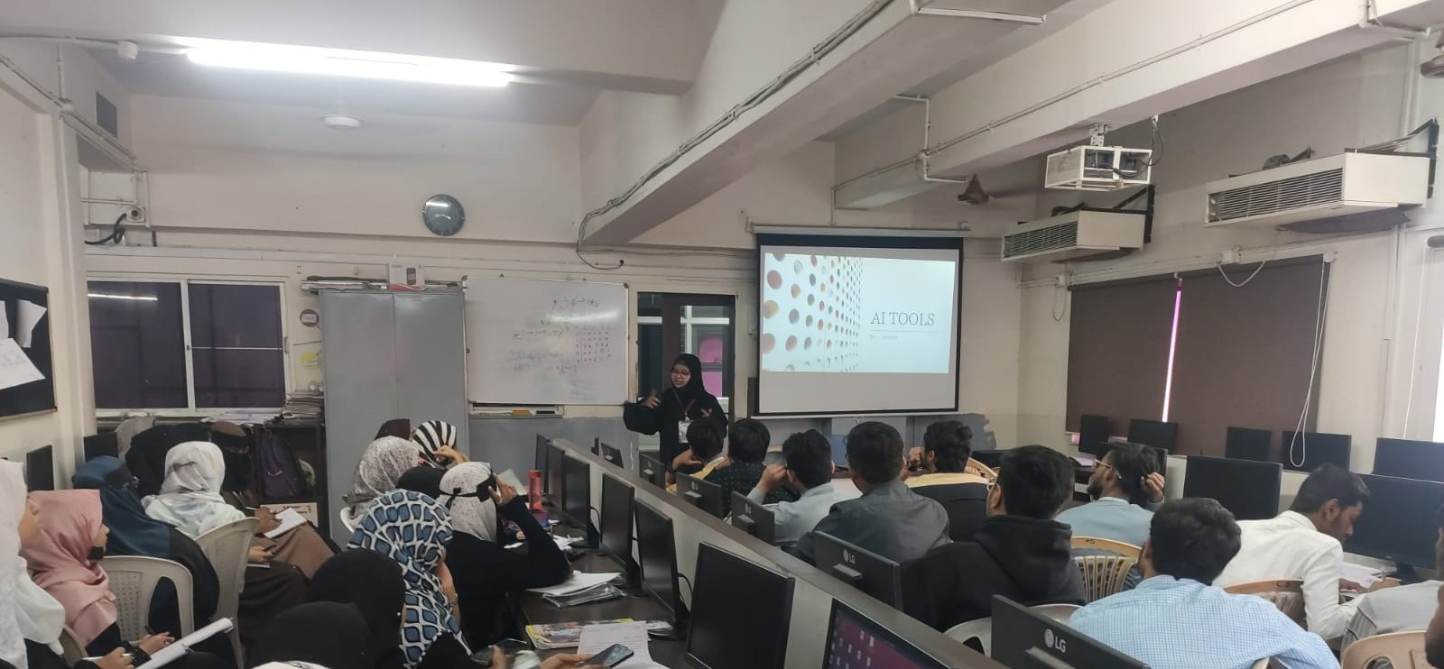
AI Tools
On the screen, in the lab. 31 January 2025, 8:40 in the morning.
03
Notes:
The projector in this photograph is titled AI Tools. Poona College of Arts, Science and Commerce, Camp, Pune.

Slide 4
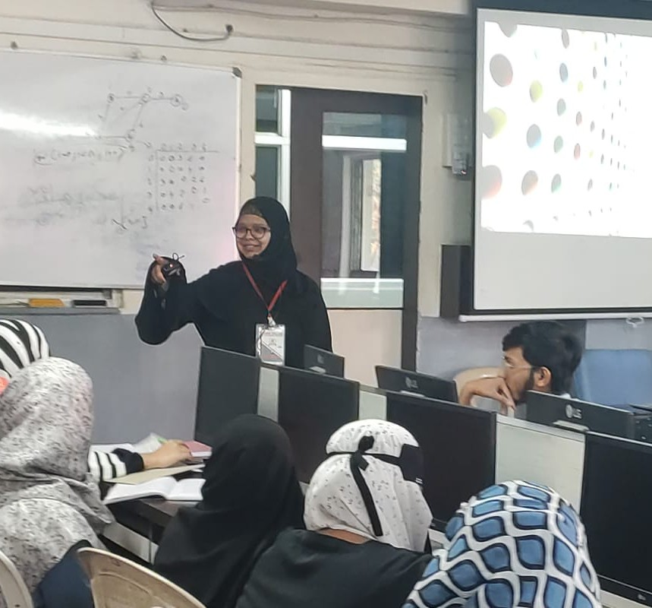
04
Marker
in hand.
Same morning, one minute later. The lesson moves from the slide to the whiteboard.
31 January 2025
8:41 in the morning
Notes:
Whiteboard frame from the same AI Tools session, timestamped 8:41 a.m. on 31 January 2025.

Slide 5
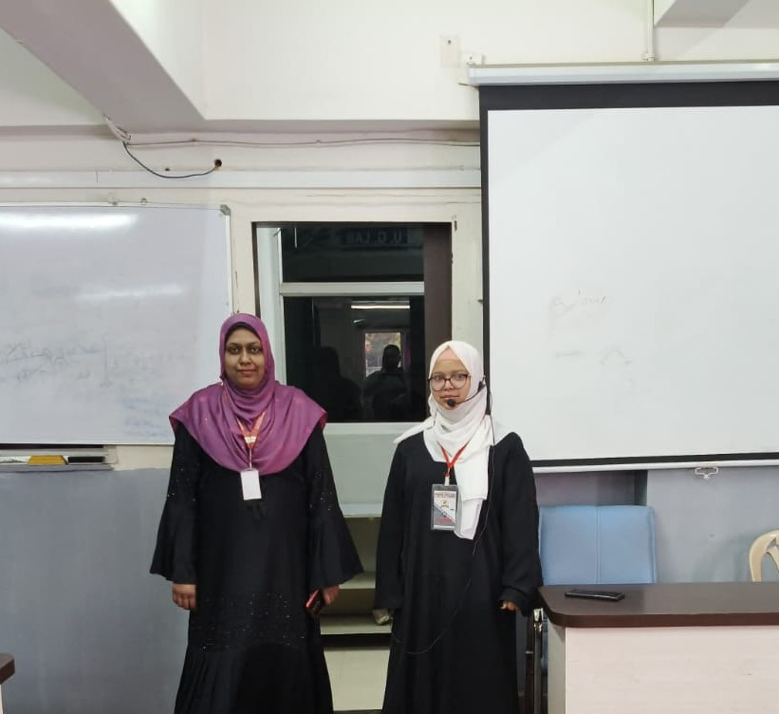
05
Two
facilitators.
A computer laboratory in Pune, just after half past eight.
3 February 2025
8:26 in the morning
Notes:
3 February 2025, 8:26 a.m. The photograph is stamped Pune. It was taken a few metres from the 31 January college pin, but the stamp itself does not name the college, so the slide says Pune.

Slide 6
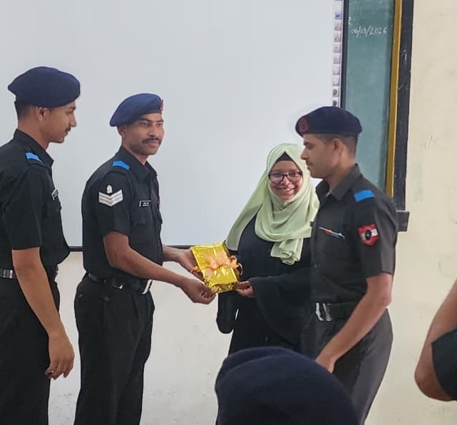
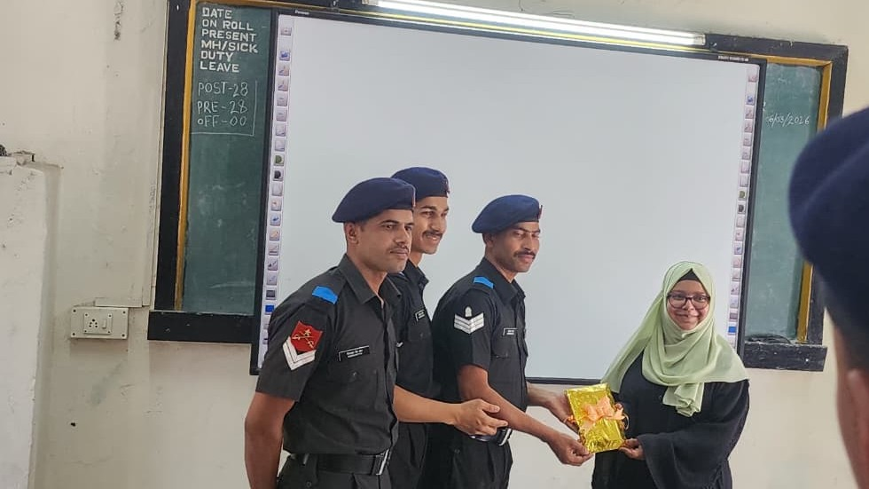
06
A gift,
wrapped in gold.
Passed across in front of the board. The smaller frame is a closer angle.
Notes:
These two frames show the same gold-wrapped gift being handed over. They do not carry a date stamp, so no date is printed.

Slide 7
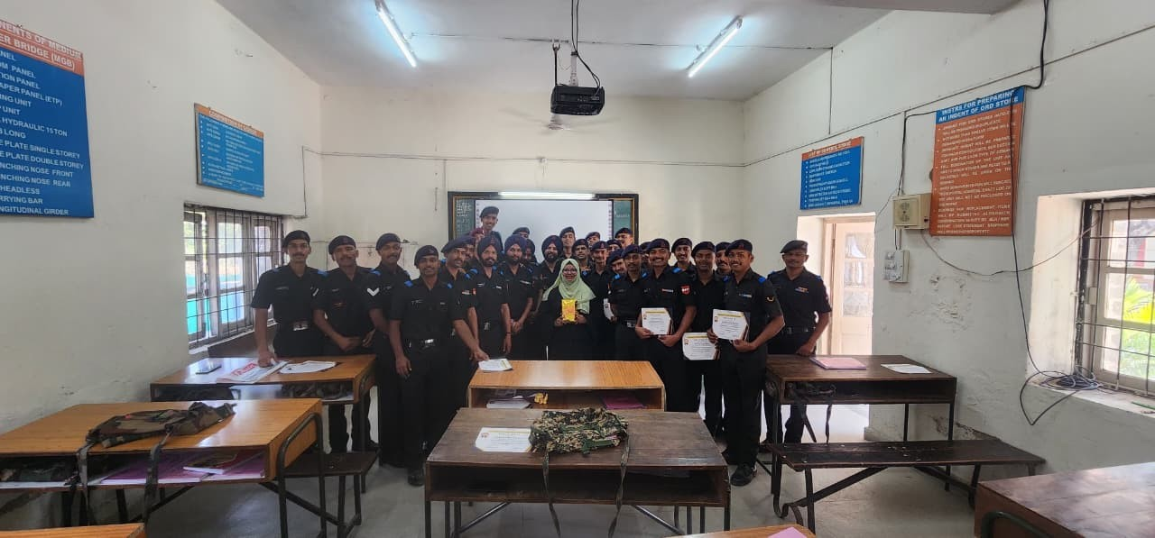
Certificates, held up.
The group fills the classroom. A gold gift is at the center.
07
Notes:
Group photograph with certificates and the gold gift. No date is printed on the slide because the picture has no readable timestamp.

Slide 8
TECHBLOOM
In the room.
31 January 2025 · AI Tools · Poona College, Camp
3 February 2025 · A computer laboratory in Pune
A gold-wrapped gift, and certificates held up with the group
08
Notes:
Closing frame. Every line on this slide is visible in the photographs.

