Slide 1
Javascript Stuff
Helen Li, Stephen Freiberg, Sherwin Wu

Slide 2
Polling the server
Send back all the comments / rerender the whole view
Eventual consistency, even through soft DB

Slide 3
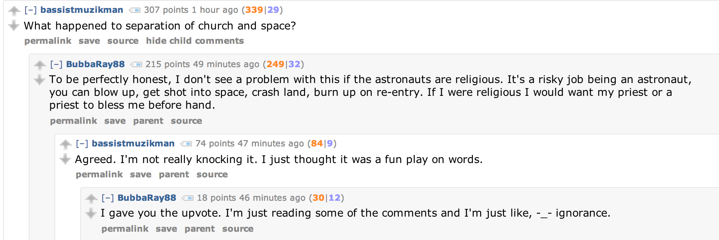
Hierarchy View
(Each comment has a parent comment)
How do we get all these comments on screen?

Slide 4
Javascript Model:
Post
Comment
Comment
Comment
Comment
Comment
Comment
Comment
Comment
There is a JS array of Comment objects. Each Comment object points to an array
of Comment objects that are the “children”.

Slide 5
In the server code…
Fix a depth to render by default (eg, only to depth 3).
Provide a button so the user can expand the depth.
When the page receives updates, these comments can be
inserted into the existing model by recursive add.
Comments can also be deleted or redacted by delete, but
requires “backtracking” to root node, then recursive delete

Slide 6
Smoothly transitioning comments

Slide 7
Storage of posts / comments
Keep a copy in Javascript at all times, perhaps an array of objects.

Slide 8
Where to put new comments?
If they are ranked by…
popularity: stick them at the bottom
time of posting: stick them at the top

