Slide 1
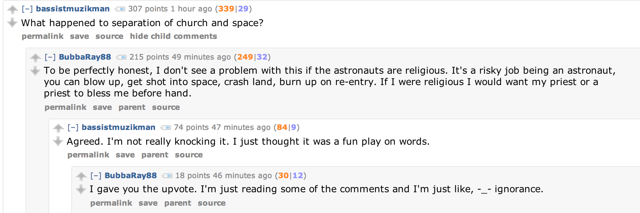
Hierarchy View
(Each comment has a parent comment)
How do we get all these comments on screen?

Slide 2
Javascript Model:
Post
Comment
Comment
Comment
Comment
Comment
Comment
Comment
Comment
There is a JS array of Comment objects. Each Comment object points to an array
of Comment objects that are the “children”.

Slide 3
In the server code…
Fix a depth to render by default (eg, only to depth 3).
Provide a button so the user can expand the depth.
When the page receives updates, these comments can be
inserted into the existing model by recursive add.
Comments can also be deleted or redacted by delete, but
requires “backtracking” to root node, then recursive delete

