Slide 1
INVESTMENT ASSIGNMENT SUBMISSION
Name: Mohamed Sheik Asan Aliyar

Slide 2
Investment Analysis for Spark Funds
Loading required Data from data sources
Analyzing data and get the insight information
Cleaning the unused, in-complete data
Preparing Data for consistencies
Data wrangling for good fitting
Data analyze for Spark Funds investment
Visualizing data for making clarity for Decision Maker
Report Generation

Slide 3
<Problem solving methodology>
Use flow chart
Visualize Data
Data Cleaning
Preparing Data Consistencies
Load Data
Report for Decision Maker
Finding Top 3 Sector (no. of investment wise)
Finding Top 3 English Speaking Country
Finding right Fund Type having 5 to 15m $

Slide 4
Fund Type Finding
After Data cleaning and Data consistency done on the dataframes, then data will be good for analysis
using Box plot we could figure out which fund type is good for our business requirement that Fund should be 5 to 15million for investment.
From the box plot we found that the Venture Fund type is good for Spark Funds

Slide 5
Top 3 Countries finding
Spark Funds interested in only english speaking countries for their investments, first manually retrieve list of english as their offical language from the internet and formed dataframe for our analysis.
Then picked only the english speaking countries from our master_frame dataframe.
Grouping by country_code on master_frame is done, then sum the raised_amount_usd columns and sort by descending order gives list of countries as per the total amount invested in that country.
Using bar chart, easily revealed that top 3 countries are USA, India, Canada

Slide 6
Top 3 Sectors in Top 3 Countries
In order to find the top sectors, first we need to use the mapping data frame which contains mapping between category_list and 9 sectors in widened dataset format.
For our simplification, widened dataset is converted to narrowed dataset using logic such as sector name to unique identity number and then multiple them with the rows data (which are 0's and 1's) and sum gives the exact sector number value.
once narrowed dataset is done, then merge with the master_frame for our analysis.
Once merged, then using group by sector, we can find the sum of fund raised in top 3 country wise and find the top 3 sectors for each country.

Slide 7
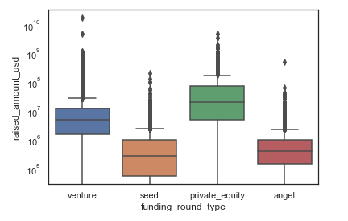
Venture is right Fund type to invest
Plot 1

Slide 8
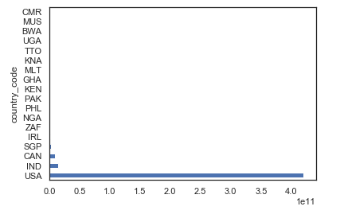
Top 3 Countries for investments
Plot 2

Slide 9
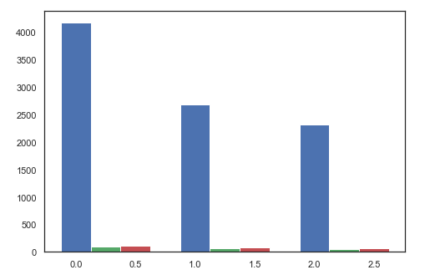
Top 3 sectors for top 3 countries
Plot 3
Blue: USA
Green: India
Red: Canada
Sector 1
Sector 2
Sector 3

Slide 10
Conclusions
Investment Analysis for Spark Funds
Venture is right choice for Spark Funds as a Fund type to invest
USA, India, Canada are the top 3 countries where Spark Funds can invest
Investment Sectors:
a. For USA, Below are the top 3 sectors for the investments:
i) Social, Finance, Analytics, Advertising
ii) News, Search and Messaging
iii) Others
b. For India, Below are top 3 sectors for the investments:
i) Others
ii) News, Search and Messaging
iii) Social, Finance, Analytics, Advertising
c. For Canada, Below are top 3 sectors for the investments:
i) Social, Finance, Analytics, Advertising
ii) Others
iii) News, Search and Messaging

