Slide 1
Reactive Systems
Building a Real Time Collaborative Pain Web App
or
#neverblock

Slide 2
Contents
Motivation
Reactive Manifesto
FRP vs Reactive Programming vs Reactive systems
Akka framework
Demo
Live Coding
Bibliography

Slide 3
Motivation
Notes:
Traim intr-o lume foarte diferita fata de cea in care s-au conceput conceptele de baza a computer science.
Gerald J Susmann: (autorul SICP – Structure and Interpretation of Computer Programs Gerald Jay Sussman and Hal Abelson)
https://www.youtube.com/watch?v=O3tVctB_VSU Gerry Sussman - We Really Don't Know How to Compute!
Sustine ca probabil, in viitor vom avea calculatoare de dimensiunea unui bob de nisip. Vom cumpara kilograme de calculatoare le amestecam in ciment.
Cum vom programa atunci acele calculatoare ? Este intrebarea lui. Si explica anumite idei despre asta intr-un video
- Costul cel mai mare acum suntem Noi. Programatorii. Puterea de calcul CPU, Memorie, etc sunt foarte ieftine, aproape gratis.

Slide 4
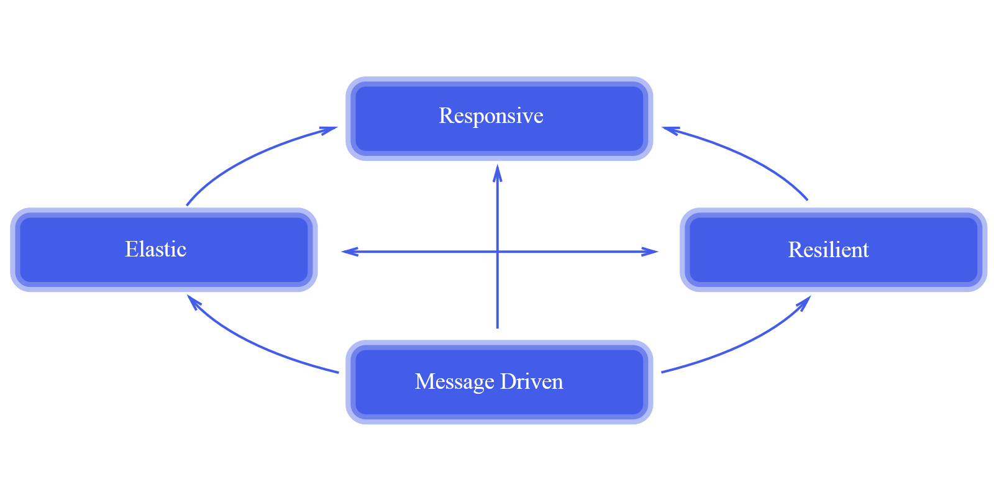
Reactive Manifesto
“We believe that a coherent approach to systems architecture is needed, and we believe that all necessary aspects are already recognised individually: we want systems that are Responsive, Resilient, Elastic and Message Driven. We call these Reactive Systems.”
“21st Century Problems are not best solved with 20th Century Architectures”
Notes:
Vrem ca systemele noastre sa fie Responsive. Vrem ca ele sa poata reactiona la inputul utilizatorilor eficient si rapid. Pentru a putea face asta trebuie sa fie Resiliente. Adica sa se comporte ok in fata defectiunilor si sa continue sa livreze serviciul.
Daca vrem sa fie resiliente, vrem sa fie elastic. Sa se poata extinde, misca, sa creasca si sa se micsoreze pentru a face fata cererii. Avem nevoie ca ele sa fie bazate pe transfer de mesaje pentru a suporta toate aceste lucruri. Asta este substratul fundamental ce iti permite sa faci toate aceste lucruri.
Responsive -> raspunde in timp util. Asta este baza uzabilitiatii. Asta inseamna si ca va fi rapid sa detectezi problem
Resilient -> Sistemele raman responsive atunci cand apar defectiuni. Se bazeaza pe Replication Containment Isolation and Delegation
Elasticitatea -> Este si mai importanta in Cloud de exemplu. Vrei ca serviciile sa se poata scala automat odata cu numarul de utilizatori
Message Passing -> Este baza celor de mai sus. Asta ne da cuplajul slab intre componente, izolarea, transparenta locatiei

Slide 5
FRP vs Reactive Programming vs Reactive systems
Functional Reactive Programming (FRP) integrates time flow and compositional events into functional programming.
The original formulation of Functional Reactive Programming can be found in the ICFP 97 paper Functional Reactive Animation by Conal Elliott and Paul Hudak.
The term has most recently been used incorrectly used to describe technologies like Elm, Bacon.js, and Reactive Extensions (RxJava, Rx.NET, RxJS) amongst others.
Most libraries claiming to support FRP are almost exclusively talking about Reactive Programming

Slide 6
FRP vs Reactive Programming vs Reactive systems
A subset of Asynchronous Programming and a paradigm where the availability of new information drives the logic forward rather than having control flow driven by a thread-of-execution.
The Application Program Interface (API) for Reactive Programming libraries are generally either:
Callback-based—where anonymous, side-effecting callbacks are attached to event sources, and are being invoked when events pass through the dataflow chain.
Declarative—through functional composition, usually using well established combinators like map, filter, fold etc.
Examples: Futures/Promises, Streams, Dataflow
Libraries: Rx, Elm, React

Slide 7
FRP vs Reactive Programming vs Reactive systems
As defined by the Reactive Manifesto—is a set of architectural design principles for building modern systems that are well prepared to meet the increasing demands that applications face today.
The principles of Reactive Systems are most definitely not new, and can be traced back to the 70s and 80s and the seminal work by Jim Gray and Pat Helland on the Tandem System and Joe Armstrong and Robert Virding on Erlang.
Reactive Programming are useful in building reactive systems.

Slide 8
Akka framework
Actors
Persistence
Streams
Remoting
Cluster
IO
Http
TestKit

Slide 9
Demo

Slide 10
Live coding

Slide 11
Bibliography
Functional Reactive Animation
Reactive Manifesto
Joe Armstrong Blog post
Reactive Systems: 21st Architecture for 21st Century Systems
Using the Actor Model with Domain-Driven Design (DDD) in Reactive Systems
Reactive programming vs reactive systems
Designing Reactive Systems - Free O'Reilly book

